Slide 1

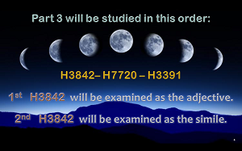
Slide 4
#2 was H3842 – had to be changed to H7720
Nov 10/20
The Moon! Oh, the Moon! Pt 3

Slide 2
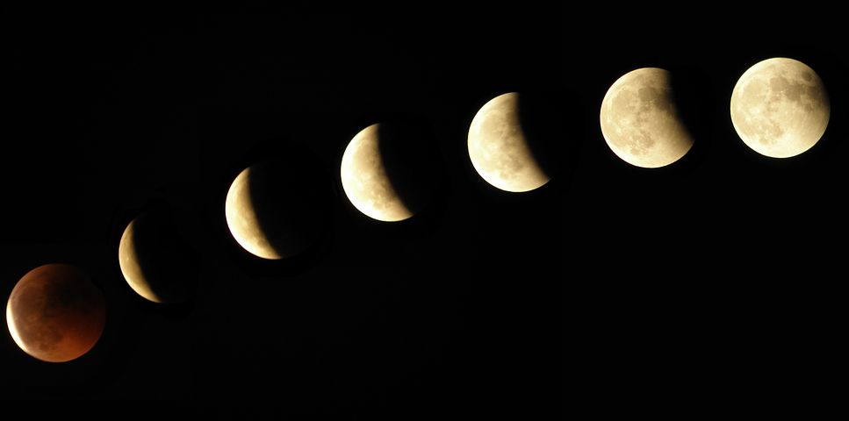
The Moon! Oh, the Moon!
Part 3
“The Moonth! Oh, the Moonth?”
Our Question: Oh Moon!
Where have you been today?
In the Day sky, or the Night sky?

Slide 3
Moon Hebrew Word #s & Grammar
Hebrew #
Part of speech
R
E
V
I
E
W
1. H3394 = 26 listings <yareach>
2. H3391 = 2 listings <yerach>
3. H3842 = 3 listings <lebanah>
4. H7720 = 1 listing <saharon>
5. H2320 = 20 listings <chodesh>
Total of 52 references.
Noun – literal moon
verb – lunation cycle
Adjective – color
Simile – comparison
Verb – repetition
Question: are there really
2 verb forms for ONE “moon”?

Slide 4
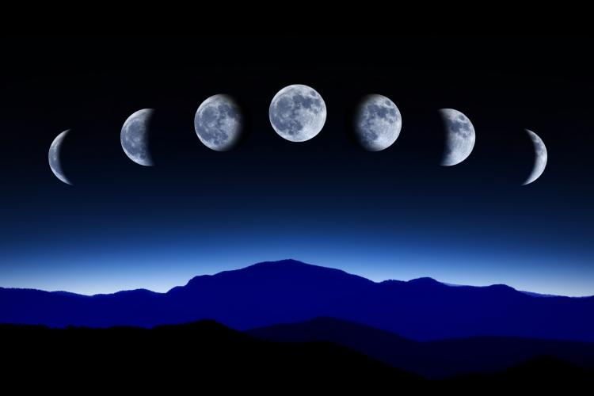
Part 3 will be studied in this order:
H3842– H7720 – H3391
1st H3842 will be examined as the adjective.
2nd H7720 will be examined as the simile.
Slide 4
#2 was H3842 – had to be changed to H7720
Nov 10/20

Slide 5
Only the first part of H3391 will be studied in this lesson.
3rd H3391 will be examined as the verb component of the moon. It is also the primitive root of H3394. Consideration will begin with the lunation cycle length. Question: Will H3391 qualify for Yahuah’s set-apart month including His special numbering system?

Slide 6
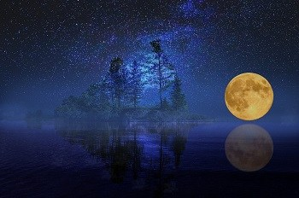
A Good Question for H3842
H3842 <lebanah>
Oh Moon!
What color will you be tonight?
Pure White
Blood Red
Harvest Gold?

Slide 7


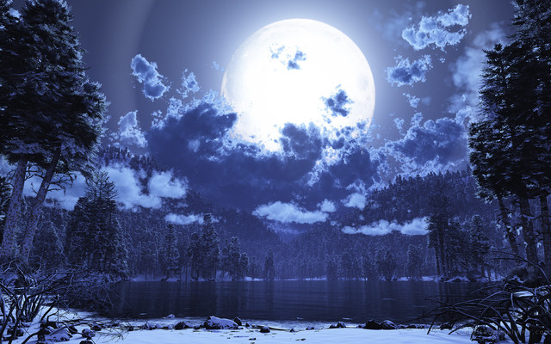
[#3] H3842 MOON <lebanah>
Taking a Closer Look
The color or whiteness
of the moon.
The moon as white!
References Found:
Strong’s: 3
Englishman’s: 3
Adjective
Notes:
108n June 21st

Slide 8
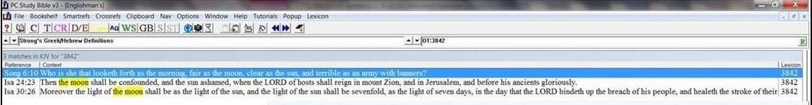
Englishman’s Concordance H3842
Strong’s: “moon” or “moons” | Englishman’s: by Hebrew Word #
3. H3842 = 3 listings <lebanah> | 3. H3842 = 3 listings <lebanah> Both sets of references are exactly the same verses.
Notes:
Aug 16 7 am

Slide 9


H3842 MOON <lebanah> [as an Adjective]
[Strong’s] MOON - H3842 lebanah; from H3835; properly, (the) white,
i.e. the moon: -moon. See also H3838.
[BDB] H3842 lebanah – the moon
(as white).
Note: Every Strong’s number connects to “Whiteness.”
Notes:
109n June 21st

Slide 10
H3842 MOON <lebanah>
[Strong’s] MOON - H3842 lebanah; from H3835; properly, (the) white, i.e. the moon: -moon. See also H3838.
  H3835 laban; a primitive root; to be (or become) white; also
  (as denominative from H3843) to make bricks: KJV - make brick,
  be (made, make) white (-r).
    H3843 lebenah; from H3835; a brick (from the whiteness of the clay):
    KJV - (altar of) brick, tile. lebonah. See H3828.
      H3828 lebownah; or lebonah; from H3836; frankincense (from its whiteness or perhaps that of its smoke): -frank-) incense.
        H3836 laban; or (Gen 49:12) laben; from H3835; white: KJV - white.
  H3838 Lebana'; or Lebanah; (the same as H3842) …
Notes:
Sept 16: added – have to edit still.

Slide 11

Scriptures for H3842 <lebanah>
Song of Solomon 6:10 Who is she that looketh forth as the morning, fair as the [H3842 white] moon clear as the sun, and terrible as an army with banners?
Isaiah 24:23 Then the [H3842 white] moon shall be confounded, and the sun ashamed, when Yahuah of hosts shall reign in mount Zion, and in Jerusalem …
Isaiah 30:26 Moreover the [H3842 white] light of the moon shall be as the light of the sun, and the light of the sun shall be sevenfold, as the light of seven days, in the day that Yahuah bindeth up the breach of his people …
Notes:
110n June 21st

Slide 12

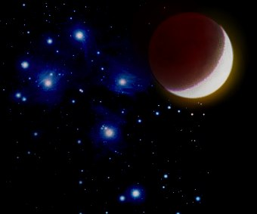


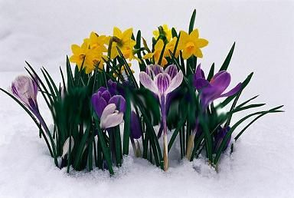



H3842 Final Conclusion <lebanah>
In all three verses, “white or whiteness” – as the “color” of the moon - is the context of the verses.
The definition for MOON in these
three verses lends no support to
commence the Biblical month with
any MOON phase in the sky.
The
H3842 MOON
color
cannot commence the
Biblical month.
Notes:
June 19/17
37

Slide 13
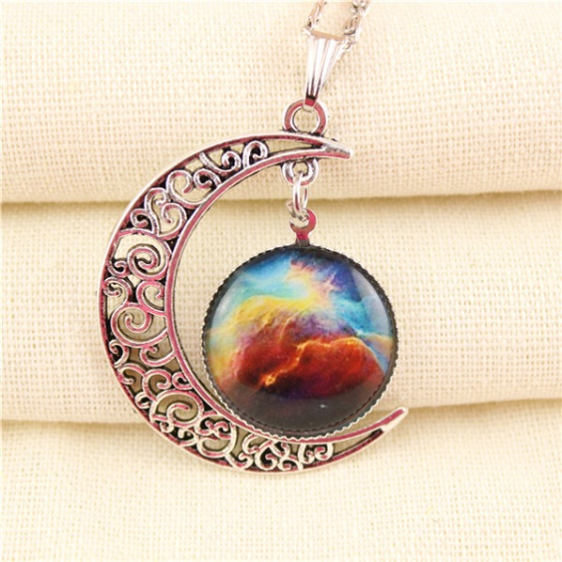
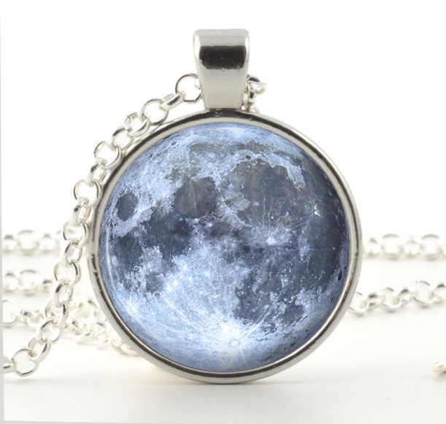
[#4] H7720 MOON <saharon>
Taking a Closer Look
A simile/comparison
[using the words “like” or “as”]
of something that is round
like the moon.
References Found:
Strong’s: 1
Englishman’s: 3
Simile
Notes:
Aug 16 730 pm

Slide 14
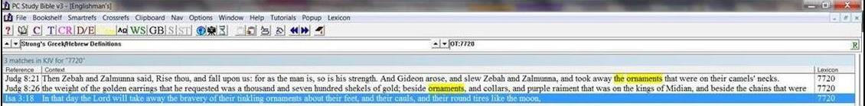
Englishman’s Concordance H7720
Strong’s: “moon” or “moons” | Englishman’s: by Hebrew Word #
4. H7720 = 1 listing <saharon> | 4. H7720 = 3 listings <saharon> This set has 2 extra listings for comparisons.
Notes:
Aug 16 7 am

Slide 15
H7720 MOON <saharon> [as a Simile]
Definition: H7720 means the actual “simile comparison of another object” to the moon in the sky.
[Strong’s] MOON - H7720 saharon; from the same as
H5469 [roundness]; a round pendant for the neck:
KJV – ornament, round tire like the MOON.
shav. See H7723 [next slide].
[BDB] H7720 saharon – the moon, the crescent
(as an ornament).
Notes:
67n June 20th

Slide 16

H7720 [shav. See H7723]
  Note: Pay attention to these next two Strong’s definitions regarding destruction and devastation. How are the following definitions connected to H7720?
  H7723 shav'; from the same as H7722 in the sense of desolating; evil
  (as destructive), literally (ruin) or morally (especially guile); figuratively idolatry (as false, subjective), uselessness (as deceptive, objective; also adverbially, in vain): KJV - false (-ly), lie, lying, vain, vanity.
    H7722 show'; … from an unused root meaning to rush over; a tempest; by implication, devastation: KJV - desolate (-ion), destroy, destruction, storm, wasteness.

Slide 17
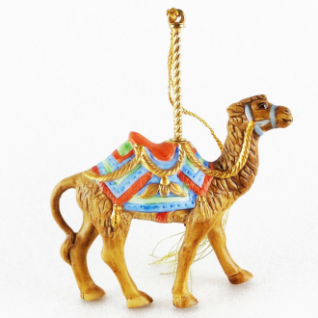
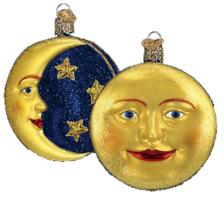
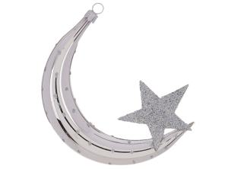
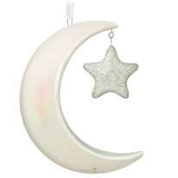
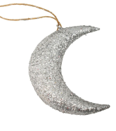
Scriptures for H7720 <saharon>
Judges 8:21 And Gideon arose, and slew Zebah and Zalmunna, and took away the ornaments [H7720] that were on their camels' necks.
Judges 8:26 And the weight of the golden earrings … beside ornaments [H7720], and collars, and purple raiment … and beside the chains that were about their camels' necks.
Notes:
June 21st: Very nice4 slide – with good images for illustration. But, you had “four verses” in the title – but there are only 3. On the next slide, I’ll make the distinction so you and listeners do not get mixed up.

Slide 18
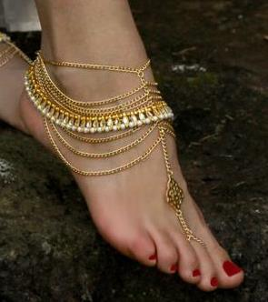

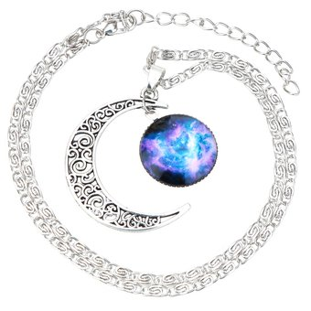
Isa 3:18 In that day Yahuah will take away the bravery of
their tinkling ornaments [H5914] about their feet, and their
cauls, and their round tires [H6287] like the MOON [H7720].
Isa 3:18 (Note the extra Hebrew definitions
that are similar to “roundness.”)
tinkling ornaments; H5914; an anklet [bracelet]
cauls; H7636; [round] netting for the hair
(Compare to Eze 24:17, 23 “bind the tire [H6287]
of thine head” [H6287 - a fancy head-dress].)
round tires like the moon; H7720; round neck pendant.
How do these definitions link to H7723 and H7722?
Notes:
June 21st: Very nice4 slide – with good images for illustration. But, you had “four verses” in the title – but there are only 3. On the next slide, I’ll make the distinction so you and listeners do not get mixed up.

Slide 19
H7720 Final Conclusion <saharon>
All definitions compare the “roundness”
of ornaments to the “roundness”
of the MOON.
These verses lend no support
to commence the Biblical month
with any phase of the MOON in the sky.
The
H7720 MOON
simile
comparison
cannot commence the
Biblical month.
Notes:
June 19/17
37

Slide 20
Yahuah’s
Covenant
of
Division

Slide 21
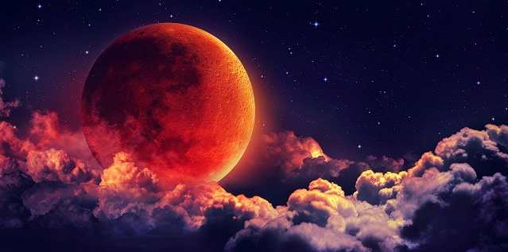
Which Two Celestial Entities Determine the Divisions
as commanded
by Yahuah?
???
Gen 1:14
21

Slide 22
Jeremiah 33:20 -
Covenants of the
Light Season and of the Night Season.
Question: Does the moon have
a part in either of these two Covenants?

Slide 23
The 4th Day of Creation
Gen 1:16 And Elohim made TWO GREAT LIGHTS: the greater light to
rule the day, and the lesser light to rule the night, and the stars.
Gen 1:17 And Elohim set them in the expanse of the heavens TO GIVE
LIGHT ON THE EARTH,
Gen 1:18 and to RULE over the day and over the night, and to SEPARATE
the light from the darkness. And Elohim saw that it was good.
Gen 1:19 And there came to be evening and there came to be morning, the
fourth day.
Gen 1:14 And Elohim said, “Let lights come to be in the expanse of the heavens to SEPARATE the day from the night, and let them be for signs and appointed times, and for DAYS and YEARS,
Gen 1:15 and let them be for lights in the expanse of the heavens to give light on the earth.” And it came to be so.
Gen 1:16 And Elohim made TWO GREAT LIGHTS: the greater light to rule the day, and the lesser light to rule the night, and the stars.
Gen 1:17 And Elohim set them in the expanse of the heavens TO GIVE LIGHT ON THE EARTH,
Gen 1:18 and to RULE over the day and over the night, and to SEPARATE the light
from the darkness. And Elohim saw that it was good.
Gen 1:19 And there came to be evening and there came to be morning, the fourth day.

Slide 24
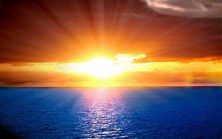
When the sun rises,
how much darkness
is seen afterwards?
Is it possible the sun can
DIVIDE
the Light from the Night?

Slide 25
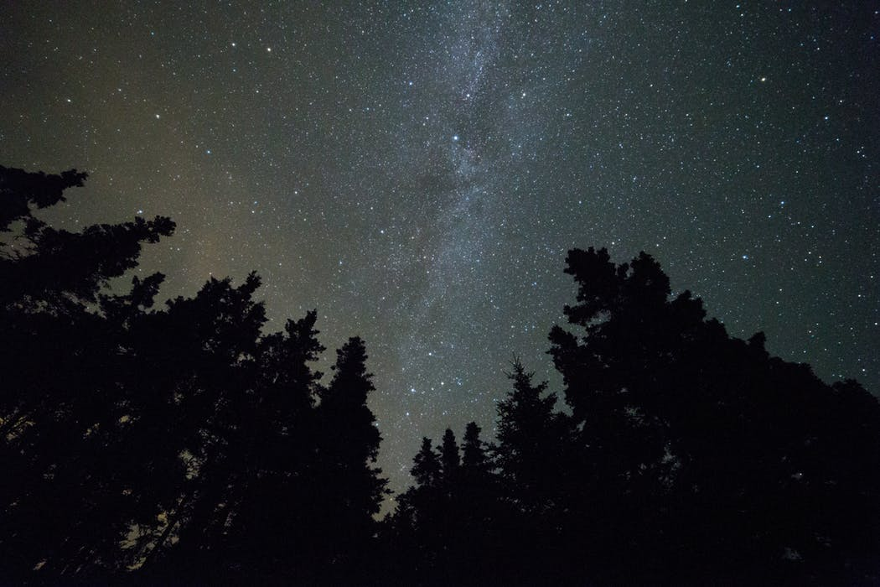

The MAZZAROTH!
In the absence of clouds, what LIGHT is seen CONSISTENTLY - ALL night, EVERY night, 365 nights of the year?
DIVIDE
Gen 1:14!
Have you EVER seen a full array of stars
in the daylight?
Can the MAZZAROTH and other stars differentiate a NIGHT season from a Light season?

Slide 26
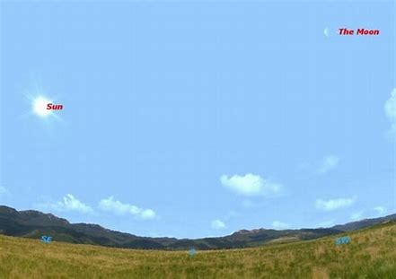
Sky Event captured: Sept 10, 2009
Context of Gen 1:14 -
The moon is visible in daylight nearly every day, the exceptions being close to new moon, when the moon is too close to the sun to be visible, and close to full moon when it is only visible at night. The best times in the month to see the moon in daylight are close to first and last quarter, when the moon is 90 degrees away from the sun in the sky.
See notes below in chat area.
Is the Moon capable of SEPARATING
the Light and
Night seasons?
Notes:
https://www.space.com/7267-moon-daylight.html
For the picture above, the website says this: Any clear morning this week around 10 a.m. [Sept 10/2009] you can see the moon riding high in the western sky. Many people are surprised to see the moon in full daylight, yet it is a completely normal occurrence.
Because of the Earth's rotation, the moon is above the horizon roughly 12 hours out of every 24. Since those 12 hours almost never coincide with the roughly 12 hours of daylight in every 24 hours, the possible window for observing the moon in daylight averages about 6 hours a day.
The moon is visible in daylight nearly every day, the exceptions being close to new moon, when the moon is too close to the sun to be visible, and close to full moon when it is only visible at night. The best times in the month to see the moon in daylight are close to first and last quarter, when the moon is 90 degrees away from the sun in the sky.
That's the situation this week. Last quarter is on Saturday, Sept. 12. If we set Starry Night software to that date, and its location to New York, we see that the moon rises at 11:06 p.m. the night before. The sun rises at 6:34 a.m., at which time the moon is 74 degrees above the horizon, almost overhead. Sun and moon will both be above the horizon until the moon sets at 3:03 p.m., although the moon will be hard to see for the last hour or so because of horizon haze.
Similarly, the moon will be well placed for daytime observation near first quarter, which next falls on Saturday, Sept. 26. The difference here is that the sun will be leading the moon, setting at 6:46 p.m., followed by moonset at 12:06 a.m.
Once you've seen the daylight moon on these "easy" dates, it's worth trying to see how many days in the month you can manage to spot it.

Slide 27
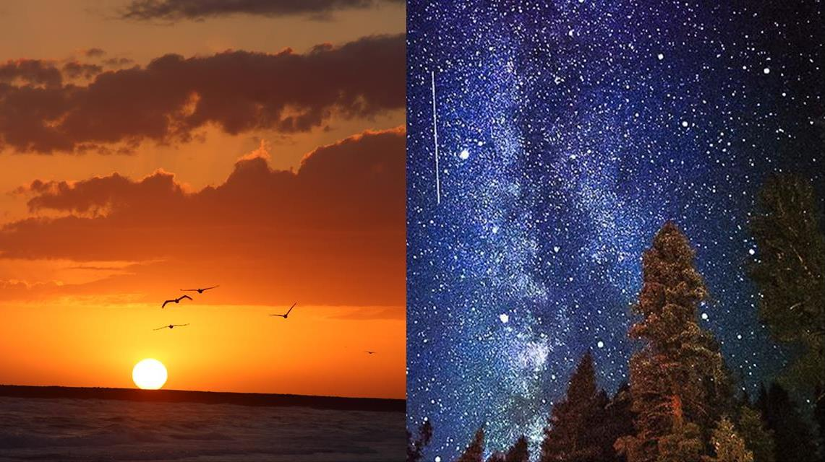
Jer 31:35 gives
declaration for
the two great
LIGHT-givers.
The Mazzaroth!
  Thus saith Yahuah, which giveth the sun for a light by day …
  … and of the stars for a light by night …
Notes:
may 18th: new slide to show the two LIGHT-givers by day and night. This is to separate the idea that the moon is a light-giver – first of all it has no light of its own – it is reflected from the sun!

Slide 28
Does the Moon produce its own light?
Strong's H216 - 'owr
אוֹר
Transliteration
'owr
Pronunciation
ōre (Key)
Part of Speech
feminine noun
Root Word (Etymology) From אוֹר(H215)

Slide 29
Isa 13:10
For the stars ^{H3556} of heaven ^{H8064} and the constellations ^{H3685} thereof shall not give ^{H1984} their light: ^{H216} the sun ^{H8121} shall be darkened ^{H2821} in his going forth, ^{H3318} and the moon ^{H3394} shall not cause her light ^{H216} to shine. ^{H5050}
Let’s look at some gender concerns!
29

Slide 30
Strong's H3394 - yareach
יָרֵחַ
Transliteration
yareach
Pronunciation
yä·rā'·akh (Key)
Part of Speech
masculine noun
Root Word (Etymology)
From the same as יֶרַח (H3391)
What gender is the
H3394 moon?
Yareach (moon) has a
MASCULINE gender.

Slide 31
Isa 13:10 For the stars ^{H3556} of heaven and the constellations ^{H3685} thereof shall not give their light: ^{H216} the sun ^{H8121} shall be darkened in his going forth, and the moon ^{H3394} shall not cause her [??] light ^{H216}
to shine.
Strong's H8121 - shemesh
שֶׁמֶשׁ
Transliteration
shemesh
Pronunciation
sheh'·mesh (Key)
Part of Speech
masculine/feminine noun
Root Word (Etymology)
From an unused root meaning to be brilliant.
What gender is the
H8121 sun?
For Isa 13:10 … while it may appear on the surface that the
masculine moon produces its own light, how can it be said
that the masculine moon is producing ITS OWN light when
Isaiah’s reference to “her light” is FEMININE (like the sun)?

Slide 32
x
Eze 32:7
And when I shall put thee out, ^{H3518} I will cover ^{H3680} the heaven, ^{H8064} and make ^{H6937 ➔} the stars ^{H3556} thereof dark; ^{H6937} I will cover ^{H3680} the SUN ^{H8121} with a
cloud, ^{H6051} and the moon ^{H3394} shall not give ^{H215}
her light. ^{H216}
Masculine &
Masculine
Feminine

Slide 33


In that day, the covered sun cannot give the moon its light. Therefore the moon cannot in turn reflect any light!
Yes, we notice that modern translations insert “its,” replacing the feminine “her.”
Yet the word `owr (light)
remains feminine!

Slide 34
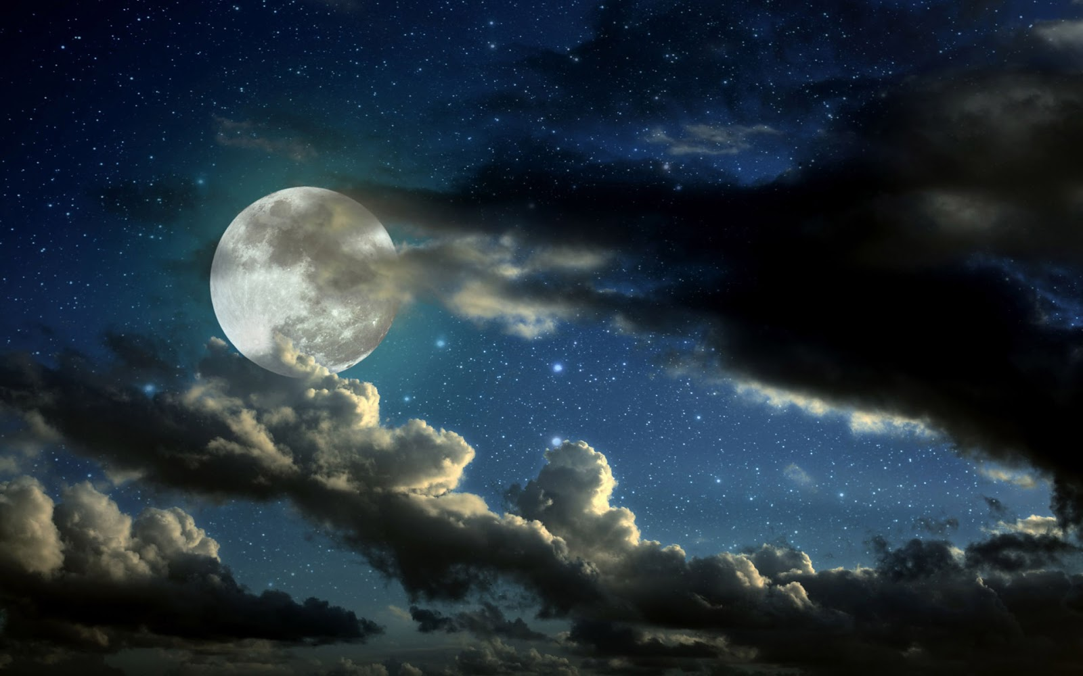
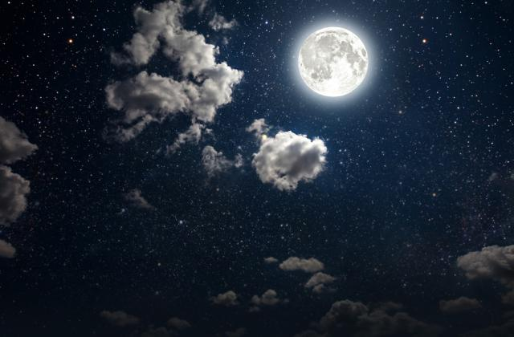
Everyone has seen a moon in the night sky.
Does that mean the moon “rules the night”?
34
Notes:
http://earthsky.org/space/when-can-you-see-a-daytime-moon july 17/18 the information below is for this website but not for the banner picture above.
In fact, the moon is up in the daytime as often as at night. It’s only the full moon that that rises in the east as the sun is setting in the west and reigns in the sky all night long. That means the moon is up all night long only one night each month. Otherwise, the moon rises and sets on its own schedule, having nothing to do with sunrise or sunset, and varying in a systematic way throughout each month as the moon pursues its monthly orbit around Earth. If you want to understand more about the moon’s rising and setting times, and subsequent phases, check out this post: Understanding moon phases
So when can you see the moon in the daytime? Basically, you need three things to see the daytime moon:
Look within a week or so of the date of full moon.
Before full moon, look for the daytime moon in the afternoon.
After full moon, look for the daytime moon in the morning.
Look up! The daytime moon is often up there, but it’s pale against the blue sky.

Slide 35
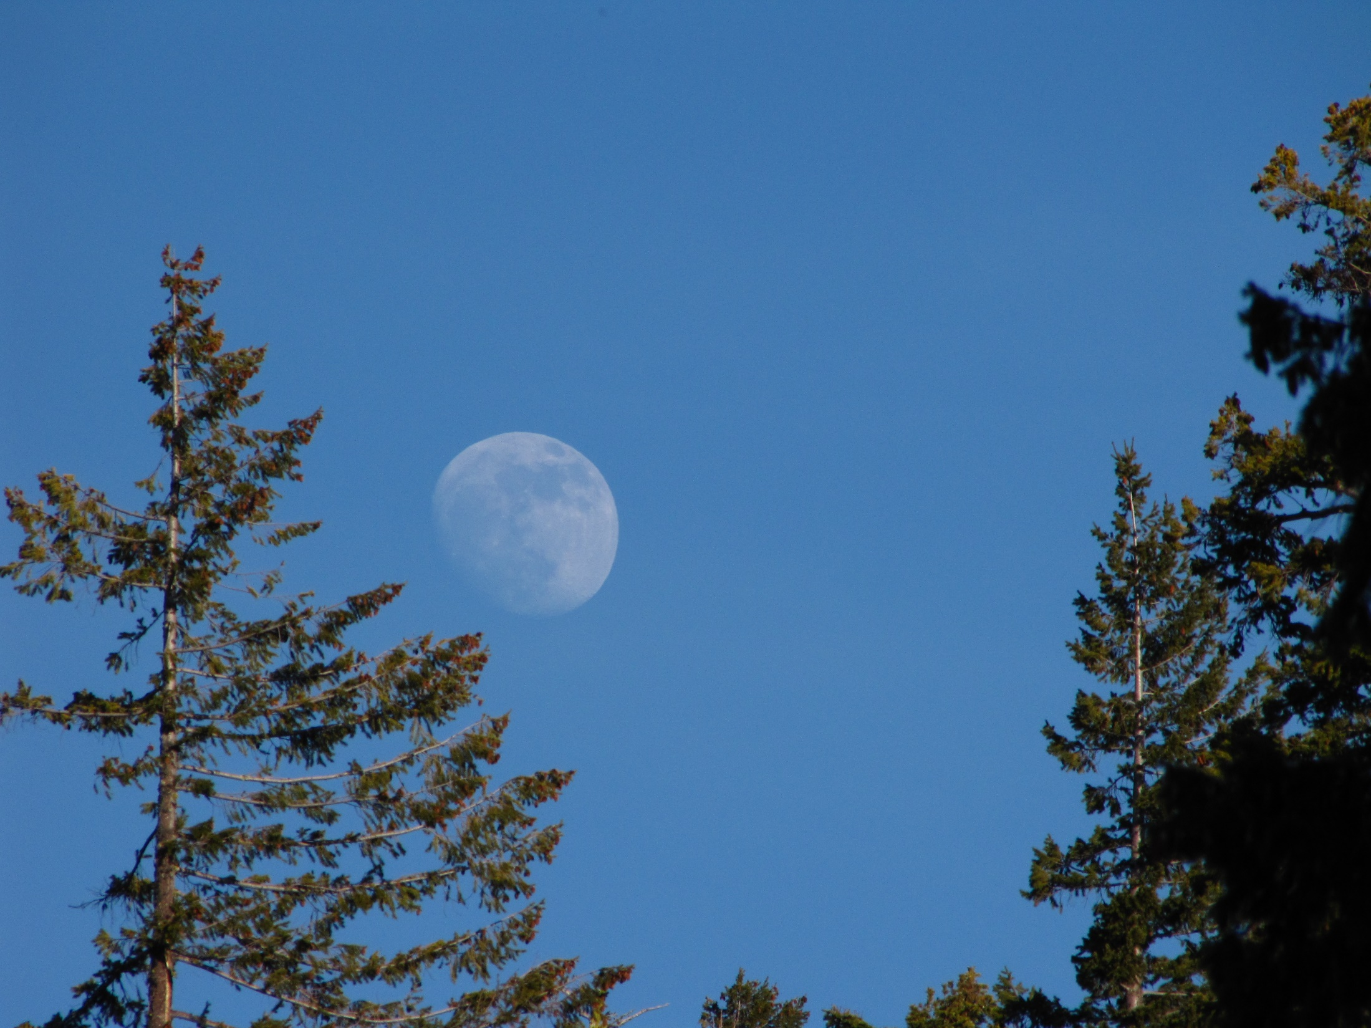
Before the next Scriptures look at the blue sky. Observe the moon in the daylight sky for nearly half of each month and ask yourself if you understand this next verse correctly!?

Slide 36
Gen 1:16 And [Yahuah] maketh the TWO great luminaries, the great luminary for the rule of the day, and the small luminary--and the stars--for the rule of the night; YLT
Psa 136:8 The [great] sun to rule by day; for his mercy endures for ever.
Psa 136:9 The moon and the [small]
stars to rule the night;
for his mercy endures for ever.
Question: Why is the moon in this verse appearing as one of the sky rulers?

Slide 37
Read Psalms 136 again:
7 To him who alone made great lights;
for his mercy endures for ever.
8 The sun to rule by day …
9 The moon and the stars to rule the night …
Brenton’s Septuagint 1851
The chapter Context is about
the Creator establishing heavenly bodies in the heavens.
Not all of them are “light-givers.”
Question: But what type of ruler rules in absence, without an authoritative representation present?

Slide 38
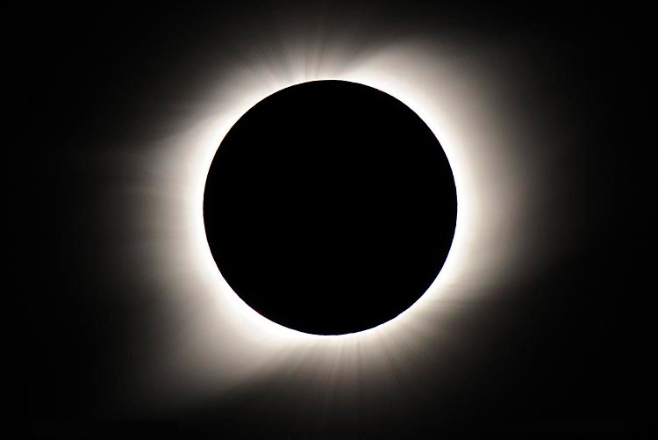
In any type of eclipse, (when the sunlight is removed from our viewpoint by the moon), HOW MUCH LIGHT DOES THE MOON EMIT?
How much of this darkness radiates LIGHT?

Slide 39
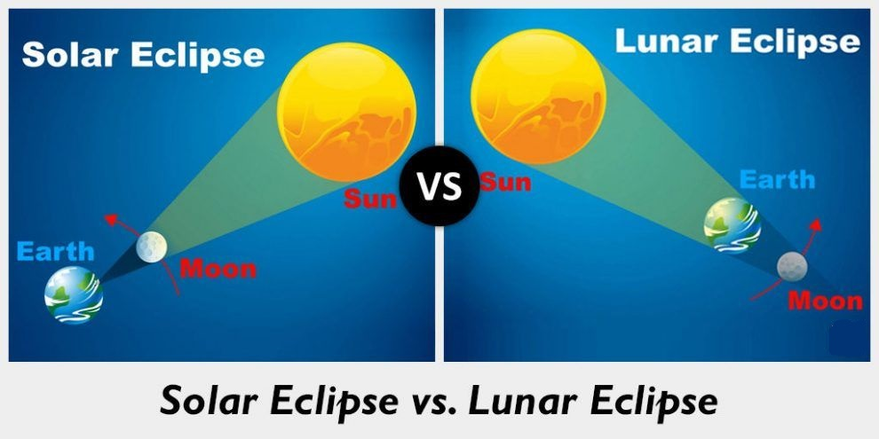
No LIGHT from the moon in either eclipse!

Slide 40
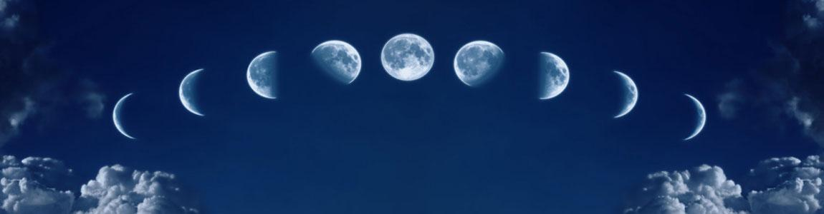
Moon Questions
Is this sky picture a night sky, or day sky?
Will you ever see a full moon in the day sky?
Notes:
http://earthsky.org/space/when-can-you-see-a-daytime-moon july 17/18 the information below is for this website but not for the banner picture above.
In fact, the moon is up in the daytime as often as at night. It’s only the full moon that that rises in the east as the sun is setting in the west and reigns in the sky all night long. That means the moon is up all night long only one night each month. Otherwise, the moon rises and sets on its own schedule, having nothing to do with sunrise or sunset, and varying in a systematic way throughout each month as the moon pursues its monthly orbit around Earth. If you want to understand more about the moon’s rising and setting times, and subsequent phases, check out this post: Understanding moon phases
So when can you see the moon in the daytime? Basically, you need three things to see the daytime moon:
Look within a week or so of the date of full moon.
Before full moon, look for the daytime moon in the afternoon.
After full moon, look for the daytime moon in the morning.
Look up! The daytime moon is often up there, but it’s pale against the blue sky.

Slide 41
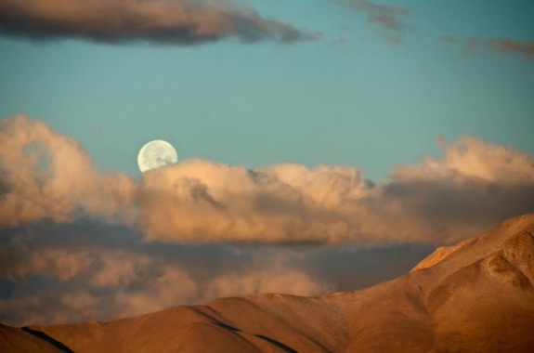
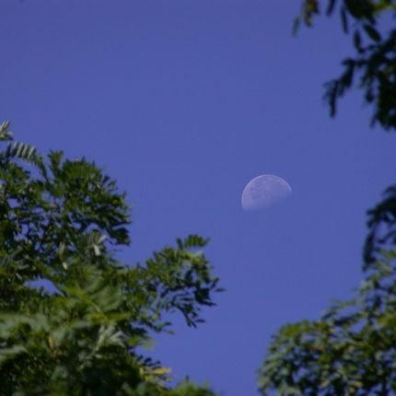
What about this moon in the day sky?
Here’s a daytime moon on January 28, 2013 as seen by an EarthSky Facebook observer from Ridgecrest, California, in the Mojave Desert. Notice the moon in this photo is closer to the (western) horizon at sunrise than the moon one day later (photo with blue sky and trees).
Website: http://earthsky.org/space/when-can-you-see-a-daytime-moon
Notes:
http://earthsky.org/space/when-can-you-see-a-daytime-moon july 17/18 the information below is for this website and for the 2 pictures above, even if I have some information on another slide.
In fact, the moon is up in the daytime as often as at night. It’s only the full moon that that rises in the east as the sun is setting in the west and reigns in the sky all night long. That means the moon is up all night long only one night each month. Otherwise, the moon rises and sets on its own schedule, having nothing to do with sunrise or sunset, and varying in a systematic way throughout each month as the moon pursues its monthly orbit around Earth. If you want to understand more about the moon’s rising and setting times, and subsequent phases, check out this post: Understanding moon phases
So when can you see the moon in the daytime? Basically, you need three things to see the daytime moon:
Look within a week or so of the date of full moon.
Before full moon, look for the daytime moon in the afternoon.
After full moon, look for the daytime moon in the morning.
Look up! The daytime moon is often up there, but it’s pale against the blue sky.

Slide 42
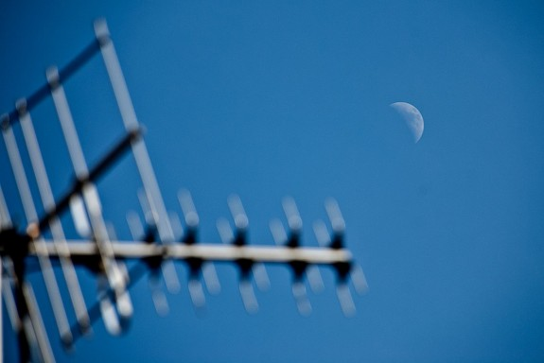
http://earthsky.org/space/when-can-you-see-a-daytime-moon
Daytime moon – May 27, 2012 – Darren Danks in Netherton UK.
You can see the moon during the day whenever it’s fairly large in phase and fairly far from the sun on the sky’s dome.
So you need to know the date of full moon to know when to see a daytime moon. Learn the date of the next (or last) full moon, then start to look for the daytime moon about a week before full moon, in the afternoon sky.
After the full moon, look again
for a week or so, this time in the morning sky.
Most important criterion:
look up!
If you do, you’ll often see the moon in the day.

Slide 43
Observation of the Day Moon
So, when can you see the moon in the daytime?
Basically, you need three things to see the daytime moon:
Look within a week or so of the date of full moon.
Before full moon, look for the daytime moon in the afternoon.
After full moon, look for the daytime moon in the morning.
Look up! The daytime moon is often up there, even though it may be pale against the blue sky.
Notes:
http://earthsky.org/space/when-can-you-see-a-daytime-moon july 17/18 the information below is for this website but not for the banner picture above.
In fact, the moon is up in the daytime as often as at night. It’s only the full moon that that rises in the east as the sun is setting in the west and reigns in the sky all night long. That means the moon is up all night long only one night each month. Otherwise, the moon rises and sets on its own schedule, having nothing to do with sunrise or sunset, and varying in a systematic way throughout each month as the moon pursues its monthly orbit around Earth. If you want to understand more about the moon’s rising and setting times, and subsequent phases, check out this post: Understanding moon phases
So when can you see the moon in the daytime? Basically, you need three things to see the daytime moon:
Look within a week or so of the date of full moon.
Before full moon, look for the daytime moon in the afternoon.
After full moon, look for the daytime moon in the morning.
Look up! The daytime moon is often up there, but it’s pale against the blue sky.

Slide 44
Only the full moon
reigns in the sky all
night long one night
each lunar month.
Just because the moon has nothing to do with the separation of the day and night seasons, what has that got to do with the moon determining the commencement of any months?
44
Notes:
It’s only the full moon that that rises in the east as the sun is setting in the west and reigns in the sky all night long. That means the moon is up all night long only one night each month.

Slide 45
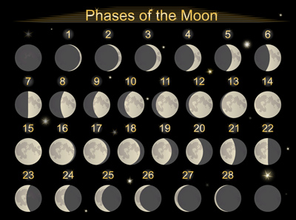
Can the phases of the moon separate or rule the months?
It depends on who you ask!
It depends on “which” month!
Will H3391 provide answers?

Slide 46
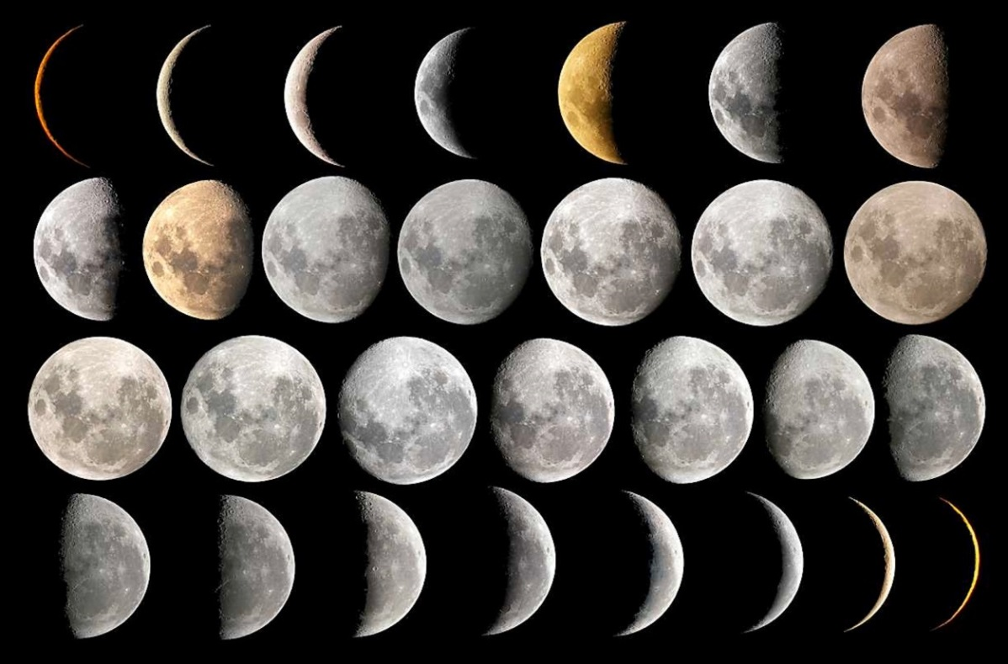
[#2] H3391 MOON <yerach>
Taking a Closer Look
This means: the cycle or lunation of the moon – labeled as a month.
References Found:
Strong’s: 2
Englishman’s: 13!
Verb
Notes:
June 19/17
47

Slide 47
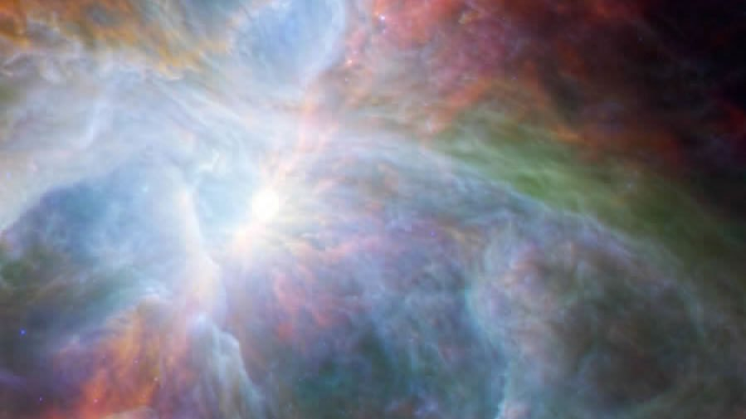
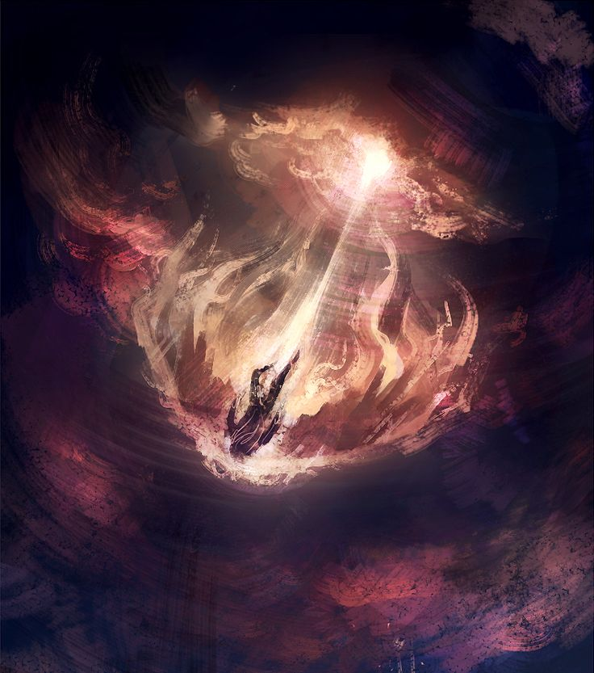
For this study, please remember:
Yahuah knows the end from the beginning.
(Isa 46:9-10).
Yahuah also knew:
Lucifer would rebel
Lucifer would be cast out of heaven
Creation week would hold the pattern
for worship statutes
Satan would try to usurp worship
from Yahuah’s children on earth as
he did in heaven.
Notes:
Feb 19/17: new slide

Slide 48

Part 1: Mapping the Topics for H3391
1. Creation Patterns
5.
Perfection, Devastation, Restoration
6.
2. Creation Months
1st Day – 30 day month
4th Day – 30 day month
7.
3. Lunar Months
8.
Sidereal – 27.3 day month
Synodic – 29.5 day month
4.
9.

Slide 49
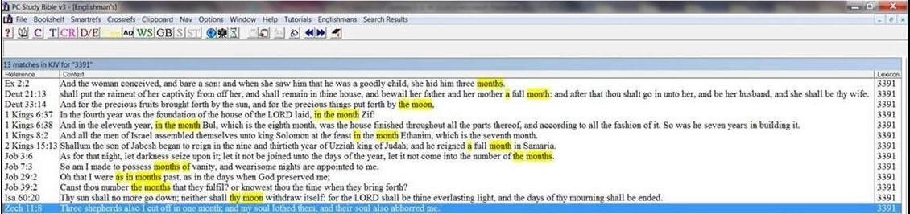
Englishman’s Concordance H3391
Strong’s: “moon” or “moons” | Englishman’s: by Hebrew Word #
2. H3391 = 2 listings <yerach> | 2. H3391 = 13 listings <yerach> (11 extra listings) 2 listings are translated as moon 11 listings are translated as month
Notes:
Aug 16 7 am

Slide 50
A Note for H3391 MOON <yerach>
ONLY 2 of the 13 references actually use the word MOON.
Strong’s will list this “unused root” as uncertain!!!
Strong’s will list the definition of “lunation” before the definition of “month” – which will be closely examined.
Brown Driver & Brigg’s is opposite, listing the first definition as “month.”
Notes:
820 AM – Feb 17/17 … changes to this slide to update the information for H3391. H3391 is the Root Word – that changes things from the way I saw it before.
Aug 10th pg 14
Aug 16 540 pm

Slide 51
H3391 MOON <yerach> [as a Verb]
[Strong’s] MOON - H3391 yerach (yeh'-rakh); from an unused root of uncertain signification; a lunation,
i.e. month: KJV – month [11 times], moon [2 times].
[BDB] H3391 yerach – a month (lunar cycle),
the moon [2 times].
a) a month
b) a calendar month [11 times].
“Lunation”
will be
defined soon.
Notes:
Aug 16 7 am

Slide 52
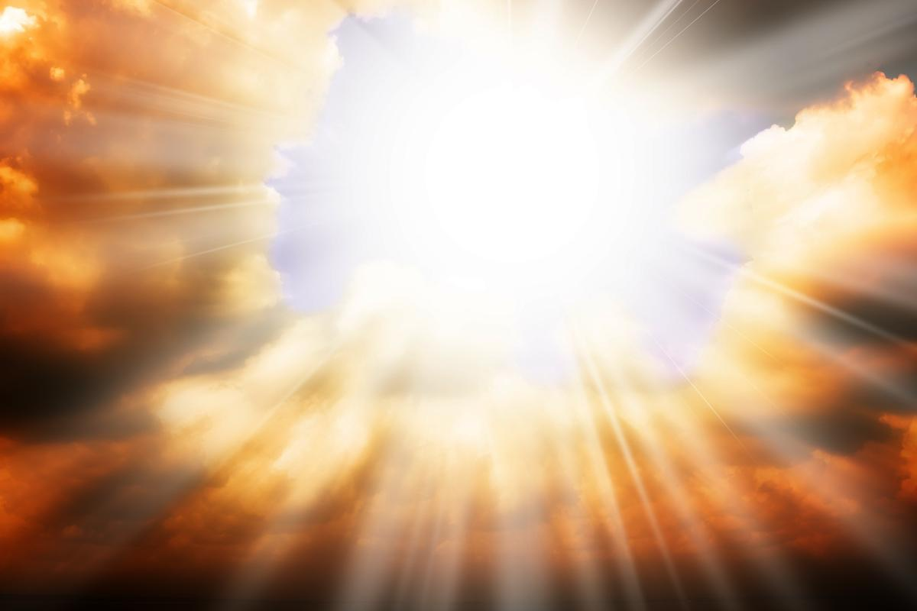
Perfection devastation restoration
#1 Creation Patterns
2 SLIDES

Slide 53

Creation Week Has 2 Types of Months
Remember: Yahuah is smarter than we are!
He knows what He is doing!
That’s why He gave mankind and the earth two types of months at creation.
  The 30 day creation month for the commencement of His monthly and yearly worship statutes;
  The 30 day lunar month for the agricultural ordinances
  to bless the earth and mankind with food & water; seasons for planting & harvesting of the land;
  tides to bless the seas. (Deut 33:14 – H3391)
53
Notes:
Gen 1 Pattern: vs 1: Perfection; vs 2: Devastation; vs 3: Restoration.

Slide 54

A Scriptural Pattern & the Moon
This Pattern has many repetitions:
Perfection ~ Devastation ~ Restoration
Examples for this pattern:
  First day of Creation
  Adam & Eve
  Yahuah’s people & their disobedience
  Creation Moon; Hezekiah’s miracle altered the moon cycle 3300 years after creation; moon will be restored in the new Earth.
54
Gen 1 Pattern: vs 1: Perfection; vs 2: Devastation; vs 3: Restoration.
Includes: creation week; adam and eve; yah’s people & idol worship; creation lunar cycle/sundial/new earth restoration.
Notes:
Gen 1 Pattern: vs 1: Perfection; vs 2: Devastation; vs 3: Restoration.

Slide 55

1st Day begins scriptural month
4th day begins lunar month
#2 Creation Months
55
5 SLIDES

Slide 56

Earlier we mentioned Yahuah has 2 different kinds of creation months.
Festal Month 2) Moon Month
Both types of months had 30 days each.
Next:
A simple examination of
the 1st week
of creation.
Notes:
61n
June 20th

Slide 57
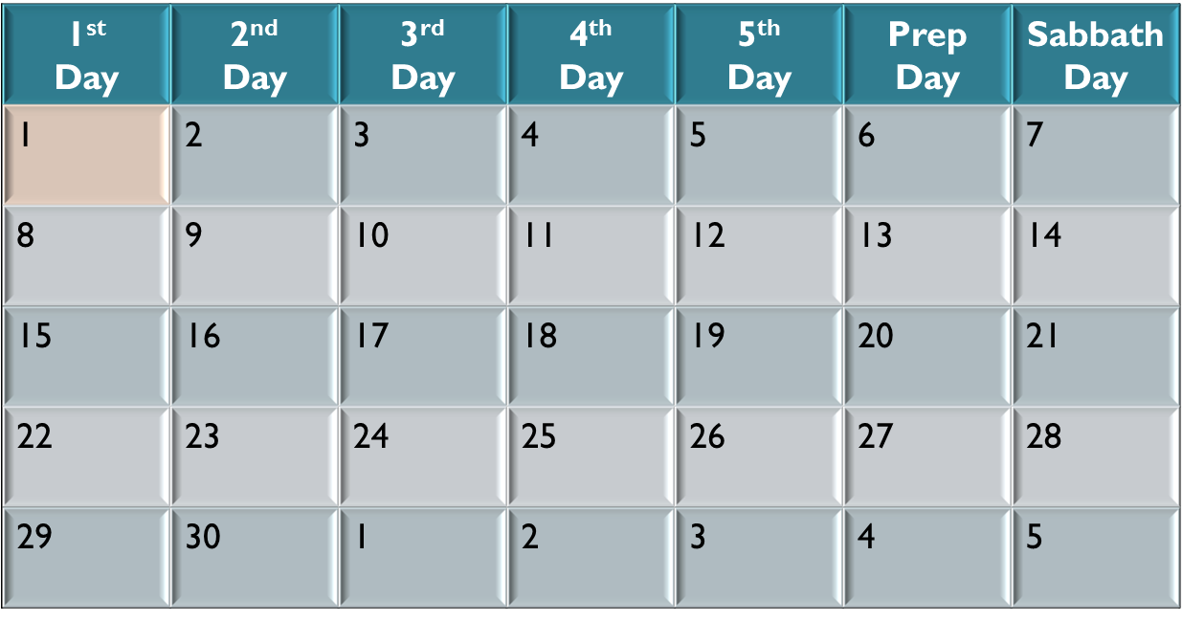
1st Day of Creation Begins Yahuah’s Calendar
The 1st day of the 1st week!
The 1st day of the 1st month!
The 1st day of the 1st year!
Notes:
May 23/17 … added this slide to show that 4150 is not always something to do with worship statutes.

Slide 58
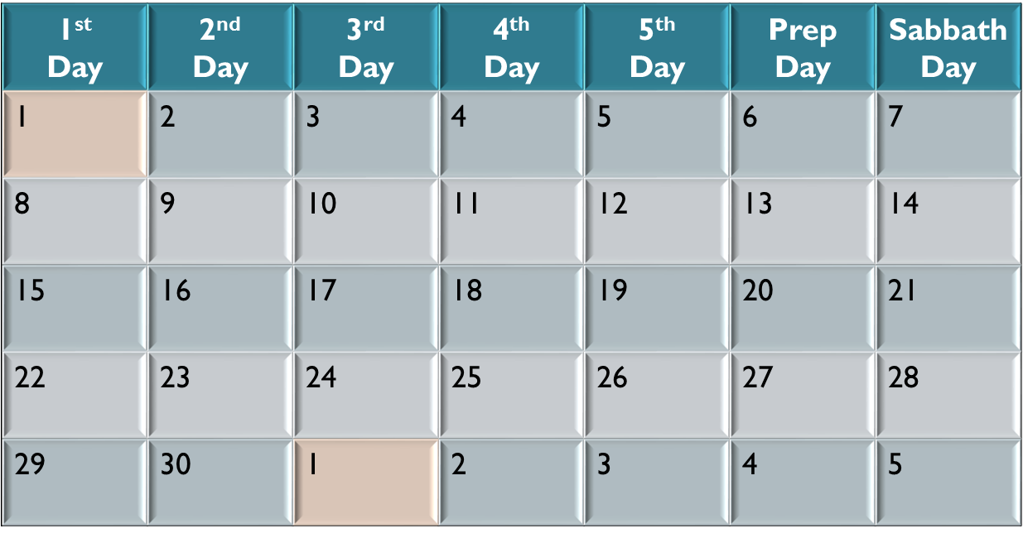
30 Days in Yahuah’s Creation Month
Gen 7:11 In the six hundredth year of Noah's life, in the second month, the seventeenth day of the month, the same day were all the fountains of the great deep broken up …
Gen 8:3 … and after the end of the hundred and fifty days the waters
were abated.
Gen 8:4 And the ark rested in the seventh month, on the seventeenth day of the month …
The 1st day of the 1st month of creation.
The 1st day of the 2nd month.
DATE: Approx. 2300 BC
(or 1700 Years From Creation)
Notes:
63N June 20th

Slide 59

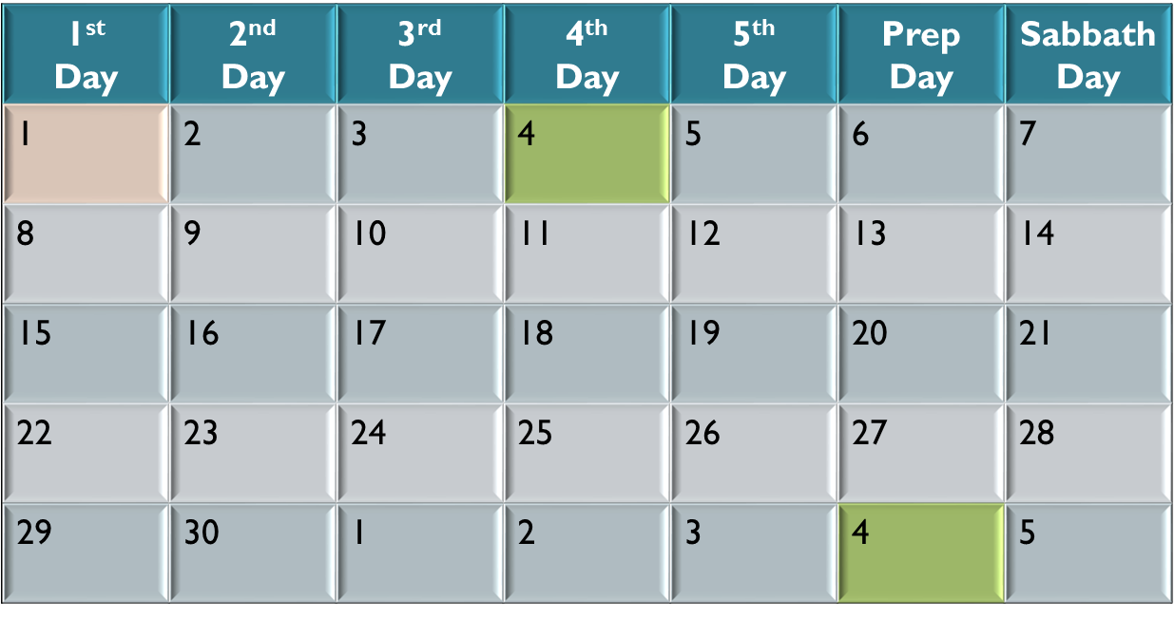
Moon’s Lunation Cycle Given at Creation
The lunar month was always
3 days behind Yahuah’s
set-apart month start.
The 1st day of the 1st Lunar Cycle.
The 1st day of the 2nd Lunar Cycle.
Notes:
64n June 20th

Slide 60
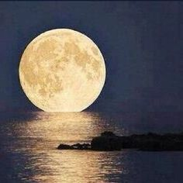
Moon’s Lunation is Special
The lunation cycle was a special 30 day period created for the “Ordinances of the Moon.” (Remember the review of these “ordinances” given with H3394.)
There was nothing imperfect about this
moon-month.
The moon was given specific job descriptions to bless the earth and mankind with agricultural bounties.
The moon-month was never to be linked to the commencement of Yahuah’s worship statutes.
Notes:
65n June 20th

Slide 61

#3 Lunar Months
(aside from Creation Week)
Sidereal month: 27.3 days
Synodic month: 29.5 days
61
12 SLIDES

Slide 62
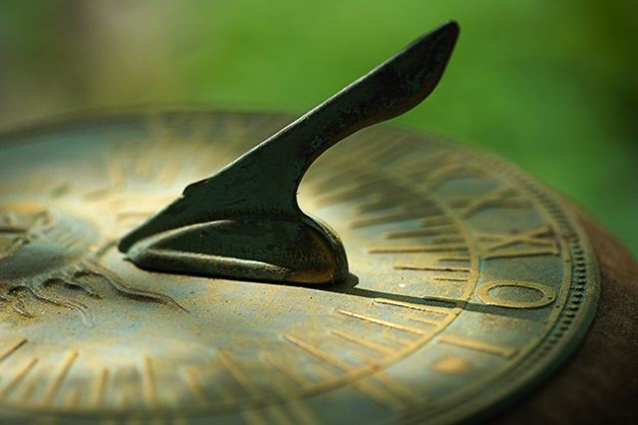
At Creation, there was no such thing
as a Sidereal or Synodic Lunar Month.
2 Chron 32:24 In those days Hezekiah was sick to the death, and prayed unto the LORD: … and he gave him a sign.
2 Kings 20:9-11 … shall the shadow go forth ten degrees, or go back ten degrees? 10 And Hezekiah answered, It is a light thing for the shadow to go down ten degrees: nay, but let the shadow return backward ten degrees. 11 And … he brought the shadow ten degrees backward …
Isa 38:7-8 And this shall be a sign unto thee …
8 Behold, I will bring again the shadow of the degrees … ten degrees backward …
3 Scripture Witnesses:
2 Kings 20:9-11
2 Chron 32:24
Isa 38:7-8
This happened with Hezekiah’s Sundial Event ~701 BC (or 3300 years after creation).
(Details of this study are forthcoming.)
62

Slide 63


Yahuah’s Special Significant Numbers
The Scriptures speak of some very special numbers which are significant for Yahuah’s purposes. Some examples are:
1 2 3 4 7 10 12 24 30 40 42
50 70 100 120 400 430 490 1000
And … 144,000!
Consider these numbers: ~27.3 & ~29.5
Are they part of Yahuah’s numbering system?
The Scriptures speak of some very special numbers which are significant for Yahuah’s purposes. Some examples are:
1 (One Elohim)
2 (Union/Two Sides)
3 (Completeness to a lesser degree than 7)
4 (Love to Yahuah)
6 (Human weakness/Love to Mankind)
7 (Sabbath/Festivals / Perfection)
      8 (New Beginnings)
10 (Completeness)
http://www.biblestudy.org/bibleref/meaning-of-numbers-in-bible/3.html
Biblical Meaning of Numbers (July 20/18)
1 - 2 - 3 - 4 - 5 - 6 - 7 - 8 - 9
10 - 11 - 12 - 13 - 14 - 15 - 16 - 17
18 - 19 - 20 - 21 - 22 - 23 - 24 - 25
27 - 28 - 29 - 30 - 31 - 33 - 34 - 40
42 - 44 - 50 - 65 - 70 - 120 - 153 - 200
390 - 400 - 430 - 444 - 490 - 666 - 1000
The Meaning of Numbers: The Number 3
The number 3 is used 467 times in the Bible. It pictures completeness, though to a lesser degree than 7. The meaning of this number derives from the fact that it is the first of four spiritually perfect numerals (the others being 7, 10 and 12). The 3 righteous patriarchs before the flood were Abel, Enoch and Noah. After the deluge there was the righteous "fathers" Abraham, Isaac and Jacob (later renamed Israel).
There are 27 books in the New Testament, which is 3x3x3, or completeness to the third power.Jesus prayed three times in the Garden of Gethsemane before His arrest. He was placed on the cross at the 3rd hour of the day (9 a.m.) and died at the 9th hour (3 p.m.). There were 3 hours of darkness that covered the land while Jesus was suffering on the cross from the 6th hour to the 9th hour. Three is the number of resurrection. Christ was dead for three full days and three full nights, a total of 72 hours, before being resurrected on Saturday, April 8, just before sunset.
Appearances of the number three
There were only three individuals who witnessed Jesus' transfiguration on Mount Hermon. Those who saw Jesus' glory on the mount were John, Peter and James.
The apostle Paul was an exceptionally well educated person. In three different occasions he quotes directly from Greek poets (Acts 17:28, 1Corinthians 15:33 and Titus 1:12). He also was privileged to visit the location of God's throne, which is in the third heaven (2Corinthians 12:2 - 4).
Notes:
http://applygodsword.com/what-does-the-number-three-mean-in-the-bible/
prophesying what’s going to happen and using specific numbers repeatedly, such as the number three; The number three in relation to the gospel of Jesus Christ at minimum proves that God is in control of all these events that took place which resulted in our salvation.
Jesus was 30 years old when he started his public ministry.
• Jesus was tempted 3 times in the desert by Satan.
• Peter, James, and John were the three disciples with Jesus in the Garden of Gethsemane who were in his inner circle.
• The disciples failed to stay awake three times in the Garden of Gethsemane.
• Peter denied Jesus three times.
• In John 21 when Jesus reinstates Peter, he asks him 3 times if Peter loves him.
• It says in Mark 15:25 that it was the third hour of the day when Jesus was crucified.
• The Holy Spirit’s anointing at Pentecost according to Acts 2:15 happened at the third hour of the day.
• Jesus rose from dead on the third day.

Slide 64
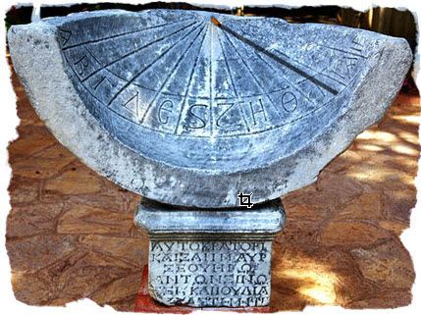
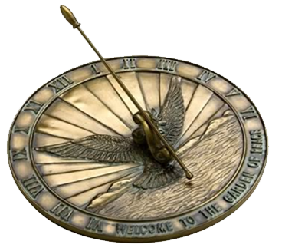

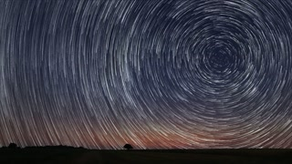

Two Different Lunar Months Today
Today we are told/taught the lunar cycle is 29½ days long.
At the sundial event in 701 BC, the lunation of the moon was moved back to 28 days. Just under it actually. The 29.5 lunation claim of man is simply false! That is, if we accept Yahuah's designation of a complete orbit. Scriptures tells us that one full orbit of the sun is from the starting place back to the original starting place.
(See Eccl 1:5.)
The 29.5 day lunation of the moon is a fully false claim because the 29.5 day lunation demands about a 375 degree circle. Yes it returns to the original place of entry and continues until man can declare a lunation close to Yahuah's design of a 30 day lunar cycle. In this way, Yahuah's peripheries are abolished and replaced to claim a 29.5 day lunation.
There is simply no such identity as a
29.5 day lunar month according to Yahuah.
Note the number of moon phases as given here:
1) Sidereal Month [alignment with the stars]
The time it takes for the moon
to complete one orbit of Earth;
an average of 27.3 days.
2) Synodic Month [alignment with sun & moon phase]
The time it takes the moon to
reach the same visual phase; an
average of 29.5 days & 29 phases.
Neither of these moon/months
align with Yahuah’s 30 day month!
Notes:
July 18/18: The sidereal month is the time it takes to make one complete orbit around Earth with respect to the fixed stars. It is about 27.32 days. The synodic month is the time it takes the Moon to reach the same visual phase. This varies notably throughout the year, but averages around 29.53 days.
[57n – these numbers are for me to link to my original PPT] June 19th – Walter … the text box beside the slide above is Tim’s explanation of the real moon month of only 28 days, and how man has manipulated the moon month to be 29.5 days long. If you want to skip this long explanation and just say 29.5 days is NOT the same as Yah’s 30 day month no matter which way one wants to work it – that may be easier for you in English, and for German. I tried to explain it in more simple terms, so if you don’t like it … you can go back to what Tim had on the original slide.

Slide 65
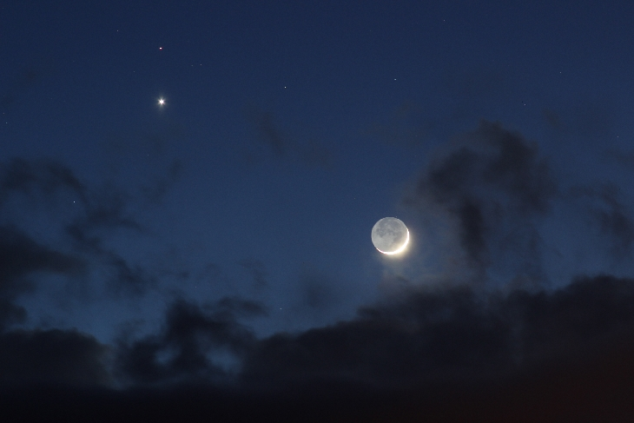
Lunar Sidereal and Synodic Periods
The Moon's sidereal orbital period (or sidereal month)
is ~27.3 days.
  This is the time interval that the Moon takes to complete its 360° orbit
  of the Earth relative to the "fixed" stars.
The period of the lunar phases (the synodic month),
e.g. the full moon to full moon period,
is longer at ~29.5 days.
  At New Moon, the Moon has extended its orbit for a total of ~390° to align with the Sun again – thus completing the synodic month.
  https://community.dur.ac.uk/john.lucey/users/lunar_sid_syn.html

Slide 66
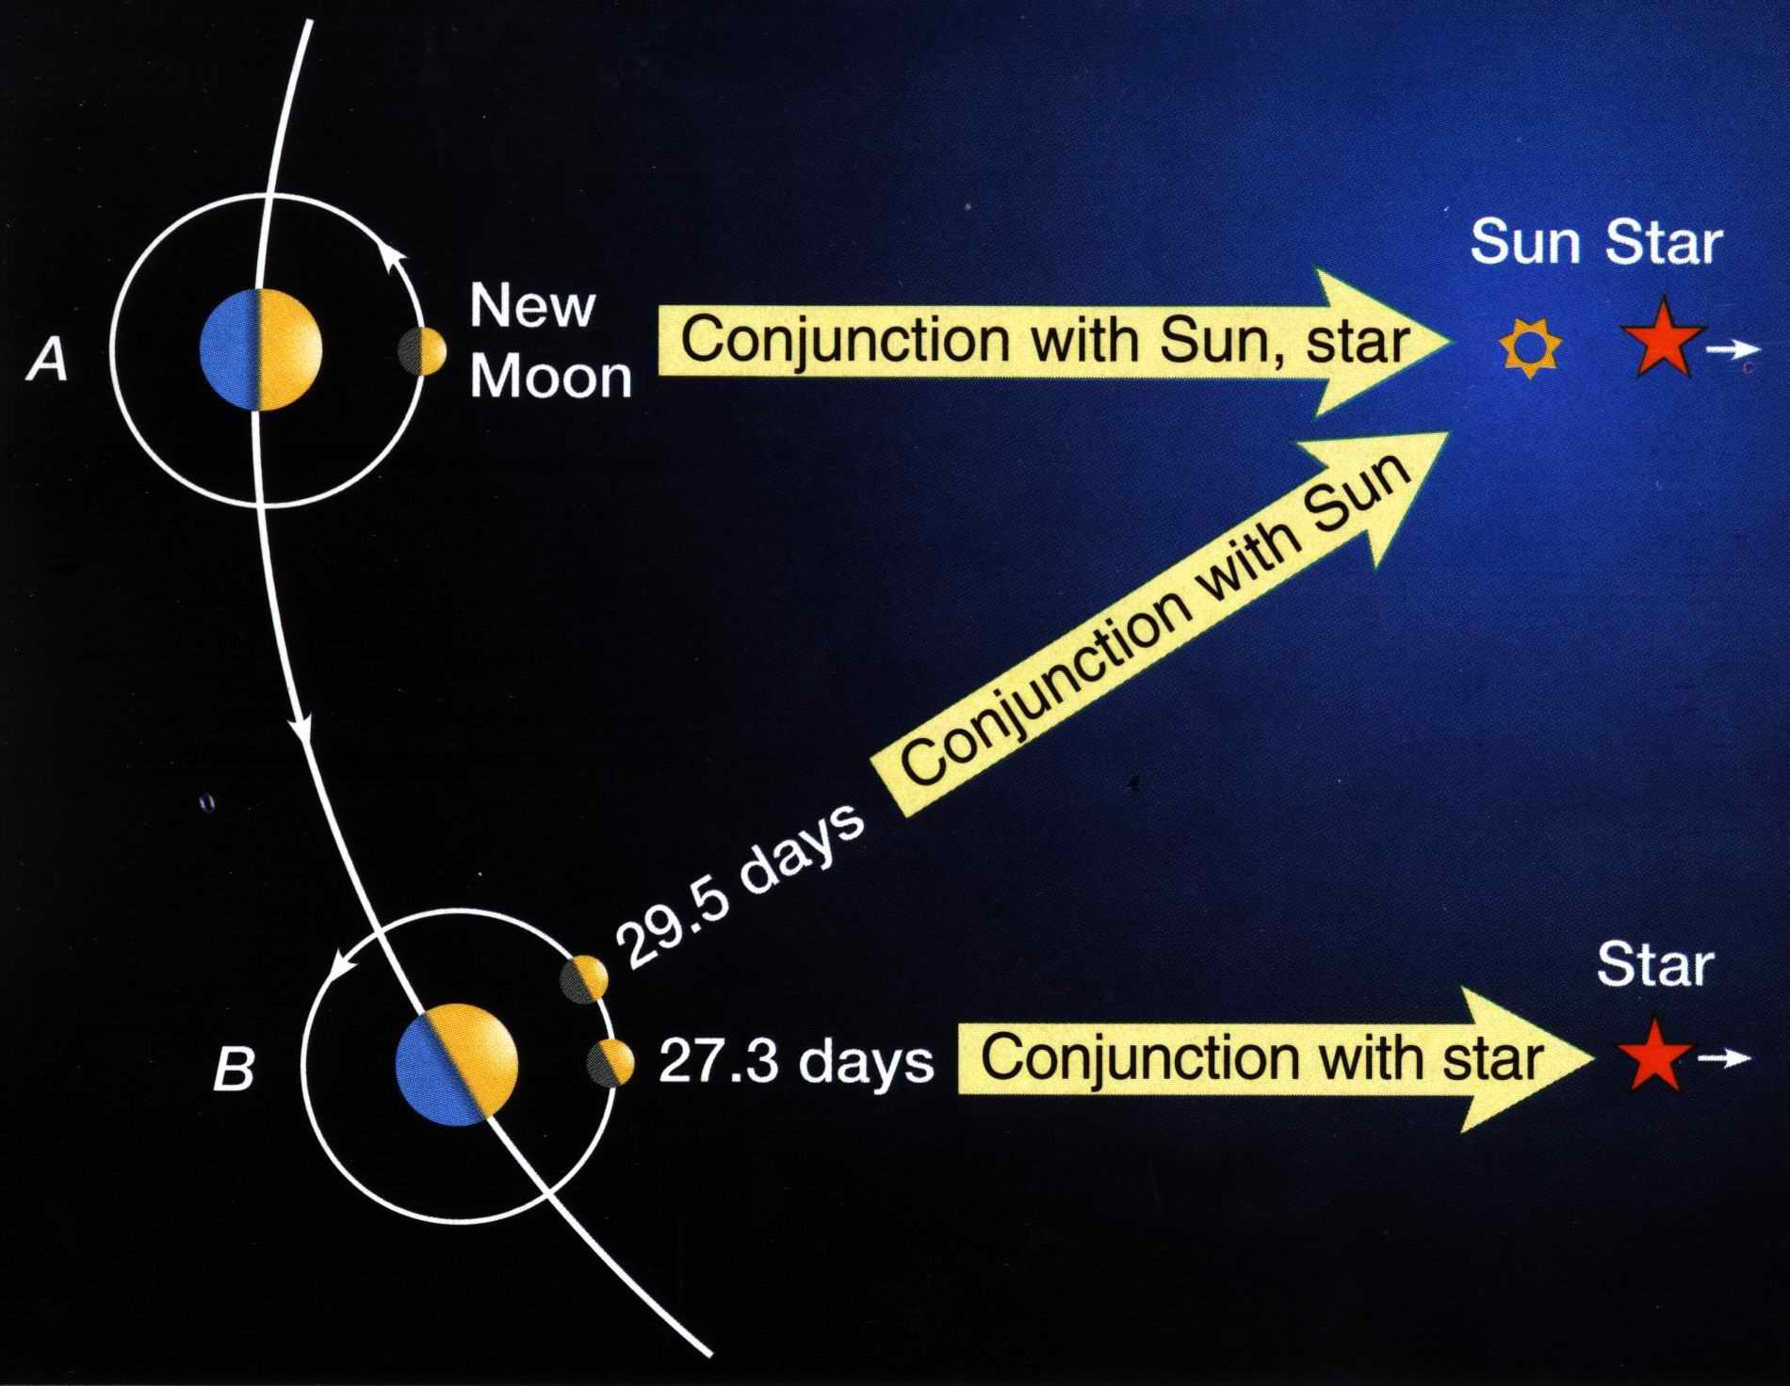
Synodic Month (Globe Earth Model)
Diagram
New moon aligns
with sun & star.

Slide 67
Synodic Month (Globe Earth Model)
Diagram
New moon aligns
with sun & star.
Diagram
27.3 days later the
moon conjuncts
with the same star.

Slide 68
Synodic Month (Globe Earth Model)
Diagram
New moon aligns
with sun & star.
Diagram
27.3 days later the
moon conjuncts
with the same star.
29.5 days later the
moon conjuncts
with the sun.

Slide 69
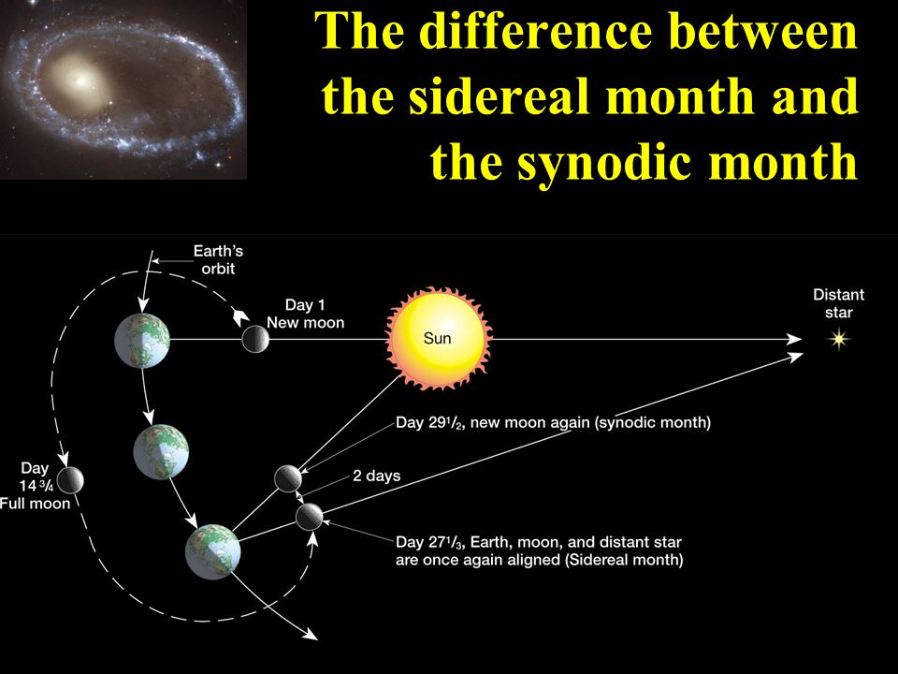
Globe
Earth
Model
(Another
View)

Slide 70
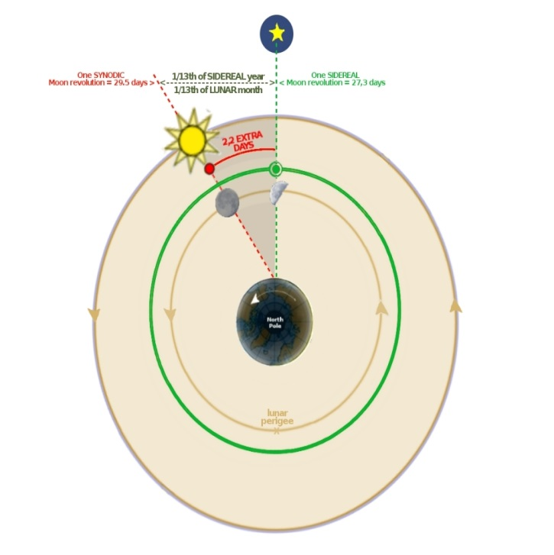
Lunar Sidereal Month
Flat Earth
Model

Slide 71


Lunar Sidereal Month
Flat Earth
(Close View)

Slide 72


Can you answer this question?
Which month is the true lunar month according to the Rabbis?
1) Sidereal Month?
2) Synodic Month?!
Most feast calendars that use the moon
month mark the new moon day according
to a particular moon phase, not the
completion of the Sidereal Month cycle.
Neither of these moon/months
align with Yahuah’s 30 day month!
Notes:
July 18/18: The sidereal month is the time it takes to make one complete orbit around Earth with respect to the fixed stars. It is about 27.32 days. The synodic month is the time it takes the Moon to reach the same visual phase. This varies notably throughout the year, but averages around 29.53 days.
[57n – these numbers are for me to link to my original PPT] June 19th – Walter … the text box beside the slide above is Tim’s explanation of the real moon month of only 28 days, and how man has manipulated the moon month to be 29.5 days long. If you want to skip this long explanation and just say 29.5 days is NOT the same as Yah’s 30 day month no matter which way one wants to work it – that may be easier for you in English, and for German. I tried to explain it in more simple terms, so if you don’t like it … you can go back to what Tim had on the original slide.

Slide 73



The Synodic Month and the great Cover-up
The Synodic month produces a 13th month about every
3 years. It is definitely linked to the festal worship statutes of every moon
based calendar.
The Sidereal month
produces a 13th month
every year.
Neither of these moon/months
align with Yahuah’s 30 day month!
Notes:
July 18/18: The sidereal month is the time it takes to make one complete orbit around Earth with respect to the fixed stars. It is about 27.32 days. The synodic month is the time it takes the Moon to reach the same visual phase. This varies notably throughout the year, but averages around 29.53 days.
[57n – these numbers are for me to link to my original PPT] June 19th – Walter … the text box beside the slide above is Tim’s explanation of the real moon month of only 28 days, and how man has manipulated the moon month to be 29.5 days long. If you want to skip this long explanation and just say 29.5 days is NOT the same as Yah’s 30 day month no matter which way one wants to work it – that may be easier for you in English, and for German. I tried to explain it in more simple terms, so if you don’t like it … you can go back to what Tim had on the original slide.

Slide 74

What is your answer to this question?
Did Yahuah change His mind and give His people
a “new” set-apart month with
~27.3 days, or ~29.5 days/month?
Answer: ~27.3 & ~29.5 do not seem to be
part of Yahuah’s numbering system?

Slide 75
Can you answer another question?
How did the synodic moon cycle ever receive custody of the
festal month ?
The history of the Synodic Month and its attachment to worship and religious service has deep roots with the pagans (first) then eventually adopted by Yahuah’s rebellious leaders and people.
It was closer to Yahuah’s 30 day month!
Notes:
July 18/18: The sidereal month is the time it takes to make one complete orbit around Earth with respect to the fixed stars. It is about 27.32 days. The synodic month is the time it takes the Moon to reach the same visual phase. This varies notably throughout the year, but averages around 29.53 days.
[57n – these numbers are for me to link to my original PPT] June 19th – Walter … the text box beside the slide above is Tim’s explanation of the real moon month of only 28 days, and how man has manipulated the moon month to be 29.5 days long. If you want to skip this long explanation and just say 29.5 days is NOT the same as Yah’s 30 day month no matter which way one wants to work it – that may be easier for you in English, and for German. I tried to explain it in more simple terms, so if you don’t like it … you can go back to what Tim had on the original slide.

Slide 76
The Truth of the Matter for H3391
Part 4
“The Moonth! Oh, the Moonth?”
(con’t) Aug 3/18
H3391 will be fully investigated to see how its
Lunation Cycle month aligns with the Synodic Month.
Will the definitions of “Lunar” and “Lunation” lend
any surprising information?
The End
Notes:
FEB 19/17: NEW SLIDE.

Slide 77




If you need assistance with this information, please send your questions to
Charlene Fortsch or
Timothy Astleford:
charlene@torahtothetribes.com
or
Shofar1owr@gmail.com

