Slide 1

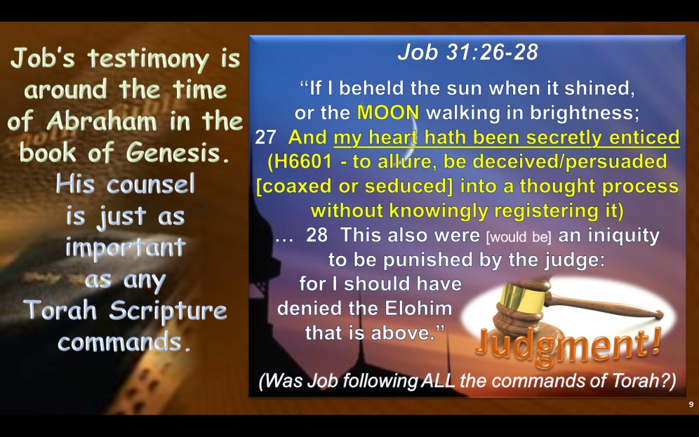
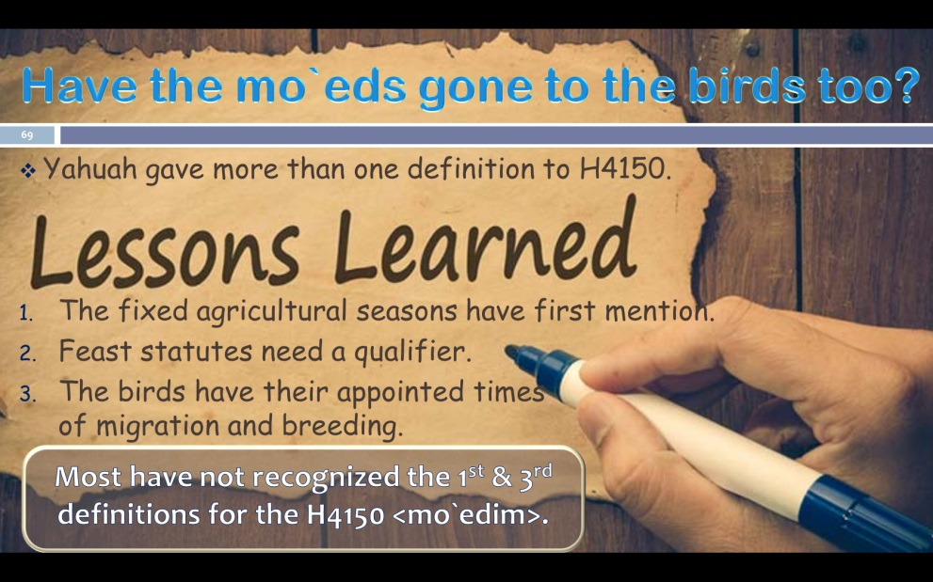
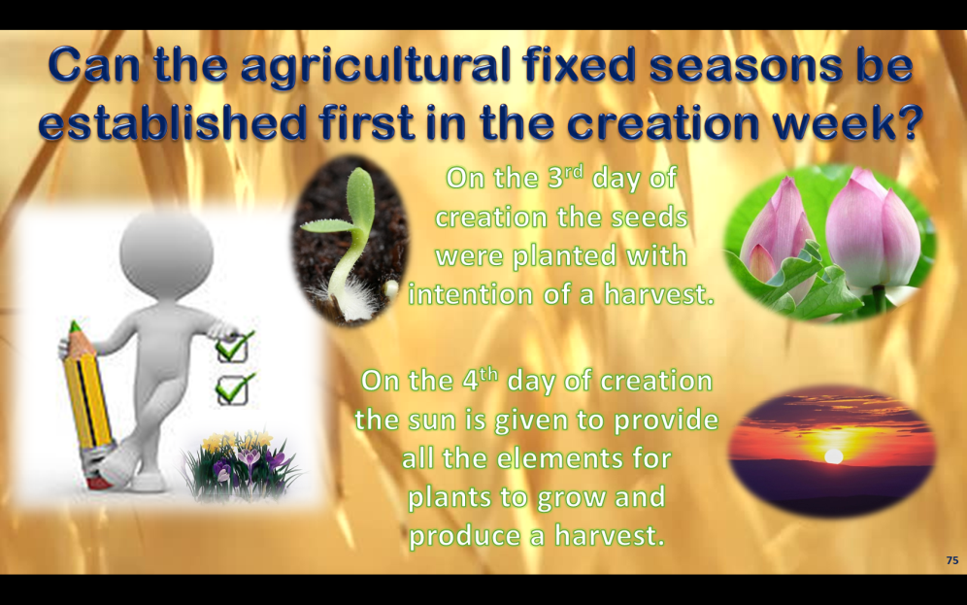
Oct 23/19 corrections from Chris F.
The Moon! Oh, the Moon! Pt 2

Slide 2
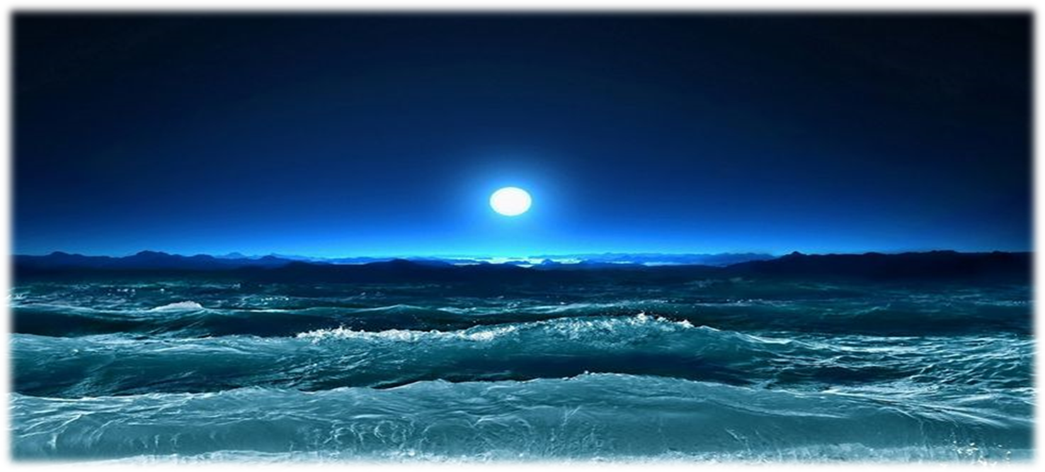
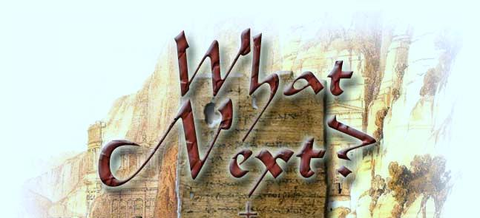
Part 2 :
The Moon! Oh, the Moon!
Yes! The moon in the heavens
has its own ordinances.
[H3394] ~ yareach
“Ordinances” of the Moon
2
Notes:
may 18th: new slide to show the ordinances of the moon are completely separate and different from the 2 LIGHT-givers in the sky (sun and stars.)

Slide 3

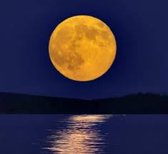
H3394 MOON <yareach>
Review for Part 1 on H3394
H3394 is the Hebrew word number for the literal moon
in the sky – the noun – used 26 times in the Tanach.
H3394 is used in the Torah only 3 times.
  The first usage in Gen 37:9 is of prophetic significance.
  The 2nd & 3rd usages in Deut 4 and Deut 17 are strict warnings
  not to look to the moon for commencement of worship practices.
Moses does not use H3394 (as a noun) to designate the moon is in charge of the festal month commencement in any Torah verses.
Noun
Notes:
May 11th

Slide 4

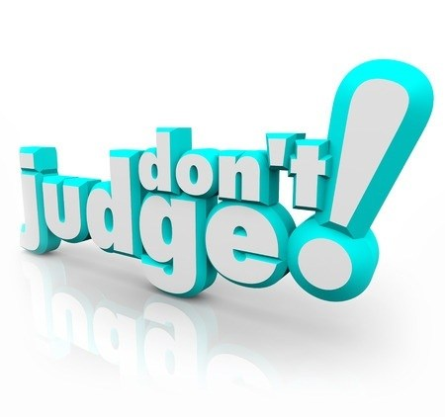
A Valid Concern About Judgment
Yahuah’s calendar does not use the moon to calculate the month commencement for the purpose of defining the appointed times.
Question:
When this study is presented to those that still use the moon-month, can/will there
be any judgmental concerns either from the study itself, or from those that present it?
This is a serious question, with a very valid concern that must be addressed before Part 2 of the Moon Study can proceed.
Where is this concern coming from?

Slide 5

A Closer Look At Deut 4:19 1451 BC
Deut 4:1, 2, 19, 23, 26
1 Now therefore hearken, O Israel, unto the statutes and unto the judgments, which I teach you, for to do them, that ye may live,
2 Ye shall not add unto the word which I command you, neither shall ye diminish ought from it,
19 And lest thou lift up thine eyes unto heaven, and when thou seest the sun, and
the MOON, and the stars, even all the host
of heaven, shouldest be driven to worship [H7812] them, and SERVE [H5647] them,
which Yahuah thy Elohim hath divided unto
all nations under the whole heaven.
23 Take heed unto yourselves, lest ye forget the covenant of Yahuah your Elohim, which he made with you, and make you a graven image, or the likeness of any thing, which Yahuah thy Elohim hath forbidden thee.
26 I call heaven and earth to witness against you this day, that ye shall soon utterly perish from off the land whereunto ye go over Jordan to possess it; ye shall not prolong your days upon it, but shall utterly be destroyed.

Slide 6

A Closer Look At Deut 17:3 ‘If/Then’
Deut 17:2-5 IF there be found among you, within any
of thy gates which Yahuah
thy Elohim giveth thee,
man or woman, that hath wrought wickedness in the
sight of Yahuah thy Elohim,
in transgressing His covenant,
3 And hath gone and SERVED [H5647] other gods, and worshipped [H7812] them,
either the sun, or MOON,
or any of the host of heaven, which I have not commanded;
4 And it be told thee, and thou hast heard of it, and inquired diligently, and,
behold, it be true, and the thing certain, THAT SUCH ABOMINATION IS WROUGHT IN ISRAEL:
5 THEN shalt thou bring forth that man or that woman, which have committed that wicked thing, unto thy gates, even that man or that woman, and shalt stone them with stones, till they die.
Concern?

Slide 7
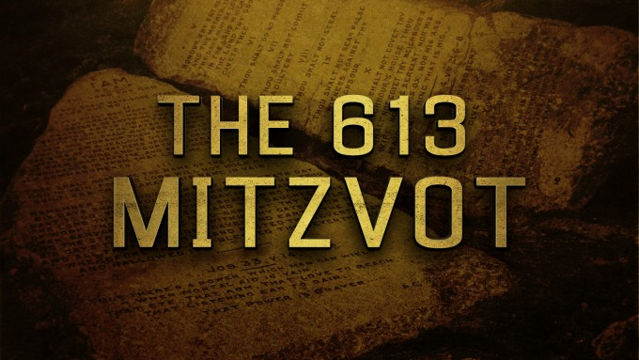

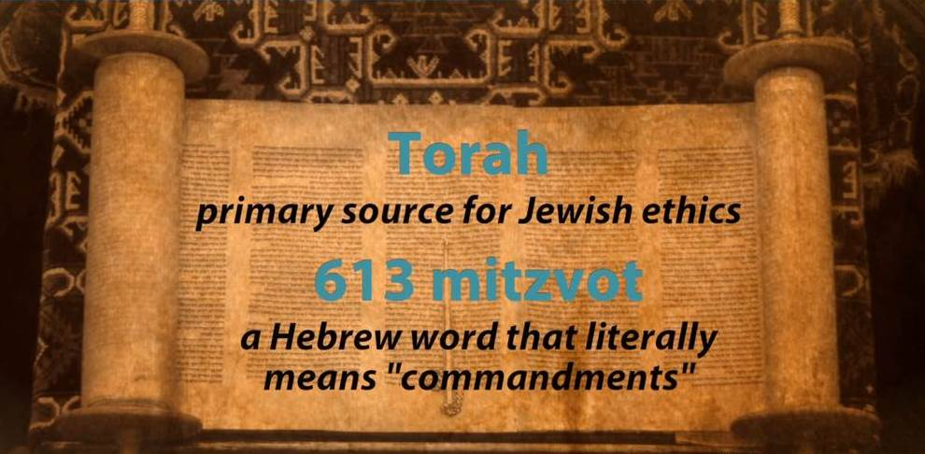
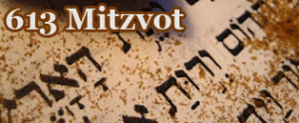
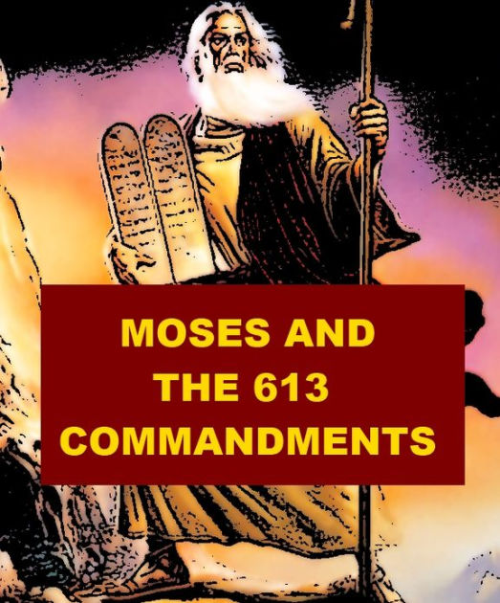
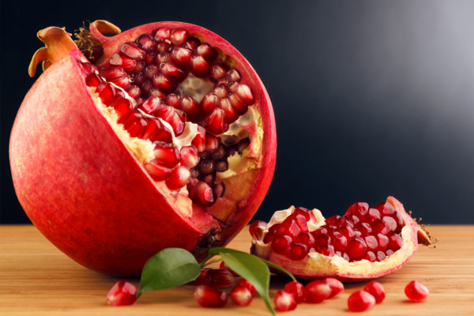
What are the …
?
Those that teach these 613 commands say:
By eating the pomegranate,
we figuratively show our desire and hope to fulfill all 613 commands given by Moses!

Slide 8
There is a Problem!
Moses also gave the commands found in
Deut 4 & 17 not to look
to the sun & moon, etc.!
These 2 commands are
not found among the
613 listed commands!
What would Job say about this?

Slide 9

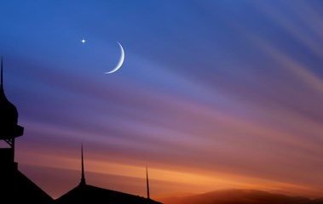
Job’s testimony is around the time of Abraham in the
book of Genesis.
His counsel
is just as
important
as any
Torah Scripture commands.
Job 31:26-28
“If I beheld the sun when it shined,
or the MOON walking in brightness;
27 And my heart hath been secretly enticed
(H6601 - to allure, be deceived/persuaded [coaxed or seduced] into a thought process without knowingly registering it)
… 28 This also were [would be] an iniquity
to be punished by the judge:
for I should have
denied the Elohim
that is above.”
(Was Job following ALL the commands of Torah?)
Judgment!
Notes:
OT:6601
pathah (paw-thaw'); a primitive root; to open, i.e. be (causatively, make) roomy; usually figuratively (in a mental or moral sense) to be (causatively, make) simple or (in a sinister way) delude:
KJV - allure, deceive, enlarge, entice, flatter, persuade, silly (one).

Slide 10



What About Judging?
Are Yahuah’s people allowed to judge words and actions of Torah believers that violate Torah commands?
Yes! With love, mercy and kindness!
However, no one is allowed to judge (unto salvation) what is in the heart.
But, if the Deut 4 & 17 commands are not found among the 613, is there
no place for judgment to salvage
an erring child of Yahuah?
[the heart]

Slide 11
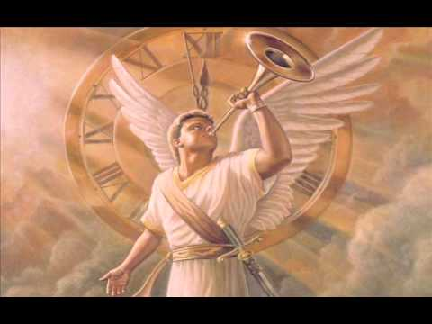
A Command from Isaiah 58:1
Cry aloud, spare not,
lift up thy voice like a trumpet,
and shew my people
their transgression,
and the house of Jacob
their sins.
This verse does not say to judge the LIFE – but to judge the sin.

Slide 12
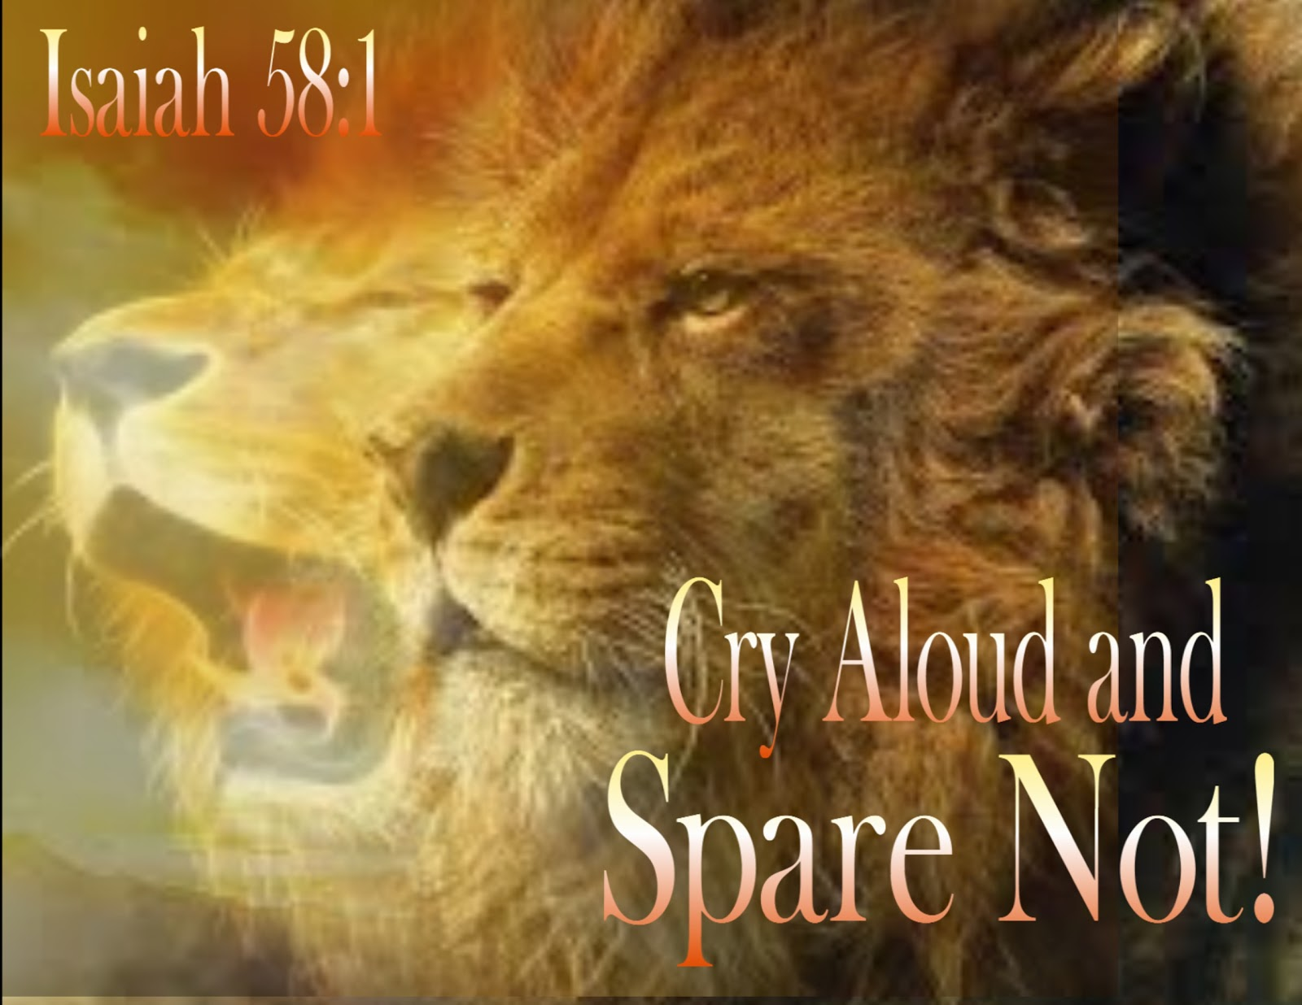
Does Isaiah not give permission
to determine the fruits of others as to whether they are in violation of covenant or not?
How can others be warned of their covenant violations if no one is allowed to judge the
evidence of what is seen?!

Slide 13
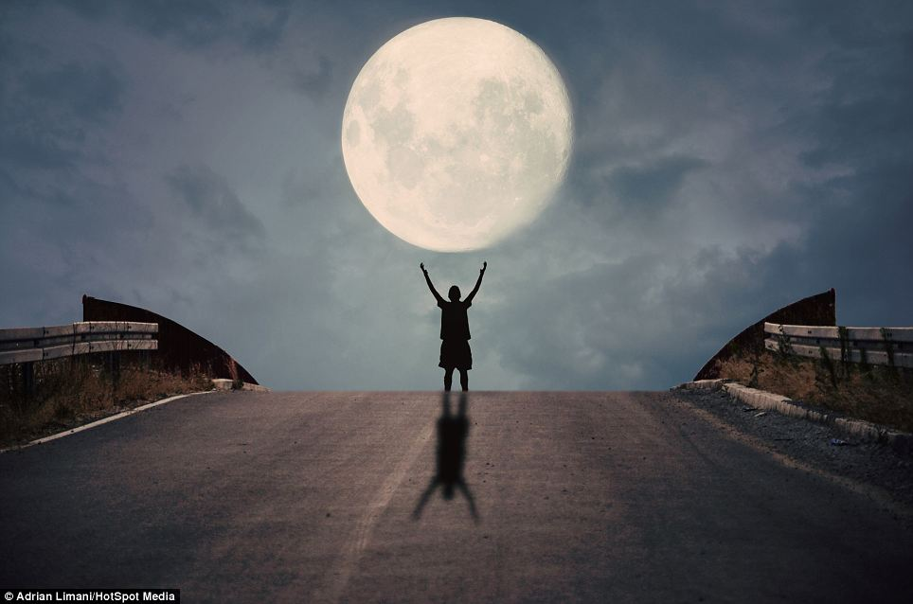
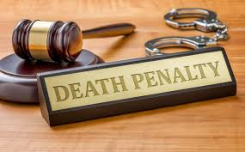
Deuteronomy Worship Reminders
Deut 4:19
And lest thou lift up thine eyes unto heaven, and when thou seest the sun, and the MOON, and the stars, even all the host of heaven, shouldest be driven to worship [H7812] them, and SERVE [H5647] them …
Deut 17:3
And hath gone and SERVED [H5647] other gods, and worshipped [H7812] them,
either the sun, or MOON, or any of the host of heaven, which
I have not
commanded.

Slide 14
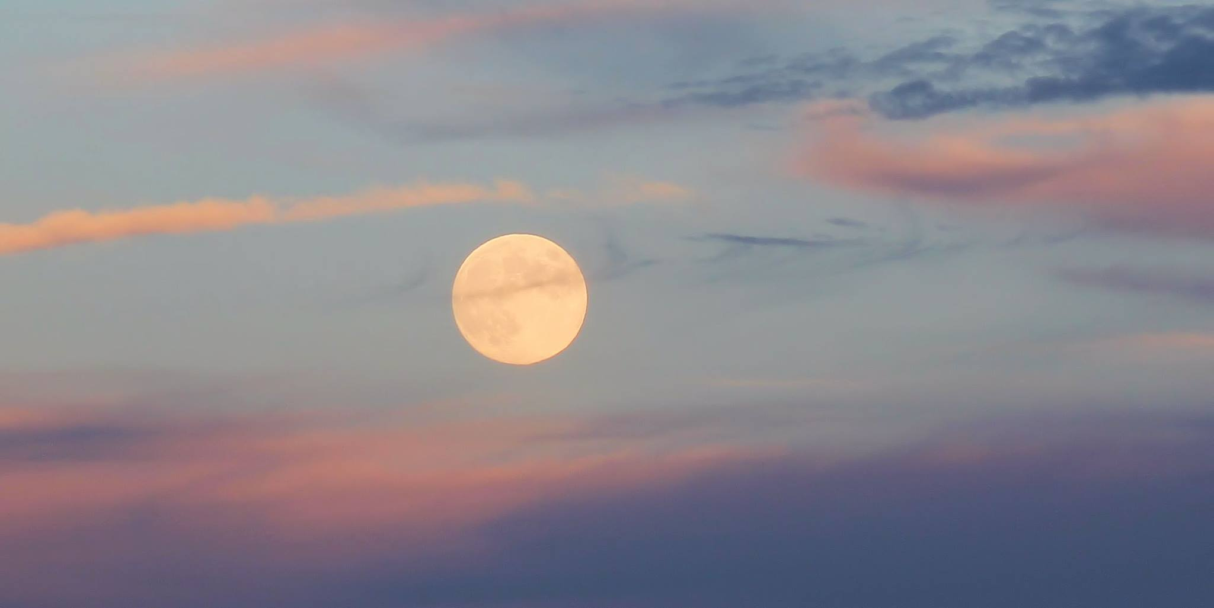
Judgmental Connotation of Worship & Serve
Deut 4:19 & 17:3
speak of two serious commands not to
even look to any of
the heavenly bodies
lest they be “served” and “worshipped.”
This is 40 years after worshipping the golden calf at Mt Sinai.
What was Moses really trying to tell these people? Could it be …
  “If you don’t look you likely won’t worship the gods
  of the pagans, or worship the way the pagans do”?

Slide 15

A Closer Look at “Worship” in Deut.
worship H7812; shachah; a primitive root; to depress, i.e. prostrate (especially reflexive, in homage to royalty or God [Elohim]):
  KJV - bow (self) down, crouch,
  fall down (flat), humbly beseech,
  do (make) obeisance, do reverence,
  make to stoop, worship.
Will the Hebrew definitions differ from today?

Slide 16
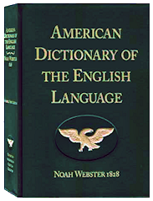
“Worship” Definitions Today – Webster’s 1828
WORSHIP, noun
  4. Chiefly and eminently, the act of paying divine honors to the Supreme Being; or the reverence and homage paid to Him in religious exercises, consisting in adoration, confession, prayer, thanksgiving and the like.
  5. The homage paid to idols or false gods by pagans;
  as the worship of Isis.
WORSHIP, verb
  1. To adore; to pay divine honors to; to reverence with supreme
  respect and veneration.
  2. To perform acts of adoration. 3. To perform religious SERVICE.

Slide 17
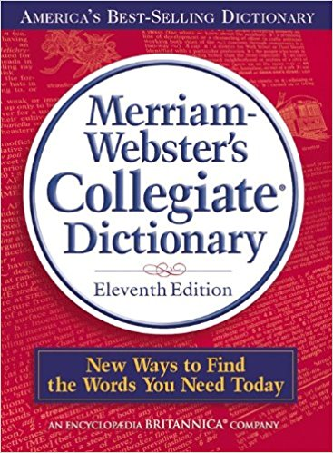
Worship Definition – Merriam-Webster
Worship transitive verb
  1: to honor or reverence as a divine being or supernatural power
  2: to regard with great or extravagant respect, honor, or devotion
intransitive verb to perform or take part in worship or an act of worship.
https://www.merriam-webster.com/dictionary/worship

Slide 18
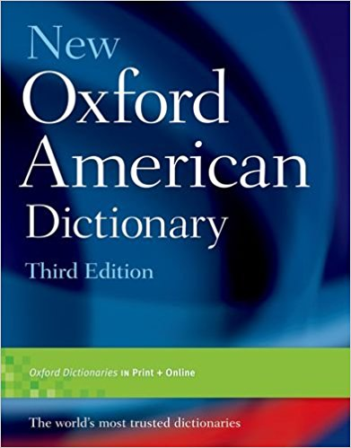
Worship Definition – Oxford
Worship
Noun The feeling or expression of reverence and adoration for a deity.
E.g.: worship of the Mother Goddess’
Verb Show reverence and adoration
for (a deity)
E.g.: ‘the Maya built jungle pyramids to worship their gods’
https://en.oxforddictionaries.com/definition/worship

Slide 19
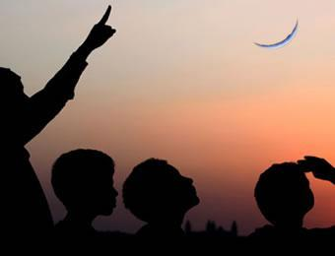
A Closer Look at “Serve” in Deut.
serve H5647; `abad; a primitive root; to work
(in any sense); by implication, to serve, till,
(causatively) enslave, etc.:
  KJV - be, keep in bondage, be bondmen, bond-service, compel, do, dress, ear, execute, husbandman, keep, labour (-ing man, bring to pass, (cause to, make to)
  serve (-ingself,), (be, become) servant (-s), do (use) service, till (-er), transgress [from margin], (set a) work,
  be wrought, worshipper.
serve H5647; `abad; a primitive root; to work (in any sense); by implication, to serve, till, (causatively) enslave, etc.:
  KJV - be, keep in bondage, be bondmen,
  bond-service, compel, do, dress, ear, execute, husbandman, keep, labour (-ing man, bring to pass, (cause to, make to) serve (-ingself,), (be, become) servant (-s),
  do (use) service, till (-er), transgress [from margin], (set a) work, be wrought, worshipper.
Will today’s definitions differ from Hebrew?

Slide 20
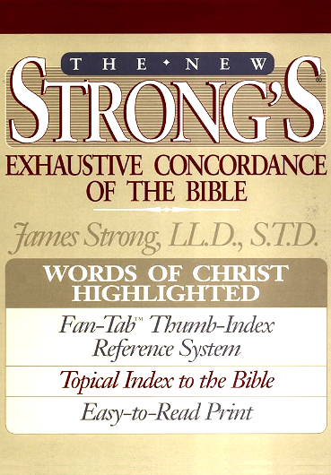
Unwavering Definitions
Between the Strong’s Hebrew definitions and the dictionaries of today, the definitions for worship are about the same.
Nothing changes for the word SERVE either.
However, there is another word we need to define to understand why Moses gave these commands, and how this may be linked to the issue of judging.

Slide 21

syncretism
What does that mean?

Slide 22
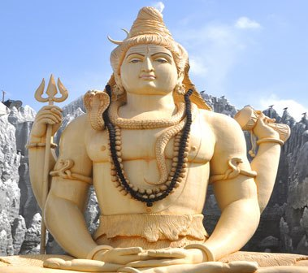
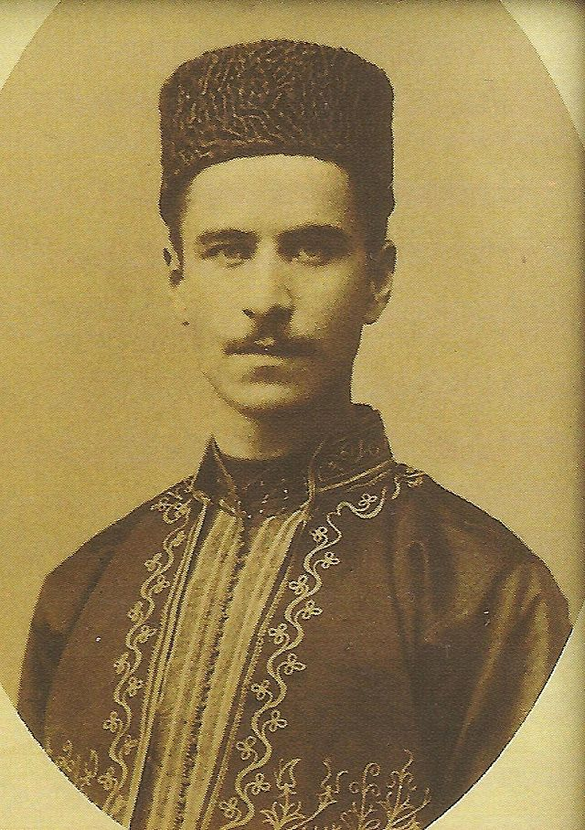
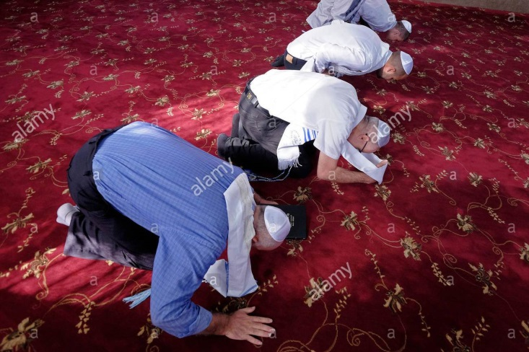
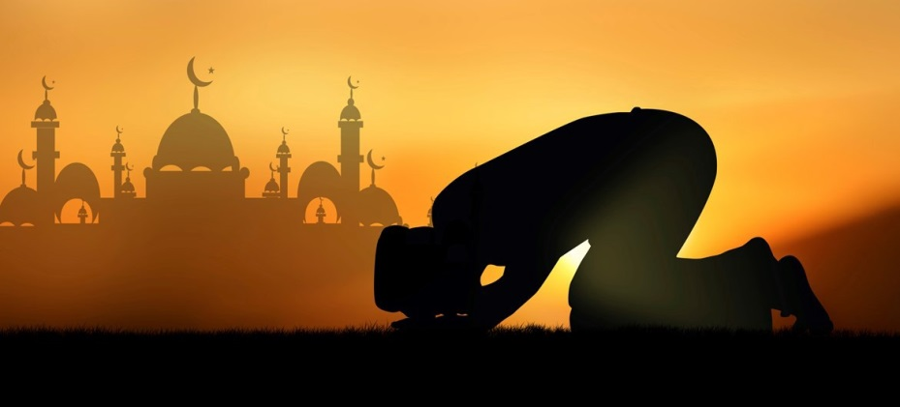
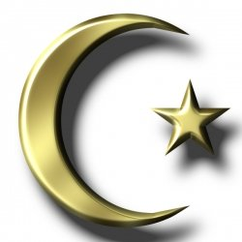
Islam – Hindu’s – Karaite Jews
22
Remember: Anan Ben Daud synchronized
the Hindu’s, Karaite Jews and Islam!
They have similar ways of
worship from the same area.
They all have the star &
crescent moon symbols.
Serve?
Worship?

Slide 23
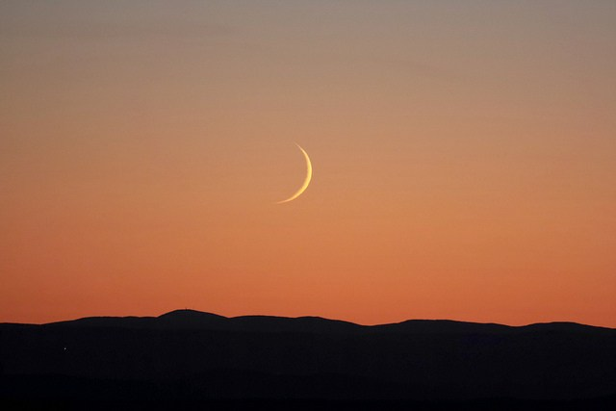
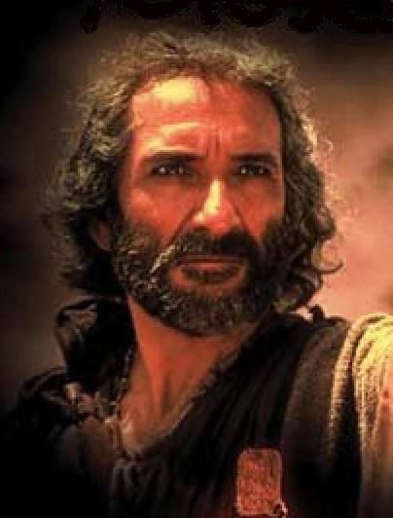
Moses & Syncretism
This is a practice of adaptation that joins elements of one, or more, religions into another.
As a result, the basic principles of ALL religions are fundamentally altered with
a common thread.
Twice in Deuteronomy, Moses warned the people of the INSIDIOUS and crafty forms of false worship, especially the worship of deities fashioned after the heavenly bodies including religious syncretism.
What is religious syncretism?

Slide 24

Syncretism Then & Now
The warning to Israel was very clear to avoid all religious syncretism that attempted to join the worship of Yahuah with the worship of pagan gods. Moses said, “Don’t even look, lest you worship…” He was “dead serious” about this warning also telling Israel they would do exactly the opposite after his death.
(Deut 28:14, 36, 64; 29:26; 30:17; 31:18, 20 and many more!)
  The Old Testament history documents Israel’s sun worship with Baal;
  Israel’s moon worship with Ashtoreth and the groves/high places.
  The prophet Elijah chided the people for attempting
  to "waver between two opinions" (1 Kings 18:21). [678 BC]
  Ezekiel also had many serious warnings, both for
  the erring and the watchman. [596-586 BC]
The same warning applies to us.

Slide 25

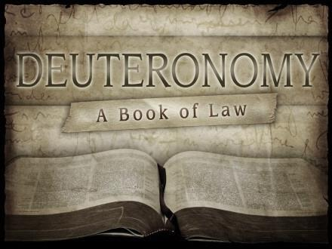
How Should Deut 4 & 17 be Viewed Today?
When we learn that our prior worship practices were based on ignorance that amounted to worshipping [according to Moses], or “giving sacred regard” to the heavenly bodies that were falsely connected to defining weekly and annual worship times – then it is time to repent and accept Yahuah’s calendar that does not align with:
  the sun for day-start,
  the moon for month start [& year-start],
  and/or the equi-lux for year-start.

Slide 26
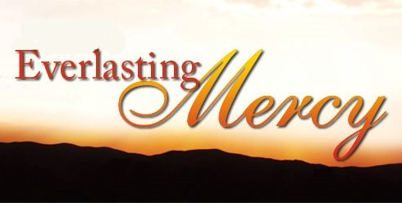
Yahuah’s
Acts 17:30 And the times of this ignorance Yahuah winked at; but now commandeth all men every where to repent.
Yahuah in His great mercy does not bring judgment upon those that do not know His calendar truths.
What is Yahuah’s choice for those that have become aware of these Mosaic commands, yet deliberately turn away from them to intentionally seek out sun & moon calendars as Jews, Karaites, Islam and pagan cultures do?
Notes:
Jer 3:12 Return, thou backsliding Israel, saith Yahuah; and I will not cause mine anger to fall upon you: for I am merciful … and I will not keep anger for ever.

Slide 27

Eze 33:7
So thou, O son of man, I have set thee a watchman unto the house of Israel; therefore thou shalt hear the word at my mouth, and warn them from me.
Watchman Responsibilities

Slide 28
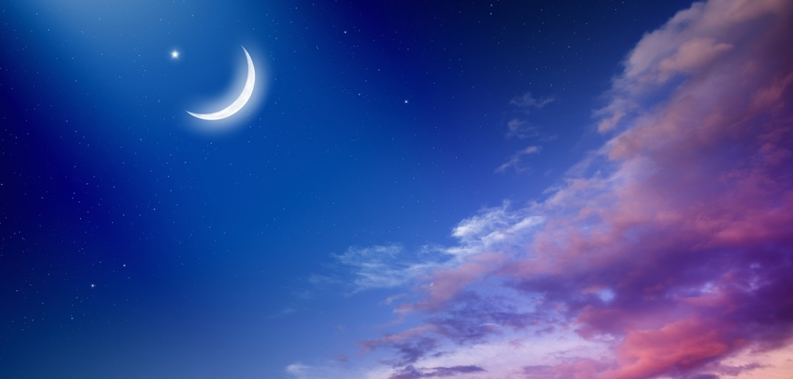


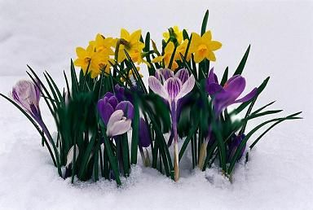


Consequences for not Watching
Ezek 33:6, 8
But if the watchman … blow not the trumpet, and the people be not warned …
8 … if thou dost not speak to warn the wicked from his way, that wicked man shall die in his iniquity; but his blood will I require at thine hand.

Slide 29
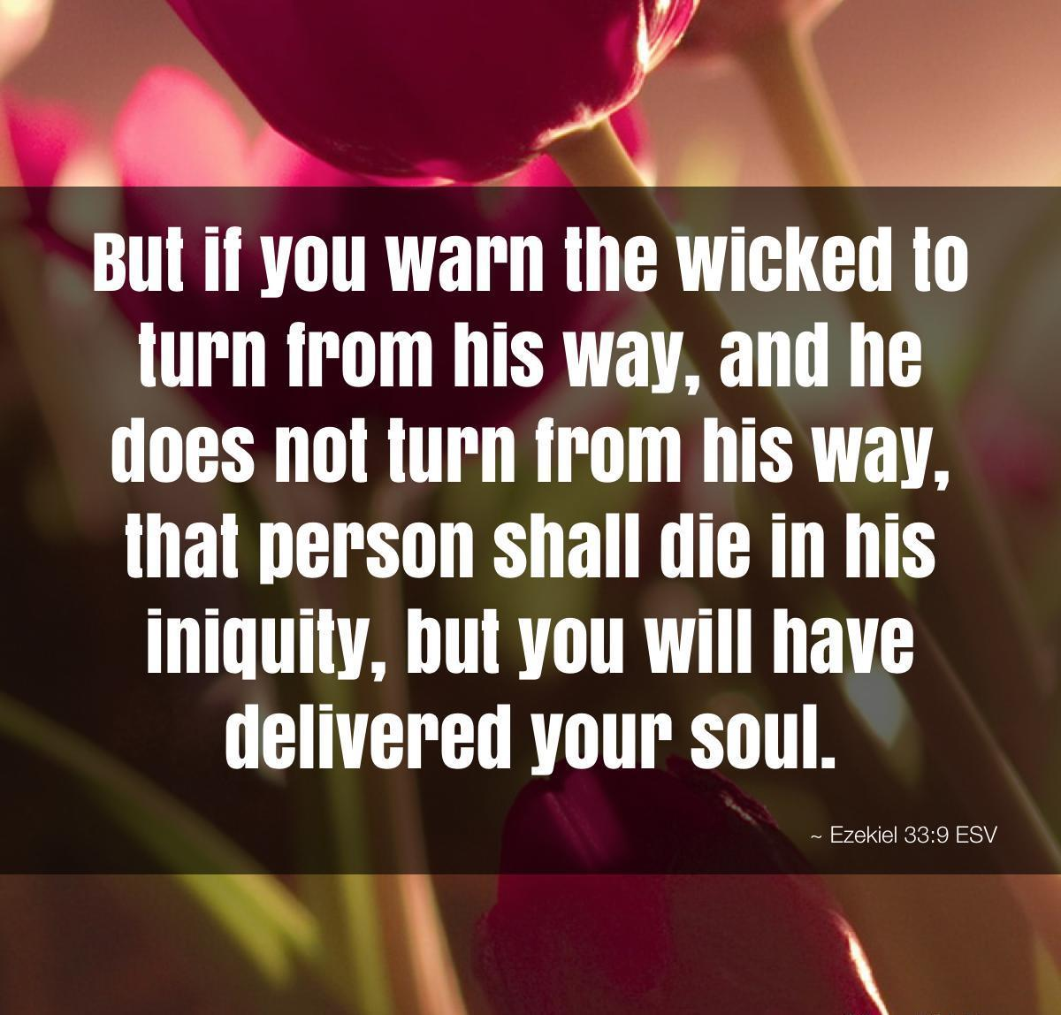
Rewards for the Watchman

Slide 30

Responsibilities of Covenant Teachers
Answers to the Question on Judging:
Messengers of Yahuah’s Covenant Calendar
that choose to alert others to these 2 serious
commands of Moses found in Deuteronomy have
no intent on placing judgment on others lives
or salvation, but are merely sounding an alarm
for the fruits of their choices.
Should some “feel” there is judgment pronounced on the reckoning of their non-covenant calendar, which inherently causes discrepancies with the STATUTES of the Torah, may they recognize this can only be the conviction from Yahuah’s Ruach.

Slide 31
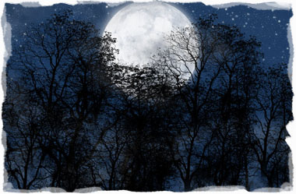
Mandate of the Moon Study
This whole study is designed to provide ample information for everyone that perceives the full study - to make a decision according to Yahuah’s divine outline for every detail of His Covenant Calendar.
Keeping this in mind, the conclusion for H3394 follows after a short review.

Slide 32
Moon Hebrew Word #s & Grammar
Hebrew #
Part of speech
R
E
V
I
E
W
1. H3394 = 26 listings <yareach>
2. H3391 = 2 listings <yerach>
3. H3842 = 3 listings <lebanah>
4. H7720 = 1 listing <saharon>
5. H2320 = 20 listings <chodesh>
Total of 52 references.
Noun – literal moon
verb – lunation cycle
Adjective – color
Simile – comparison
Verb – repetition
Question: are there really
2 verb forms for ONE “moon”?

Slide 33
Part 2: Understanding H3394
Hebrew #
Part of speech
1. H3394 = 26 listings <yareach>
Noun – literal moon
The H3394 study will be completed by a careful examination of:
The moon’s ordinances [Jer 31:35]
The definition of H4150 [seasons/mo`ed]
The moon’s seasons [Ps 104:19]

Slide 34
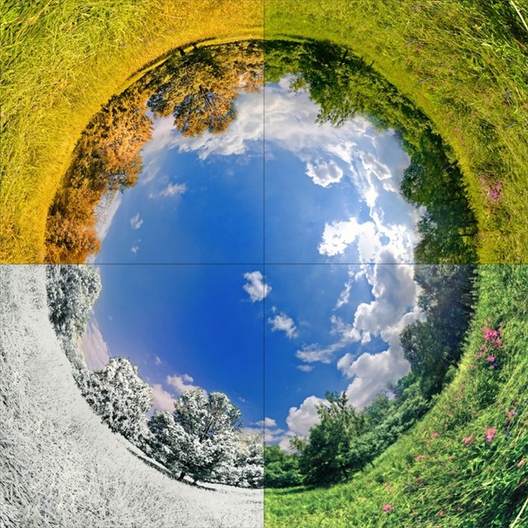

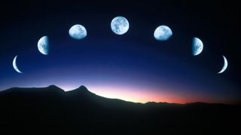



Taking a Closer Look
Questions for:
Jer 31:35 “ordinances”
Does an ordinance of the moon determine
the commencement of the H4150 <mo`ed>
“seasons” for the Feasts & Festivals?
If the moon is not ordained to commence Abba’s calendar months to determine the worship statutes, what is the moon’s heavenly purpose?

Slide 35


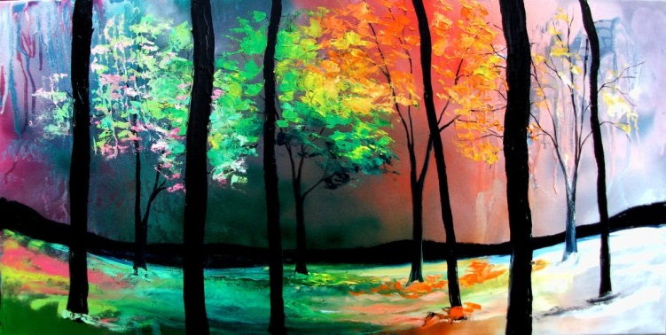
More
Questions for
Jer 31:35 “ordinances”
Has “mankind” added job descriptions to the
moon outside of what the Creator has given?
Does the moon have a prominent position which it does not deserve regarding the Feasts & Festivals? (eg: Passover full moon & 1st day of Trumpets new moon [Ps 81:3]?)
What is the definition for ordinances?

Slide 36
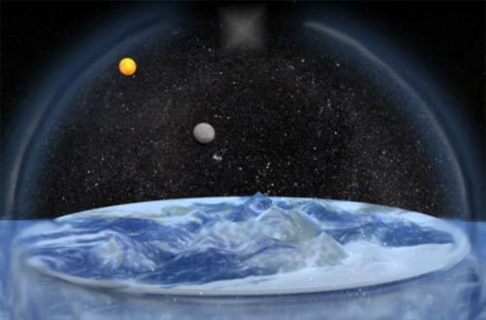
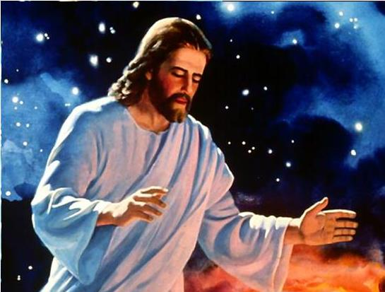
Yahuah declares there are ordinances of heaven and earth. [H2706 & H2708]
Job 38:33 Knowest thou the ordinances [H2708] of heaven? canst thou set the dominion thereof in the earth?
Jer 33:25-26 Thus saith Yahuah … if I have not appointed the ordinances [H2708] of heaven and earth;
26 Then will I cast away the seed of Jacob, and David …
Yahuah’s laws have governed the universe since its creation and continue to do so with astounding predictability in
the movements of the heavenly bodies. This proves Yahuah’s perfect order in His universe. His covenant promises to His people are as fixed as the
perfect universal laws, or “the ordinances of heaven and earth.”
36
Notes:
June 1st: animate both boxes to come in.
May 18th: new slide to show the moon is given for “ordinances” not as a “light giver” to dictate the commencement of the month by any phase of the moon, or conjunction.

Slide 37

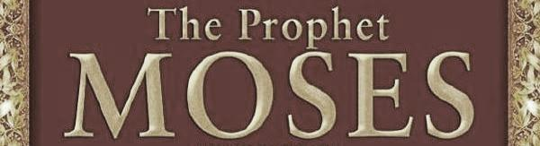
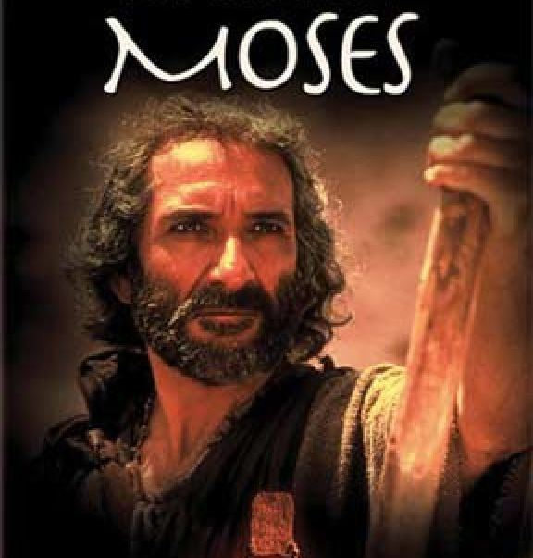
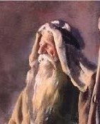
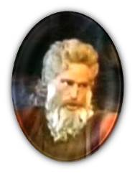
What are the “LIGHT” Ordinances of the Heavens?
Gen 1:16 And Yahuah made two great lights;
the greater light to rule the day,
and the lesser light to rule the night:
he made the stars also.
Questions:
Where did Moses
refer to the H3394
[literal] moon
as a light on
the 4th day
of creation?
Everyone knows the sun is the
greater light ruling the day.
Most believe the moon is the
lesser light ruling the night. Is it?
Does the moon really rule the night?

Slide 38
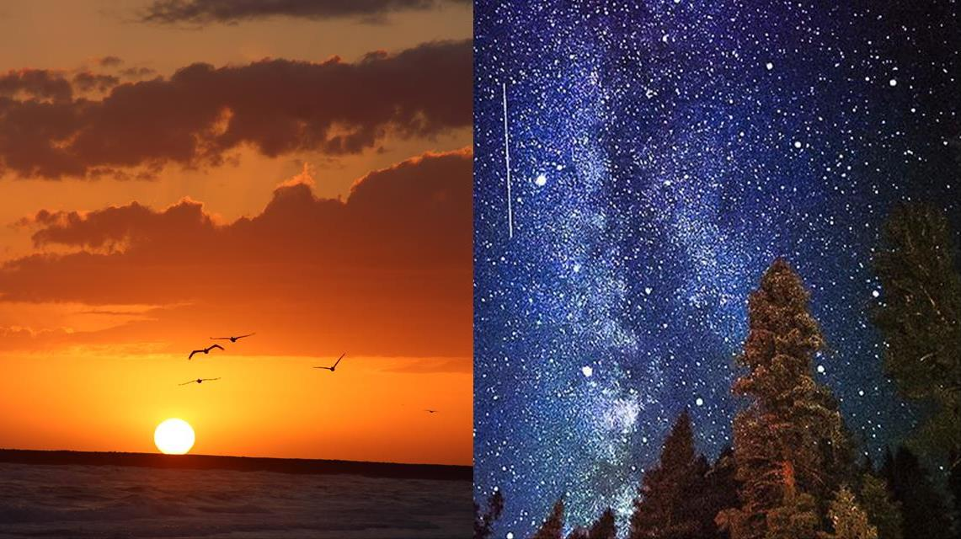
(Ordinances)
Jer 31:35 gives
declaration for
the two great
LIGHT-givers.
The Mazzaroth!
  Thus saith Yahuah, which giveth the sun for a light by day …
  … and of the stars for a light by night …
Notes:
may 18th: new slide to show the two LIGHT-givers by day and night. This is to separate the idea that the moon is a light-giver – first of all it has no light of its own – it is reflected from the sun!

Slide 39

Oh the Moon! Seen in the night sky
about only ½ of the month!
The moon has no light of its own.
Therefore it is not ordained
as a “light giver” to rule the night.
Is the moon ordained for anything?
Notes:
May 18th: changed the question in the box; changed the background picture.

Slide 40
Yes! The moon in the heavens
has its own ordinances.
Jer 31:35
  Thus saith Yahuah, which giveth … the ordinances [H2708] of the moon …
What are ordinances?
40
Notes:
may 18th: new slide to show the ordinances of the moon are completely separate and different from the 2 LIGHT-givers in the sky (sun and stars.)

Slide 41
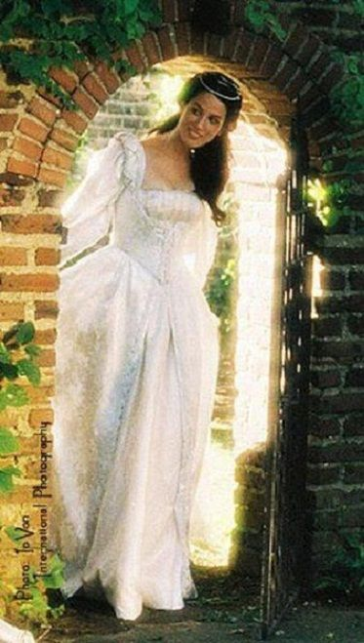
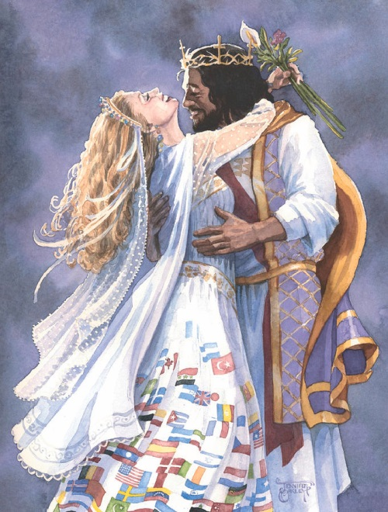
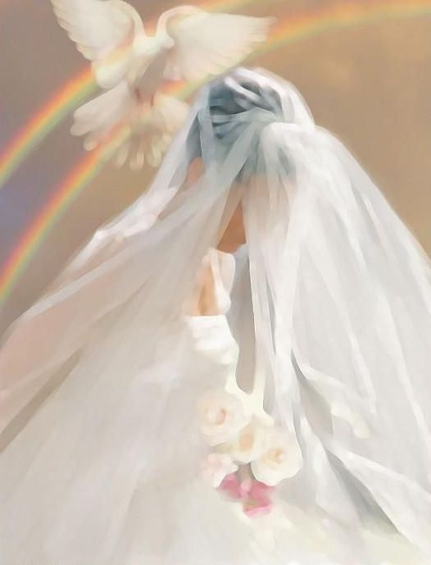
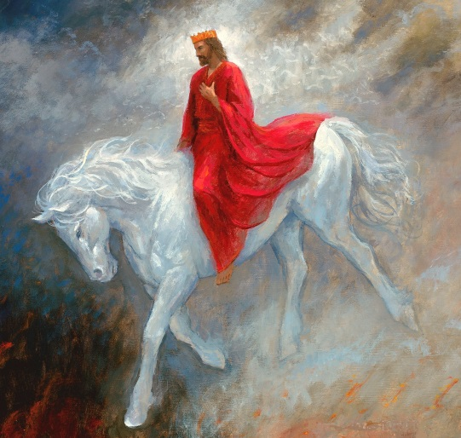

Definitions of Ordinances [for Heaven & Earth]
BRIDEGROOM
Root Word
BRIDE
The masculine ordinances are managed by the Bridegroom for blessing.
H2706 choq (khoke); from H2710; an enactment … (of time, space, labor or usage):
KJV – decree, task.
The primitive root ensures the Creator’s heavenly ordinances are unchangeable.
H2710 chaqaq (khaw-kak');
a primitive root; properly,
to engrave; … by implication,
to enact: decree, set.
The feminine ordinances
are given to the Bride to
follow, keep & enjoy!
H2708 chuqqah (khook-kaw'); feminine of H2706, meaning substantially the
same: [the Bride
follows the
enactment given
by the Bridegroom].
Notes:
Aug 10th pg 11
Aug 16 am color

Slide 42

Jer 31:35 Thus saith Yahuah,
which giveth … the
ordinances of the moon …
Questions
What are Ordinances of the Moon?
Many say the “ordinances of the moon” determine Yahuah’s set-apart month commencement. Do they?
Notes:
Aug 10 pg 12 Moon Ordinances

Slide 43

Moon Ordinances & the Pull of the Lunar Cycle
Count
the
Blessings
from
Yahuah
[H2706]
to His
Bride
[H2708]
This section will address a tidbit of information on the pull of the lunar cycle for water, land, animals & plants.

Slide 44

Lunar Cycle Pull Water [H2708]
Tides are pulled by the gravitational force of the
sun and the moon.
The tidal waters
supply oxygen to
the plants and animals in
the sea.
Jer 31:35 …
Yahuah giveth the
ordinances [H2708]
of the moon …
which divideth
the sea
when the waves thereof roar.

Slide 45

Job’s Illustration [H2706]
Job 38:8, 10, 11
8 Or who shut up the sea with doors, when it brake
forth, as if it had issued out of the womb?
10 And brake up for it my decreed [H2706] place,
and set bars and doors,
11 And said, Hitherto shalt thou come, but no further:
and here shall thy proud waves be stayed?
45
Notes:
May 23/17: new slide to show some of the ordinances of the moon.

Slide 46

Jeremiah’s Illustration [H2706]
Jer 5:22
Fear ye not me? saith Yahuah: will ye not tremble at my presence, which have placed the sand for the bound of the sea by a perpetual decree [H2706], that it cannot pass it: and though the waves thereof toss themselves, yet can they not prevail; though they roar, yet can they not pass over it?
Notes:
May 18th:

Slide 47

Lunar Cycle Pull Land Animals
The lunar cycle impacts human reproduction
as well as land & sea animal husbandry.
Farm animals are dehorned/castrated successfully.
Hair grows fuller and faster when cut by lunar cycles.
Parasite cleansing is more successful if done before parasites begin to reproduce at the full moon.

Slide 48

Lunar Cycle Pull Land Plants
Lunar cycles also influence agricultural seasons of seeding and harvesting (haying).
Gardens flourish when planted according to various lunar phases.
This Lunar Pull affects soil moisture,
plant sap and the water table of the earth.
Next: Deut 33:14; Ps 104:19.

Slide 49

Ordinance of the Harvest Moon
Deut 33:14 … and for the precious things [H4022] put forth by the moon [H3391].
  [H4022] – something valuable; precious fruit
  [H3391] – lunation of the moon
This verse aligns with agricultural seasons.
Let’s compare to Ps 104:19 and the word “seasons.”
Notes:
May 23/17: new slide … expanding “ordinances of the moon.”

Slide 50


Does Ps 104:19 Define Ordinances of the Moon?
50
Ps 104:19 He appointed the moon [H3394] for seasons [H4150] …
This is a verse that is often used to place the moon in a position to commence Yahuah’s set-apart months and related appointed worship times. Why?

Slide 51


Let’s examine the definitions for H4150.
There might be
something there if
we look carefully!
Notes:
May 23/17 … new slide to make the transition to the 5 Hebrew words and their definitions.

Slide 52



A Note about “italicized words” in the Strong’s Concordance
Words in italics in the Strong’s Concordance are to be noted
like this: [quote] “they [words in italics] are a rendering from
the A.V. and denote an explanation of the variations from
the usual form.” Variations from the usual form could mean the usual definition as taught by the Jewish mindset. When considering the word “seasons” (H4150 <mo`ed>) the Jewish mindset can most often mean that H4150 defines and designates this word “seasons” to be first linked to the annual appointed Feast and Festival Seasons.
True or false?

Slide 53

My computer program for Strong’s gives this information.
H4150 mowed` (mo-ade'); or moed` (mo-ade'); or (feminine) mow` adah (2 Chron 8:13) (mo-aw-daw'); from H3259; properly, an appointment, i.e. a fixed time or season; specifically, a festival; conventionally a year; by implication, an assembly (as convened for a definite purpose); technically the congregation; by extension, the place of meeting; also a signal (as appointed beforehand): KJV - appointed (sign, time), (place of, solemn) assembly, congregation, (set, solemn) feast, (appointed, due) season, solemn (-ity), synagogue, (set) time (appointed).
H3259 ya` ad (yaw-ad'); a primitive root; to fix upon (by agreement or appointment); by implication, to meet (at a stated time), to summon (to trial), to direct (in a certain quarter or position), to engage (for marriage): -agree, make an) appoint (-ment, a time), assemble (selves), betroth, gather (selves, together), meet (together), set (a time).
There is not one italicized word!

Slide 54
Strong’s Handbook [1986] Italicized Words
[masculine of 3259] H4150 mowed` (mo-ade'); or moed` (mo-ade'); or (feminine) mow` adah
(2 Chron 8:13) (mo-aw-daw'); from H3259; properly, an appointment, i.e. a fixed time or season; specifically, a festival; conventionally a year; by implication, an assembly (as convened for a definite purpose); technically the congregation; by extension, the place of meeting; also a signal (as appointed beforehand):
KJV [usages, explanation or variations] - appointed (sign, time), (place of, solemn) assembly, congregation, (set, solemn) feast, (appointed, due) season, solemn (-ity), synagogue, (set) time (appointed).
[feminine of 4150] H3259 ya` ad (yaw-ad’); a primitive root; to fix upon (by agreement or appointment); by implication, to meet (at a stated time), to summon (to trial), to direct (in a certain quarter or position), to engage
(for marriage): -agree, make an) appoint (-ment, a time), assemble (selves), betroth, gather (selves, together), meet (together), set (a time).
Note: For H3259 there are 29 verses in the Tanach … not one of them are linked
to feasts or festivals … just appointments of meeting for a variety of reasons.

Slide 55
Removing the Italicized Words from H4150
What is left?
(masculine of 3259) H4150 mowed` (mo-ade'); or moed` (mo-ade'); or
(feminine) mow` adah (2 Chron 8:13) (mo-aw-daw'); from H3259; properly, an appointment, i.e. a fixed time or season; specifically, a festival; conventionally a year;
by implication, an assembly (as convened for a definite purpose); technically the congregation; by extension, the place of meeting; also a signal (as appointed beforehand):
KJV [usages, explanation or variations] - appointed (sign, time), (place of, solemn) assembly, congregation, (set, solemn) feast, (appointed, due) season, solemn (-ity), synagogue, (set) time (appointed). (Note: These KJV terms are not considered as they are suggestions for KJV usage, whether correct all the time or not.)
properly
a fixed season
Can you discern the 1st definition?

Slide 56
Properly Discerning the 1st Definition of H4150 as a “fixed season”
Lev 26:5 And your threshing shall reach unto the vintage, and the vintage shall reach unto the sowing time [H2233]:
1 Sam 6:13 And they … were reaping [H7114] their wheat harvest [H7105] in the valley:
Ex 34:22 And thou shalt observe the feast of weeks, of the firstfruits of wheat harvest, and the feast of ingathering [H614] at the year's end [H8141].
Spring Season
Summer Season
Autumn Season
These are H4150 agricultural seasonal markers.
Is it possible the ordinances of the moon are connected
to the agricultural harvests of the yearly seasons?

Slide 57
Other uses of “seasons” & H4150
Day & Night Seasons
(Duration of Time, not a Festival)
Feast & Festival Seasons (H4150)
(Feasts are always Qualified in the Context)
Job 30:17 My bones are pierced in me in the night season [3915]:
and my sinews take no rest.
Psa 22:2 O my Elohim, I cry …
in the night season [H3915], and
am not silent.
Jer 33:20 Thus saith Yahuah; If ye can break my covenant of the day, and my covenant of the night, and that there should not be day and night in their season [H6256].
Exo 13:10 Thou shalt therefore keep this [Unleavened Bread] ordinance in his season from year to year.
Lev 23:4 These are the feasts of Yahuah, even holy convocations, which ye shall proclaim in their seasons.
Num 9:2 Let the children of Israel also keep
the passover at his appointed season.
Deut 16:6 … thou shalt sacrifice the passover
at even, at the going down of the sun, at the season that thou camest forth out of Egypt.

Slide 58
Back to the “Moon” & “Seasons”
58
Ps 104:19 He appointed the moon for seasons [H4150] …
Question: Is there a qualifier in Ps 104 to designate the moon is involved with the feasts?
Now that we have examined the definition[s] for H4150 very carefully it is time to align the proper definition with the context of Ps 104:19.
And, it must agree with Torah!

Slide 59


Thoughts to Ponder
  Ps 104:19 He appointed the
  moon [H3394] for seasons …
  This is NOT a Torah Verse.
  Isa 8:20 We learned that any non-Torah Tanach Scriptures have to be in full alignment with Torah.
  Ps 104:19 definitely sounds like the moon is involved with Yahuah’s month-start.
  Ps 104:19 must be examined very closely.

Slide 60




  This whole slide is going to get re-arranged! Tim: question … the sun does not give us the F&F worship statutes, right? The sun marks off the old year, then we count for the F&F, right? The Gen 1:14 vs about the sun is given for signs, seasons, days and years … it seems to me in that verse, the sun is first given for the seasons of “sowing & reaping” [before it is given for F&F statutes] … The seeds were in the ground on Day 3 – then the sun on Day 4. The 1st Feast & Festival season came sometime later. I’m not addressing the weekly Sabbath right now, as on most calendars the moon does not appoint the weekly Sabbath. I’m not going to take the time to do another slide just for lunar Sabbath calendars.
Strong’s H4150 “Seasons” 1st Def.
  Seasons – Strong’s H4150;
  moed`; … properly
  [1st def.] a fixed season;
  It is true the moon is ordained [along with the
  sun] to usher in the agricultural seasons.
  The term moed`, [1st defined as] a fixed season, is rightly understood first in the context of the appointed agricultural seasons of Gen 1:14.
  Why did Moses use H4150 and
  not another option?
Notes:
In the Hebrew Stone’s Edition Tanach, (O.T.) Genesis 1:14 translates "… and they shall serve as signs, and for festivals, and for days and years."

Slide 61



Strong’s H4150 “Seasons” 2nd Def.
  Seasons – Strong’s H4150;
  moed`; …
  [1st def.] a fixed season;
  [The following terms are 2nd defs. according to KJV usages for feasts & festivals.] … specifically, a festival; conventionally a year [or end of an agricultural season, or festival];
  by implication, an assembly
  (as convened for a definite purpose); technically the congregation;
  by extension, the place of meeting;
  also a signal (as appointed beforehand).
  The 2nd definition[s] of moed, are implied as:
  a festival; an assembly, or congregational place of meeting for a definite purpose.
Notes:
Aug 16 500 pm very hard

Slide 62





H4150 Moses & King David
  Review: The 1st of many moed`, definition for Gen 1:14 is correct as:
  a festival; an assembly, or congregational place of meeting.
  Seasons – Strong’s H4150; moed`;
  [1st def.] a fixed season
King David used H4150
in Ps 104:19 “appointing the moon for seasons.”
David meant
“agricultural seasons.”
Does Moses write
about this?
1st time Moses connects
the “moon”
to harvests.
The only word that
Moses or David could use for
the moon’s
agricultural seasons
is mo`ed H4150.
  Deut 33:14. … and for the precious things put forth by the moon [H3391].
  H3391 defines the moon’s lunation cycle that ushers in these H4150 agricultural seasons for Ps 104:19 as well.

Slide 63


The Puzzle of & H4150 “Seasons”
  H4150 <mo`ed>
  1st Def: agricultural
  2nd Def: worship statutes
  3rd Def: coming soon!
  The 1st definition for H4150 is a fixed time or season; which must be first rightly understood in the context
  of the four seasons of the year. These seasons are fixed; they do not vary. One of the ordinances of the moon is to maintain these fixed seasons for agricultural purposes that happen to coincide with the harvests of the appointed festivals.
  H4150 mo`ed is the only Hebrew word number
  that can designate the agricultural seasons and/or
  the worship statutes.
Notes:
Aug 16 500 pm very hard

Slide 64

About the Moon
  When the moon is used to appoint Yahuah’s month commencement, the festivals are NEVER fixed! They can vary between 1-5 weeks dependent on the arrival of the specific moon phase after the equinox.
  Ps 104:19 is not a Torah verse but it testifies as
  a companion verse to Deut 33:14.
  The precious fruits are brought forth because of the agricultural seasons – a mandated description, or ordinance of the moon, appointed by Yahuah.
Notes:
Aug 16 500 pm very hard

Slide 65



Even with all this evidence, some still believe H4150 (mo`ed) is only defined as a worship statute!
Let’s examine the 3rd definition!
Thought to Ponder:
Has man tampered with the divine mandate for the moon?

Slide 66

  Is it possible the stork will have something to say about
  the mo`ed definition?
Why?

Slide 67

Here’s one example:
  Jer 8:7a Yea, the stork in the heaven knoweth her appointed times [H4150] …
  Adam Clark Commentary:
  The birds of passage know the times of their going and return, and punctually observe them;
  they obey the dictates of nature …
Notes:
May 23/17 … added this slide to show that 4150 is not always something to do with worship statutes.

Slide 68





  Jer 8:7b … and the
  turtle[dove] and
  the crane and the
  swallow observe the
  time of their coming …
Jer 8:7 Storks in the sky know their seasons; doves, swallows and cranes their migration times; but my people do not
know the rulings
of ADONAI!
Complete Jewish Bible
Notes:
May 23/17 … added this slide to show that 4150 is not always something to do with worship statutes.

Slide 69

Have the mo`eds gone to the birds too?
Yahuah gave more than one definition to H4150.
The fixed agricultural seasons have first mention.
Feast statutes need a qualifier.
The birds have their appointed times
of migration and breeding.
Let’s also check
with some Bible
Commentators.
Most have not recognized the 1st & 3rd definitions for the H4150 <mo`edim>.

Slide 70


Are you saying the agricultural fixed seasons are found first in creation week?
AA: Let’s see … could it be like this?
3rd day of creation: the seeds are dropped into the ground – as sowing.
4th day of creation: the sun is given to provide all the workings needed for the plants to grow towards a harvest.
7th day of creation: this is the weekly Sabbath, but it is not connected to any agricultural harvests. The feast days would follow later hovering around the harvests.
Yes, the sun’s first mandate for H4150 seasons would been for agricultural purposes.
Any more commentators?
Most of us were taught H4150 seasons in Gen 1:14 refer to only festival worship seasons, ordained by the moon-month!

Slide 71

No, the word “seasons” in Gen 1:14 does not refer first to festival seasons appointed by the moon.

Slide 72
CF: I don’t know how to make the
Transition from the birds to the commentators.
Let’s review how the agricultural seasons have first mention in Scripture.
Gen 1:14 … and let them
[the heavenly lights] be
for … seasons⁴¹⁵⁰ …
The great light that rules the day brings vitality to the life in the seed.
Notes:
May 23/17 … new slide to make the transition to the 5 Hebrew words and their definitions.

Slide 73



Are there other commentators that agree the 1st definition of seasons
points to agricultural purposes?
Let’s investigate!

Slide 74
Gen 1:14 (seasons) Comparison to Other Commentators
#1
Gen 1:14 “(b) for seasons, or for fixed, definite times (mow`adiym, from y`d to fix, establish) - not for festal seasons merely, but "to regulate definite points and periods of time, by virtue of their periodical influence upon agriculture, navigation, and other human occupations, as well as upon the course of human, animal, and vegetable life (e.g., the breeding time of animals, and the migrations of birds, Jer 8:7, etc.)”
(Keil & Delitzsch)

Slide 75





Are you saying the agricultural fixed seasons are found first in creation week?
AA: Let’s see … could it be like this?
3rd day of creation: the seeds are dropped into the ground – as sowing.
4th day of creation: the sun is given to provide all the workings needed for the plants to grow towards a harvest.
7th day of creation: this is the weekly Sabbath, but it is not connected to any agricultural harvests. The feast days would follow later hovering around the harvests.
Yes, the sun’s first mandate for H4150 seasons would been for agricultural purposes.
Any more commentators?
Can the order for agricultural seasons be demonstrated in the creation week?
Can the agricultural fixed seasons be established first in the creation week?
On the 3rd day of creation the seeds were planted with intention of a harvest.
On the 4th day of creation the sun is given to provide all the elements for
plants to grow and
produce a harvest.

Slide 76


On the 7th day of creation the weekly Sabbath
is given to man.
It is the first day in the creation week designated
as a mo`ed
worship statute.
It is not connected to any agricultural harvests.
Can the agricultural fixed seasons be found first in the creation week?
Yes, the sun’s first mandate in the creation week was for the agricultural seasons.

Slide 77

Brian Neumann on pigment colors of creation.
The H4150 feast days will follow later hovering around the harvests of spring, summer
and the beautiful colors of fall.

Slide 78
Gen 1:14 (seasons) Other Commentators (con’t)
#2
Gen 1:14 “The "seasons" are [1] the natural seasons of the year, and the [2] set times for civil and [3] sacred purposes which man has attached to special days and years in the revolution of time.” (Barnes' Notes)
Gen 1:14 “… the luminaries are ‘for seasons.’ … Therefore, ‘seasons’ or times in the widest sense are to be thought of: agricultural seasons (Hos 2:9, 11; 9:5), seasons for seafaring men, seasons for beasts and birds (Jer 8:7), as long as they are times that are fixed and come with stated regularity.” (H.C. Leupold)
#3

Slide 79


Hosea’s Perfect Illustration
Hos 2:9 Therefore will I return, and take away my corn in the
time⁶²⁵⁶ [of harvest] thereof, and my wine in the season⁴¹⁵⁰ [of harvest] …
[H4150 in this verse is referring to the agricultural time of harvest.]
Hos 2:11 I will also cause all her mirth to cease, feast days,
her new moons ²³²⁰, and her sabbaths, ⁷⁶⁷⁶ and all her solemn feasts.⁴¹⁵⁰
[H4150 here refers to the annual festivals. The verse has several qualifiers – feast days; solemn feasts].
Hos 9:5 What will ye do in the solemn⁴¹⁵⁰ day, and in the day of the
feast²²⁸² of Yahuah?
[H4150 again refers to “appointed worship statutes” with the qualifiers of “solemn day” and “feast of Yahuah.”]

Slide 80
Back to the “Moon” & “Seasons”
80
Ps 104:19 He appointed the moon [H3394] for seasons [H4150] ...
In this verse the moon is appointed for agricultural seasons.
The moon has no part in defining the timing of the appointed
festivals even though these “worship statutes” do align with
the agricultural harvests we enjoy on this earth.
The definition of “mo-ed` appointed seasons” is not given to the [H3394] moon in the Torah. What about a H3391 moon?
Non-Torah verses like Ps 104:19 must align with Torah teachings.
R
E
V
I
E
W
Man has indeed added ordinances to the moon
that were never authorized by Yahuah.

Slide 81

Quick Review for Psalm 89:37
Psalms 89:37
It [?] shall be established for ever as the MOON, and as a faithful witness in heaven.
Many use this verse to establish the moon as the faithful witness for the mo`edim.
Question:
Is this verse really saying the moon is the faithful witness in heaven for the mo`ed appointed times?

Slide 82

Confirming the Context for Ps 89:37
34 My covenant will I not break, nor alter the thing that is gone out of my lips. (Context: Yahuah will not break His Covenant.)
35 Once have I sworn by my holiness that I will not lie unto David. (Context: For Yahuah to profane the covenant would be to profane His own holiness, one of His essential attributes.)
36 His [David’s] seed shall endure forever [through Yahuah], and
his [David’s] throne as the sun before me [Yahuah].
37 It [David’s spiritual seed] shall be established for ever as the moon, and as a faithful witness in heaven. (Context: Just as the sun and moon are faithful witnesses in the sky to the Creator’s design, so will Yahuah be faithful to His everlasting covenant.)

Slide 83

Matthew Henry Commentary Ps 89:37
For the covenant's sake: My faithfulness shall not fail, my covenant will I not break. It was supposed that they had broken God's [Yahuah’s] statutes, profaned and polluted them (so the word signifies); "But," says God [Yahuah], "I will not break, I will not profane and pollute, my covenant“ … That which is said and sworn is that God [Yahuah] will have a church in the world as long as sun and moon endure, v. 36, 37. The sun and moon are faithful witnesses in heaven of the wisdom, power, and goodness of the Creator, and shall continue while time lasts … but the seed of Christ shall be established for ever, as lights of the world while the world stands, to shine in it, and, when it is at an end, they shall be established lights shining in the firmament of the Father.

Slide 84
Conclusion for Psalm 89:37
Psalms 89:37
It [Yahuah’s witness]
shall be established for
ever as the MOON, and
as a faithful witness in heaven.
Ps 72:5
They shall fear thee as long as the sun and moon endure, throughout all generations.
Summary:
Yahuah is witness to, and attests to, His own oath and promises as a the faithful witness; literally as the sun and moon are in the heavens.

Slide 85


H3394 Final Conclusion <yareach>
The very first mention of MOON in the Scriptures for the word number H3394 is in Gen 37:9 – a prophecy given through Joseph’s dream.
There is no confirmation for the literal moon to declare the beginning of Yahuah’s calendar months.
First Mention affirms the moon’s most important job description is “prophetic.” (All of Yahusha’s references to the moon are “prophetic.” See Matt 24:29; Mark 13:24; Luke 21:25.)
Consider: H3394 is used as a SIGN 10 times in only the non-Torah pages. This is in agreement with Torah that never once is the literal moon declared to be the sign to begin Yahuah’s calendar month.
1st Mention of the H3394
Moon
is prophetic utterance for us.
Notes:
June 19/17
36

Slide 86
H3394 Final Conclusion (Con’t)
Gen 1:14-16 does tell us there are two lights in the sky for “signs.” It does not say the moon is “one” of those lights.
Jer 31:35 confirms the sun as the greater light; the Mazzaroth as the lesser light.
Jer 31:35 also confirms the [H3394] moon is given for ordinances to bless the earth and mankind with agricultural seasons for sowing & reaping. (Ps 104:19; Deut 33:14 [H3391]).
The moon is a faithful witness in the sky for creation and our Creator’s oath (Ps 89:37), not as a witness for Yahuah’s
set-apart months.
The moon is not ordained by Yahuah for any calculation and/or proclamation of His Feasts and Festivals.
The
H3394 MOON
does not commence Yahuah’s
set-apart month.
Notes:
June 19/17
37

Slide 87



The Truth of the Matter for H3394
Under the most searching
scrutiny for the research on H3394, there is not one shred of evidence to support the literal moon commences
Yahuah’s calendar month.

Slide 88

The Truth of the Matter for H3391
H3391 is the primitive root of H3394. As the “verb” component it represents the lunation cycle of the moon. Will there be evidence the lunation cycle commences Yahuah’s set-apart month or will we
find something else even more startling?

Slide 89

Next Study for: “The Moon! Oh, the Moon!
Part 3
“The Moonth! Oh, the Moonth?”
on July 20/18
Oh Moon!
Where Will You Be That Night?
The End

Slide 90



If you need assistance with this information, please send your questions to
Charlene Fortsch or
Timothy Astleford:
charlene@torahtothetribes.com
or
Shofar1owr@gmail.com

