Slide 1
The Moon! Oh, the Moon! Pt 1

Slide 2
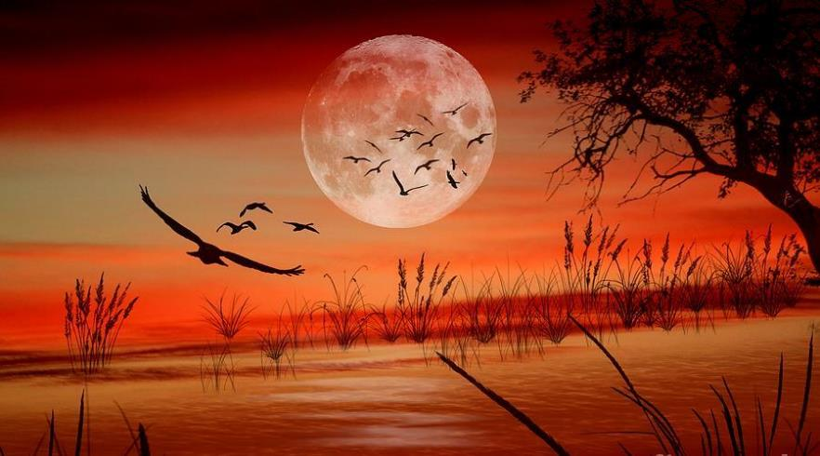
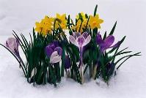
IS THE MOON REALLY IN CHARGE of …
the Scriptural month?

Slide 3
Question: Which Scriptural month?
(There are 2 of them!)
Which month is the moon in charge of? That is a good question! It deserves an answer from Scripture.
The truth is: Yahuah’s moon is in charge of “a” month – but is it a “calendar” month?!
Is the moon in charge of Yahuah’s Way, the Worship Cycles which utilize His “set-apart 30 day month” and also aligns magnificently with His annual worship statutes?

Slide 4
MORE Additional Comments!
The search in this study is to determine if the H3394 “moon month” is related to Yahuah’s set-apart Feasts & Festival Cycles.
All comments about the moon commencing “any” month will be intentionally compared to Yahuah’s “set-apart celestially coordinated months” for HIS worship statutes.
For H3391 the “moon month” will be discussed at length.

Slide 5
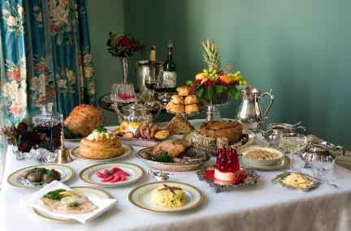
I’m so hungry I could eat at a …
Pauper’s Table
King’s Table
This study on the “moon” is the “real-meal” deal.
Scripture will describe the moon’s mandate.

Slide 6
The Mandate of the Moon in a few Minutes??
Mandate (Def.)
An official order or commission to do something.
Synonyms: instruction, directive, decree, command, order, charge, formal ordinance.
In a few minutes you can discover the moon is not in charge of Yahuah’s set-apart month with a simple examination in Torah.
You may not know how to explain Ps 104:19.
However:
“He appointed the moon for seasons…”

Slide 7
There is …
The Moon is NOT in Charge of set-apart Months!
The moon is under other divine mandates!

Slide 8
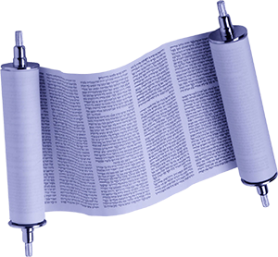
How many have been taught …
Torah! Torah!! Torah!!!
The foundation of all Scriptural truth must be found in Torah?!
Would that include the study of Yahuah’s Calendar?
Should it? Can it? Will it?

Slide 9
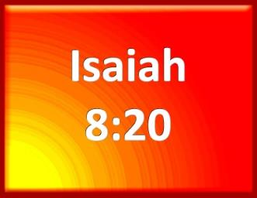
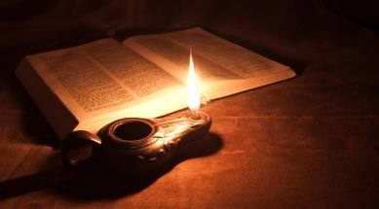
Have you heard this?
“Today it is no longer: Torah! Torah! Torah!”
To the law [Torah H8451] and to the testimony [precept H8584]: if they speak not according to this word, it is because there is no light in them. KJV
In other words, Torah is not complete for the full calendar study; one definitely has to look outside of Torah to find the pure truth for calendar!
Really?

Slide 10
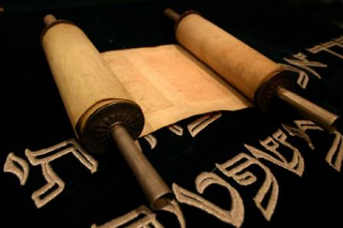
Could it be true that Torah is deficient?
To the law [Torah H8451] and to the testimony [precept H8584]: if they speak not according to this word [Is that Torah? or Testimony?] …
law H8451; torah; from H3384; a precept or statute, especially the Decalogue or Pentateuch: KJV - law.
Isa 8:20

Slide 11
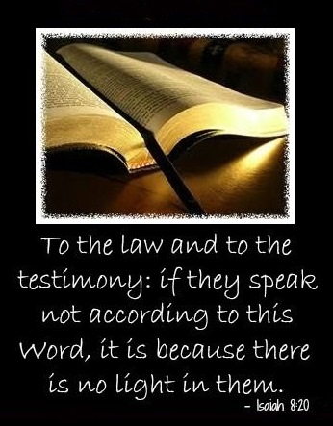
Is Testimony Above Torah?
testimony H8584; te`uwdah; from H5749; attestation, i.e. a precept [H6673 – Isa 28:10, 13], usage: KJV - testimony.
H5749; `uwd; a primitive root; to duplicate or repeat; by implication, to protest, testify (as by reiteration); intensively, to encompass, restore (as a sort of reduplication): KJV - admonish, charge, earnestly, lift up, protest, call (take) to record, relieve, rob, solemnly, stand upright, testify, give warning, (bear, call to, give, take to) witness.
“Precept”
H6673 – Isa 28 context – the Word of Yahuah; a divine commandment
H4687 – a command whether divine or human
11

Slide 12
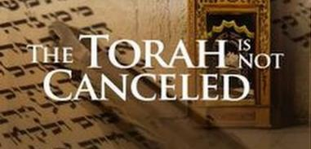
The H8584 “testimonies” of the Non-Torah books must INTENSIVELY:
Duplicate or repeat the Torah
Reiterate the Torah
Restore the Torah
Encompass the Torah
Admonish the Torah
Lift up the Torah
Testify of the Torah
Stand upright with Torah
Give warning with Torah
Be a witness of Torah
Ever!
These ‘testimonies’ are:
Torah is Light!

Slide 13
“Light” of Isa 8:20
“… there is no light [H7837] in them.”
Light (Gen 1:3) H216; 'owr; from H215; illumination or (concrete) luminary.
Now, compare this “light” definition to the “light” definition of Isa 8:20:
Light (Isa 8:20) H7837; shachar; from H7836; DAWN (literal, figurative or adverbial): KJV – day (-spring), early, light, morning, whence riseth.
Does Isaiah have a special message for us?

Slide 14
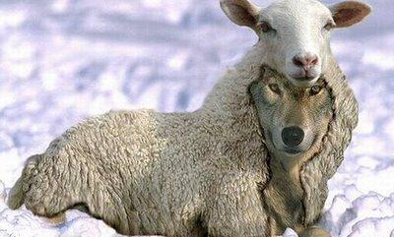
For the “moon component” in the Covenant Calendar study, don’t let anyone tell you that you have to go outside of Torah to find the true calendar!
WARNING
14
Is this “sheep” really a “wolf?
It absolutely is not true!

Slide 15
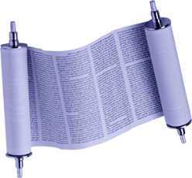
The Location of Covenant Calendar
Definition for the term Covenant Torah: For all Covenant Calendar studies, this term refers to only the Everlasting Covenant found between Gen 1:1-Exo 24:11 – also being referred to as “Covenant Torah.” This Covenant Calendar easily establishes the day-start and year-start components. Both are completely found within Covenant Torah pages, exactly where the Everlasting Melchizedek Covenant is found.
There are several studies to demonstrate how Covenant Calendar is explained.

Slide 16
Day-start IN Covenant Torah (Gen 1 – Exo 24:11)
Other witnesses between Gen 1:1 – Exo 24:11 are:
Gen 1 – Creation Week
Gen 15 – Abram’s Covenant
Gen 19 – Lot & his daughters
Gen 31 – Jacob & Laban
Exo 10 – Locust Plague
Exo 12 – Passover in Egypt
Exo 12 – Unleavened Bread Week
Exo 14 – Red Sea Crossing
Exo 16 – Quail & Manna
Exo 19/20 – Pentecost at Mt Sinai
Total: 10
Witnesses

Slide 17
Day-start AFTER Covenant Torah
2 Torah witnesses between Exo 24:12-Deut are:
Lev 7 – Peace/Thank Offerings
Lev 23 – Day of Atonement
15 Non Torah witnesses of Tanach:
Joshua 3-5
Judges 6 & 20
Ruth
1 Samuel 5, 9, 14, 19, 28, 30
Total: 27 Witnesses
2 Kings 7
2 Chron 35
Nehemiah
Daniel
Jonah
Remember: the 15 non-Torah witnesses have to agree with the Torah witnesses.

Slide 18
Festal Year-start in Covenant Torah
Exo 34:22 (Torah only) Civil “year-start” is linked to the autumnal equinox along with the Feast of Ingathering.
Festal “Year-start” is linked to the spring equinox (or tequfah [H8622]) in Covenant Torah.
Exo 12:2 Passover was in the 1st month of the year.
Exo 9:31 This was the time of the year the barley and flax was smitten – the spring time. (Note: Festal year-start & month-start are linked.)

Slide 19
Reasonable Questions:
Because there are 10 witnesses for the Day-start in Covenant Torah verses, would it not seem reasonable to find at least 2-3 witnesses for “a set-apart” moon/month start in Covenant Torah as well?
Is it even reasonable to expect to find at least 2-3 witnesses in all five Torah books for a moon/month?
Do the Scriptures allow for the option to establish a sacred moon/month from ONLY non-Torah books?

Slide 20
What to Expect from this Study:
The full study on the moon component of the Covenant Calendar will prove beyond a shadow of any doubt the moon is not part of Yahuah’s sacred calendar.
Everything that can be considered will be considered in full.

Slide 21
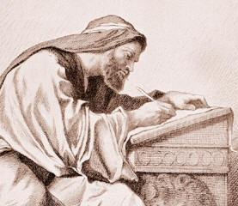
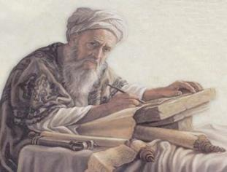
Were the Patriarchs, Prophets & Kings
Or, were they teaching laws from non-Torah books?
What is a non-Torah book for Tanach Teachers?

Slide 22
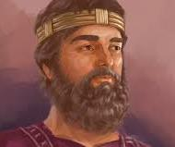
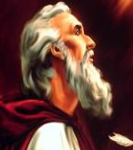
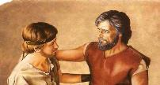
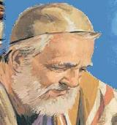
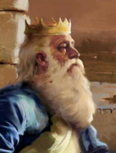
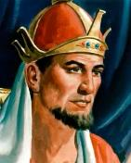
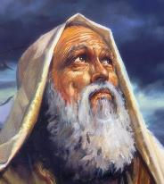
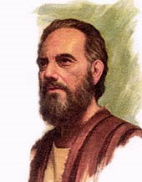
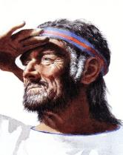
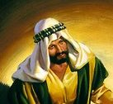
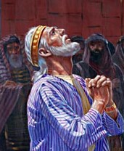
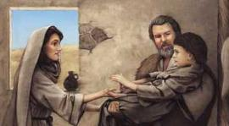
In the comprehensive study on the moon:
Nehemiah
King Saul Jonathan/David
We will investigate 12 Great Leaders around the 20 “new moon” verses to see if they taught from Moses’ Torah or other books!
Ezra
King David
Zerubbabel
King Solomon
Ezekiel
King Hezekiah
Amos
Hosea
Isaiah
Elisha

Slide 23
Some claim Yahuah’s set-apart month begins:
with the first sliver of the moon;
with the full moon;
with a combination of the crescent moon and the ripening of the barley, etc.
Others claim the festal month begins around the spring equi-LUX calculation. Some are surprised the moon has absolutely nothing to do with the start of Yahuah’s set-apart month?

Slide 24
It is interesting that the Word of Yahuah never instructs His people to sight any phase of the moon in the sky! There is not one place in the original Hebrew Scriptures where Yahuah points directly to the moon as an authority over set-apart time.
Let’s
briefly examine some history:
Jericho
Jeremiah
Karaites Hindu’s
Islam
If a teaching is not found in Scripture, why should it be practiced as if it were there?

Slide 25
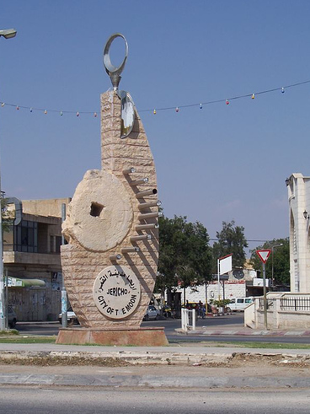
Yahuah tells us explicitly the moon is NOT TO BE FOLLOWED! He destroyed Jericho and placed a curse on the one who rebuilds it.
The Hebrew language reveals a deeper understanding that the curse is placed upon the ones who REBUILD THE WORSHIP PRACTICES OF THE MOON!
That is why the moon of Rev 12 is placed UNDER the feet of the Bride!
Jericho
Approx.
1451 BC
Jericho, the city of the Moon!

Slide 26
Jeremiah’s Wisdom in Chapter 8:1 & 2
“At that time,” declares יהוה Yahuah, “they shall bring the bones of the sovereigns of Yehuḏah (Judah), and the bones of its heads, and the bones of the priests, and the bones of the prophets, and the bones of the inhabitants of Yerushalayim, out of their graves, 2. and shall spread them before the sun and the moon and all the host of the heavens, which they have loved and which they have served and after which they have walked, which they have sought, and to which they have bowed themselves. They shall … be for dung on the face of the earth.” The Scriptures
Approx. 600 BC
VIOLATION of:
Deut 18:9 [Approx. 1450 BC]
“…thou shalt not learn to do after the abominations of those nations.” KJV

Slide 27
One source claims that certain sects developed a procedure that involved the sighting of the moon by two witnesses. This is believed to be correct by many today. Today this sect is called the “Karaites.”
Karaites “came to be”
Approx.
200 BC
Do the Karaites “connect” to Islam?
The source of this practice is from Rabbinic Jewish Oral Law [the Mishna] - NOT THE TORAH!
http://www.fossilizedcustoms.com/sightedmoonorigins.html

Slide 28
THE KARAITE CONNECTION (Between Hinduism & Islam)
Anan Ben Daud is widely believed to be the founder of the Karaite Sect.
In the mid-8th century CE under Islamic rule, he started a movement which broke away from Rabbinical Judaism.
It was Anan’s hope to become the head Rabbi, but he was passed-over by his younger brother who held more closely to the Torah and the “oral law,” - the traditions of the fathers.
Still, Anan’s followers installed him in the position of the “Jewish leader.”
The Caliph Al-Mansur viewed this argument as rebellion, and arrested Anan in 767, setting his execution date.
While in prison, Anan met an Islamic teacher who gave him advice that saved his life. Anan was to establish a new religious sect based on moon observation, not perpetual calculation [like Hillel II].
http://www.fossilizedcustoms.com/sightedmoonorigins.html
Notes:
Exilarch eg-zuh-lahrk: one of a line of hereditary rulers of the Jewish community in Babylonia from about the 2nd century a.d. to the beginning of the 11th century.
According to this version, Anan stressed before the caliph that in matters pertaining to calculation of the calendar his method was akin to the Muslim system, namely it was based on observation and not on perpetual calculation. He was thus released. Anan ben David - Dictionary definition of Anan ben David | Encyclopedia.com: FREE online dictionary

Slide 29
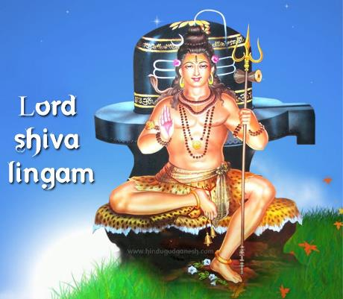
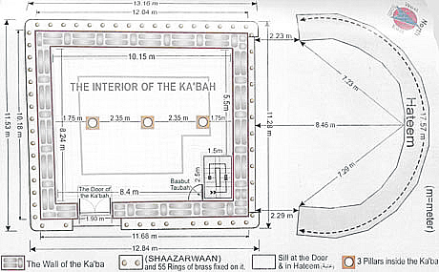
Since 1500 BC
Long before the birth of Islam, 360 deities surrounded the Kaaba, originally a Hindu shrine dedicated to the worship of the host of heaven. The crescent moon was the symbol of Lord Shiva – a god of the Hindu’s. Out of all the deities that were worshipped by the Pre-Islamic Arabs, the “greatest” was called “Allah.”
The Kaaba
Symbol: crescent moon!
Do Hindu’s & Moslem’s Connect?
Notes:
Hindu's started 1500 bc – time of Moses. 3500 years ago

Slide 30
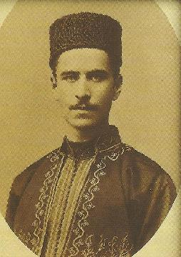
Remember:
Anan Ben Daud: founder of the Karaite Sect.
He broke away from Rabbinical Judaism.
An execution date was set for his rebellion against the Mishnah Karaites.
Anan met an Islamic teacher while in prison.
Anan’s life was spared by the establishment of a new religious sect based on crescent moon observation (following Muslim practice).
715-795 BC
He did not believe in the Mishnah like the modern Karaites.
Notes:
To preserve the unity of Israel, the patriarch Hillel II, in 358/359, published the “secret” of calendar making, which essentially consisted of the use of the Babylonian 19-year cycle with some modifications required by the Jewish ritual.
The application of these principles occasioned controversies as late as the 10th century ce. In the 8th century the Karaites, following Muslim practice, returned to the actual observation of the crescent New Moon and of the stand of barley in Judaea. But some centuries later they also had to use a precalculated calendar. The Samaritans, likewise, used a computed calendar.

Slide 31
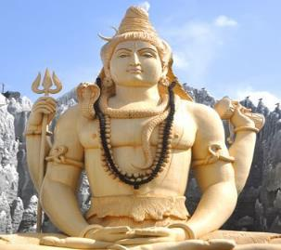
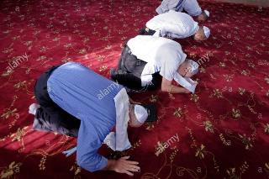
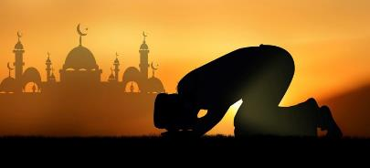
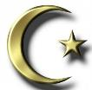
Islam – Hindu’s – Karaite Jews
31
Is Anan Daub the connecting link between the Hindu Lord Shiva, Karaite Jews and Islam?
They have similar ways of worship from the same area.
They all have the star & crescent moon symbols.
Islam’s most prominent symbol is the crescent moon.

Slide 32
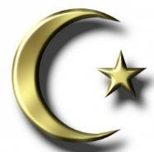
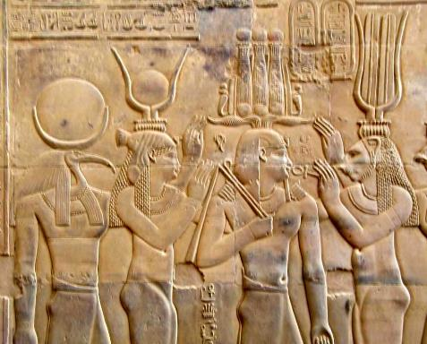
History Long Before Islam
The crescent moon was also venerated in the Egyptian culture with the moon below a solar disc.
The pre-Islamic moon deity called Allah is symbolized by a crescent moon and a star.
This origin is rooted in the Hindu culture and the worship of Hindu Lord Shiva.
Adapted from:
http://www.fossilizedcustoms.com/sightedmoonorigins.html
32
Notes:
Shiva is one of the major gods.

Slide 33
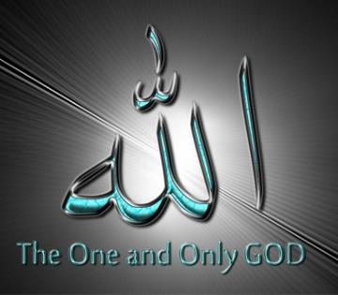
Allah is not a name. It is a title likened to Elohim.
Islam - Approx. 610 AD
Allah, as represented by the crescent moon, became the most favored of all 360 deities by Muhammad’s clan adopting the star/crescent moon symbol.
Yahuah is not represented by any kind of pagan symbol, and certainly He is not using the objects seen in the sky to determine His appointed times!
Note: Islam’s most prominent symbol is the crescent moon, Shiva’s symbol.
33
Notes:
Shiva is one of the major gods.

Slide 34
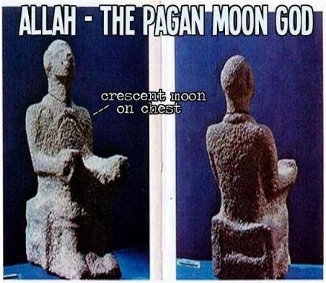
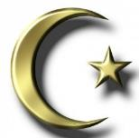
It is no surprise Islam adopted the moon!
Christianity also has roots in Alexandria, [Egypt] where these objects in the sky were also adopted for veneration.
Hindu’s, Muslims, Karaites, Rabbinic Jews, etc. are all from the same territory. It’s no wonder their religious cultures have similarities.
Common thread: the Moon!
34
Notes:
Shiva is one of the major gods.

Slide 35
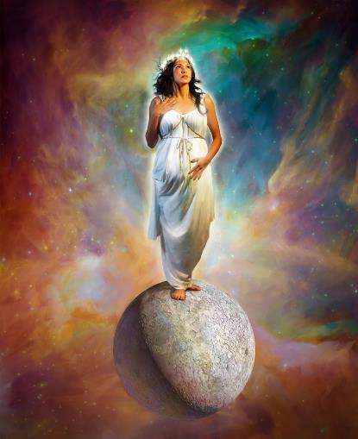
Remember Rev 12:1
And there appeared a great wonder in heaven; a woman clothed with the sun, and the moon under her feet, and upon her head a crown of twelve stars. KJV
The LIGHT of the sun illuminates the Bride.
The moon being trampled under foot is of no value for the Bride’s calendar.
She has RISEN ABOVE THE MOON DECEPTION THAT the ‘MOON COMMENCES the set-apart MONTHS for calculating Yahuah’s FEASTS AND FESTIVALS’!

Slide 36
Because most have been taught …
The moon is in charge of the commencement of Yahuah’s set-apart month …

Slide 37
This concept must be challenged to see if it is true.
There are five (5) different Hebrew words that have been translated as moon or moons!
Will any of them confirm the moon for Yahuah’s month-start?
Notes:
May 23/17 … new slide to make the transition to the 5 Hebrew words and their definitions.

Slide 38
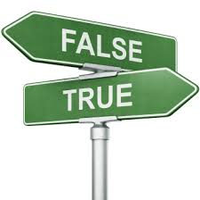
Introduction: True or False?
Truth does not fight to have a place in the heart of man. It simply presents itself – take it or leave it.
On the other hand, error – especially pagan errors that specifically counter Yahuah’s truths, resist at all costs of being replaced by truth.
What is the truth about this moon month?
Is it really in charge of determining when
Yahuah’s set-apart month begins?

Slide 39
Rightly Dividing the Truth
By the Scriptures
By Secular History (Why?)
Pagan errors recorded in history are found to wrestle for prominence above Torah truth.
It’s easier to make a good decision with an abundance of evidence. (Scriptures will be provided as the study progresses.)
2 Tim 2:15
Study/research to show thyself approved.

Slide 40
Rightly Dividing the Facts (10 Points)
There is no indication in the Tanach for a lunar month of 28-29.5 days, or 13 months [leap month] in a year approximately every 3rd year, or seven times in a 19 year cycle.
At creation, the 12 calendar months had 30 days each. The year had 360 days.
There are no Torah instructions for beginning Yahuah’s set-apart month with any phase of the moon. The Torah books date to approximately 1450 BC. This is 2550 years after creation. The covenant calendar in Exodus documents Yahuah’s 30 day month very well.
Notes:
Aug 15 1157

Slide 41
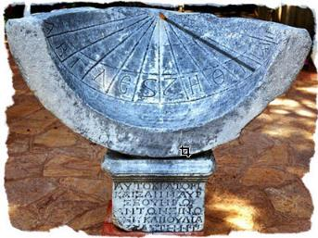
Rightly Dividing the Facts (con’td)
Yahuah’s divine calendar was compromised by His people when, in Canaan, they began to mix pagan worship practices with divine commands.
Yahuah’s people were commanded many times not to look to the sun, moon, stars, planets or any heavenly host lest they worship them as the pagans do.
Of all the heavenly hosts, the lunar cycle is closest to Yahuah’s 30 day calendar month. The pagans were moon worshippers with their own month and feasts and festivals.
the pivotal point in this puzzle is Hezekiah's sundial around 701 BC.

Slide 42
Rightly Dividing the Facts (con’t)
We used to feel that it was not possible to know if the moon originally had a cycle of 30 days/mon, or 28, or 29+ or what? Only 30 is a divine number, and now we believe the moon did have exactly 30 days to its lunation, just as Yah’s month had 30 days.
The question is this: When Yahuah’s resets the calendar to 360 days/year, will He reset the lunation cycle “back to the way it was in the beginning?” or will He leave it on its lunatic cycle because of the apostasy that resulted in the first place???
The Bride will be able to know when the 360 calendar is reset at the trumpets, or the year following. If Yah does NOT set the moon back to the original cycle, and the year is back to 360 days, THEN this is a HUGE sign for the Bride!
Hezekiah’s sundial miracle happened about 3300 years AFTER creation. The sundial event changed the lunar cycle significantly. Yahuah arranged for this on purpose to draw the attention of His people away from the moon – back to His creation order for the annual count of the Festival Sabbaths.
In a study of the Scriptural fact, along with dates, we will see: the sundial event was intended to permanently separate Yahuah’s feast worship times from the pagan lunar cycle calculations. However, one event did not change when the earth’s year-length changed from 360 to 365¼ days/year.
that event is the equinox!
Notes:
8/15 115
9/16: changes to take out the 28-29.5 moon cycle change at Hezekiah.

Slide 43
Rightly Dividing the Facts
From creation the earth has provided “sowing & reaping seasons.” The moon is agriculturally involved with these seasons.
The equinox is the “one day” focal point each year that marks the last day of Yahuah’s Covenant Calendar year (with the last day of winter in the northern hemisphere).
Yahuah’s new year begins the day after the equinox – being the 1st day of His 1st month of the new year.
The moon has absolutely no involvement in the equinox event the way the earth, sun and stars do. Light is also involved in the equinox, of which the moon has nothing to offer.
Notes:
Aug 15th 210 pm
Sept 16th … grammar changes 600 pm

Slide 44
3300 Years: Creation to Hezekiah
P R E V I E W
The moon’s cycle for 3300 years was finally disrupted by the sundial miracle (701 BC).
This was a permanent heavenly demarcation (or a SIGN to Yahuah’s people) that the moon is not associated with the commencement of His festal months.
Unfortunately the apostasy of Yahuah’s people, with regards to worship, was so deep and severe that:
The northern 10 tribes were completely scattered by Assyria (721 BC just 5 years after Hezekiah’s reformation).
About 100 years later (606 BC) the southern kingdom tribes were finally exiled to Babylon for 70 years.

Slide 45
Yahuah’s People & Pagan Worship
45
Rabbi’s attempting to sight the moon through an astronomical telescope.
Upon return to Jerusalem (536 BC), Judah was to leave the pagan ways behind.
Did they?
The “so called Jews” of today (Orthodox/Messianic, as well as many other feast camps etc.) are still gazing at the moon just as Babylon, Egypt, Islam, and other pagan nations have been practicing for eons of time.
Notes:
Aug 15 235 pm

Slide 46
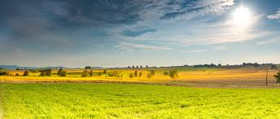
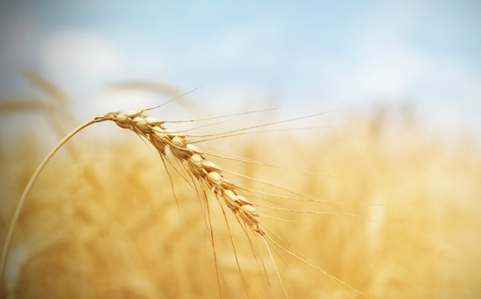
1. What to Expect From the Moon Study
History of how Yahuah’s people wandered away from His Torah Truths;
Just which of Yahuah’s servants tried to keep His people on track;
How the pagan roots of moon worship became tradition AND later as Torah Truth;
Is sacred regard for the moon about the same as pagan moon worship?
Notes:
Maybe save these 2 slides for when I do the OT history of the pagan worship and the people.

Slide 47
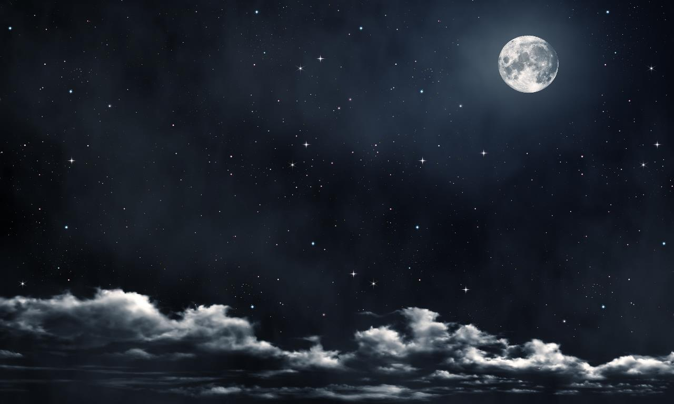
2. Main Point of This Study
Pagan moon worship crept in very early amongst Yahuah’s people. He gave them a “sign” to bring them back. Did they recognize the sign was for them?
Question: Will we, as Yahuah’s people of today follow Israel’s apostasy, or shall we heed the Torah worship guidelines? Will we be given a sign?
Challenge: For those following the lunar cycles to mark “any type of worship statutes” perhaps this study will test that belief system.

Slide 48
3. Job Descriptions of the Moon
Ordinances of the moon are given by the Creator at creation. Is the moon-month Yahuah’s set-apart month, or is it for another type of ordinance?
Has “mankind” added job descriptions to the moon outside of what the Creator has given?
Does the moon have a prominent position which it does not deserve when it comes to the observance of set-apart feasts and festivals?
Would it be important to know the divine ordinances of the moon? Where would they be found?
Questions:
Notes:
Aug 15 1145

Slide 49
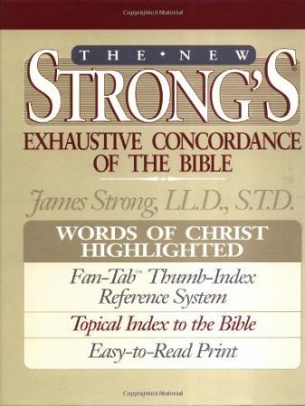
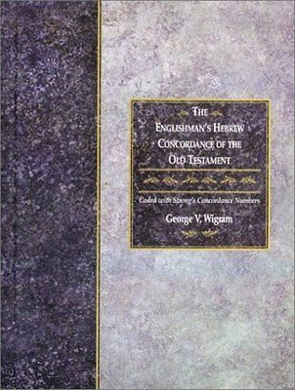
Getting Started with Simple Study Tools
There is a variety of good computer and online programs as well.
The Strong’s Concordance searches by Hebrew “words.”
The Englishman’s Concordance searches by Hebrew “number.”
Notes:
E-sword will be different than the bible program that I am using.
The literal strong’s books will be better than a computer program, because they will show the italicized words that have been added to the definitions!

Slide 50
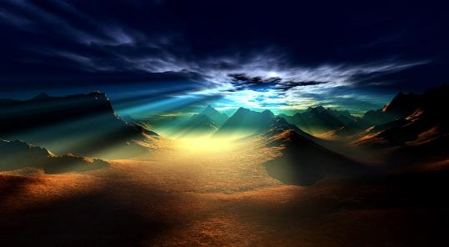
Getting Started with Strong’s
Study conducted from the Tanach.
Look up all Scriptures using “moon” or “moons.”
Examine Hebrew definition[s] of each word number.
Notes:
8/15 250 pm

Slide 51
Understanding Hebrew Definitions
Facts:
1. As in other languages, Hebrew words can have different definitions within one word number.
2. Or: there can be several different Hebrew word numbers to define the same word.
Definition of LOVE
In the Old Testament alone there are 10 different Hebrew word numbers and meanings for the word LOVE.
Notes:
8/15 730 pm

Slide 52
Strong’s Concordance Search
For “moon” or “moons”
1. H3394 = 26 listings <yareach>
2. H3391 = 2 listings <yerach>
3. H3842 = 3 listings <lebanah>
4. H7720 = 1 listing <saharon>
5. H2320 = 20 listings <chodesh>
Total of 52 references.
Question:
How can there be so many different Hebrew word numbers for one moon in the sky?
Notes:
8/15 725 pm

Slide 53
Moon Hebrew Word #s & Grammar
Hebrew #
Part of speech
1. H3394 = 26 listings <yareach>
2. H3391 = 2 listings <yerach>
3. H3842 = 3 listings <lebanah>
4. H7720 = 1 listing <saharon>
5. H2320 = 20 listings <chodesh>
Total of 52 references.
Noun – literal moon
verb – lunation cycle
Adjective – color
Simile – comparison
Verb – repetition
Question: are there really 2 verb forms for ONE “moon”?

Slide 54
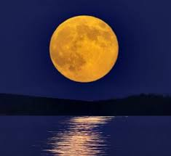
#1 H3394 MOON <yareach>
Taking a Closer Look
The Literal Moon in the Sky
26 identical Scriptural references are found in both Strong’s and Englishman’s.
This part of the study will separate the 26 verses into four different categories.
Noun
Notes:
May 11th

Slide 55
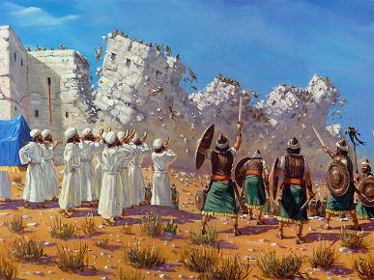
H3394 MOON <yareach> [as a Noun]
[Strong’s] MOON - H3394 yareach (yaw-ray'-akh); from the same as H3391; the MOON: KJV – MOON. Yerechow [or Jericho]. See H3405. H3391 is the primitive root.
Caution:
Brown-Driver-Brigg’s (BDB) does NOT take H3394 back to the original root!
H3405 links to Jericho, a city that worshipped the moon.
Notes:
29n – June 21st … Walter, I feel it is really important to have the Strong’s definitions for every word number, as this is the proof that not every word for “moon” is the same or used the same – neither do these definitions command the moon in charge of the Biblical month. If people do not see these definitions, and they don’t go and look them up, they may not figure out the whole big problem. The 5 moon definitions will only add 5 slides – something that should not be overlooked.

Slide 56
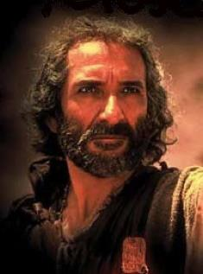
H3394 describes the literal moon.
Question:
If Moses wants us to know the moon commences Yahuah’s set-apart month, should he use H3394 (the noun) so we know for sure? In Genesis 1? Covenant Torah? Torah??

Slide 57
Englishman’s Concordance H3394
Strong’s: “moon” or “moons” | Englishman’s: by Hebrew Word #
1. H3394 = 26 listings <yareach> | 1. H3394 = 26 listings <yareach>
Notes:
Aug 16 7 am

Slide 58
H3394 26 Verses; 4 Categories
26 references for H3394 are exactly the same in both the Strong’s and Englishman’s.
Prophecy 5 verses: Has the 1st mention of “moon” [H3394] in the Torah. (Gen 37:9; Psalms 72:5; 72:7; 121:6 and Isaiah 60:19.)
Warning 5 verses: The 2nd mention of “moon” [H3394] in the Torah. (Deuteronomy 4:19; 17:3; 2 Kings 23:5; Job 31:26-28 and Jeremiah 8:2.)
Sign 10 verses: For the 3rd categorical mention of “moon” [H3394] (now found) in the non-Torah Scriptures, it is used as a “sign.” (Joshua 10:12, 10:13; Job 25:5; Isaiah 13:10; Jeremiah 31:35-36; Ezekiel 32:7; Joel 2:10; 2:31; 3:15; Habakkuk 3:11.)
Creation 6 verses: The 4th and last categorical mention of “moon” [H3394] found in the non-Torah Scriptures relates to creation. (Psalm 8:3, 89:37, 136:9, 104:19, 148:3 and Ecclesiastes 12:2.)

Slide 59
H3394 Prophecy Category
Genesis 37:9 And he dreamed yet another dream, and told it his brethren, and said, Behold, I have dreamed a dream more; and, behold, the sun and the MOON and the eleven stars made obeisance to me.
Psalms 72:5 They shall fear thee as long as the sun and MOON endure, throughout all generations.
Psalms 72:7 In his days shall the righteous flourish; and abundance of peace so long as the MOON endureth.
Psalms 121:6 The sun shall not smite thee by day, nor the MOON by night.
Isaiah 60:19 The sun shall be no more thy light by day; neither for brightness shall the MOON give light unto thee: but Yahuah shall be unto thee an everlasting light, and thy Elohim thy glory.
Notes:
Aug 10th pg 10

Slide 60
Did any of the 5 Prophecy Scriptures command the moon to begin the festal month?
NO!
60

Slide 61
H3394 Warning Category
In this category there are 5 very strict commands about gazing and/or worshipping any of the heavenly bodies.
TWO of these commands are in Torah.
THREE commands follow in support.
Note The 2 commands in Torah do nOT promote the moon is to commence the beginning of yahuah’s months!

Slide 62
#6
1st Torah Warning: Deut 4:19
“And lest thou lift up thine eyes unto heaven, and when thou seest the sun, and the MOON, and the stars, even all the host of heaven, shouldest be driven to worship them, and serve them, which Yahuah thy Elohim hath divided unto all nations under the whole heaven.”

Slide 63
2nd Torah Warning: Deut 17:3
“And hath gone and served other gods, and worshipped them, either the sun, or MOON, or any of the host of heaven, which I have not commanded.”
#7
Before Moses died, he specifically gave these two commands as a safeguard from the pagan ways of worship.
Penalty for disobedience: Death!

Slide 64
#8
1st non-Torah Warning: 2 Kings 23:5
“And he [King Josiah] put down the idolatrous priests, whom the kings of Judah had ordained to burn incense in the high places in the cities of Judah, and in the places round about Jerusalem; them also that burned incense unto Baal, to the sun, and to the MOON, and to the planets, and to all the host of heaven.”

Slide 65
#9
2nd non-Torah Warning: Job 31:26-28
“If I beheld the sun when it shined, or the MOON walking in brightness; 27 And my heart hath been secretly enticed … 28 This also were [would be] an iniquity to be punished by the judge: for I should have denied the Elohim that is above.”
(Note: These verses are talking about giving more regard to the sun and moon than what was ever allowed by Yahuah. There are several other Scriptures that give the same warning.)
Job lived between the time of Abraham and Moses (the author of his book). Would you consider Job to be a Covenant-Torah patriarch? If so, this quote is of extreme importance! Some feel this should be a Covenant-Torah warning!

Slide 66
#10
3rd non-Torah Warning: Jer 8:2
“And they [the enemy] shall spread them [the bones of Yahuah’s people] before the sun, and the MOON and all the host of heaven, whom they have loved, … served, … walked, … sought, and … have worshipped.”
Jeremiah declares following this moon-month is worship!

Slide 67
Did any of the 5 Warning Scriptures command the moon to begin the festal month?
Absolutely not!

Slide 68
H3394 Sign Category
Joshua 10:12 Then spake Joshua to Yahuah in the day when He delivered up the Amorites before the children of Israel, and he said in the sight of Israel, Sun, stand thou still upon Gibeon; and thou, MOON, [stand thou still] in the valley of Ajalon.
Joshua 10:13 And the sun stood still, and the MOON stayed, until the people had avenged themselves upon their enemies… So the sun stood still in the midst of heaven, and hasted not to go down about a whole day.
Job 25:5 Behold even to the MOON, and it shineth not; yea, the stars are not pure in his sight.
Isaiah 13:10 For the stars of heaven and the constellations thereof shall not give their light: the sun shall be darkened in his going forth, and the MOON shall not cause her light to shine.
Notes:
Aug 10th pg 11
Aug 16 am color

Slide 69
H3394 Sign Category (con’t)
Jer 31:35 Thus saith Yahuah, which giveth the sun for a light by day, and the ordinances [H2708] of the MOON and of the stars for a light by night, which divideth the sea when the waves thereof roar; Yahuah of hosts is his name.
Jer 31:36 If those ordinances [H2706] depart from before me, saith Yahuah, then the seed of Israel also shall cease from being a nation before me for ever.
Watch for information on the ordinances of the moon.
Notes:
Aug 10th pg 11
Aug 16 am color

Slide 70
H3394 Sign Category (con’t)
Eze 32:7 And when I shall put thee out, I will cover the heaven, and make the stars thereof dark; I will cover the sun with a cloud, and the MOON shall not give her light.
Joel 2:10 The earth shall quake before them; the heavens shall tremble: the sun and the MOON shall be dark, and the stars shall withdraw their shining:
Joel 2:31 The sun shall be turned into darkness, and the MOON into blood, before the great and the terrible day of Yahuah comes.
Joel 3:15 The sun and the MOON shall be darkened, and the stars shall withdraw their shining.
Hab 3:11 The sun and MOON stood still in their habitation: at the light of thine arrows they went, and at the shining of thy glittering spear.
Notes:
Aug 10th pg 11
Aug 16 am color

Slide 71
Did any of the 10 Sign Category Scriptures command the moon to begin the festal month?
NO!

Slide 72
H3394 Creation Category
Psalms 8:3 When I consider thy heavens, the work of thy fingers, the MOON and the stars, which thou hast ordained;
Psalms 89:37 It [David’s throne vs 36] shall be established for ever as the [vs 36: sun and] MOON, and as a faithful witness in heaven. (Context: The moon as the faithful witness links back to the Creator.)
Psalms 104:19 He appointed the MOON for seasons: the sun knoweth his going down.
(This verse will be dealt with in great detail later in the next teaching.)
Notes:
Aug 10th pg 12
Aug 16 am color

Slide 73
H3394 Creation Category (con’t)
Psalms 136:9 The MOON and stars to rule by night.
Psalms 148:3 Praise ye him, sun and MOON: praise him, all ye stars of light.
Eccl 12:2* While the sun, or the light, or the MOON, or the stars, be not darkened …
*The context of verses 1-8 is to remember THE Creator during the days of our youth.
Notes:
Aug 10th pg 12
Aug 16 am color

Slide 74
Did any of the 6 Creation Category
Scriptures command the moon to begin the festal month?
NO!

Slide 75
Summary of 26 Verses for H3394 (Noun)
Prophecy 5 verses Has the 1st mention in the Torah.
Warning 5 verses The 2nd mention in the Torah.
Sign 10 verses The 3rd categorical mention found in the non-Torah Scriptures.
Creation 6 verses The 4th and last categorical mention found in the non-Torah Scriptures.
H3394 is the best choice to establish the moon for the festal month.
Moses did NOT use it once for a very good reason!

Slide 76
The End of Part 1 for:
The Moon! Oh, the Moon!
Part 2:
[H3394]
“Ordinances” of the Moon (Jer 31:35)
76
Notes:
may 18th: new slide to show the ordinances of the moon are completely separate and different from the 2 LIGHT-givers in the sky (sun and stars.)

Slide 77
If you need assistance with this information, please send your questions to Charlene Fortsch or Timothy Astleford:
questions@studythecalendar.com

