Slide 1

Yahusha’s Contempt for the
Lunar Based Calendar

Slide 2

Yahusha’s for the Lunar Based Calendar!
Contempt
Notes:
Rec’d 945 AM May 13th

Slide 3
1. The feeling or attitude of regarding someone or something as inferior, base, or worthless; scorn.
2. The state of being despised or dishonored: was held in contempt by his former friends.
3. Open disrespect or willful disobedience of the authority of a court of law or legislative body.
Contempt
Notes:
Rec’d 945 AM May 13th

Slide 4
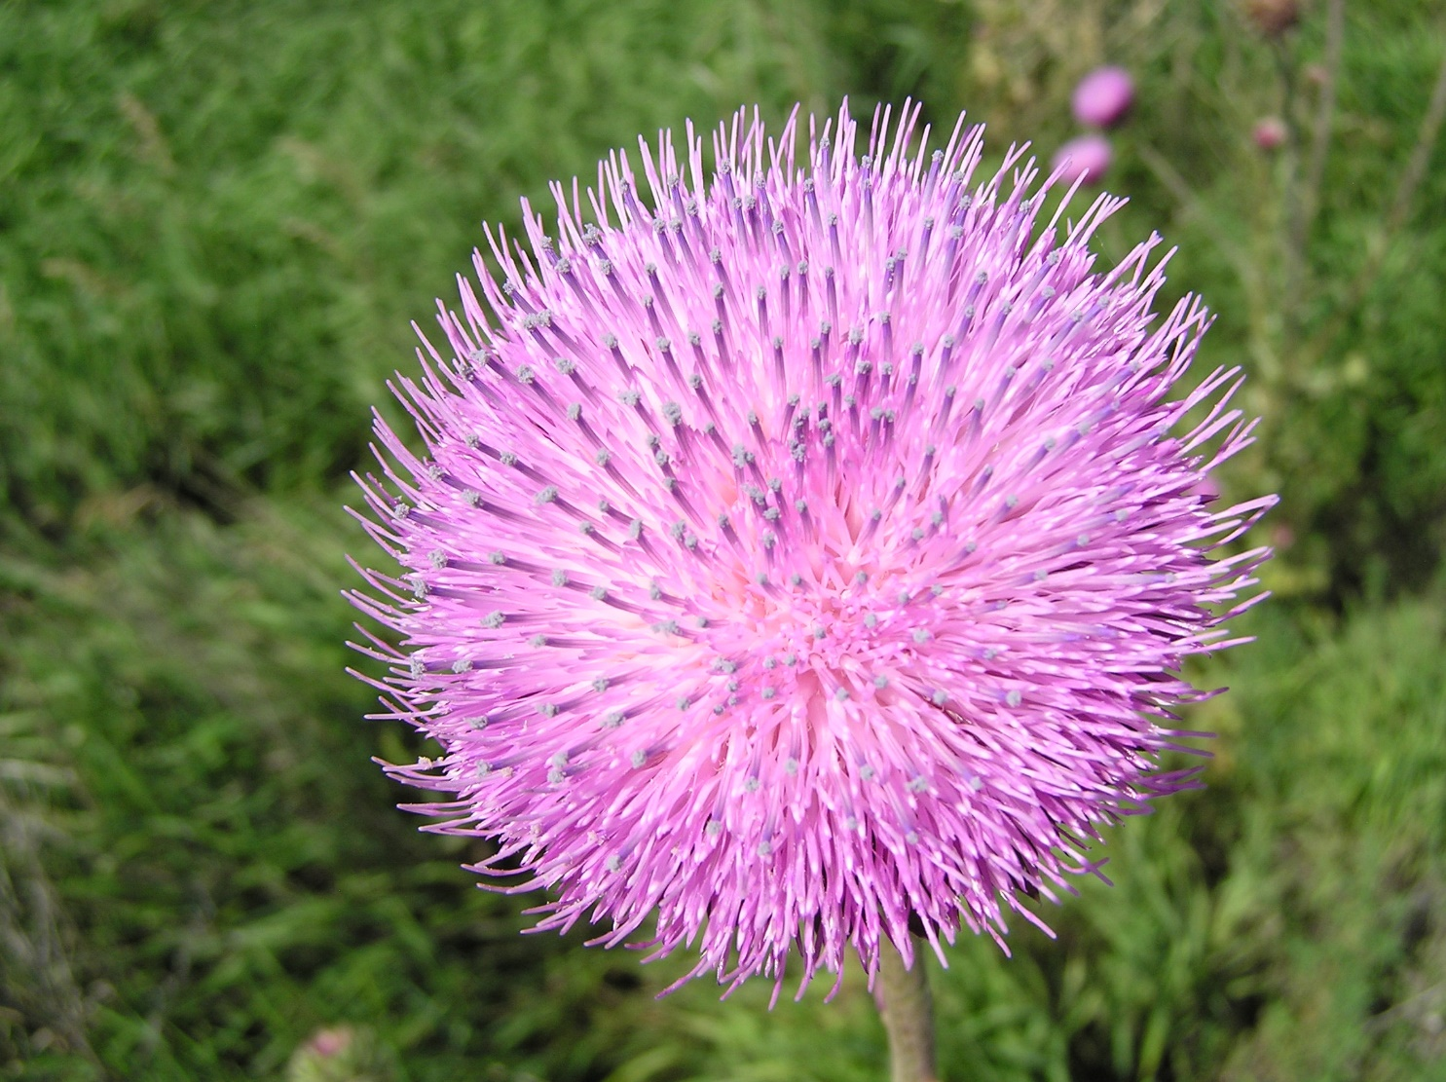
The appearance of the flower of this thistle is most beautiful.

Slide 5
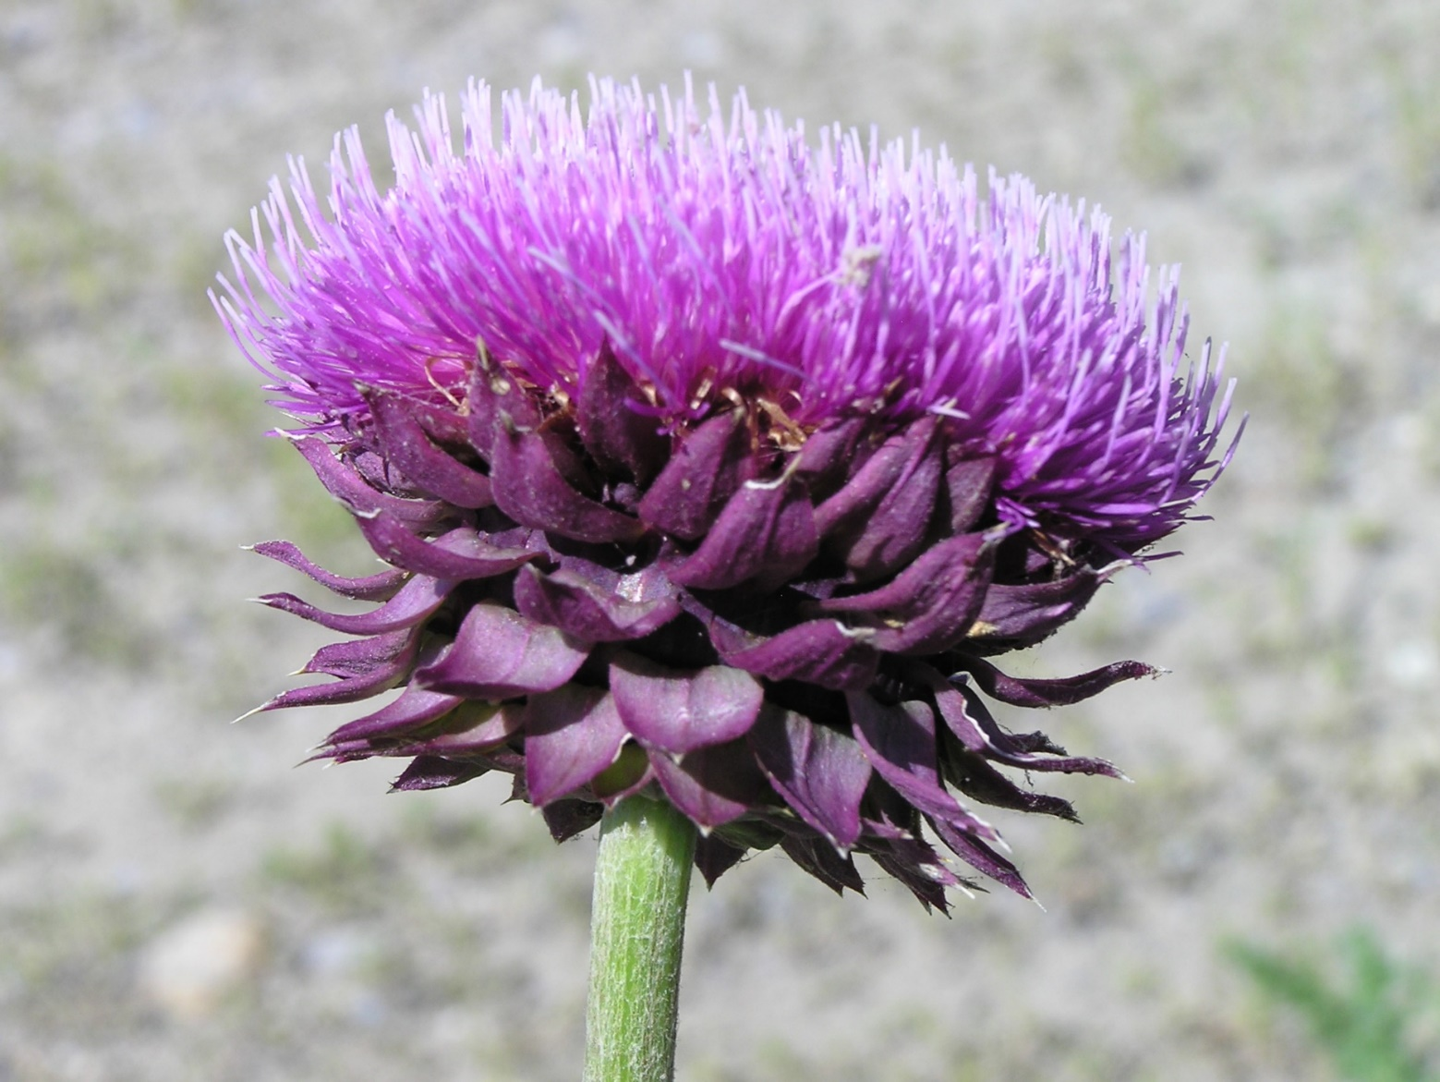
While the top surface portrays exquisite beauty,
underneath the surface is a more rugged appearance.

Slide 6
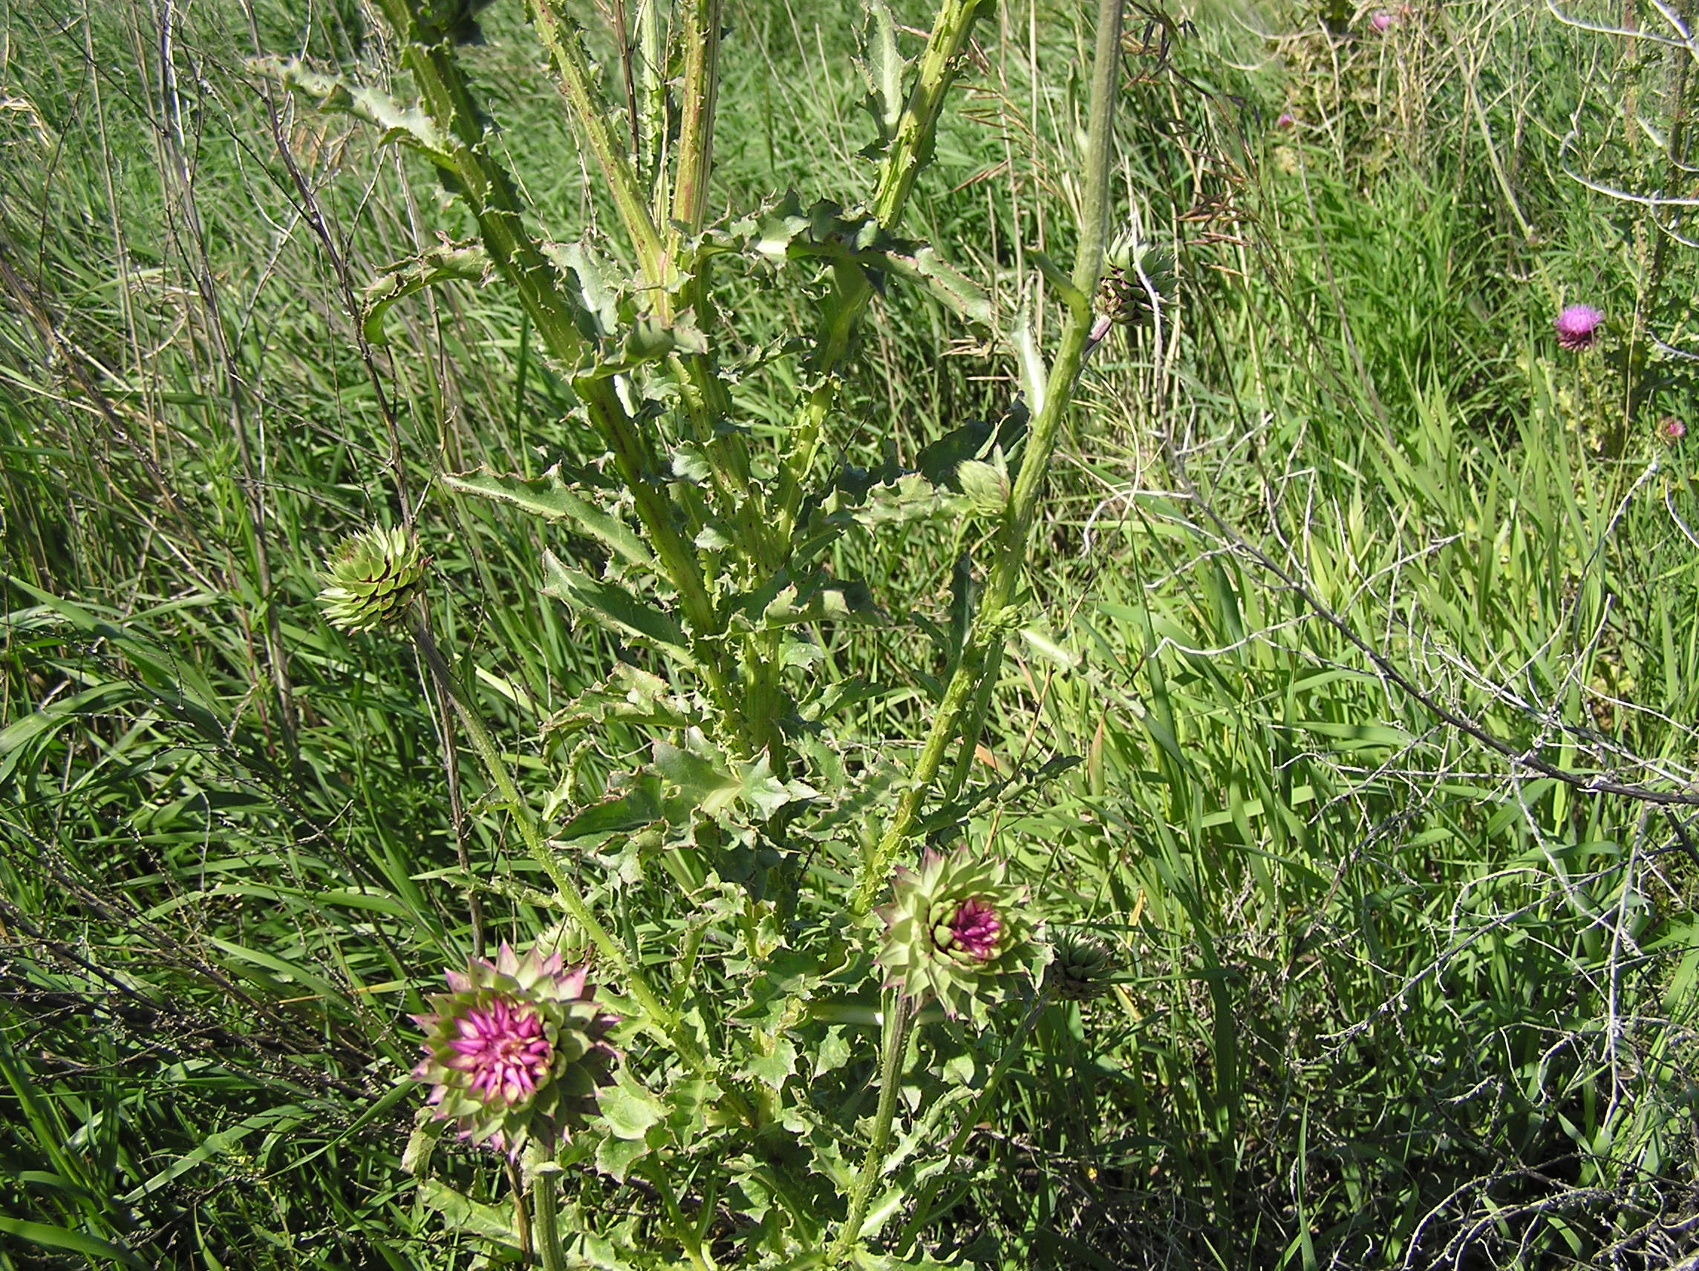
The deeper investigation reveals the location of the darker features.
The thorns that destroy are in full abundance.
They are an integral part of this plant.
Pun intended.
This study will examine something potentially very destructive!

Slide 7
Important! - The Blood Ratified Covenant Calendar of Yahuah has zero lunar connections. It is NOT a luni/solar calendar. This is a Mazzaroth facilitated LIGHT BASED calendar!
Have we applied sufficient attention to the documentations addressing the lunar based calendar from the Testimonies of the Tanach (Old Testament)?
Are there witness texts within the Scriptures that will give us a clear view of the “celestial vs lunar calendar” controversy that we can connect with the life of Yahusha?
Will the life of Yahusha on this earth reveal knowledge
on this highly contentious subject?

Slide 8
Was Yahusha in agreement with the
TIMING of the Feast of the Yehudim (Jews)?
The book of John gives us a great place to begin.
John 7:1 And after this יהושע [Yahusha] was walking in Galil, for He did not wish to walk in Yehuḏah, because the Yehuḏim were seeking to kill Him.
John 7:2 And the festival of the Yehudim [Jews] was near, the Festival of Booths [Sukkot/Tabernacles],
John 7:3 So His brothers said to Him, ‘Get away from here and go into Yehuḏah, so that Your taught ones also see the works that You are doing.
John 7:4 “For no one acts in secret while he himself seeks to be known openly. If You do these works, show Yourself to the world.”
Paraphrased: Show us your works! - Prove your worth!

Slide 9


Question With a Clue
Why do the Scriptures document –
...the festival of the Yahudim [Jews]...?
Leviticus tells us very clearly to Whom the Feasts and Festivals belong.
Why then do the Scriptures record this festival as one that belongs to the Yahudim?

Slide 10
Yahusha’s Brother’s Unbelief
John 7:5 For even His brothers did not believe in Him.
John 7:6 יהושע [Yahusha] therefore said to them, “My time [Yahuah’s Covenant Calendar] has not yet come, but
YOUR time [the lunar reckoned calendar]
is always ready. -
Question: Is it possible that the calendar of the 2nd Temple era was designed and adjusted according to the declared belief standards of the Jews – very similar to the lunar-solar calendar of - today?
Always - through lunar manipulation!

Slide 11
Important Questions
Why did Yahusha declare the Feast of the Jews to His brothers as “YOUR” time?
Yahusha is the One who Inspired the documentation within the Tanach (Old Testament).
Is it likely that we will find the same style of terminology used there too?
Why on earth would Yahusha intentionally distance Himself from a Feast that was originally commanded by Yahuah?
Is not the Feast of Sukkot (Tabernacles) found in Exo 23:16, which is the Everlasting Covenant upheld under the Melchi-Tzedok Administration?
Is not this same Festival required of ALL MALES, under statute command?
Yahusha!

Slide 12
Your Time = Your Appointed Times
Yahusha spoke to His brothers and told them that THEIR TIME was ready.
But His Time was not yet!
What did Yahusha mean by this? Let’s look into Isaiah’s writings.
Isa 1:12 “When you come to appear before Me, who has required this from your hand, to trample My courtyards?
Paraphrased: - Who has taught you to desecrate My Principles?
Isa 1:13 “Stop bringing futile offerings, incense, it is an abomination to Me. New Moons, Sabbaths, the calling of meetings – I am unable to bear
What was it about these different Sabbaths and assemblies that Yahuah emphatically despised?
UNRIGHTEOUSNESS AND ASSEMBLY.

Slide 13
Isaiah Continued
Isa 1:14 “My being hates YOUR New Moons and YOUR appointed times, they are a trouble to Me, I am weary of bearing them.
Isa 1:15 “And when you spread out your hands, I hide My eyes from you; even though you make many prayers, I do not hear. Your hands have become filled with blood.
Isa 1:16 “Wash yourselves, make yourselves clean; put away the evil of your doings from before My eyes.
Questions: What characteristic personalized THEIR Sabbaths, assemblies, a “New Moon” and appointed times, that was such a
to Yahuah?
From WHOM did this evil characteristic derive?
Stop doing evil!
?!
SERIOUS EVIL OFFENCE

Slide 14
“Your” – in Amos
Amos 5:21 “I have hated, I have despised YOUR festivals, and I am not pleased with YOUR assemblies.
Tell me please – were the Yisra’elites observing Feasts and Festivals that were opposed to the commands within the Everlasting Covenant?
Amos 8:9 “And it shall be in that day,” declares the Master יהוה [Yahuah], “that I shall cause the sun to go down at noon, and shall darken the earth on a day of brightness,
Amos 8:10 and shall turn YOUR festivals into mourning, and all YOUR songs into lamentation, and bring sackcloth on all loins, and baldness on every head, and shall make it like mourning for an only son, and its end like a day of bitterness.

Slide 15
“Your” – in Malachi
Mal 2:3 “See, I shall rebuke your seed, and scatter dung before your faces, the dung of YOUR festivals. And you shall be taken away with it.
Will we receive the message that there is something profoundly sinister about these events that Yahusha will have absolutely nothing to do with?
Why does He “pin” these events on humans? Yahuah did after all command His followers to observe the Feast and Festival assemblies!
Will we be able to discern a characteristic which Yahusha displayed in His life (pertaining to His observance of the Feasts), as a profound declaration supported by His actions? Will His actions provide a clue to this mystery?

Slide 16
Back to Yahusha’s Conversation with His brothers
John 7:7 “It is impossible for the world to hate you, but it hates Me because of it, [from a LIGHT based calendar viewpoint] that its [the 2nd Temple era traditional teachings] works are wicked.
John 7:8 “You go up to this festival. I am not yet going up to this festival, for
has not yet been filled.”
The 15th of Tishri (7th month) had not arrived yet, according to the Tequfah based Covenant Calendar written in the Torah. {Gen 1 – Exo 24:11}
Why should Yahusha go and observe the Sukkot/Tabernacles Festival when the Torah appointed, Qodesh (Set-Apart) LIGHT based designated time for Sukkot had not arrived?
I bear witness
MY TIME [Blood Ratified Covenant Calendar for Sukkot]

Slide 17

Yahusha Witnesses? HOW!
Yahusha tells us in no uncertain terms –
When Yahusha actually physically witnesses to a situation, what is it that you would expect to notice? Would a very clear DISCERNABLE DISCREPANCY between the tradition of the Pharisees and the Torah Truth be exposed to us?
Could Yahusha’s witness extend even to a very physical example?
Or will His witness pass unnoticed over our heads?
I am, and will, give you evidence through of this insidious evil!
My Witness

Slide 18
Yahusha refrains from going...
John 7:9 And having said this to them, He stayed in Galil.
Is this verse indicating to us that Yahusha from being required to observe the statutes and attend the Feasts of Yahuah?
It appears on the surface that Yahusha was ignoring the statute based command that need to present themselves before Yahuah at the Appointed Times – Mo-edim! (Reference specifically Exo 23:17.)
Ex 23:17 “Three times in the year your males are to appear before the Master יהוה [Yahuah].
had an exemption
ALL MALES
all
Is there any place in the Scriptures where we learn that Yahusha need not observe the will of His Father? What factor gave Yahusha the authority to
“skip out” from presenting Himself to the Father on the first of Sukkot?

Slide 19
Yahusha’s next action – His WITNESS
John 7:10 But when His brothers had gone up to the festival, then He also went up, not openly, but as it were in secret.
At the Feast, we learn in verses 11-12, the Yehudim (Jews) were wondering where Yahusha was and were searching for Him.
The Yehudim understood the rule that ALL MALES WERE TO PRESENT THEMSELVES BEFORE YAHUAH 3 TIMES PER YEAR, as written in Exodus 23:17.
They were fully expecting Yahusha to observe their Feast.
Where was Yahusha Ha Mashiach?
When did Yahusha arrive at the Feast?
Was Yahusha Witnessing?

Slide 20
Feast of the Yahudim (Jews) #1
Tishri the 7th Month; the Eight Days of Sukkot
John 7:6 יהושע [Yahusha] therefore said to them, “MY TIME has not yet come,
Human Manipulation
but Your Time
is ALWAYS ready.
Sukkot Feast of the Yahudim!
15 1 | 16 2 | 17 3 | 18 4 | 19 5 | 20 6 | 21 7 | 22 8
MIDST of the Feast of the Yahudim - John 7:14
Yahuah’s Covenant Feast of Sukkot started here!
15 1 | 16 2 | 17 3 | 18 4 | 19 5

Slide 21
Sukkot Feast of the Yahudim (Jews)
But when His brothers had gone up to the festival,
up, not openly, but as it were in secret.
John 7:1o
John 7:11 The Yehuḏim, therefore, were seeking Him at the
festival, and said,
THEN He also went
15 1 | 16 2 | 17 3 | 18 4 | 19 5 | 20 6 | 21 7 | 22 8
“Where is He?”

Slide 22

Yahusha – AWOL From Yahuah’s Feast?
To this date, there has not been a text found advising us that Yahusha was exempt from obeying Exo 23:16 & 17!
  Exo 23:16 And the Festival of the Harvest, the first-fruits of your labours which you have sown in the field; and the Festival of the Ingathering at the outgoing of the year, when you have gathered in the fruit of your labours from the field.
  Exo 23:17 “Three times in the year ALL your males are to appear before the Master יהוה [Yahuah].
What Scriptural right did Yahusha have to be from the first Shabbath of Sukkot (Tabernacles) ?? ??
absent

Slide 23
Did Yahusha arrive – LATE?
John 7:14 And about the MIDDLE of the festival יהושע [Yahusha] went up into the Set-apart Place, and He was teaching.
What could possibly be Yahusha’s reasoning for arriving in the middle of the Festival?
What Scriptural Calendar Reckoning could Yahusha cite
that would still reckon Him SINLESS, in alignment with
Yahuah’s will and justify being absent
for the first part of the Yahudim Feast?

Slide 24
Yahusha Arrives “Late” - But Right “On Time!”
John 7:6 יהושע [Yahusha] therefore said to them, “MY TIME has not yet come,
John 7:14 And about the יהושע [Yahusha]
went up into the Set-apart Place, and He was teaching.
but Your Time is always ready.
Sukkot Feast of the Yahudim!
15 1 | 16 2 | 17 3 | 18 4 | 19 5 | 20 6 | 21 7 | 22 8
15 1 | 16 2 | 17 3 | 18 4 | 19 5
middle of the festival

Slide 25
Yahusha Arrives “Late” - But Very - “On Time!”
John 7:14 And about the יהושע [Yahusha] went up into the Set-apart Place, and He was teaching.
Lunar Based
Feast of the Yahudim!
15 1 | 16 2 | 17 3 | 18 4 | 19 5 | 20 6 | 21 7 | 22 8
MIDDLE of the festival
What LEGAL right does Yahusha Ha Mashiach claim from the Scriptures that legally allowed Him to miss out on the first part of Sukkot (Tabernacles) –
AND NOT BREAK THE STATUTES OF EXODUS 23:17?

Slide 26
Yahusha’s Legal Right!
John 7:8 “You go up to this festival. I am not yet going up to this festival, for My Time has not yet been filled.” The Scriptures
Where do we find “Yahusha’s Time?”
In the Covenant Calendar: Gen 1 – Exo 24:11! ☺
What? Why? & How?

Slide 27
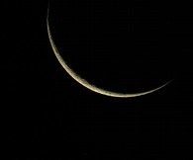
Melchi-Tzedek Witness or Lunar Confusion?
Sukkot starts here!
??
Sukkot starts here!
Mazzaroth!

Slide 28
Yahusha’s Time – Leviticus 23
Lev 23:24 “Speak to the children of Yisra’ĕl, saying, ‘In the seventh month, on the first day of the month, you have a rest, a remembrance of blowing of trumpets,
a set-apart gathering.
Lev 23:34 “Speak to the children of Yisra’ĕl, saying, ‘On the fifteenth day of this seventh month is the Festival
of Booths for seven days to יהוה [Yahuah].
When Yahusha said – ... For My Time has not yet been filled..., it is these times found in the Torah, that must be fulfilled completely.

Slide 29
Determining the Start of the Year
To determine the 7th month correctly, the very first day of the year must be correctly ascertained first.
There are 10 verses in the Tanach that indicate very clearly what celestial event maintains Yahuah’s worship year. One is Exodus 34:22 in which the autumnal tequfah (equinox) signals final events of Yahuah’s worship calendar year.
6 Months prior is the spring tequfah (equinox) and consequently the start of the new year. If this is not realized specifically by the Torah instructions, the Feasts and Festivals will not be on Yahuah’s Qodesh (Set-Apart) Calendar.
Yahusha was living out the Torah and His Time was according to the tequfah (equinox) system for determining the new year.
The Pharisees (Yahudim) of the second Temple era were observing their “month-start” [for the appointed times] by the lunar calculations.
Yahusha could not, and would not, observe the feasts of Yahuah that were placed on a lunar based calendar.

Slide 30
Yahusha – declares His METHOD of Witnessing
John 10:25 יהושע answered them [Jews], “I have told you, and you do
not believe. in My Father’s Name,
they concerning Me.
John 10:26 “But you do not believe, because you are not of My sheep, as I said to you.
John 10:27 “My sheep hear My voice, and I know them,
and they follow Me.
The WORKS that I DO
BEAR WITNESS

Slide 31



Did Yahusha WITNESS AGAINST the lunar based worship system of the 2nd Temple?
From where did Yahusha receive His DIRECTIVES?

Slide 32
Yahusha - a Witness for Yahuah
How can we know that Yahusha is testifying for Yahuah’s will?
Yahusha was teaching the people and they were amazed at the depth of understanding being delivered to them.
What was His response to their inquiry of where He received His knowledge?
John 7:16 יהושע [Yahusha] answered them and said, “My teaching is not Mine, but His who sent Me.
Can we verify this from the Torah?
!

Slide 33
Your Clue – Yahuah Speaks to Mosheh
Deut 18:18 ‘I shall raise up for them a Prophet like you out of the midst of their brothers. And I shall put My Words in His mouth, and He shall speak to them all that I command Him.
Deut 18:19 ‘And it shall be, the man who does not listen to My Words which He speaks in My Name, I require it of him.’
With this information in mind, when Yahusha told His brothers –
from Whom did these words originate?
“My Time has not yet come ...”

Slide 34
Teaching by example, or just simple conversation?
When Yahusha told His brothers – “My Time has not yet come...,” is it possible He was alluding to an imposter calendar issue which was being enforced by the high priest at that time? Would that also be the imposter high priest that later tore his faulty priestly garment? !!
Was Yahusha TEACHING his brothers with WORDS instilled in Him from Yahuah (Deut 18:18), and also by walking out His PHYSICAL EXAMPLE?
Let’s read His words further in the same conversation with His brothers –
John 7:17 “If anyone desires to do His desire, he shall know concerning the teaching, whether it is from Elohim, or whether I speak from Myself.
John 7:18 “He who speaks from himself is seeking his own esteem, but He who seeks the esteem of the One who sent Him is true, and no unrighteousness is in Him.

Slide 35
Yahusha’s Example
Luke 24:27 And beginning at Mosheh [Torah] and all the Prophets, He was explaining to them in all the Scriptures the matters concerning Himself.
Yahusha tells us (John 7:17) if we truly desire to know His ways we will be given that understanding.
So, if we are truly desiring to be on the correct Worship Calendar of Yahuah, would it be appropriate to search the Torah for information exposing –
“MY TIME”????? (Reference to John 7:6.)
Or, should we just accept the Rabbinical Luni/Solar calendar named the “Hebraic Calendar” which is formulated and promoted by Judaism today?

Slide 36


Yahusha’s HAMMER
John 7:19
“Did not Mosheh give you the Torah?
Yet not one of you the Torah!
Why do you seek to kill Me?”
Note: “DOES” is an action word, not a belief value.
Physical steps must be taken to fulfill this word. What physical action were the Pharisees either innocently or intentionally going afoul with by observing their Feasts (the feasts of the Yehudim)?
Read also - Matthew 5:20. What is it that we need to be doing that
“exceeds” that of the Scribes and Pharisees?
What declaration from Yahusha should send red flags blazing into the sky before our eyes?
DOES

Slide 37
The Key of Knowledge Removed!
?!
Luke 11:52 “Woe to you learned in the Torah, because you took away the key of knowledge. You did not enter in yourselves, and those who were entering in you hindered.”
Link Reminder: The context of this conversation from Yahusha to His brothers, in John 7, is – What timing characteristic that the Scribes and Pharisees were observing, had efficiently defiled the Torah?
Here in Luke 11, Yahusha is outlining some of the things where the Pharisees are going astray from the Word.
Question: What is the “key to knowledge” that Yahusha was referencing?
A key, is the vital piece of information that opens the portal to knowledge.
Where in the Scriptures do we find a description of infinite knowledge?
timing.

Slide 38
Yahuah tells us where to find KNOWLEDGE
Ps 19:1 The heavens are proclaiming the esteem of Ěl; And the expanse is declaring the work of His hand.
Ps 19:2 Day to day pours forth speech, And night to night reveals
Ps 19:3 There is no speech, and there are no words, Their voice is not heard.
Ps 19:4 Their line has gone out through all the earth, And their words to the end of the world. In them He set up a tent for the
Ps 19:5 And it is like a bridegroom coming out of his room, It rejoices like a strong man to run the path.
Ps 19:6 Its rising is from one end of the heavens, And its circuit to the other end; And naught is hidden from its heat.
knowledge.
THE MAZZAROTH
sun,

Slide 39
What KNOWLEDGE are we searching for?
contains the full accurate
outline in detail, of this
The Mazzaroth’s Tequfah is the “centering pin” which determines the start of Yahuah’s new worship year.
The Tequfah is the ultra specific celestial event which places us on the correct schedule to receive the full blessings of Yahuah!
When we accept the removal of the Tequfah, (Yahuah’s “centering pin of timing”) and we follow along in the pagan lunar traditions, we then have placed ourselves on the Adversary’s schedule. Remember …
The Dragon claimed in Isaiah 14:13 & 14 that he would control the Mo-edim.
By accepting the lunar traditions, we accept the Dragons usurped authority!
THE MAZZAROTH
Knowledge; the complete Plan of Salvation!

Slide 40
?? Questions ??
Why is the sun given prominence by receiving a special designated DWELLING PLACE (Ps 19:4) within the Master Time Clock –
The Mazzaroth – of Yahuah?
The sun’s tabernacle or - DWELLING PLACE in the Mazzaroth is the start and ending point of its circuit in the heavens – the Tequfah.
We have been taught that the moon is the guiding light to start the Worship year to Yahuah. Why then is there no mention of this “supposed all important figure” in the Mazzaroth – which is the Ultimate Eternal Master Time Clock of Yahuah?
Is it possible that the wool has been pulled over our eyes – AGAIN?

Slide 41
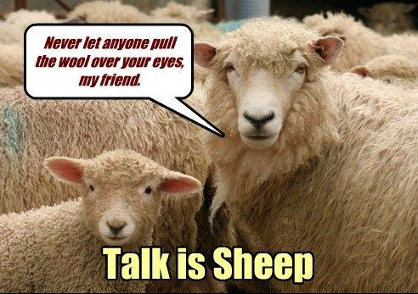
Notes:
New slide just to lighten things up!

Slide 42
The Mazzaroth Constellations = Infinite Knowledge
Job 38:31 Do you bind the bands of Kimah, [Pleiadies] or loosen the cords of Kesil [Orion]?
Job 38:32 Do you bring out the constellations [Mazzaroth] in its season? Or do you lead the Bear [Arcturus] with its sons?
The Mazzaroth is the Master Time Clock of Yahuah!
He used this system of determining time at the start of the Hebrew nation – see Gen 17, 18 & 21:2. Yahuah does not change.
The exodus of the Yisra’elites from Mitsrayim (Egypt) was timed by the Appointed Times (Mo-edim) which is governed by the Mazzaroth.
The entire plan of Salvation - within the Mazzaroth Constellations –
is written in the sky every 24 hours.

Slide 43
Keys to Knowledge – Mazzaroth’s Rulership
Immediately after Job writes about the Mazzaroth in verses 31 & 32, he asks –
Job 38:33 Knowest thou the ordinances of heaven? canst thou set the dominion thereof in the earth? KJV
Job 38:33 Do you know the laws of the heavens? Or do you set The Scriptures
Job, references the Mazzaroth, then within a question clearly indicates of their commission for dominion over the earth! What Dominion?
The Mazzaroth has absolute governing control as the commissioned
TIME CLOCK of Yahuah over eternity.
their rule over the earth?

Slide 44

Job Identifies the of the Moon!
Light
See, even the moon does not shine, and the stars have not been flawless in His eyes.
Job 25:5 H. S.

Slide 45
A Celestial Position Comparison
The Scriptures (Psalms 19:4) inform us that the sun has been given
a designated permanent residence within the Mazzaroth.
It is an ohel (H168), a dwelling place.
What physical position, in a spiritual sense, has been given to the moon
in the final days of the earth?
Rev 12:1 And a great sign was seen in the heaven:
a woman clad with the sun,
and on her head a crown of twelve stars.
the moon under her feet,

Slide 46
Questions:
Have you considered the Scriptural concept of the position “UNDER THE FEET” ?? ??
Is it a position of authority? Is it a solid platform for a truthful belief system as we have been coerced into accepting – without questioning it?
For Scriptural insight/examples on this positioning –
review the study –
It might not be as we have been previously taught !! !!
Standing On The Moon.

Slide 47
Mazzaroth Constellations
Twelve!
There are twelve Mazzaroth Constellations that expose the full and complete plan of Salvation in the sky.
One constellation for each month of the year.
One Constellation for each month of the year that the Tree of Life produces fruit, as written in Rev 22:2. Revelation tells us that there are twelve fruits. Let’s read it carefully –
Rev 22:2 In the midst of the street of it, and on either side of the river, was there the tree of life, which bare twelve manner of fruits, and yielded her fruit every month: and the leaves of the tree were for the healing of the nations. KJV
There is not a 13th constellation, nor a 13th month!!!

Slide 48
There are – TWELVE …
TWELVE fruits on the tree of life
TWELVE Mazzaroth Constellations
TWELVE captains reserved for taking care of Solomon’s kingdom – one for each month (See 1 Chron 27:1.)
TWELVE tribes of Yisra’el
TWELVE divisions in a light season declared by Yahusha – John 11:9
TWELVE months in prophetic years – (30 cycles per month)
TWELVE months in the year of Noah’s flood (proven 30 cycles per month)
TWELVE months in the year that Joshua entered Canaan
TWELVE months in the year that Yahusha stood up to speak on “that Last Great Day” of Sukkot/Tabernacles – John 7:37
TWELVE months in the year of Yahusha’s Ultimate Sacrifice

Slide 49
QUESTION -
WHERE IS A 13TH MONTH –
WITH A SECOND WITNESS AS
REQUIRED BY YAHUAH?
  WHERE?

Slide 50
The Next Set of QUESTIONS -
Is it possible that Yahusha arrived at the Feast of Sukkot in the middle of the celebration because He was observing Sukkot (Tabernacles) according to
Is this what Yahusha meant when He said to His brothers –
“...My time has not yet been filled”? John 7:8 (HalleluYah Scriptures)
Was Yahusha operating on a calendar other than the
which had become enforced after the death of Hezekiah?
Is the Metonic Cycle, the same lunar based calendar that is recorded by the Zadokite priests of Qumran; the one they so vehemently abhorred because it had insidiously crept into the 2nd Temple era worship traditions?
Is this lunar based calendar one of the reasons why the Essenes of Qumran abandoned the Tabernacle for their seclusion from evil traditions, and also the imposter leadership derived from the Hasmonean period leading into the 2nd Temple era?
His Father Yahuah’s Will?
Metonic Cycle
?

Slide 51
What about a second witness - from Yahusha?
Yahusha is TWELVE years old! His earthly parents take Him to the Passover.
Please note very carefully, the wording of this next text.
Luke 2:42 And when He was twelve years old, they went up to Yerushalayim The Scriptures
Question: Have you ever questioned why the Scriptures tell us it was according to the practice of the festival – instead of saying – according to the Torah?
Luke 2:42 And when he was twelve years old, they went up to Jerusalem after the custom of the feast. KJV
What, and/or who, set the customs of this feast of the Yehudim (Jews)?
according to the practice of the
festival.

Slide 52
“customs of the feast” – “A Mistake in translation?”
The Scriptures are very clear and quite eager to tell us exactly when the Torah is being followed.
Luke 2:27 And he came in the Spirit into the Set-apart Place. And as the parents brought in the Child יהושע [Yahusha], to do for Him
Luke 2:39 And when they had accomplished all matters
of יהוה [Yahuah], they returned to Galil, to their city Natsareth.
according to the usual practice of the Torah,
according to the Torah

Slide 53
Two Ideals - SIDE BY SIDE - a Visual, Psychological and
Contextual Separation
... according to the practice of the festival
... according to the Torah of יהוה [Yahuah].

Slide 54
Context: “...practice of the festival”
Luke 2:43 When they had accomplished the days, as they returned, the Child יהושע [Yahusha] stayed behind in Yerushalayim. And His parents did not know it.
Note: The Scriptures –
We are to understand this text is telling us by the context from the previous verse, that –
When they had accomplished the days according to the practice of the festival (of the Yehudim)...
Yahusha’s parents had outright left Him behind to be quite frank.
DO NOT SAY
When they had fulfilled the Torah...

Slide 55
Just a trivial accident? Or Torah Fulfillment?
When Yahusha’s earthly parents “FORGOT” about Yahusha and left on their return home journey, was this just a coincidental act of forgetfulness,
Wording this differently –
When Yahusha was found by His parents in the Tabernacle, what was Yahusha’s response, and does it correspond to the teachings found in the Torah?
Again – When Yahusha was found, “after three days” (Luke 2:36), witnessing of His Father’s will in the Tabernacle, was He appropriately –
John 1:1 In the beginning was the Word, and the Word was with Elohim, and the Word was Elohim.
or was the Torah deliberately being fulfilled?
“Living the Torah?”

Slide 56

Yahusha’s Response to the Inquiry -
The Inquiry –
Luke 2:48 And having seen Him, they were amazed. And His mother said to Him, “Son, WHY have You done this to us? See, Your father and I have been anxiously seeking You.”
Yahusha’s Response –
Luke 2:49 And He said to them, “Why were you seeking Me?
Did you not know that
I had to be in the MATTERS of My Father?”

Slide 57
“The Matters” of the Father - Yahuah
Ex 23:14 “Three times in the year you are to observe a festival to Me:
Ex 23:15 “Guard the Festival of Unleavened Bread. Seven days you eat unleavened bread, as I commanded you, at the time appointed in the month of Aḇiḇ – for in it you came out of Mitsrayim [Egypt] – and do not appear before Me empty-handed;
Ex 23:16 and the Festival of the Harvest, the first-fruits of your labours which you have sown in the field; and the Festival of the Ingathering at the outgoing of the year, when you have gathered in the fruit of your labours from the field.
Ex 23:17 “Three times in the year ALL YOUR MALES are
to appear before the Master יהוה [Yahuah].

Slide 58
What “ON EARTH” was Yahusha thinking?
Yahusha attended the Festival of the Yehudim (Jews) entering in the middle of the Feast of Sukkot in John 7!
Note the fearful implication of Yahusha arriving at the MIDDLE of the Feast of Sukkot;
Yahusha would have FAILED to present Himself to Yahuah during the first of the Feast, and be in attendance AT THE TABERNACLE in accordance with the statutes of Exo 23:15-17, Deut 16:2, 5, 6, 11 & 16.
FAILURE to observe a statute(s) ALWAYS results in a SIN.

Slide 59
What “on earth” was Yahusha thinking? #2
The questions we then need to ask ourselves is –
1. By NOT observing the first Sabbath of the Feast of the Yahudim (Jews), did Yahusha incur a sin upon Himself?
2. Since Yahusha is deemed - sinless, what circumstance allows Him to skip the first Sabbath of the Feast of the Yahudim (Jews) and yet remain sinless?
Back to John 7:19: the context of TIMING (midst of the Festival, v:14) has just been set by Yahusha, then when questioned by the Yahudim, Yahusha declares to them outright that THEY DO NOT THE TORAH!
Yet they were all there observing their Sukkot Feast of the Yahudim!
What part of the Torah prevents the Feast of the Yahudim from being observed according to the statutes of Yahuah?
DO

Slide 60
What “ON EARTH” is this situation?
According to Yahusha -
There is a circumstance which inevitably prevents the Yahudim from observing the Torah correctly.
Does this same optional tradition also effectively exclude
Yahusha from Yahuah’s wrath when He began attending at the
MIDDLE of THEIR Feast?

Slide 61
ON EARTH!!
AGAIN -
Does this same voluntary circumstance of
effectively exclude Yahusha from having incurred sin by entering at the
MIDDLE of THEIR Feast?
TRADITION

Slide 62
Tishri 23 - The Yahudim’s Feast has ended!
John 8 documents Yahusha returned to the Tabernacle the very next morning at dawn. It was a 7th Day Sabbath, on the 23rd of the month the day after the Festival of the Yehudim (Jews) was over and He continued to teach.
Did Yahusha return to the Tabernacle intending to, “present Himself
before the Master יהוה [Yahuah],” according to the Calendar of Torah and Exo 23:17/ 34:21-23, Num 29:12/ Duet 16:13-17?
Luke 2 documents Yahusha (12 years young) was witnessing in the Tabernacle 3 days after the Pesach Festival of the Yehudim (Jews) was over!
Yahusha declared He was attending to His Fathers Business! Was Yahusha obediently PRESENTING HIMSELF BEFORE Yahuah according to the Covenant Calendar so brilliantly documented throughout the Scriptures?

Slide 63
Yahusha’s Contention!
Question: Was Yahusha IN AGREEMENT with the Metonic Cycle - the luni/solar calendar of the imposter 2nd Temple hierarchy?
Or, have the Scriptures efficiently exposed an obvious difference in observing Mo-edim between the Yahudim and Yahusha?
Recall slide #60: the VOLUNTARY TRADITION THAT CREATES A CIRCUMSTANCE WHICH –
REMOVES YAHUSHA FROM BEING HELD ACCOUNTABLE by the Feast of the Yahudim!
PREVENTS THE YAHUDIM FROM OBSERVING THE TORAH!
“Yet of you does the Torah!” John 7:19!!!
NOT ONE

Slide 64
?? Questions ??
Why was Yahusha not conforming to the lunar/solar calendar
of the 2nd Temple era?
Would there be any connection to the destruction of Jericho the
very center of moon worship?
Would there be any connection with the order to Gideon to destroy Zebah and Tsalmunna, moon worshipping leaders of their people?
What about when Gideon retrieved the moon crescent pendants from on their camels necks and these became a snare to Gideon
later in life?
Is there a lesson here? Can we learn from these examples?

Slide 65
Next time you are asked –
Is there any proof of Yahusha being not in agreement with the lunar based calendar, in the Messianic Testament (New Testament) –
What will your answer be?
Next time you are asked –
How do we know Yahusha observed the Covenant Calendar that is recorded clearly in the flood account with Noah, and the exodus from Mitsrayim, - while living on this earth? {Messianic Testament}
What will your answer be?
Do we have any other information available to us on this topic – from the brother of Yahusha?

Slide 66
Ya’aqov - Half Brother to Yahusha
Ya’aqov (James in our English translations) has provided us with a mountain of information within one verse.
James 1:17 Every good gift and every perfect gift is from above, coming down from the Father of lights, with whom there is no change, NOR SHADOW OF TURNING.
Question: Does the moon cast forth its own light?
No? What lights could this verse possibly be pointing to? What about
Gen 1:16. There we read that Yahuah made – TWO GREAT LIGHTS.
As the moon does not have its own light but only reflects the light of the sun, how can it be said that the moon is being referenced here as one of the two great lights (or the lesser of the two great lights)?

Slide 67
What are the “TWO GREAT LIGHTS”?
According to the tequfah (equinox) initiating the beginning of the new year, there are two lights which actuate this event. (The original Hebrew language declares the tequfah as being the year-end).
These TWO are; 1. Mazzaroth light – – from the Constellations, and 2. the position of the sun light – – within the Mazzaroth.
These are the TWO GREAT LIGHTS!
It is from earth that we are to observe the LIGHT of the Sun recording its location within the LIGHT of the Mazzaroth constellations.
How was this measured in ancient times? By a sun dial!
Does the moon cast a shadow of its own light on the earth, causing a shadow from its own light (without any assistance from the sun)?
No, it does not! The moon is DARKNESS without sunlight!
Knowledge
Timing

Slide 68

What? - a Shadow?
In James 1:17 where it is recorded “... with whom there is no change, – what shadow is Ya’aqov (James) referencing?
Ya’aqov (James) confirms the shadow of the sun dial is the truth still believed by the followers of Yahusha. This tequfah (equinox) calendar system designed by Yahuah to determine time for eternity has not been altered.
On a correctly installed sun dial, when the tequfah (equinox) occurs, there is no shadow in the correct space on the sun dial. There is no shadow when the end of the year occurs and the start of the new year begins.
Ya’aqov (James) informs us most certainly that with the Father of Lights, there is no change. YAHUAH DID NOT, at the time of the sun dial incident with Hezekiah, change His system from a Tequfah based calendar to a lunar based calendar (the Metonic Cycle).
The Metonic Cycle is a designer (read - false) 29.5 cycle month.
NOR SHADOW OF TURNING.”

Slide 69

Yahuah’s Celestial Boundary
This is Yahuah’s definition of a 360 degree circuit in the heavens –
Ecc 1:5 The sun also rises, and the sun sets, and hurries back to the place where it arose.
The completion of a circuit in the heavens is found at the ORIGINAL PLACE OF DEPARTURE. That original place of departure is the completion point of a 360 degree circuit.
Now let’s look at some of man’s lunar month definitions.

Slide 70
Man’s Designer Circuits (#1)
Terminology
There are several types of lunar months.
Usually the term lunar month refers to the synodic month, because it is the cycle of visible moon phases.
Most of the following types of months (but not the distinction between sidereal and tropical months) were first recognized in Babylonian lunar astronomy.

Slide 71
Man’s Designer Circuits (#2)
Sidereal Month (Definition)
The period of the Moon's orbit as defined with respect to the celestial sphere (of the fixed stars, nowadays the International Celestial Reference Frame (ICRF)) is known as a sidereal month because it is the time it takes the Moon to return to a given position among the stars (Latin: sidera): 27.321661 days
This type of month has been observed among cultures in the Middle East, India, and China in the following way: they divided the sky into
27 or 28 lunar mansions, one for each day of the month, identified by the prominent star(s) in them.
Did you note the amount of days required for the moon to complete a 360 degree circuit?
(27 d 7 h 43 min 11.5 s).

Slide 72

Man’s Designer Circuits (#3)
Note:
Please observe the ”non-Christian” cultures (from the last slide) that observed the actual time of a full 360 degree lunation, which is a little over 27 cycles (days) in length.
Why did “Christian” cultures “stretch out” the lunar month to come as close as possible to Yahuah’s 30 cycle solar month?
You will see why I write “stretch out” the lunar month by the wording in the next lunar month (synodic) definition high-lighted in yellow. This will be further explored real soon!

Slide 73
Man’s Designer Circuits (#4)
Synodic Month (Def.) - (quotes, hence the false heliocentric earth ideals)
Is this Yahuah’s established format for determining time?
This is the average period of the Moon's revolution with respect to the line joining the Sun and Earth. The synodic month is the period of the Moon's phases, because the Moon's appearance depends on the position
of the Moon with respect to the Sun as seen from the Earth.
While the Moon is orbiting the Earth, the Earth is progressing in its orbit around the Sun. After completing a sidereal month the Moon must move a little further to reach the new position having the same angular distance from the Sun. This longer period is called the synodic month (Greek: συνοδικός, sunodikos, meaning "pertaining to a synod, i.e., a meeting" [in this case of the Sun and the Moon]).

Slide 74

Questions to Ponder?
Pertaining to the 1st paragraph quote on the last slide:
Where in the Scriptures do we find instruction to draw a line connecting the earth, sun,
The Tequfah (equinox) gives us direction for a visual connection with the earth (our viewpoint); while discerning the location of the sun within the Mazzaroth stars - (Psalms 19:1-6).
Tequfah – Exo 34:22, 1 Sam 1:20, 2 Chron 24:23, & Ps 19:6!
WHERE IS THE INSTRUCTION TO REPLACE THE MAZZAROTH
WITH THE MOON - OF ANY PHASE???
AND THE MOON?
WHERE?? ? ?

Slide 75
Man’s Designer Circuits (#5)
We see within the definitions, man’s re-designing and formation of a different set of boundaries (rules) for determining a lunation.
That way the time factor can be MANIPULATED to appear AS NEAR AS POSSIBLE TO Yahuah’s 30 days/month design for determining time.
This type of manipulation is identical to when the Dragon told Eve – ”…You shall certainly not die” BUT… (Gen 3:4).
Man’s new design includes points –
BEYOND A COMPLETED 360 DEGREE LUNATION CIRCUIT!

Slide 76
Man’s Designer Circuit Quotes (#6)
??
Synodic Month continued –
Since the Earth's orbit around the Sun is elliptical and not circular, the angular rate of Earth's progression around the Sun varies during the year. The angular rate is faster nearer periapsis and slower near apoapsis.
The same is so for the Moon's orbit around the Earth. Because of these variations in angular rate, the actual time between lunations may range from about 29.18 to about 29.93 days. The long-term average duration is 29.530587981 days (29 d 12 h 44 min 2.8016 s). ^{[citation needed]}
The synodic month is used to calculate eclipse cycles.
A synodic month is longer than a sidereal month because the Earth-Moon system is orbiting the Sun in the same direction as the Moon is orbiting the Earth. Therefore, the Sun appears to move with respect to the stars, and it takes about 2.2 days longer for the Moon to return to the same apparent position with respect to the Sun.
The Mazzaroth has been ignored!

Slide 77
The Synodic Month/Metonic Cycle Quotes (#1)
synodic period
(sĭnŏd`ĭk), in astronomy, length of time during which a body in the solar system makes one orbit, in astronomy, path in space described by a body revolving about a second body where the motion of the orbiting bodies is dominated by their mutual gravitational attraction.
of the sun relative to the earth, i.e., returns to the same elongation, in astronomy, the angular distance between two points in the sky as measured from a third point. The elongation of a planet is usually measured as the angular distance from the sun to the planet as measured from the earth.
Because the earth moves in its own orbit, the synodic period differs from the sidereal period, which is measured relative to the stars. The synodic period of the moon, which is called the lunar month, or lunation, is 29 ½ days long; it is longer than the sidereal month. The moon is full when it is at opposition, in astronomy, alignment of two celestial bodies on opposite sides of the sky as viewed from earth. Opposition of the moon or planets is often determined in reference to the sun.
Read Psalms 93:1
?? ??
Because the earth moves

Slide 78
The Synodic Month/Metonic Cycle Connection quotes (#2)
One sidereal month later it will not yet be full, since it must travel further in its orbit around the earth to reach the point of opposition, which has moved relative to the stars because of the earth's motion.
Since the calendar month is not equal to the lunar month, the full moon does not occur on the same day every month. The length of time between recurrences of the full moon on the same date is 235 lunar months, or 19 years. This period, called the Metonic cycle, was discovered by the Greek astronomer Meton in 433 B.C. It is used in determining the date of on the Gregorian calendar.
Easter

Slide 79
The Synodic Month/Metonic Cycle Connection quotes (#2)
??
One sidereal month later it will not yet be full, since it must travel further in its orbit around the earth to reach the point of opposition, which has moved relative to the stars because of the earth's motion.
Since the calendar month is not equal to the lunar month, the full moon does not occur on the same day every month. The length of time between recurrences of the full moon on the same date is 235 lunar months, or 19 years. This period, called the Metonic cycle, was discovered by the Greek astronomer Meton in 433 B.C. It is used in determining the date of on the Gregorian calendar.
Easter

Slide 80

Would that apply to the synodic month?
80

Slide 81
Who attempted to change times and laws? (Dan 7:25)
Who decided to “stretch” the lunar month by altering -
(re-designing) – Yahuah’s boundaries of a full 360 degree circuit?
Who desires to achieve a monthly circuit that NEARLY REFLECTS THAT OF YAHUAH’S MAZZAROTH BASED 30 DAY MONTH?
that can achieve replacing Yahuah’s selected celestial identities –
Sun-Light and the Mazzaroth, as the
Yahuah determined that these divine institutions founded at creation defined a completed year and a 360 degree - 30 day monthly cyclical pattern!
WHO PRODUCES AUTHORITY
Tequfah Combination?

Slide 82
What is the significance of this replacement?
When man chose to #1) replace the LIGHT of the sun and instead reference the reflected light from the moon -
When man chose to #2) remove the Mazzaroth’s TEQUFAH -
What then did man in effect do?
Man has in effect;
REMOVED THE TWO GREAT LIGHTS OF Genesis 1:16 from having any
importance whatsoever!

Slide 83
Ya’aqov (James) assures us the Mazzaroth based calendar that Noah operated on, has not, nor ever will be changed by Yahuah.
This information comes directly from the half brother of Yahusha after His crucifixion at Golgotha.
Yahusha was NOT in agreement with the Pharisee’s LUNAR BASED TRADITIONS. Consider Yahusha’s cutting statement to them!
Matt 23:15 “Woe to you, scribes and Pharisees, hypocrites! Because you go about the land and the sea to win one convert, and when he is won, you make him a son of Gehenna twofold more than yourselves.
Why? One reason is that they converted a person and placed that person on the LUNAR BASED CALENDAR that Yahuah PASSIONATELY DESPISES!

Slide 84
Another Scathing Statement
Matt 23:13 “But woe to you, scribes and Pharisees, hypocrites!
for you do not go in, nor do you allow those who are entering to go in.
How have the Pharisees accomplished this heresy of silencing the governing authority of the heavens - (Mazzaroth)?
“...because you took away the Luke 11:52
How was this evil accomplished?
The Pharisees abandoned the Word of Yahuah where we are told about the Tequfah (equinox) ending and starting the new year and gave us their tradition of giving allegiance to the moon instead.
Because you shut up the reign of the heavens before men,
key of knowledge.”

Slide 85
Tequfah Abandoned
Out Of Covenant!
What occurs when Yahuah’s Celestial Governing Event – the Tequfah – is abandoned for a dogmatic imposter?
It is then IMPOSSIBLE to enter into Covenant with your Creator!
What was it that the Pharisees did not, AND COULD NOT, “enter into” themselves?
Covenant with Yahuah!
Why could not the Pharisees enter into Covenant with Yahuah?
Because they rejected the divine institution from Creation that initiated the Qodesh Worship Calendar upon which are the Mo-edim (Feasts and Festivals).
The Pharisees thought it better to follow the moon than Yahuah’s Tequfah!

Slide 86
Yahusha’s Response to Their Choice!
The Pharisees had rejected the Tequfah for the Moon, to which Yahusha said –
Mat 23:13 “But woe to you, scribes and Pharisees, hypocrites! Because you shut up the reign of the heavens before men, for you do not go in, nor do you allow those who are entering to go.
Mat 23:15 “Woe to you, scribes and Pharisees, hypocrites! Because you go about the land and the sea to win one convert, and when he is won, you make him a son of Gehenna twofold more than yourselves.
How could the Pharisees lead a convert to be in Covenant with Yahuah when they refused it themselves?
How could they teach about the which would place people on the Covenant Calendar of Shem, Noah, Abraham, Isaac, Jacob, Moses and Joshua when they had rejected the Word of Yahuah?
key of knowledge – the Tequfah –

Slide 87
When the Feasts and Festivals are observed according to moon tradition, they are not on the Qodesh (Set-Apart) Appointed Times of Yahuah.
These feasts and festivals then become feasts, assemblies, shabbaths and NEW MOONS (Months), which are an to Yahuah. (Ref Isaiah 1:11-15.)
Why? Because they are on the Dragon’s schedule, upon which a curse was placed at the destruction of Jericho, the center of moon worship.
On the deeper context, that curse was placed upon the person(s) who continue to rebuild the pagan system of moon worship.
Yahuah cannot be with us and deliver the coveted Ruach Ha Qodesh
to us WHEN we choose to follow the traditions of man.
“YOUR”
“YOUR”
“YOUR”
“YOUR”
EVIL ABOMINATION

Slide 88

Yahuah’s Appeal
Let us not fall into the trap that Yahuah warned us about in Judges 2.
Jdg 2:3 “Therefore I also said, ‘I am not driving them out before you, and they shall be adversaries to you, and their mighty ones shall be a snare to you.’ ”
Jdg 2:13 So they forsook יהוה [Yahuah] and served Baʽal and the Ashtoreths.
Jdg 2:16 Then יהוה [Yahuah] raised up rulers who saved them from the hand of those who plundered them.
Jdg 2:17 However, they did not listen to their rulers either, but went whoring after other mighty ones, and bowed down to them. They soon turned aside from the way in which their fathers walked, in obeying the commands of יהוה [Yahuah] – they did not do so.

Slide 89
Question
If we as a people are pledging allegiance to a pagan tradition of allowing the false leadership of the moon to guide us,
ARE WE “BOWING” TO THE BA’ALS AND ASHTORETHS seen in this world - TODAY?
My friend, let us repent and return to the Word of Yahuah with a passion never before realized.
May Yahuah grant you never ending portions of guidance and wisdom.
The End … but what is next?

Slide 90


This completes two introductory studies on the problem of
the moon being in command of
the month commencement.
Next Study on
June 1/18:
The Moon!
Oh! The Moon!
Does Moses really give the “moon” the prominent position to begin each month?

Slide 91
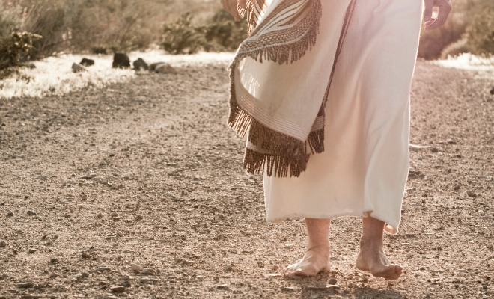



Walk in His
Footsteps!
For send
your questions
& comments to:
timothy@torahtothetribes.com

