Slide 1

Standing on
the Moon !
Rev 12:1

Slide 2
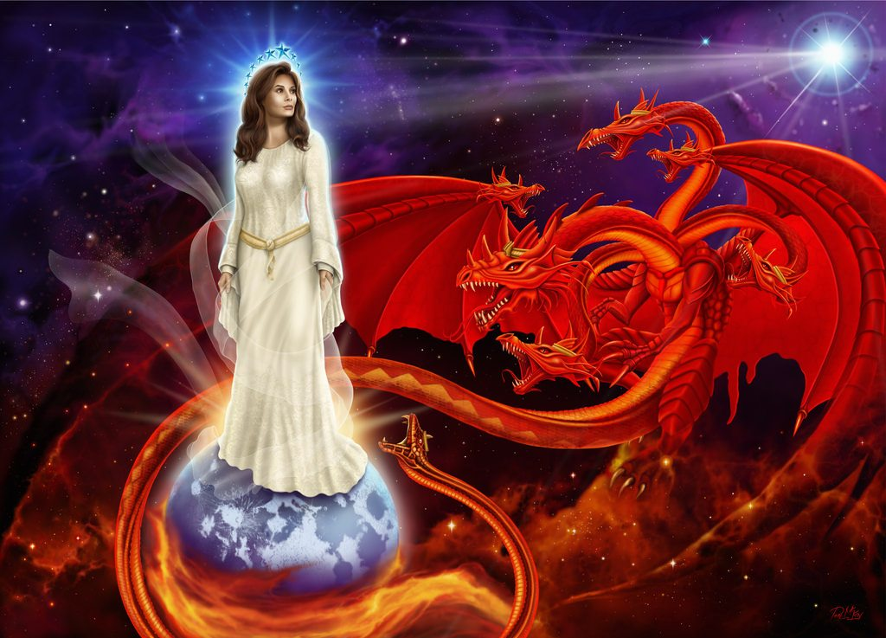
Standing on the Moon !
Rev 12:1

Slide 3
Revelation 12:1
Is the Message of the Moon as taught
to us for eons of time dating back to Jericho -
1. A Profound Foundation from Yahuah?
or – 2. False Doctrine from Ba’al?

Slide 4

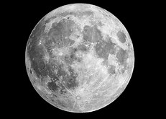
PERTINENT Questions
Will the Bride of Yahuah, standing on the moon in
Revelation 12:1, provide a true foundation for
determining Yahuah’s Appointed times (Mo-edim) –
by leaning upon the popular teachings of many prominent leaders? In other words …
Will the Bride of Yahuah give allegiance to the popular teachings that are rooted and centered upon the moon for the purpose of determining Yahuah’s Appointed Times?

Slide 5
OR . . .
Will Revelation 12:1 instruct us that the message of the moon has been – OVERCOME AND SOUNDLY DEFEATED,
by appearing to be TRAMPLED UNDERFOOT
by the Bride of Yahuah at the end of time?
Does Revelation 12:1 point us to the actual visual event
within the Mazzaroth?
When compared to the authentic Tequfah mandate established by our Creator, will this Constellation reveal the true authority
of the moon in terms of Yahuah’s Mo-edim Cycles?
Notes:
Feb 12/17: huge changes in wording. 247pm

Slide 6
Revelation 12:1
And a was seen in the heaven:
Would a SIGN (Gen 1:14) seen within the Mazzaroth of the heavens, be worthy of consideration by the Bride of Yahusha?
Will people searching The Word before it occurs - SHEMA?
GREAT SIGN

Slide 7
Revelation 12:1
What if this was highly specific of an absolute condition describing Yahusha’s chosen people near the closing period of time on this earth?
GREAT SIGN
A Sign - Gives strong indication to the context!

Slide 8
Revelation 12:1
And a great sign was seen in the shamayim: a woman clad with the sun, and the moon under her feet, and on her head a crown of twelve stars. HalleluYah Scriptures
The woman described here is non other than Bethula the
Bride of Yahusha. Let’s look into the description of her glory.

Slide 9
Of Great Significance!
Rev 12:1 (a)
“And there appeared a great wonder in heaven …” KJV
John attributed a very high importance to the event he was about to describe. It was a “GREAT WONDER”!
It was something to behold for all the generations to follow him.
What captivated John’s mind? Each detail of this SIGN/WONDER must be considered as a highly important revelation of truth.

Slide 10
Bethula’s Exaltation!
Rev 12:1 (b)
“… a woman clothed with the sun …”
This speaks directly of Bethula the Virgin constellation — one of the
12 constellations within the Mazzaroth.
Bethula occurs in this descriptive format, late in September of the Gregorian calendar. It is an actual celestial event that can be observed in the heavens.
What, and Who, provides Bethula with an aura of glory?
Bethula has been clothed/covered with the LIGHT of the sun. The LIGHT of the sun portrays everything which gives the Virgin Bride of Yahusha her magnificent glory. LIGHT OF THE SUN!
10

Slide 11
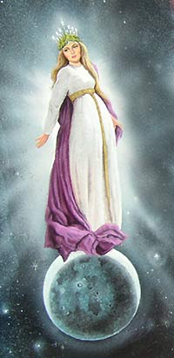
Was it the sun itself that enveloped Bethula within incredible glory?
No! It is LIGHT from the sun.
The actual sun orb is not even present
in the sky!
The orb of the sun is a secondary factor!
– LIGHT – (of the sun)
In this picture,
notice the enlarged moon below her feet.

Slide 12
As the sun sets in the western sky and the residual sunlight is still present, the constellation of Bethula appears in the eastern sky.
She is enveloped with the light from the sun.
This is her eternal splendor.
The next part of the verse is very important.
Rev 12:1 (c)
“… and the moon under her feet …”
Question: Does this text solidly indicate that Bethula is standing on the moon, as a foundational platform for her existence??

Slide 13
The Moon Under Bethula’s Feet
In the autumn the full moon shows itself under the feet of Bethula, but not every year. This occurs only 1 out of 3 years. In the constellations, the moon is not touching the feet of Bethula and does not portray her as using it as a secure foundation for her platform.
Yes the full moon is near her feet; a short distance away.
We are going to explore this factor very soon.
First we will consider the entire verse.
Rev 12:1 (d) “… and upon her head a crown of twelve stars …”
One star per month; Is the 13th star A.W.O.L?

Slide 14
12 Stars in her Crown = 12 CONSTELLATIONS
One for each month!
See Revelation 22:2.
What {& WHY} does the lunar based calendar require?
Why is there no mention of a 13th month in the Scriptures to correct the lunar calendar after it has digressed astray from the seasons?
Answer: A 13th month!

Slide 15
Returning to - the Position of the Moon
Rev 12:1 (c)
“… and the moon under her feet …”
THE QUESTION IS: Why is the moon, which has been deemed and taught by man to be the divine authority for determining time,
located under the feet of the woman of Revelation 12:1?
Do the Scriptures provide any information about this
“under the feet” positioning?

Slide 16
Before we go further, please allow me
to submit to you that –
Being AT the foot of Yahusha,
exposes an entirely different context than
Being UNDER THE FOOT of Yahusha!
These are 2 entirely different concepts.
Please avoid confusing them as being similar.

Slide 17
Position: 1. Power of authority?
Or … 2. Power relinquished?
For an answer we need to look at Scriptural examples regarding “positioning.”
  Gen 24:2 And Aḇraham said to the oldest servant of his house, who ruled over all that he had, “Please, put your hand under my thigh …”
  Gen 47:29 And the time for Yisra’ĕl to die drew near, and he called his son Yosĕph and said to him, “Now if I have found favour in your eyes,
  please put your hand under my thigh, and show kindness and truth to me. Please do not bury me in Mitsrayim …”
These "under" positions are not displaying power and strength.
They are positions of voluntary submission to superior authority.

Slide 18
Under the feet
Is there power, control and authority exuding from under these feet?
  2 Kings 9:33 And he said, “Throw her down.” And they threw her down, and some of her blood spattered on the wall and on the horses, and he trampled her under foot. (Jezebel – eaten by dogs.)
  Isaiah 14:25 That I will break the Assyrian in my land, and upon my mountains tread him under foot: then shall his yoke depart from off them, and his burden depart from off their shoulders.
The Assyrian authority was/will be stripped from them and will be placed where? Under the feet!
Notes:
348 pm

Slide 19
A Mighty Nation that Tramples - (under foot)
  Isa 18:7 In that time a present shall be brought to יהוה [Yahuah] of hosts from a people tall and smooth-skinned, and from a people awesome from their beginning onward – a nation mighty and trampling,
  whose land the rivers have divided – to the place of the Name
  of יהוה [Yahuah] of hosts, to Mount Tsiyon.
To – trample – is to crush with force. Trampling produces a crushed and defeated product — not a production of a platform for ruling authority.
Being “under foot” in this example has produced an effective elimination
of authority. The mighty nation conquers over the deficient entities.

Slide 20
Under foot & crushed!
Jer 12:10 Many shepherds have destroyed My vineyard, they have trodden My portion under foot, they have made My pleasant portion become a deserted wilderness.
Lam 1:15 The Lord [Yahuah] hath trodden under foot all my mighty men in the midst of me: he hath called an assembly against me to crush my young men: the Lord [Yahuah] hath trodden the virgin, the daughter of Judah, as in a winepress.
Dan 8:13 Then I heard one saint speaking, and another saint said unto that certain saint which spake, How long shall be the vision concerning the daily sacrifice, and the transgression of desolation, to give both the sanctuary and the host to be trodden under foot?

Slide 21
Is there any authority from - under the foot?
Matt 5:13 Ye are the salt of the earth: but if the salt have lost his savour, wherewith shall it be salted? it is thenceforth good for nothing,
but to be cast out, and to be trodden under foot of men.
Heb 10:29 Of how much sorer punishment, suppose ye, shall he be thought worthy, who hath trodden under foot the Son of God [Yahuah], and hath counted the blood of the covenant, wherewith he was sanctified, an unholy thing, and hath done despite unto the Spirit of grace?
Rev 11:2 But the court which is without the temple leave out,
and measure it not; for it is given unto the Gentiles: and the holy city
shall they tread under foot forty and two months.

Slide 22
Rev 12:1 – “... moon under her feet ...”
These are some very clear Scriptural indications of authority being purposely located under the feet.
Under the feet is NOT a position of power and authority as man has taught us. Neither does the moon have any authority by being located under the feet of the Bride of Yahusha in Rev 12.
The Bride of Yahusha, in Rev 12:1, is NOT portraying a picture of the Bride as incorporating the lunar based system of worship for praising Yahuah!
Quite the contrary. The moon, being under the feet, is a sign of the moon involuntarily relinquishing power and authority!
Yes, the moon in Rev 12:1 is portrayed as having NO authority whatsoever.
22

Slide 23
Joseph’s Oppression:
Under the foot of Potiphar!
  Gen 39:20 Then Yosĕph’s master [Potiphar] took him and put him into the prison, a place where the sovereign’s prisoners were confined. And he was there in the prison.
Joseph no longer ruled Potiphar’s household from prison? Joseph was oppressed by Potiphar and definitely “under the foot” of Potiphar.
What position was given to Joseph as second in command under Pharaoh?

Slide 24
Joseph’s Authority:
The Second Chariot of Pharaoh!
  Gen 41:42 And Pharaoh took his seal-ring off his hand and put it on Yosĕph’s hand. And he dressed him in garments of fine linen and put a gold chain around his neck.
  Gen 41:43 And he had him ride in the second chariot which he had. And they cried out before him, “Bow the knee!”
  And he set him over all the land of Mitsrayim.
  Joseph is no longer “under the foot” of anyone, but has been elevated to the position of Pharaoh’s “second in command.”

Slide 25
Joseph did not rule Mitsrayim (Egypt) from a position of oppression - that of being at the bottom.
Joseph was given glory and honour which was displayed when he rode in the second chariot of the Pharaoh – an ELEVATED position!
Yahuah provided for Joseph, the top ruling position available in the land.
His authority was recognized from being exalted – not from being placed “under the foot.”
The opposite was true when Joseph was placed in prison by Potiphar, a position of “under Potiphar’s foot.” At that moment Joseph’s authority over the immediate house of Potiphar was vanquished instantly. (However: remember in short order, Joseph was elevated to a position of authority under the prison guard.)

Slide 26
Yahuah Expresses His Thoughts
What does our Creator and Father proclaim about His thoughts on man's acclaimed authority given to the moon?
  Isa 1:12 When you come to appear before Me, who has required this from your hand, to trample My courtyards?
Does – trampling – produce an authority which is – “under foot”?
26

Slide 27
Expressed contempt
  Isa 1:13 Stop bringing futile offerings, incense, it is an abomination
  to Me. New Moons, Sabbaths, the calling of meetings – I am unable to bear unrighteousness and assembly.
The Hebrew nation were certainly observing all the Sabbaths, Appointed Times and Festivals. What made Yahuah express His emphatic contempt for the way
the Yisra'elites were worshipping Him?
Isa 1:14 My being hates your New Moons and your appointed times, they are a trouble to Me, I am weary of bearing them.
What and Why?

Slide 28
Why were these appointed times declared – “YOUR new moons and – YOUR appointed times”?
Why does Yahuah DISTANCE HIMSELF and REJECT the worship of the Yisra'elites if they were observing His Sabbaths, Feasts and Festivals?
What characteristic had the Yisra'elites incorporated into their worship system that caused Yahuah to vehemently LOATH the worship of the Hebrew nation?
  Isa 1:15 And when you spread out your hands, I hide My eyes from you; even though you make many prayers, I do not hear.
  Your hands have become filled with blood.
What pagan worship practice caused Yahuah to reject their worship?
  Isa 1:16 Wash yourselves, make yourselves clean; put away the evil of your doings from before My eyes. Stop doing evil!

Slide 29
What evil was being practiced by the Yisra'elites in their observance of the Sabbaths, Feasts and Festivals???
  Amos 5:21 I have hated, I have despised
  your festivals, and I am not pleased with
  your assemblies.
Yahuah gives clear commands in the Torah for the observation of the Sabbaths and Feast assemblies.
Is it possible that Yahuah HATED the pagan lunar traditions that had been silently infused into their observance of His Set-Apart Appointed Times?

Slide 30

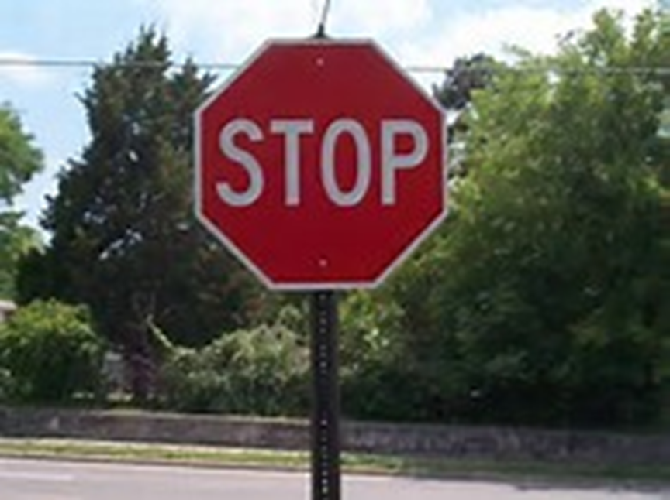
We have been taught to treat all of these texts as speed bumps before a stop sign. Oh yes we realize an uncomfortable
feeling, it arouses us from our sleepiness.
It warns us of possible doom!
But, like some drivers, people do not take the SIGNS seriously.
They continue driving by traditional design, through the warning signs provided by Yahuah. They continue merrily along their way – completely oblivious to the warning signs provided TO SAVE OUR VERY LIFE.
30

Slide 31
A - SIGN?
When learning to drive a vehicle, EXTREME importance is commanded towards the condition required upon seeing this SIGN!
A certain action for a performed condition is required to preserve life!
31

Slide 32
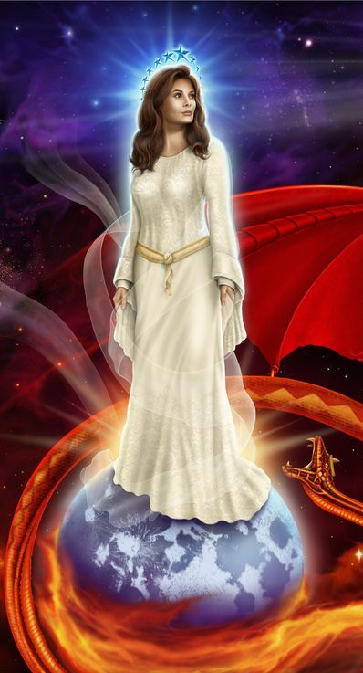
Picture - with a MESSAGE?
Have we heard that a picture is worth a THOUSAND WORDS?
32

Slide 33

ME?
What is it? Yahuah tells us unequivocally that the moon is
NOT TO GUIDE OUR WORSHIP ALLEGIANCE!
Yahuah destroyed Jericho and placed a curse on the one who rebuilds the city. Have we granted enough attention to this?
Or will we regard the event but
The Hebrew language reveals a deeper understanding that
the curse is placed upon the ones who
REBUILD THE WORSHIP PRACTICES OF THE MOON!
ignore the greater significance?
33

Slide 34
Her Crowning Glory
Twelve, NOT 13!
Revelation 12 declares the moon as being positioned UNDER the feet of the Bride!
What is the crowning GLORY of the Bride of Yahusha?
It is the MAZZAROTH (Twelve Constellations) that Yahuah has declared as the CROWNING GLORY for the Bride of Yahusha.
34

Slide 35
Yahusha’s Words
  Matt 5:20 For I say to you, that unless your righteousness
  EXCEEDS that of the scribes and Pharisees, you shall by
  no means enter into the reign of the heavens.
What were the Pharisees and the leadership of the 2nd Temple doing?
This imposter priesthood -
INCLUDED DETERMINING APPOINTED TIMES, FEASTS AND FESTIVALS –
BY MOON RECKONING!!!!
Were they observing APPOINTED TIMES and seasons according to the moon? Have you read in the Qumran scrolls how the Zadokite priests living there, fully documented and emphatically despised the usurped priesthood?

Slide 36
Lunar deception trampled!
In Revelation 12:1 the Bride Bethula is illuminated by the LIGHT of the sun! The LIGHT of the Son provides the glory.
The moon is not providing any light of glory whatsoever!
The Bride of Yahusha has victoriously debased the pagan moon traditions.
The lunar traditions are of no value because the Bride of Yahusha has RISEN ABOVE AND TRAMPLED the FALSE DECEPTION of the MOON for DETERMINING the FEASTS and FESTIVALS.
OBSERVED WHERE? BELOW HER FEET!

Slide 37


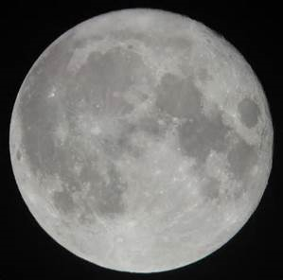
Isa 1:16 (C)
DOING EVIL!

Slide 38
Mazzaroth based Appointed Times
  Isa 2:1 The word that Yeshayahu [Isaiah] the son of Amots saw concerning Yehuḏah and Yerushalayim:
  Isa 2:2 And it shall be in the latter days that the mountain
  [The Mo-edim] of the House of יהוה [Yahuah] is established on the top of the mountains, and shall be exalted above the hills.
  And all nations shall flow to it.
Question: What is it about the mountain – the Mo-edim - that will be
RE-ESTABLISHED in the latter days,
IF they were already established when Yahusha was living on the earth?

Slide 39
What is inclusive with Yahuah’s Mo-edim, that will be
RE-ESTABLISHED
towards the end times?
And they that shall be of thee shall build the old waste places:
thou shalt raise up the foundations of many generations;
and thou shalt be called, the repairer of the breach,
The restorer of paths to dwell in. Isa 58:12

Slide 40
What is inclusive with Yahuah’s Mo-edim, that will be
RE-ESTABLISHED
towards the end times?
And they that shall be of thee shall build the old waste places:
thou shalt raise up the foundations of many generations;
and thou shalt be called, the repairer of the breach,
The RESTORER of paths to dwell in. Isa 58:12

Slide 41
Important! - The Covenant Calendar of Yahuah has zero lunar connections. It is NOT a luni/solar calendar but is a fully
LIGHT BASED calendar!
If the Blood ratified Mazzaroth LIGHT BASED calendar is to be re-established toward the end of time - WHAT TYPE OF CALENDAR WAS IN OPERATION while Yahusha was living on the earth?
The power point – Yahusha’s Contempt – exposes
Yahusha directly addressing calendar issues through witnessing while living on this earth!

Slide 42
What about This Possibility?
WHAT IF Isaiah was prophesying of the imminent victory of the Bride
(See Rev 12:1), pertaining to the latter days, close to the end of the 6000
years of allotted earthly time?
And, WHAT IF Isaiah is forecasting that the lunar calendar will be replaced and the Mo-edim (Appointed Times)will once again
be RESTORED and be centered on the Covenant Calendar?
Yahuah HATES the lunar calendar because it is based upon the infusion
of false, pagan, lunar traditions on His Mo-edim (Appointed Times).
Please read this verse again!
  Isa 2:2 And it shall be in the latter days that the mountain
  [The Mo-edim] of the House of יהוה [Yahuah] is established
  on the top of the mountains, and shall be exalted above the hills. And all nations shall flow to it.

Slide 43
RECOGNITION OF OLD PATHS – RESTORED!
Questions about the re-establishment of “Old Paths” to dwell in (Jer 6:16):
1. Can Isaiah be speaking about the Light based Mo-edim (Appointed Times) which are forever to be determined by the Statutes of Yahuah?
2. Is Jeremiah prophesying of an imminent correction that will be made to man’s traditions, which are HATED by Yahuah? (Reference Isaiah 1:11-16.)
  Isa 2:3 And many peoples shall come and say, “Come, and let us go up to the mountain [Mo-edim] of יהוה [Yahuah], to the House of the Elohim of Yaʽaqoḇ, and let Him teach us His WAYS [Celestial/Light based timing], and let us walk in His PATHS [the Mazzaroth based circuits], for out of Tziyon comes forth the Torah, and the Word of יהוה [Yahuah] from Yerushalayim.”

Slide 44
Mountain = Mo-edim? Is there a connection?
QUESTION:
Is there an acceptable Scriptural example to show a direct connection from –
MOUNTAIN (hey, resh) to the MO-EDIM (Set-Apart Appointed Times)?
What was the original statement from the Dragon?
What was his ultimate desire and intent?
It was to usurp the worship (of man) intended for Yahuah, to himself.
Where is this found?
Isa 14:13 For you have said in your heart, ‘Let me go up to the heavens, let me raise my throne above the stars of Ěl, and let me sit in the
MOUNT OF MEETING [er – Mo-edim] on the sides of the north.

Slide 45
The - Mountain/Mo-ed Connection ☺
Hey, Resh - “er” (har) is mountain – an elevated item, ranging from earth protrusion, to pregnancy, something raised up above other surrounding identities. {“er” is from the Interlinear Scripture Analyzer. In pregnancy the tummy is raised up from the body.}
This mountain in Isaiah 2:2 is referencing the comprehensive foundation of eternal life based on righteousness within the statutes – The Mo-edim – of Yahuah.
This (elevated above all else), Qodesh (Set-Apart) cyclical yearly schedule of worship oriented assemblies, has a direct connection in the Hebrew language to the “OLD PATHS” as seen in Jeremiah.

Slide 46
The re-establishing confirmed
  Jer 6:16 Thus said יהוה [Yahuah], “Stand in the ways and see, and ASK FOR THE OLD PATHS, where the good way is, and walk in it; and find rest for yourselves.” But they said, ‘We do not walk in it.’
  Isa 58:12 “And those from among you shall build the old waste places. You shall raise up the foundations
  of many generations. And you would be called
  the Repairer of the Breach, the Restorer of Streets to Dwell In.”

Slide 47
OLD PATHS?
Is Noah’s documentary old enough to consider his ways as an example from the Torah, that we may walk accordingly?
Did Noah count according to the lunar system and smudge the documentation to hide the truth?
Did Noah accurately record his epic voyage according to the Mazzaroth Light based calendar exactly as the dates and numbers of days were exposed in the story? Ask for the PPt – Noah; Yahuah’s Chosen Captain and discover the extremely intense grade of accuracy in Genesis 7&8!
What - OLD PATHS - would Jeremiah have us restore and follow?

Slide 48
Back to Isaiah 2 – Where is - it ?
  Isa 2:4 And He shall judge between the nations, and shall reprove many peoples. And they shall beat their swords into ploughshares, and their spears into pruning hooks. Nation shall not lift up sword against nation, neither teach battle any more.
Is this instruction from Isaiah to walk according to the
“LIGHT – OF THE MOON”?
  Isa 2:5 O house of Yaʽaqoḇ, come and let us walk in the LIGHT of [Yahuah].

Slide 49
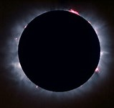
Where is THE - LIGHT ?
Where is the “light from the moon”? Has anyone seen light given from the moon when there is no light from the sun to illuminate it?
How much NON REFLECTED LIGHT do you observe
EMITTING FROM THE MOON DURING A FULL
ECLIPSE?
What two identities recorded in Genesis 1:14-18 give Light?
Yes, it is the Mazzaroth and the Sun! The Moon emits no light!
LIGHT???

Slide 50
Isaiah continues:
  Isa 2:6 For You have forsaken Your people, the house of Yaʽaqoḇ, because they have been filled from the East, and practice magic like the Philistines, and they are pleased with the children of foreigners.
Filled with pagan traditions from people not interested in following Yahuah!
  Isa 2:7 And their land is filled with silver and gold, and there is no end to their treasures. And their land is filled with horses, and there is no end to their chariots.
  Isa 2:8 And their land is filled with idols; they bow themselves to the work of their own hands, to what their own fingers have made.
They choose to worship the Ba’als of the pagan religions including following the human manufactured lunar traditions of the same pagan people. This is why Yahuah hates and utterly despises the lunar-based calendar and its traditional assemblies.

Slide 51
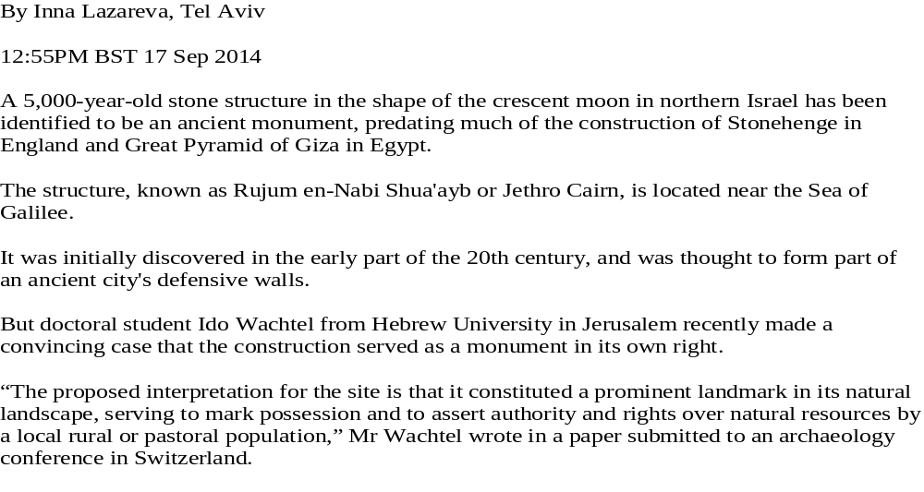
Israel and Moon worship?

Slide 52
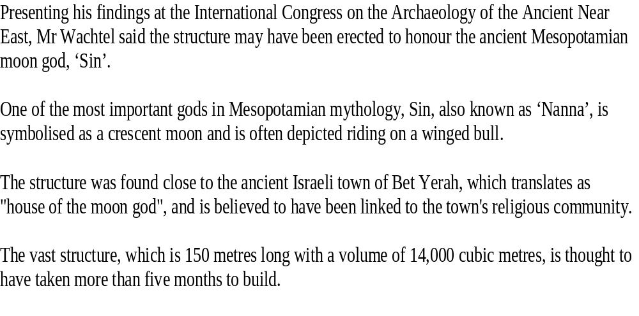
Israel and moon worship? – (con’t)
n

Slide 53
Once Again
It is very clear that Yisra’el, was directly involved with moon worship in the vicinity of 5000 years ago. Scripture declares it and history documents it. Yahusha directly opposed moon worship while He was living on the earth.
The Qumran scrolls record the evil of the lunar-based calendar insidiously overtaking the Covenant Calendar worship services during the Hasmonean period just before Yahusha came to this earth.
Isaiah forecasts about the Mountain of Yahuah (the Mo-edim), being
re-established in the latter times.
What then could possibly be replacing this present lunar based Mo-edim (Appointed Times) that Yahuah so vehemently abhorred?

Slide 54
Could it be that the Bride of Yahusha (Bethula of the Mazzaroth – found in Revelation 12:1) is presently OVERCOMING and will be VICTORIOUS, defeating the false
lunar system of worship?
Could it be The Bride {Yahuah’s people}
will cause ALLEGIANCE TO THE MOON to be
TRAMPLED UNDER FOOT in the latter days?

Slide 55
Could it be Yahuah’s Word actually declares a reality?

Slide 56
Yahusha’s Words
Matt 11:30 For My yoke is gentle and My burden is light.
Yahusha spoke these words while on earth in the time that the lunar based system of darkness was prevailing. In the 2nd Temple era,
moon based worship proceedings from the Hasmonean period
were the protocol of the imposter priesthood.
When Yahusha spoke the word – light – was He simply referencing an issue of weight? Maybe, on the surface level. However in a deeper look, He was referencing the Mazzaroth LIGHT based calendar which RE-ESTABLISHES the Mo-edim back onto His Covenant Calendar.

Slide 57
Matt 11:30
When Yahusha witnessed the evil proceedings of the 2nd Temple lunar based worship system –
IS IT ANY WONDER THAT HIS BURDEN WOULD BE THE RETURN TO THE MAZZAROTH LIGHT BASED COVENANT CALENDAR?
TESHUVA
Yahusha’s Bride will have previously returned to the MelchiTzedek Administration!

Slide 58
Continued
Paul addresses his brothers in the faith –
  1 Thess 5:4 But you, brothers, are not in darkness, so that this Day should overtake you as a thief.
They understood the Covenant Calendar as witnessed to in James 1:17. When the lunar system removes the key to understanding (Luke 11:52) by offsetting the Mo-edim (Appointed Times) onto a calendar other than that of Yahuah’s – darkness then prevails. At that point one is enveloped in darkness and
cannot know the truth’s of Yahuah, and cannot discern the Set-Apart “times.”
Yahusha’s return will then come as a complete surprise,
as will also the Day of Atonement!
58

Slide 59
Continued
    1 Thess 5:5 For you are all sons of light and sons of the day. We are not of the night nor of darkness.
The moral? LOOK TO THE LIGHT, not the darkness of the moon!
This last statement sounds so simplistic that it is almost silly!
  1 Cor 1:27 But Elohim has chosen the foolish matters of the world to put to shame the wise, and Elohim has chosen the weak of the world to put to shame the strong.
Yahuah is highly efficient in simplicity.
It is man that insists on fouling things up with his own theories.

Slide 60
Question …
Why do you think the moon
is positioned under the feet
of Bethula – the Bride
of Yahusha?

Slide 61
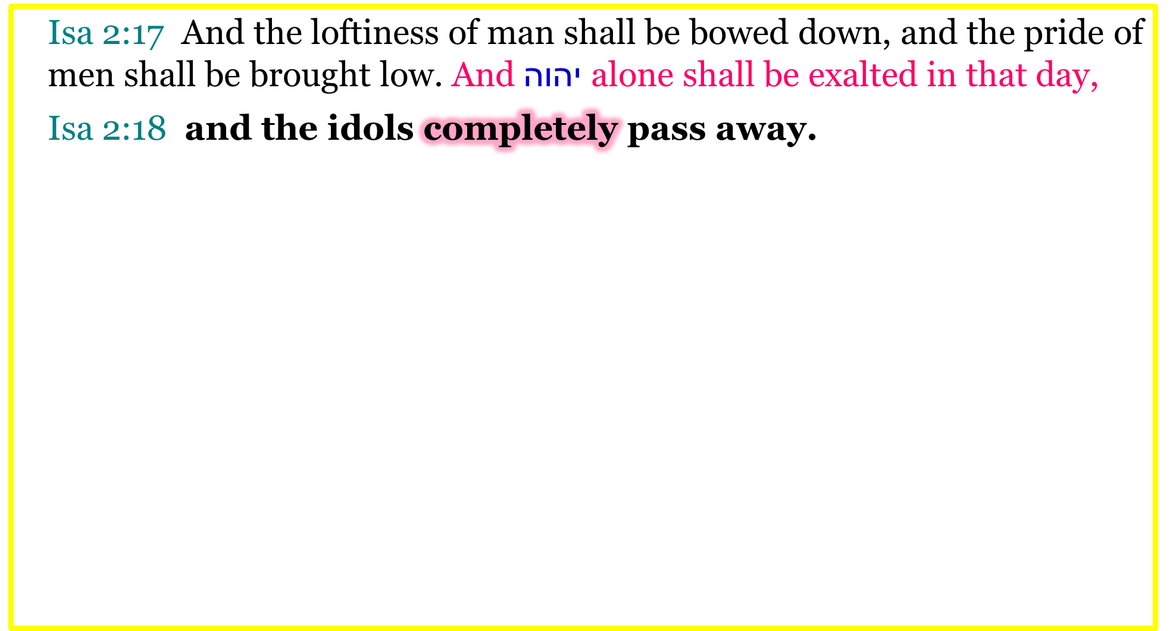
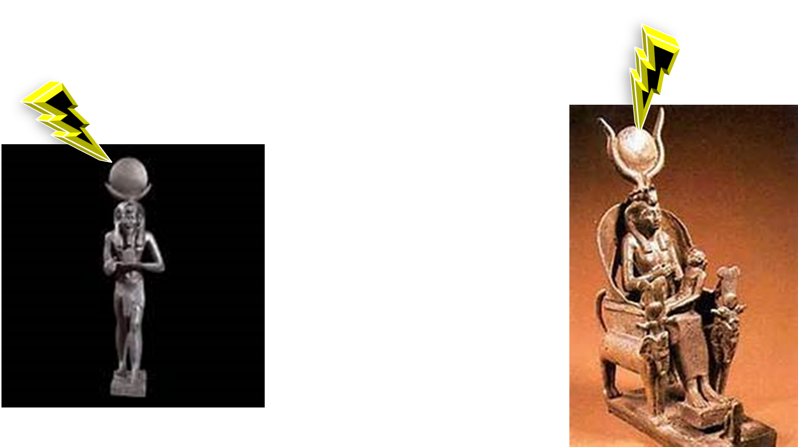

Slide 62
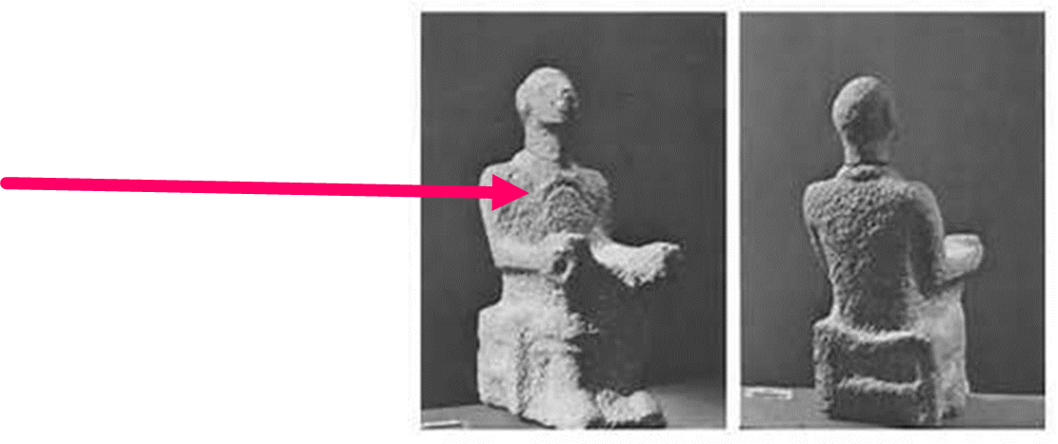
Isa 2:20 In that day man shall throw away his idols of silver
and his idols of gold, which they made, each for himself to worship,
to the moles and bats,
Isa 2:21 to go into the clefts of the rocks, and into the crags of the rugged rocks, because of the fear of יהוה [Yahuah] and the splendour of His excellency, when He arises to shake the earth mightily.
Isa 2:22 Cease from man, whose breath is in his nostrils,
for in what is he to be reckoned upon?
Allah the moon god.

Slide 63
Man does not need a physical representation before him to “bow down to a foreign god”!
“Bowing down” may consist of simply paying allegiance to whatever false system is chosen and by walking after it; which results in giving one’s respect (or sacred regard) to
that very practice.

Slide 64
Isa 3:12 My people! Youths exert pressure on them, and women rule over them. O My people! Your leaders lead you astray,
and swallow the way of your paths.
Isa 9:16 For the leaders of this people lead them astray, and those who are guided by them are swallowed up.

Slide 65
Isaiah has just written to us about how much Yahuah despises the pagan traditions involving the moon.
Look how clear Isaiah states it here. Involving the moon, for your determination of mo-eds, IS AGAINST THE WILL OF YAHUAH!
    Isa 3:8 For Yerushalayim has stumbled, and
    Yehuḏah has fallen, because their tongue and
    their doings are against יהוה [Yahuah],
    to provoke the eyes of His esteem.

Slide 66
Bethula’s Victory
Bethula, the Virgin Bride
of Yahusha, seen in
Rev 12:1, has overcome (trampled under foot)
the abomination found in the pagan moon worship.

Slide 67







The Jericho Fortress Connection
Yod Resh Yod Chet Vav = Yericho
City of the Moon (Gesenius) (Joshua 2: 1-3)
Moon - H3394 = Yareach
This is a “family word!” Do you see the similarities?
Jericho was the central axis of moon worship indoctrination.
Next up –

Slide 68
The fortress walls of Jericho
protected the center of moon worship at that time.
What were Joshua’s commands concerning the
City of the Moon?

Slide 69
Jos 6:2 And Jehovah saith unto Joshua, 'See, I have given into thy hand Jericho and its king—mighty ones of valour,
Jos 6:3 and ye have compassed the city—all the men of battle—going round the city once; thus thou dost six days;
Jos 6:4 and seven priests do bear seven trumpets of the jubilee before the ark, and on the seventh day ye compass the city seven times, and the priests blow with the trumpets.
How many times in total did Joshua encompass the Fortress of the Moon? 6? 7? 12? 13?

Slide 70
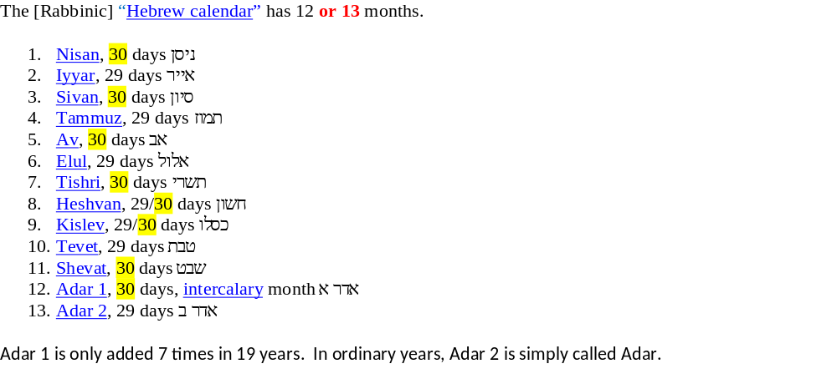
What identity do we know that uses a base of 13?
Adar 2 is the Luni/Solar Calendar’s 13th month!

Slide 71
One encompassing march, once per day for 6 days, and 7 rotations around the city on the 7th day makes for a total of 13 times!
What happened on the 13 ^{th} march around the
City of the Moon?
The Lunar Based Obstacle which opposed Yahuah in bringing His people into the Promised Land was not only defeated, but eliminated. The foundations of the lunar based worship system were removed so that they did not impede the workers of Yahuah in accomplishing His Plan to bring His people into the Promised Land.

Slide 72
Where were the foundations of lunar worship positioned?
Jos 6:20 And the people shout, and blow with the trumpets, and it cometh to pass when the people hear the voice of the trumpet, that the people shout—a great shout, and the wall falleth under it, and the people goeth up into the city, each over-against him, and they capture the city; YLT
Jos 6:20 And the people shouted when the priests blew the shopharot. And it came to be when the people heard the voice of the shophar, and the people shouted with a great shout, that the wall fell down flat. And the people went up into the city, every man straight before him, and they captured the city. The Scriptures

Slide 73
It seems that by Hebrew definitions the walls fell into the ground. There was no mound of rubble for an obstacle to hinder or restrict the Army of Yahuah!
All resistance in terms of accomplishing the goal of rapidly entering the city of the moon was eliminated by Yahuah!
The foundations of moon worship were literally placed - Under the Feet – to be trampled upon by the Hebrew army which were commanded to destroy the City of the Moon.
Yahuah has provided sufficient resource tools to correctly discern the evils of moon worship and just why He Banished the Moon to Under the Feet of His Bride.

Slide 74
The big question now lies with us!
Will we grasp the opportunity, accepting Yahuah’s offer to enter the Promised Land under His Plan?
Will we pay close attention to the Words of the Scriptures and SHEMA [listen and act accordingly]?
Or will the same choice be made as the Hebrew nation when they sent spies into the Promised Land AND FAILED TO TRUST THEIR CREATOR?
This time, the sentence for failure to trust and obey is a fair bit longer than 40 years. It is now – Eternity!

Slide 75
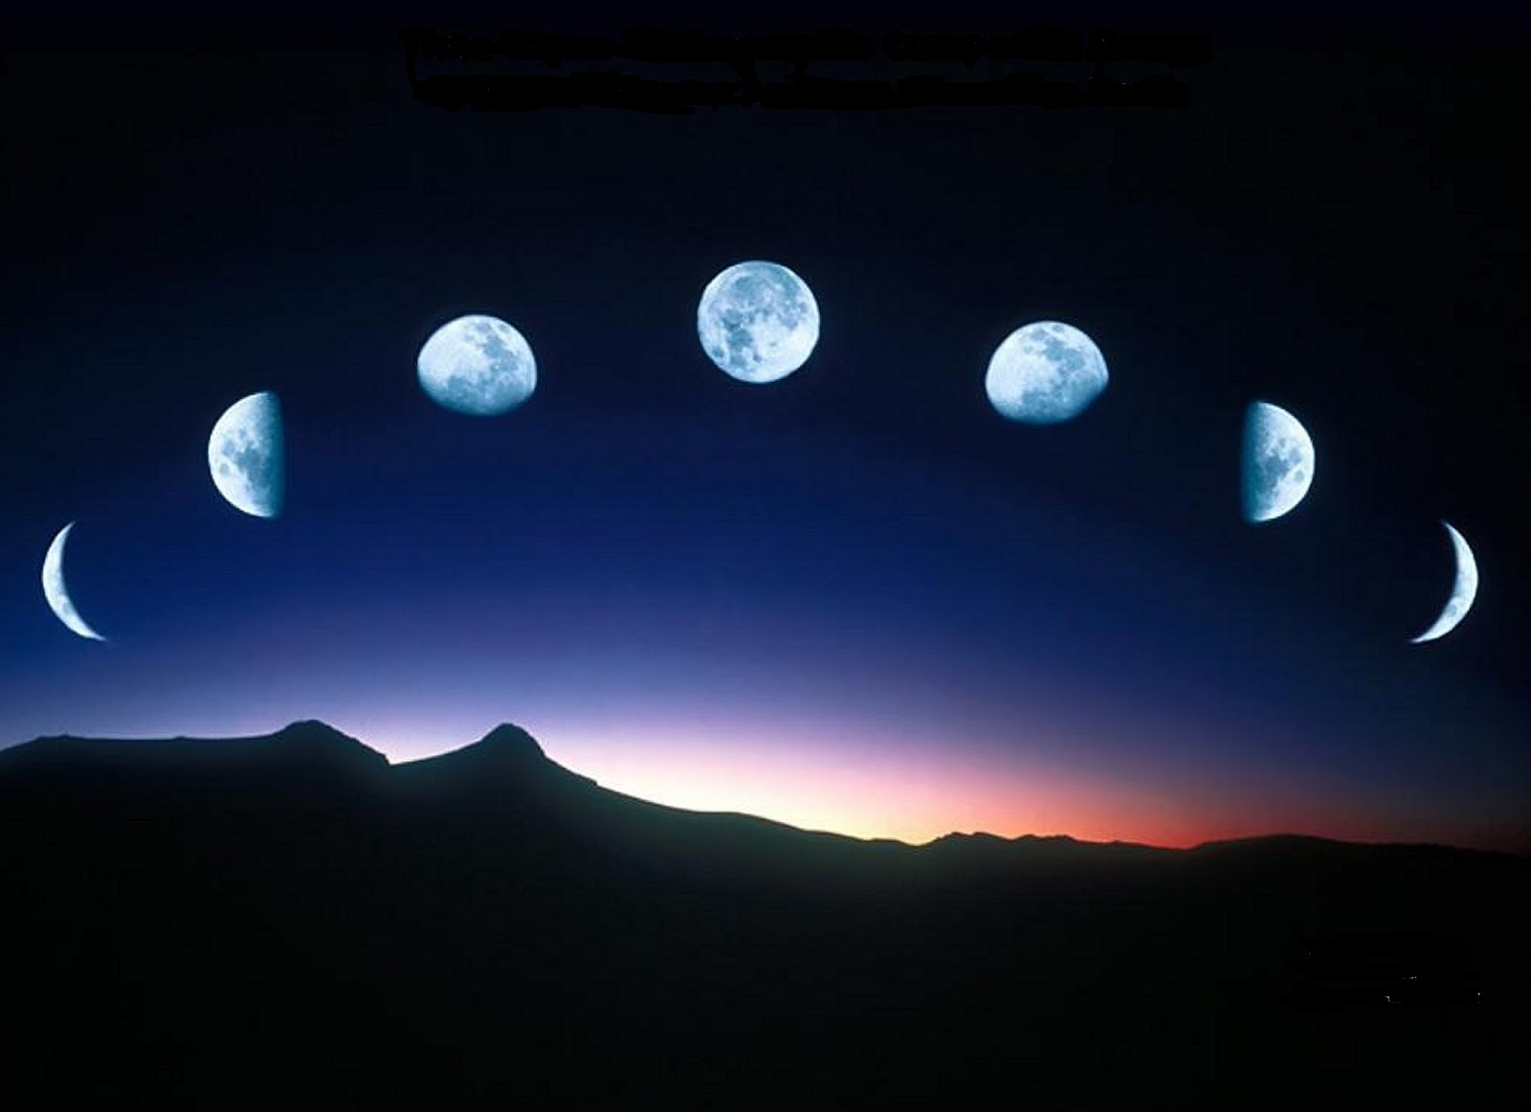
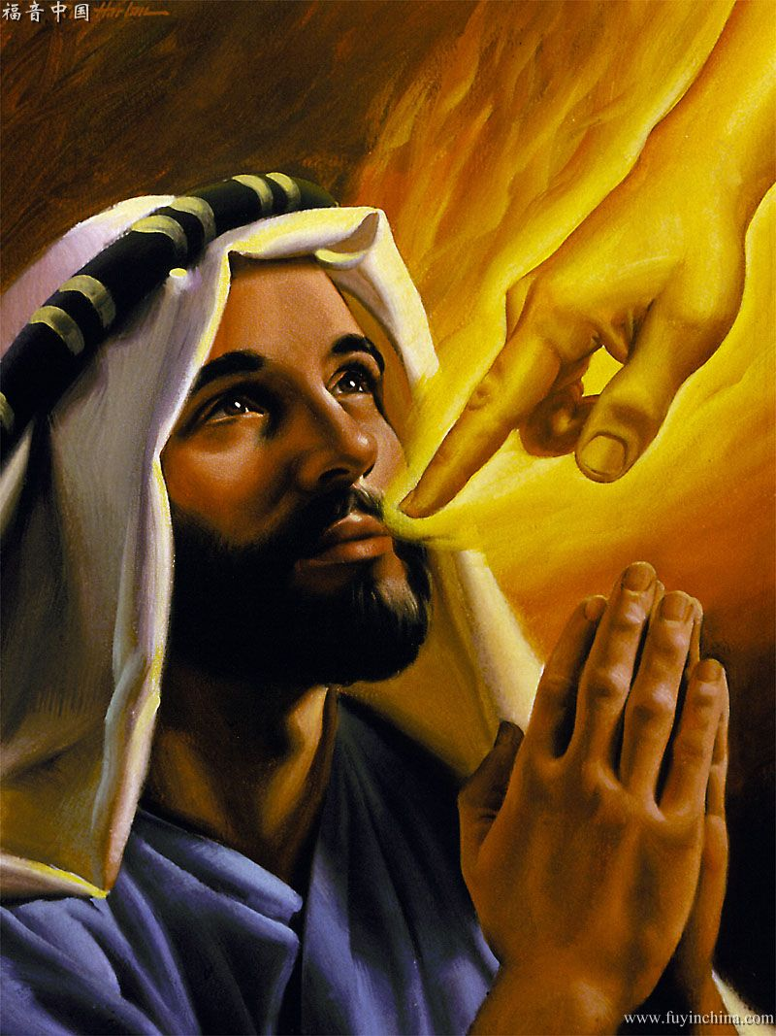
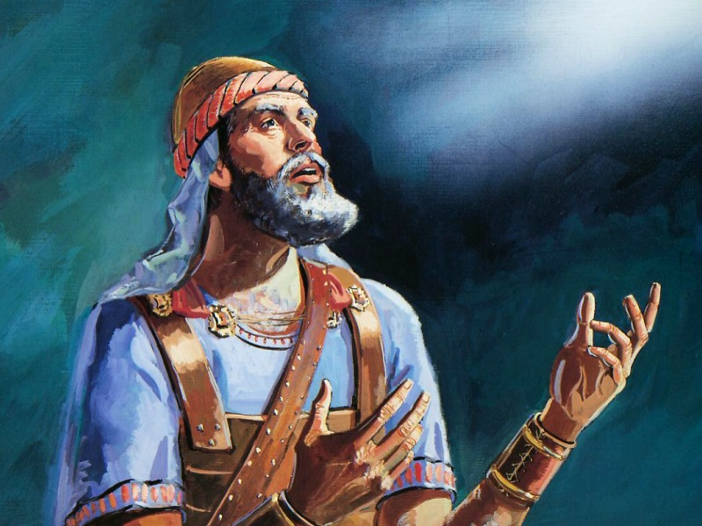
Will Joshua & Isaiah be in Agreement?
Joshua was asked to destroy all traces of moon worship.
700 Years later:
Will Isaiah give sacred
regard to the moon?

Slide 76
Some Last Thoughts to Ponder
Will there be a HUGE PROBLEM determining time in the future!
    Isa 60:20 No longer does your sun go down, nor your moon withdraw itself, for יהוה [Yahuah] shall be
    your everlasting light, and the days of your
    mourning shall be ended.
The moon will no longer withdraw itself?! That means no longer changing phases, for it is the withdrawing process which changes the phases of the moon.
This will make it very difficult observing worship practices to Yahuah "from New Moon to New Moon" (Isa 66:23) when a “New Moon” will be an impossibility!

Slide 77
WHAT AND HOW?
    Isa 66:23 And it shall be that from New Moon to New Moon, and from Sabbath to Sabbath, all flesh shall come to worship before Me, declares יהוה [Yahuah].
    Did not Isaiah just inform us in ch. 60:20 that
    the moon will no longer withdraw itself,
    thus eliminating the phases of the moon forever?
    How can Isaiah first tell us that the moon will no longer go through the phases creating the renewing of the moon, and then
    just a few chapters later, tell us that we will be worshipping
    according to the “NEW MOON” ???
    IS THERE A PROBLEM HERE SOMEWHERE?

Slide 78
Why is this a problem?
First and Foremost: The term – “New Moon” does not exist in the original Hebrew manuscript. “New Moon” exists only because of (mis)translators opinions!
Second: A most definite problem because a “New Moon” can only occur as new if it withdraws and "renews" itself! Therefore, according to Isaiah 60:3, there will not be any “New Moons” in heaven! Neither will there be phases of the moon!
If one chooses to accept the lunar based path, it will seem that Isaiah is a
very confused man with a totally opposed and equally confusing
{and contaminated} message.
Worshipping by the new moon which will not exist?!
This would be incredible confusion in heaven!
It would also be: Babylon's moon confusion message in its purest form.
Who is the author of confusion?
78

Slide 79
The LUNAR Based - Isaiah Option #1!
Isa 60:20 “No longer does your sun go down, nor your moon withdraw itself, for יהוה [Yahuah] shall be your everlasting light, and the
days of your mourning
shall be ended.
If the New Moon event is truth (Isa 66:23), then what Isaiah wrote in Isa 60:20 is false!
See option below
Could Isaiah be declared a liar and a false prophet -
{if the lunar based theory has been accepted}?

Slide 80
The LUNAR Based - Isaiah Option #2!
Isa 66:23 “And it shall be that from New Moon to New Moon, and from Sabbath to Sabbath, all flesh shall come to worship before Me,” declares יהוה [Yahuah].
If the Moon no longer withdraws itself (Isa 60:20) providing new phases and namely a new moon, then Isaiah 66:23 is FALSE!
See option below-
Is Isaiah still a liar and a false prophet -
{if the lunar based theory has been accepted}?

Slide 81
Sadly, if one chooses the lunar based method of worship,
then a devastating decision must be made concerning the opposing messages seen in Isaiah.
We can be extremely thankful to Yahuah that He has given us another option revealed throughout the Scriptures!
The Keys to Understanding timing issues are:
1. The Tequfah &
2. Learning to Count!

Slide 82
Clarification for – “NEW MOON”
The word – chodesh – (the renewing/the rebuilding) as seen in the Tanach (Old Testament), has been (mis)translated as – new moon – in our copies of the Scriptures.
This contamination in translation does NOT CORRECTLY REFLECT
the true definitions extracted from the original Hebrew manuscript.
It is a false translation derived from the time the Metonic Cycle
(the 29.5 day lunar month) was infused into the 2nd Temple worship services of the Hasmonean period, just before Yahusha lived here.
The word – chodesh – has absolutely zero connection to the moon.

Slide 83
Clarification of New Moon (con’t)
Chodesh (the renewing/the rebuilding, in it’s basic form),
when applied to TIME, has direct reference to the first cycle,
or (day) of the month.
It is the desire of the Dragon to connect this first day of the month with the lunar ideals of his own making. When one examines closely in our personal research resources, one will find that the moon has but an INFERRED CONNECTION ONLY!
Starting with the Torah we have ultra clear instruction to the
non-existence of the lunar calendar in Yahuah’s Kingdom.
If this is all new to you, please ask for the mountain of information supporting this statement.

Slide 84
Jeremiah’s Wisdom
Jer 8:2 And shall spread them before the sun and the moon and all the host of the heavens, which they have loved and which they have served and AFTER WHICH THEY HAVE WALKED, which they have sought, and to which they have bowed themselves. They shall not be gathered nor buried, they shall be for dung on the face of the earth.

Slide 85
Amos’ Wisdom
Amos 5:21 “I have HATED, I have despised your festivals, and I am not pleased with your assemblies.
What reason did Yahuah supply to inspire Amos to record this incredulous statement of His SEVERE DISPLEASURE?
Amos 5:25 Did you bring me sacrifices and grain offerings in the desert for 40 years, nation of Israel?
Amos 5:26 You carried along the statues of the god Sikkuth [Moloch] as your king and the star Kiyyun, the gods you made for yourselves. Footnote: Acts 7:43.

Slide 86
Isaiah’s very direct message:
Isaiah 1:5 (b)
You continue in apostasy.
HalleluYah Scriptures
Isaiah then begins to document (Isa 1:10-17)
the traditions that insidiously infiltrated and contaminated
the worship services of the Hebrew nation.
Paying allegiance to the Moon as a guiding identity is the TOP ALARM OF THE LIST!

Slide 87
Rom 6:16 Do you not know that
to whom you present yourselves
servants for obedience,
you are servants of the one
whom you obey,
whether of sin to death,
or of obedience to righteousness?
The End

Slide 88
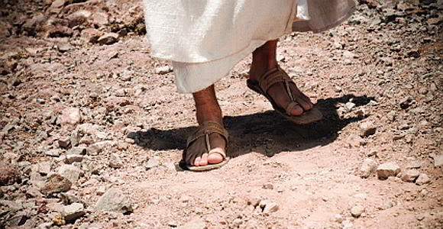
The next study will be:
Yahusha’s Contempt at Sukkot
by Timothy Astleford
Some questions to ponder:
John 7 records the “festival of the Jews.” Was this the festival of Yahuah from Galilee? Yahusha declared the timing of this Feast of Tabernacles to someone, but who?
Is it OK to observe the festivals just “any old time” – just as long as you get there? Or is Yahuah longing for His children to come into alignment with His times, and no other?
Enjoy Yahusha’s witness!
See you May 18th!

Slide 89


May Yahuah bless, guide and give you wisdom and understanding.
Send your questions & comments to:
timothy@torahtothetribes.com

