Slide 1
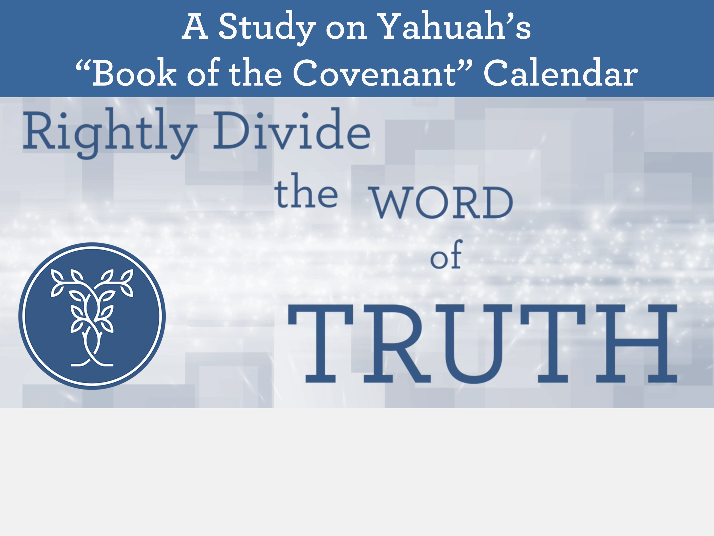


Detecting the Equi-LUX Deception

Slide 2

detecting
the
Equi-lux deception

Slide 3

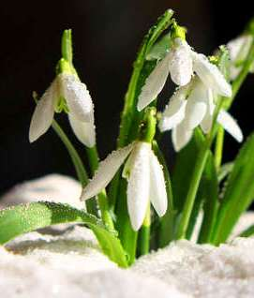





Why Consider Equi-LUX?
Many have rightly mentioned a concern about studying any counterfeit calendars.
Wouldn’t it be better to just study the true Covenant Calendar?
The reason this study is being presented today is because a thorough Covenant Calendar study on the tequfah has already been done!
That means:
Tequfah is understood to align with the equinox, not equi-LUX.
Yes!
But…

Slide 4

One True Calendar ~
Many Counterfeits
There is ever only just one truth for anything in the Scriptures including one True Covenant Calendar.
However, there are many counterfeit calendars that must be proven false by a comparison to the only
true calendar.
This study is meant to give you some tools so you don’t have to find them yourself – over years of study.
Over the years, Covenant Calendar has been challenged by many different counterfeit calendars including:
Lunar Calendars
Solar Calendars
Luni-Solar Calendars
Lunar Sabbath Calendars
Barley Calendars
Enoch/Zadok Calendars, etc.
It used to be they basically all used the equinox as their tequfah. Not any more!
Why not?

Slide 5

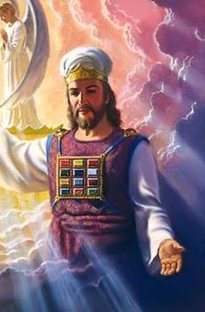
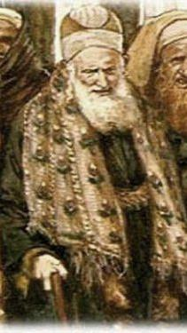
Who Wears the Calendar Tool Belt?
Covenant Calendar has the:
Melchizedek Priesthood
(originally based on earth as it is in
the heavenly sanctuary Matt 6:10)
Based in Covenant Torah (Gen 1:1 – Exo 24:11)
Counterfeit Calendars have:
Any OLD Priesthood
(originally based on Paganism including
the Priesthood of the Sanhedrin)
Based in Non-Torah Books
& Pagan Traditions
5

Slide 6


Personal Calendar Tool Belt
Along with your Scriptures and Melchizedek Priest,
you need:
Dictionary tools
Basic Computer Skills
Basic Research Skills
Understanding of commencement for
the day and month
Understanding of twilights
Logic & Common Sense
Understanding of year-start
Brain-storming; ask questions
Off to tackle the
task of
Equi-LUX!

Slide 7


Many Options for Calendar Year-Start
Equinox & 1st new moon AFTER equinox
Equinox & new moon CLOSEST to equinox
Equinox & Abib of Barley AFTER equinox
Equinox & 1st day of calendar AFTER shadow sign
(eg: The Covenant Calendar of Yahuah - also Enoch Calendar!)
equi-LUX and 1st
new moon AFTER equi-LUX
equi-LUX and 1st new moon CLOSEST to equi-LUX
equi-LUX and Abib of Barley
And this: Altitude has something to do with
when the day begins?!
Covenant Calendar &
Enoch Calendar are
not near the same!

Slide 8
The Calendar Challenge
Most calendars historically used to always calculate the feast dates from the vernal equinox.
No one ever heard of an equi-LUX!
With the abundance and variety of
new feast calendars flooding this area,
equi-LUX is beginning to bloom! Why?
Maybe it has something to do with the Enoch Calendar – the closest counterfeit to Yahuah’s Covenant Calendar today.
Guess what? The Enoch calendar uses equinox!

Slide 9

Examination of 6 Mystery Questions
To examine the equi-LUX problem is a
huge study so only 6 mystery areas
will be examined today.
Constantine gets
the blame
Confusing Calendars
Equi-LUX Disunity
Hebrew Evening Definition
Looking to the Sun!
Mystery Question from Yahuah

Slide 10
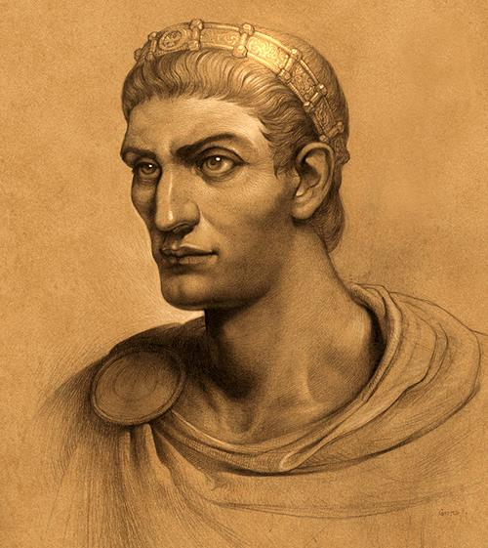
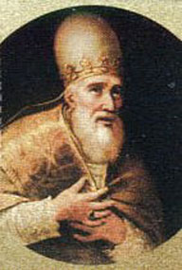
Problem #1
Constantine’s Quote
Constantine’s decision on change of calendar
Council of Nicea 325 AD supported by ecclesiastical influences from:
  The Papal church
  Pope Sylvester I
  (314 - 335 AD)
  Hillel II (Pres. of
  the Sanhedrin)

Slide 11

Why the Change to Equi-LUX
The claim is made by a lot of feast
keepers (that used to go by the
equinox) that it was Constantine who
changed things at his infamous Council of
Nicea in 325 AD. It is believed the Mar 20-21 date was set as the Vernal Equinox by the papal council to prevent Passover and Easter from ever falling on the same day (which in 2018 it does, even when using the Mar 17 equi-LUX that is now being wrongfully
named as Tekufah)! How did this happen?

Slide 12
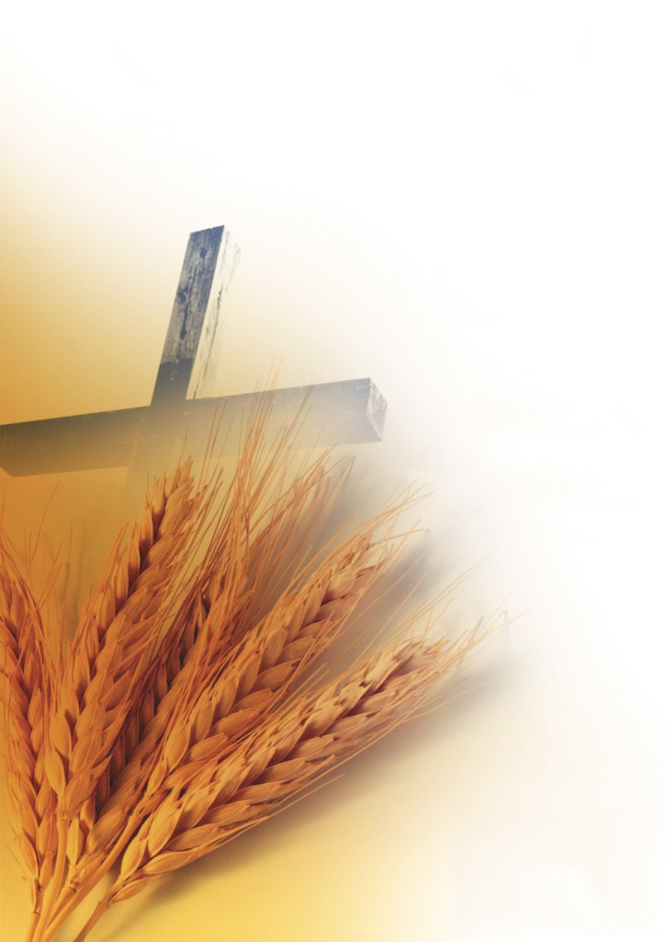
Constantine & Council of Nicea
“In 325 (AD) the Council of Nicaea established that Easter would be held on the first Sunday AFTER the first full moon occurring on, or after, the Vernal Equinox. From that point forward, the Easter date DEPENDED on the ecclesiastical approximation of March 21 for the Vernal Equinox. Easter is delayed by 1 week if the full moon is on Sunday, which decreases the chances of it [Easter] falling on the same day as the Jewish Passover. The council’s ruling is contrary to the Quartodecimans (14th day keepers-a term which referred to people keeping the
14th day, which is Passover), a group of Christians who celebrated [Passover] on the day of the full moon,
14 days into the month.”
Source: “Calculating the Easter Date” – www.timeanddate.com

Slide 13

Many Calendars use Constantine’s Quote to Establish their own Calendar
Barley Calendars Search for Abib Month
The new year is determined by the barley in abib, not by Rome’s calculation of Easter.
Lunar Sabbath Calendars Sight the Moon
When Rome introduced their pagan feast calendar Hillell II set Saturday as the weekly Sabbath.
Equi-LUX Calendars Look to the Sun
Because Rome uses equinox for Easter placement, is “equinox” completely pagan? The claim is: equi-LUX is the true marker for tequfah & feast calculation.
Is the Mazzaroth pagan because of the horoscope?

Slide 14
Barley & Constantine Quote
Barley Calendars Search for Abib – not Rome’s Equinox!
Abib: H24 'abiyb (aw-beeb'); from an unused root (meaning to be tender); green, i.e. a young ear of grain; hence, the month name Abib or Nisan: KJV - Abib, ear, green ears of corn (not maize).
(All grains are “abib” when in the greening-not just barley.)
“Fine Flour” [H5560] Wheat: for Wavesheaf (Ex 34:22; Lev 23:13)
H5560 coleth (so'-leth); from an unused root meaning to strip; flour (as chipped off): KJV - (fine) flour, meal. (Wheat: H2406)
It is believed barley is needed for the Firstfruits Wavesheaf offering.
“Rough Flour” [H8184] Barley: Jealousy Offering (Num 5:15)
H8184 se`orah; from OT:8175 in the sense of roughness; barley (as villose): KJV - barley.

Slide 15
Lunar Sabbath & Constantine Quote
Lunar Sabbath Calendars Sight the Moon for Feasts & Sabbaths
These calendars teach that the weekly Sabbath from Creation was set by the cycles of the moon. Their ‘Sabbath’ can be on any cycle of the week.
Covenant Calendar Studies show the creation Sabbath has
always been the 7th day of the week, also proven in Yahusha’s resurrection on His Sabbath, just 2000 years ago.
Sunday Laws legislated by Constantine 321 AD – caused much persecution amongst the Sabbath keepers.
Many chose Sunday over the Torah Sabbath.
When Constantine fixed the Easter date, Hillel II (president of the Sanhedrin) fixed “pagan Saturday” as the weekly day of worship having one day of worship in 7 according to Talmud.

Slide 16
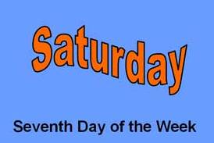
What is a Pagan Saturday?
Roman Calendar History:
Originally the early Roman calendar (of 63 BC had 355 days/yr) was reformed to the Julian calendar (46 BC had 365 days/yr) retaining 8 days/week (for years after 46 BC).
Each week day was assigned a letter A to H.
As Rome expanded, it came into contact with Mithraism which quickly became a popular religious cult in Rome.
Mithraism brought Rome the seven-day week with days named after their planetary gods.
A Roman seven day week can be
traced to Caesar Augustus.
He died in 14 AD.
Yahusha’s ministry would have
been during Rome’s 7 day week.
Pagan?
Notes:
Wiki: The Julian calendar, proposed by Julius Caesar in 46 BC (708 AUC), was a reform of the Roman calendar.^{[1]} It took effect on 1 January 45 BC (AUC 709), by edict. It was the predominant calendar in the Roman world, most of Europe, and in European settlements in the Americas and elsewhere, until it was refined and gradually replaced by the Gregorian calendar, promulgated in 1582 by Pope Gregory XIII. The Julian calendar gains against the mean tropical year at the rate of one day in 128 years. For the Gregorian calendar, the figure is one day in 3,030 years.^{[2]} The difference in the average length of the year between Julian (365.25 days) and Gregorian (365.2425 days) is 0.002%.
NB: https://en.wikipedia.org/wiki/Week -- super important information … during the reign of Augustus, the 7 day week cycle can be traced. His reign: 16 January 27 BC – 19 August AD 14 (40 years) … So, that means, during Yahusha’s ministry, the week was only 7 days/week even in Rome! Amazing!
Hellenistic and Roman era
Main article: Nundinae
In Jewish sources by the time of the Septuagint, the term "Sabbath" (Greek Sabbaton) by synecdoche also came to refer to an entire seven-day week,^{[28]} the interval between two weekly Sabbaths. Jesus's parable of the Pharisee and the Publican (Luke 18:12) describes the Pharisee as fasting "twice in the week" (Greek δὶς τοῦ σαββάτου dis tou sabbatou).
The ancient Romans traditionally used the eight-day nundinum but, after the Julian calendar had come into effect in 45 BC, the seven-day week came into increasing use.
For a while, the week and the nundinal cycle coexisted, but by the time the week was officially adopted by Constantine in AD 321, the nundinal cycle had fallen out of use. The association of the days of the week with the Sun, the Moon and the five planets visible to the naked eye dates to the Roman era (2nd century). ^{[29]}
The continuous seven-day cycle of the days of the week can be traced back to the reign of Augustus; the first identifiable date cited complete with day of the week is 6 February AD 60, identified as a "Sunday" (as viii idus Februarius dies solis "eighth day before the ides of February, day of the Sun") in a Pompeiian graffito. According to the currently-used Julian calendar, 6 February 60 was, however, a Wednesday. This is explained by the existence of two conventions of naming days of the weeks based on the planetary hours system: 6 February was a "Sunday" based on the sunset naming convention, and a "Wednesday" based on the sunrise naming convention.^{[30]}

Slide 17
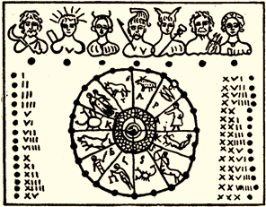
Rome’s 8 Day Week Reduced
This is a stick calendar that was found at the Baths of Titus, built in Rome about 79-81 AD.
The 8 day week of Rome was gradually replaced with the 7 day week.
Over time the 8 day week lost all of its appeal.
Why would this happen?
Will history bear out the reason?
Count the number of
gods on this calendar.
The 8 day week
did not last long.

Slide 18
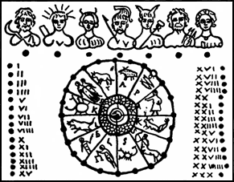
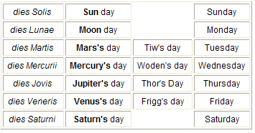
Rome’s 8 Day Week Reduced but Sunday is not the 1st day.
Saturn’s Day or Saturday | Sun’s Day Or Sunday | Luna’s Day Moon Day; Monday | Mar’s Day Tiu’s Day; Tuesday | Mercury’s Day or Woden’s; Day Wednesday | Jupiter’s Day or Thor’s Day; Thursday | Venus’ Day or Frigg’s Day; Friday
Will the order of the days
change with a 7 day week?

Slide 19
History of the Pagan Sunday
Mithraism and Christianism
The popular worship of Mithra [the "Invincible Sun-god"] became so pre-eminent in the Roman Empire in the days
of Constantine, that he decreed "The Venerable Day of the Sun" to be the weekly rest day of the Empire [321 AD].
One authority points out the influence of Mithraism on Christianity, saying:
"It [Mithraism] had so much acceptance that it was able to impose on the Christian world its own Sun-day in place of the Sabbath, its Sun's birthday, 25th December, as the birthday of Jesus." -- G. Murray, Christianity in the Light of Modern Knowledge, pp. 73, 74.

Slide 20
Mithraism and Christianism (con’t):
Still another author confirms: "The early Christians had at first adopted the Jewish seven-day week, with its numbered week days, but by the close of the third century A.D. this began to give way to the planetary week; and in the fourth and fifth centuries the pagan designations became generally accepted in the western half of Christendom.
“... During these same centuries the spread of Oriental solar worships, especially that of Mithra, in the Roman world, had already led to the substitution by the pagans of dies Solis (Sun-day) for dies Saturni (Saturday), as the first day of the planetary week... Thus gradually a pagan institution was engrafted on Christianity.”
--Hutton Webster, Rest Days, pp. 220, 221.
Notes:
Constantine would have naturally adopted to the 7 day week because: of joining with Mitraism; get the Christians to join Rome – making leagues for reason of power.

Slide 21
Lunar Sabbath; Constantine & Hillel II
Because Hillel II (pres. of the Sanhedrin) was working with Constantine at the Council of Nicea in 325 AD, eventually his suggestion was accepted to provide a regular worship day/week for the Jews without persecution. He arbitrarily chose “Saturday” as the 7th weekly day of worship for the Jews – the requirement being only 1 day in 7 needs to be set aside for worship according to the Tulmud – no matter what day it is.
By this time, Saturday had been moved to the 7th day position of the week, granting Sunday the position of the 1st day of the week … a very unique move! Why?
Sunday did not exist in the eight-day Julian week. Sunday now becomes the day on which Yahusha arose from the dead – thus being declared Rome’s weekly Sabbath to celebrate the resurrection.

Slide 22
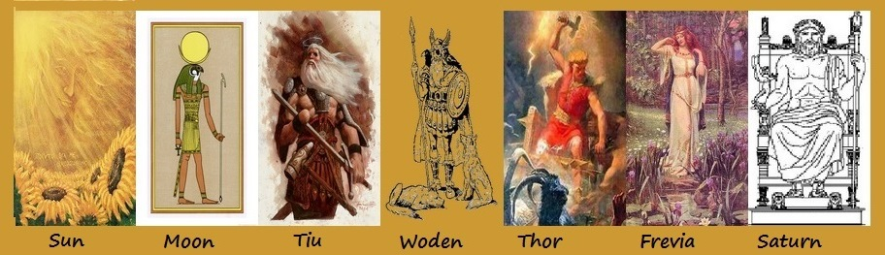



Sun & Saturn Positions Rearranged
When Rome finally
accepted the error that
Yahusha’s resurrection was on Sunday the 1st day of the week, then the sun god needed to be placed in day position #1, not #2.
Order of days are the same.

Slide 23
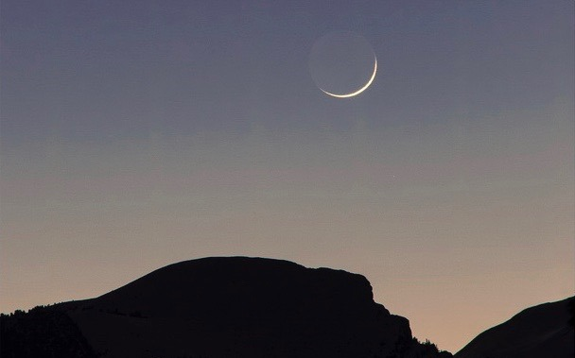

Pagan Saturday Claims
Because of the history between Mithraism
(7 day week) and Rome (originally an 8 day week), the Lunar Sabbatarians claim the true weekly Sabbath has been completely lost.
They claim that Hillel II’s calendar is a counterfeit especially because he randomly chose “Saturday” (a rather new invention)
as the weekly Sabbath – which is still in alignment with the Talmud (honouring at
least one weekly day for rest in 7).
Therefore, the Lunar Sabbath is to be honoured as it has not been tainted by Constantine, Hillel II, nor other forms
of paganism and Christianity.
Lunar Sabbatarians claim the Lunar Sabbath was set at creation week; and that the weekly Roman Saturday can never be trusted as Yahuah’s weekly Sabbath.

Slide 24

Lunar Sabbatarians do not trust the Rabbi’s to determine the
7th day Sabbath and neither should you!
However …

Slide 25
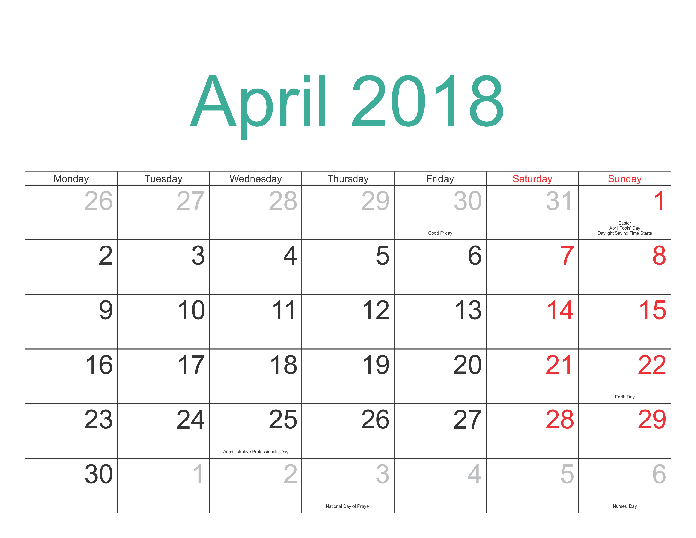
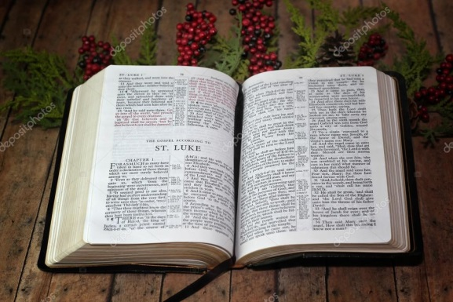
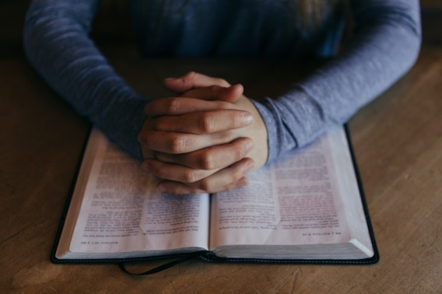
7th Day Sunday
Can you prove
from the Scriptures
this Saturday
is the true
7th day
Sabbath?
How?

Slide 26
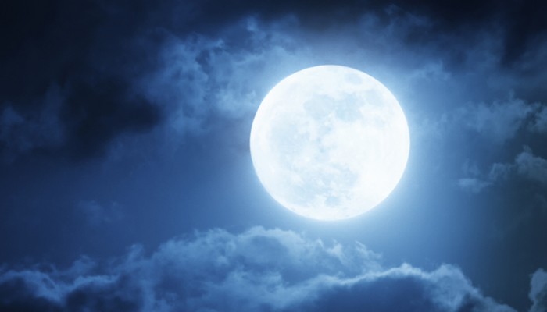
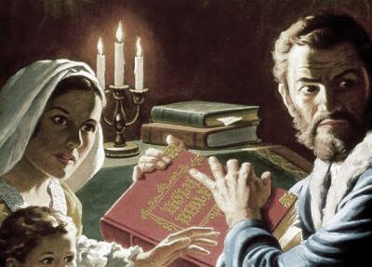

There is a Solution!
We, along with the
Lunar Sabbath
keepers, need
to do a careful
Scripture study
on the Exo 16 Quail,
David & Jonathan, the moon, and the Passion Account in the four Gospels.
Don’t forget the historical
account of the Waldenses!

Slide 27
Rome’s Easter vs the Passover
Pagan Easter: follows the Full Moon AFTER Mar 20-21.
The sliver can be sighted before or after the equinox.
The Passover was usually counted as the 14th day from the sighted crescent moon AFTER the equinox. Rome cares nothing about that!
Today many feast keepers want to move away from Rome’s “equinox” so they are choosing equi-LUX as the tequfah alternative. Passover dates remain close to Easter.
Rome has the best of all the counterfeits. She can satisfy every counterfeit around either equinox or equi-LUX and still have world acceptance.

Slide 28

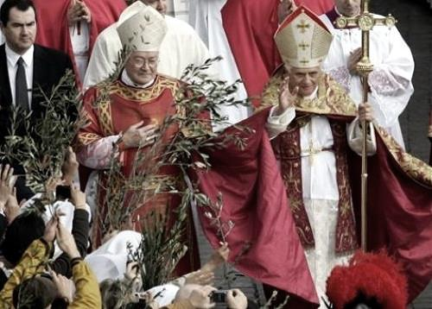
What About Rome’s Easter?
Easter is not the replacement for Passover – but the counterfeit for the Sabbath resurrection.
However, Rome’s Easter is always on the same “cycle of the week” as the Scriptural Firstfruits.
Easter was always to be dated the Sunday after the Jewish Passover. 20% of the time, Easter is before the Jewish Passover.
If Easter represents “ascension”
how can it be celebrated before
the Passover? It can’t!
That’s why Rome always has her
“passover” on what is called “Good Friday.”

Slide 29
“THE” Next Question
Because the Council of Nicea set the equinox at Mar 20-21, many are
now saying
equinox is pagan.
Why?
Occasionally equinox does occur on
Mar 19th.
Can Rome
mark the
true
equinox
as being
pagan?

Slide 30
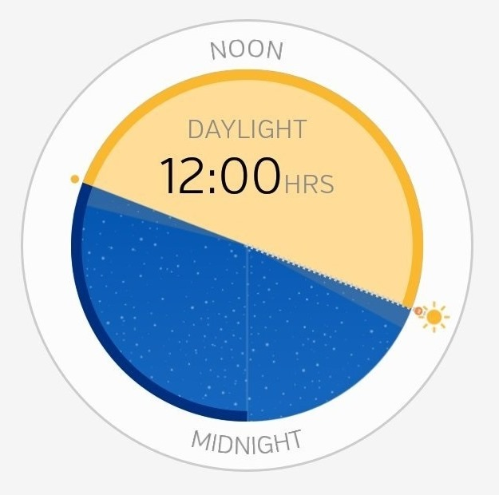
Definitions of Equi-LUX
The equi-LUX does not occur at one single calculated moment for every place around the world at the same time.
According to “man’s definition”
equi-LUX is a relative mathematically calculated (mean hour analysis) identification of a day when man
says the hours of the light and hours of night are approximately equal.
“Man” defines these daylight hours as only – from sunrise to sunset – in any particular location of the world.

Slide 31
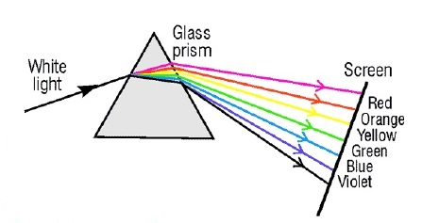
Definitions of Equi-LUX (con’t)
Equi-lux is highly dependent on the refraction of light on
the surface of the earth.
The equator is the ONE
place where “equinox”
and “equi-LUX” occur at the same time.
Calculation of equi-lux: one must have a computer.
Equi-LUX calendation presents a calendar of confusion.
Equi-LUX calendation has been subtly influenced by Rabbinic tradition to relocate Passover much earlier.
Equi-LUX Calendars are man’s inventions – not Yahuah’s design.

Slide 32

Equinox Information for 2018
Equinox occurred on
March 20/18 at
615 PM Greenwich Mean Time (GMT).
By Divine Design,
this happened at the same time all over
the world.

Slide 33
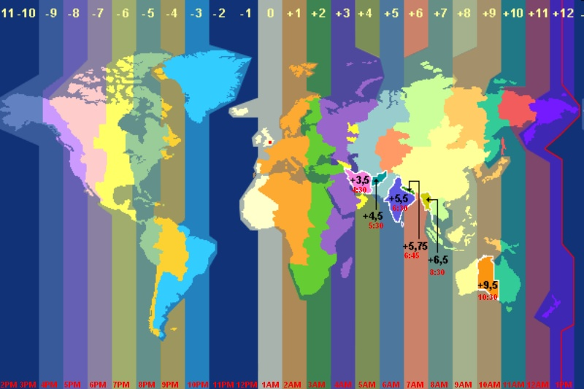
Mar 20/18 GMT
MOUN
T
A
I
N
T
I
ME
G
M
T
T
I
ME
I
N
D
I
A
T
I
ME
A
F
R
I
C
A
T
I
ME
6:15 PM
Mar 21st
11:15 PM
10:15 AM
The equinox moment is
very precise.
8:15PM

Slide 34
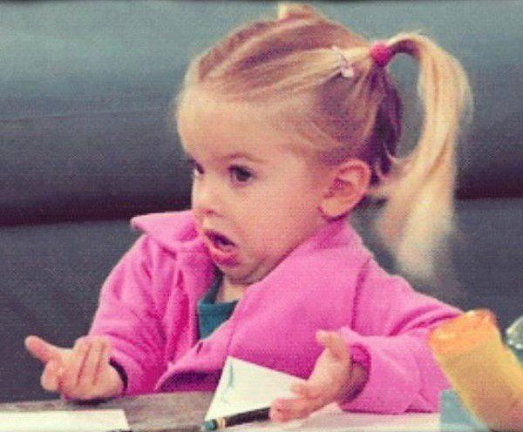
Problem #2
Confusing Calendars!
There has always been many counterfeit feast calendars.
In recent years this problem has escalated
an incredible amount.
Now, many are changing
their calendars that
were based on “equinox” – over to “equi-LUX” timing.
What is going on?

Slide 35
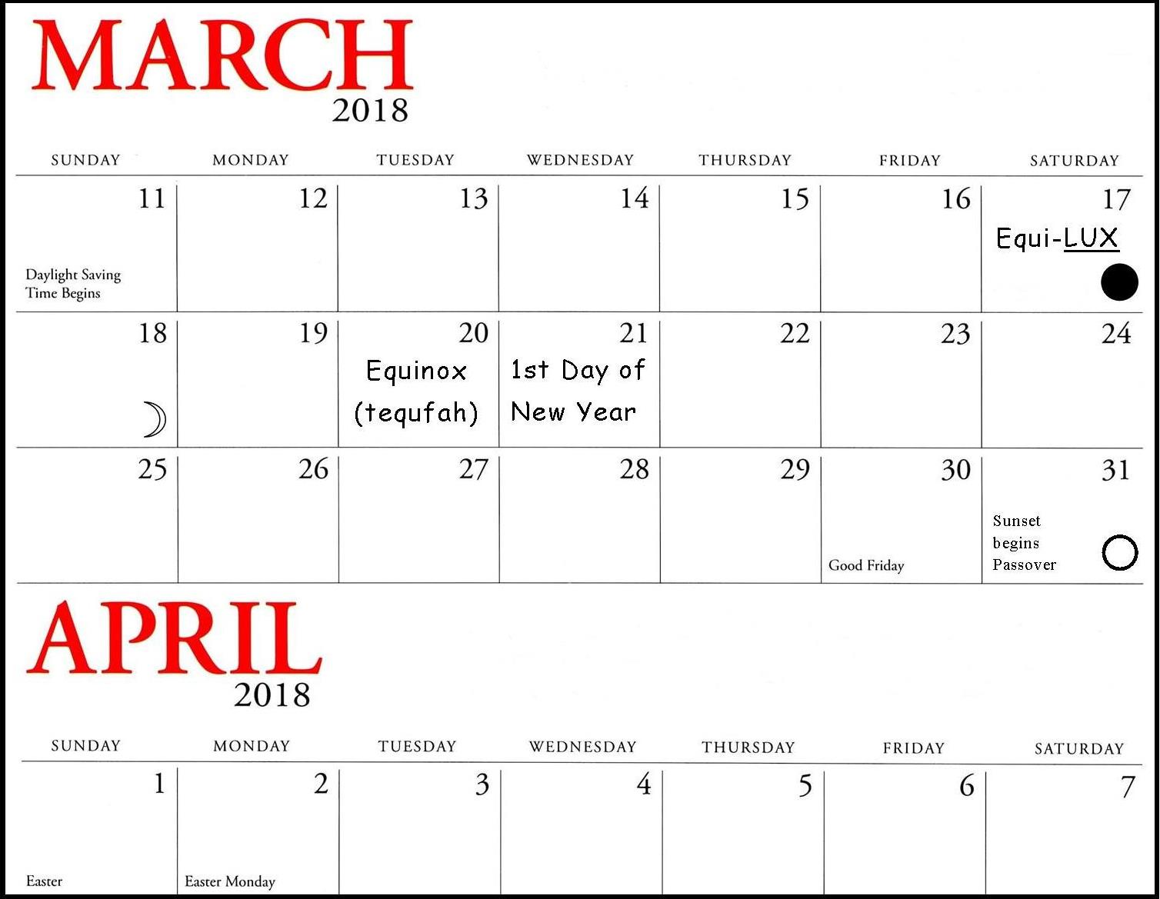
Roman Calendar
Easter Calculation:
Determine Mar 20/21 Equinox
Find next Full Moon
Next Sunday is Easter
Easter Calculation
Notes:
2 full moons in march 2018: 2nd and 31st

Slide 36
Roman Calendar
This calendar calculates the feasts and the weekly Sabbath according to the moon – all moon phases are used depending on the interpretation.
Determine the moon phase desired
That “cycle of the week” marks the monthly Sabbath
Weekly Sabbaths follow this pattern until the next sighting of the new moon phase.
Lunar Sabbath
Calendar
Notes:
2 full moons in march 2018: 2nd and 31st

Slide 37
Roman Calendar
Covenant Calendar Calculation:
Determine Mar 20 Equinox
Mar 21 is 1st day of the Yr.
Count 14 days to Passover
Covenant Calculation
Passover
Notes:
2 full moons in march 2018: 2nd and 31st

Slide 38
Roman Calendar
Counterfeit Passover Calculation:
Determine Equi-LUX for local area
Find next Crescent Moon
Count 14 days to Full Moon
Passover begins at sunset
Equi-LUX Calculation
Notes:
2 full moons in march 2018: 2nd and 31st

Slide 39
The Calendar Challenge
Next we are going to examine several different
feast calendars searching for unity.
Yahweh’s Assembly in Yahshua
(2018 & 2013) (Kingdom City, MO)
Yahweh’s Restoration Calendar 2018
(Holts Summit, MO)
Lighted Way Ministries 2018 (Roseburg, Oregon)
Bible Explorations Calendar 2018
(Terra Bella, California)
Will there
be unity?

Slide 40
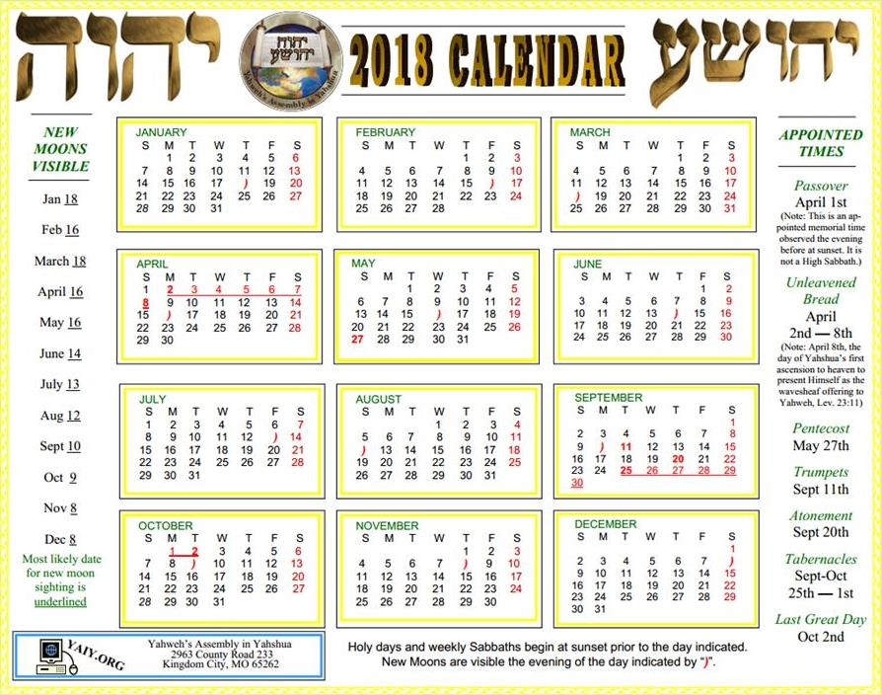
Yahweh’s Assembly in Yahshua (Missouri) – Calendar for 2018:
There is nothing on this calendar to tell you they use equi-lux – Mar 17.
The next crescent moon is Mar 18th.
Then they count 14 days from the winter sliver moon to the full moon.
Passover begins at sunset on Mar 31st.
Notes:
2018 done

Slide 41
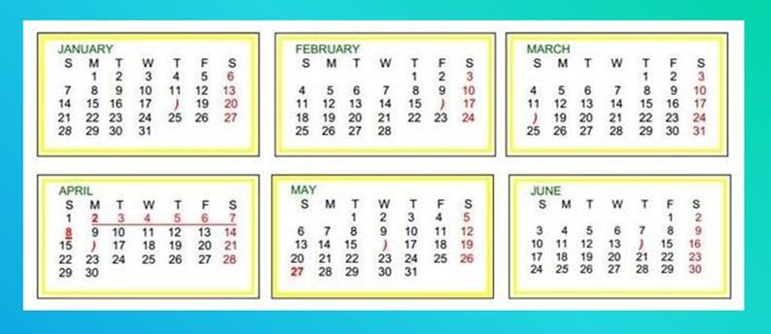
Yahweh’s Assembly in Yahshua – Calendar for 2018:
This calendar substitutes the Mar 17th equi-lux as the tequfah alternative.
(There’s no mention of this anywhere in the calendar information.)
The next crescent moon is Mar 18th.
Then they count 14 days from the winter sliver moon to the Full Moon.
Passover DAY is on Apr 1st together with Easter.
This calculation is chosen so Passover is not celebrated at the end of Apr.
The excuse of many equi-lux based calendars is: to celebrate Passover at a more reasonable time of the year, as they feel end of Apr or early May is way too late.
Note: It certainly is way too late to celebrate Passover, but is this the Scriptural method to correct the problem?
Notes:
2018 done

Slide 42
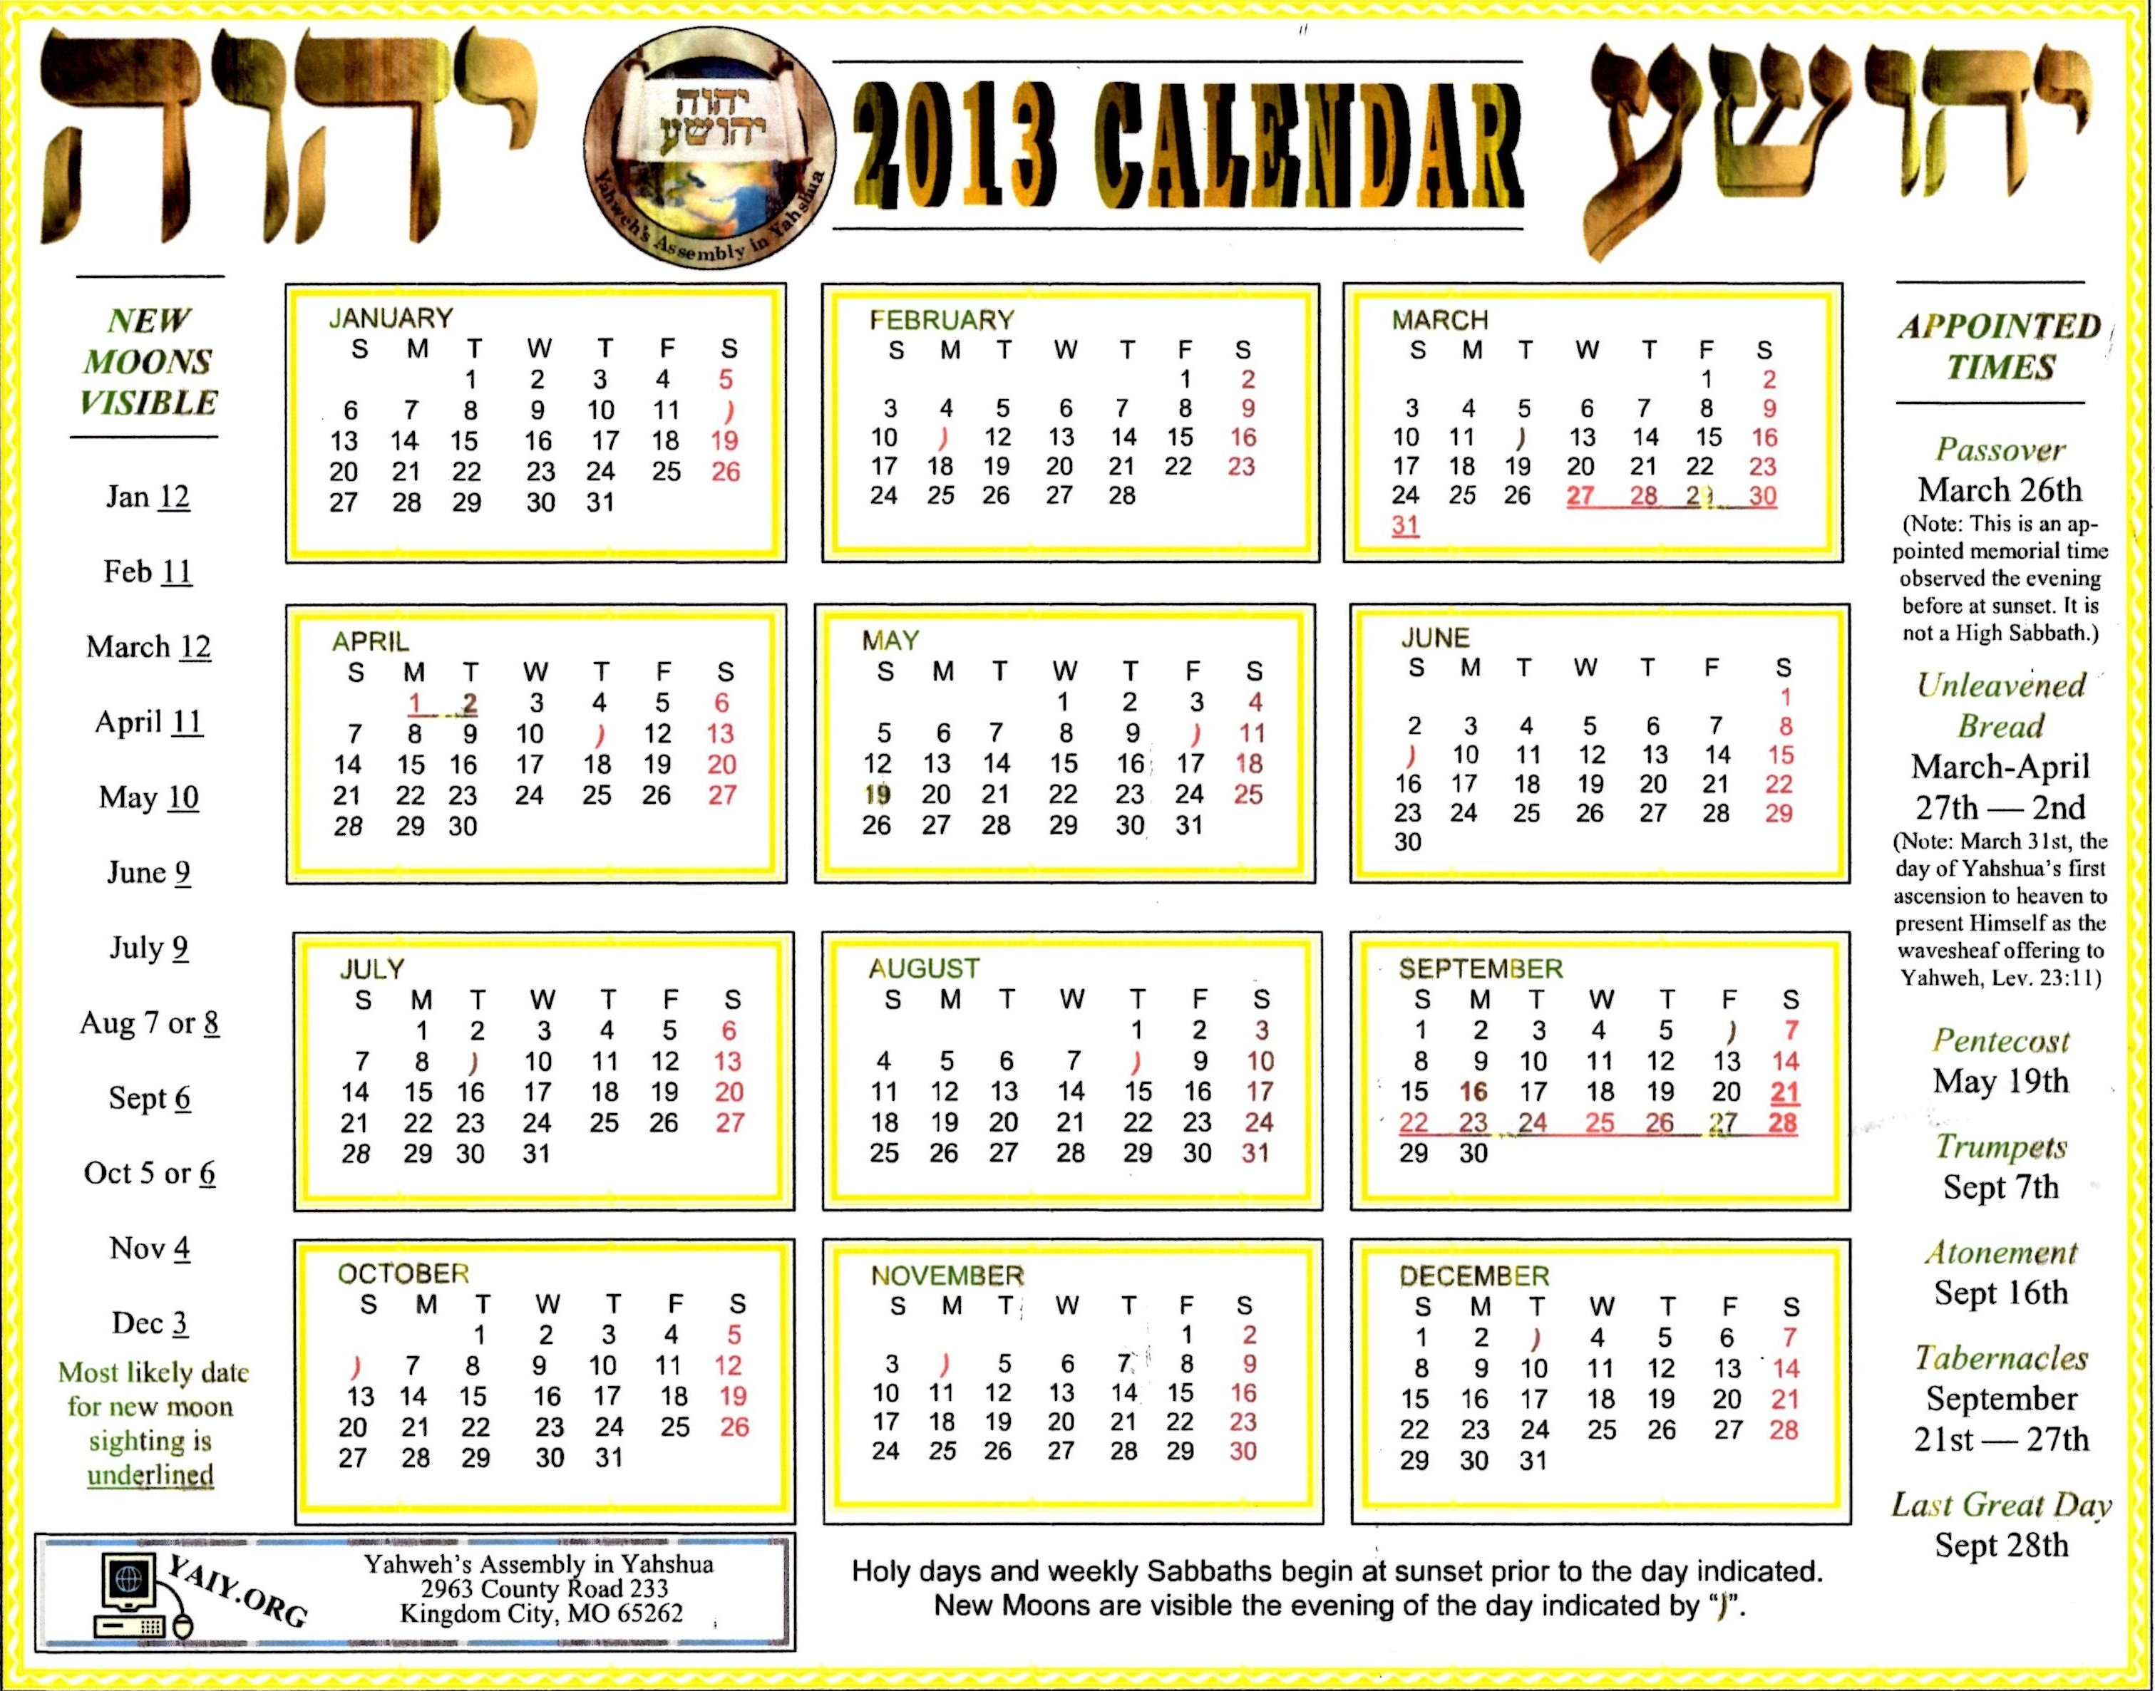
Yahweh’s Assembly in Yahshua – Calendar for 2013:
Again: nothing on this calendar to tell you they use equi-lux – Mar 17.
This time they are using the crescent moon on Mar 12th, CLOSEST to the equi-lux and about 8 days BEFORE the spring equinox!
Count 14 days from a VERY OLD WINTER sliver moon to the full moon.
Passover begins at sunset on Mar 26th; Passover Day on Mar 27th.
Notes:
2013 Do pink box still 7 am.

Slide 43
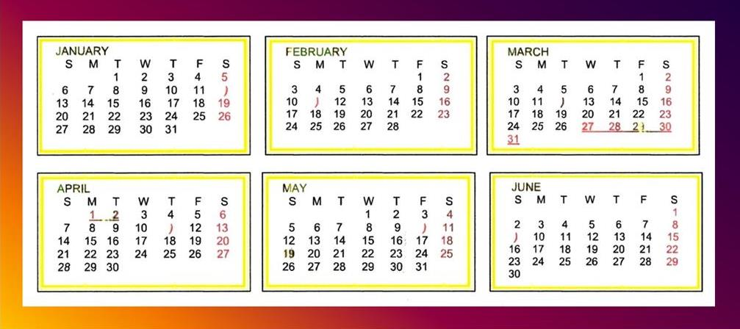
Passover DAY is on Mar 27th – very close to Easter Sunday on Mar 31st.
This is extremely early for any Passover. Was it set this way to be celebrated before Rome’s Good Friday on Mar 29th and Easter on the 31st?
Summary: the 2018 sliver moon was chosen AFTER the equi-lux.
But … the 2013 sliver moon was chosen MANY DAYS BEFORE the equi-lux!
Question: What are the rules of this calendar? Do both calendars hover around Roman dates?
Does this ministry recognize there is a serious problem with the moon/month calculation?
Are they substituting equiu-LUX for tequfah to compensate for this huge problem?
Notes:
2013 Finish pink box

Slide 44
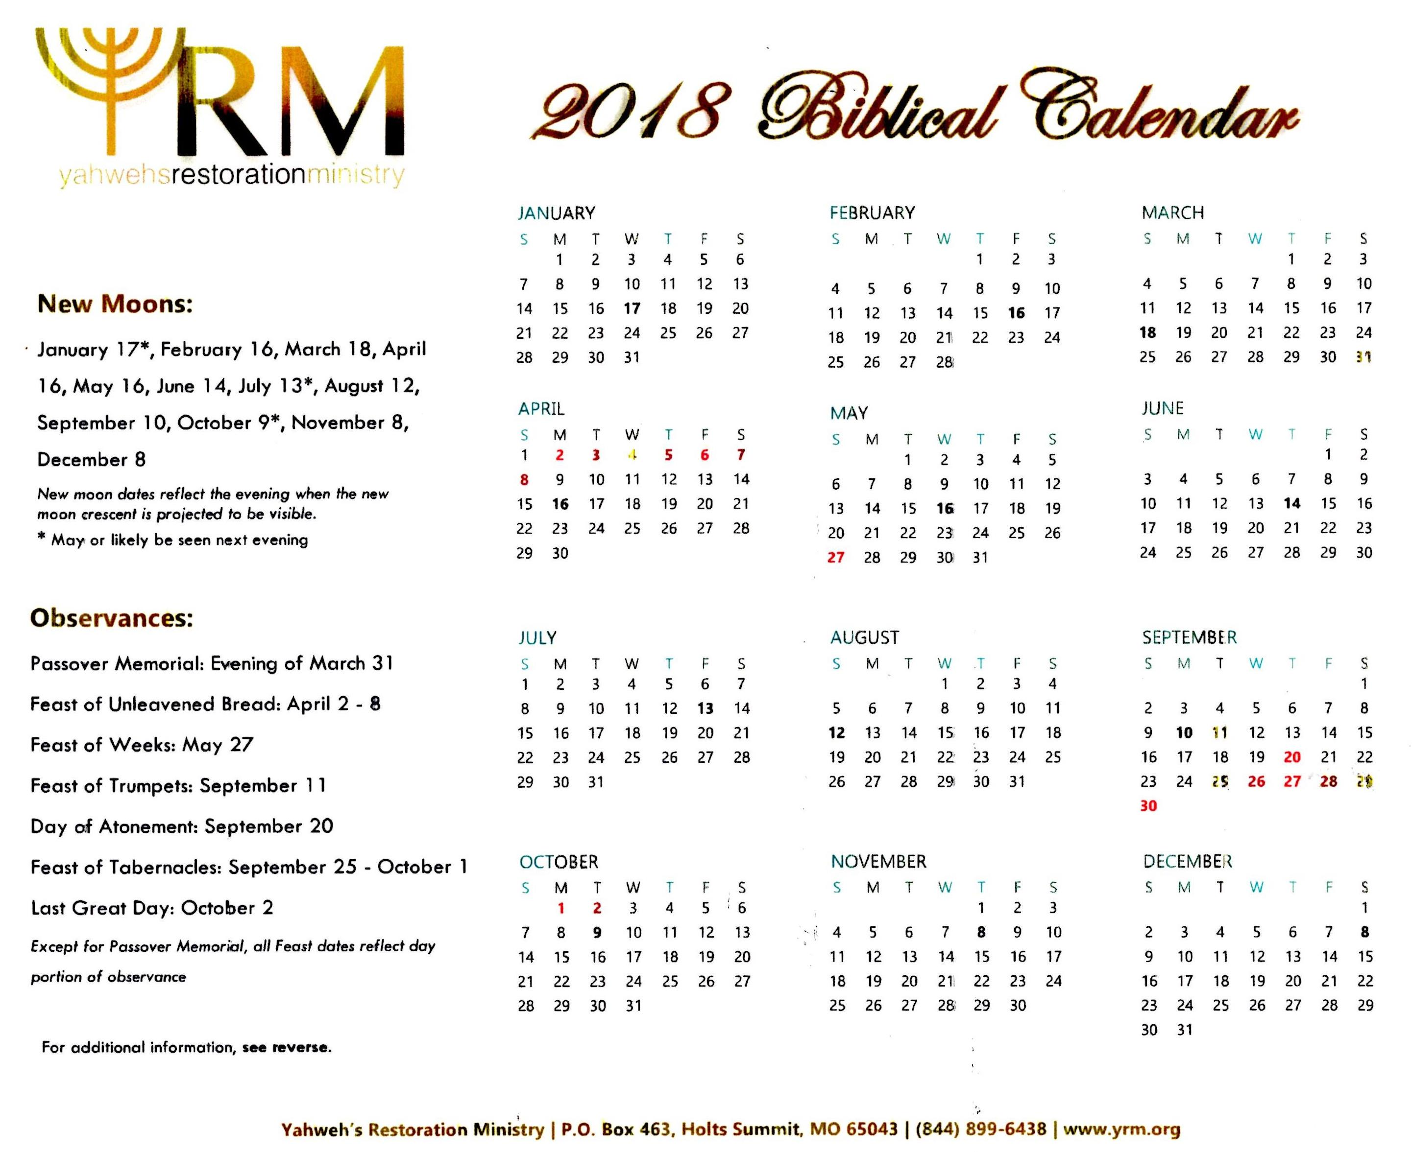
Adventist Feast
Calendar (Missouri)
Let’s take a closer look at this counterfeit!

Slide 45
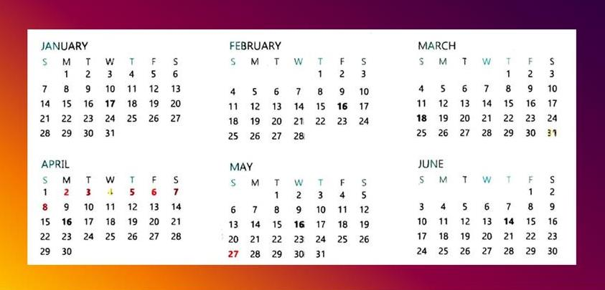
Adventist Feast
Calendar (Missouri)
Yahweh’s Restoration Ministry (Missouri) – Calendar for 2018:
This calendar is also using equi-lux on Mar 17th as tequfah.
The next crescent moon is Mar 18th.
They also count 14 days from the winter sliver moon to the full moon.
Passover begins at sunset on Mar 31st; Passover Day on Easter’s Apr 1st.

Slide 46
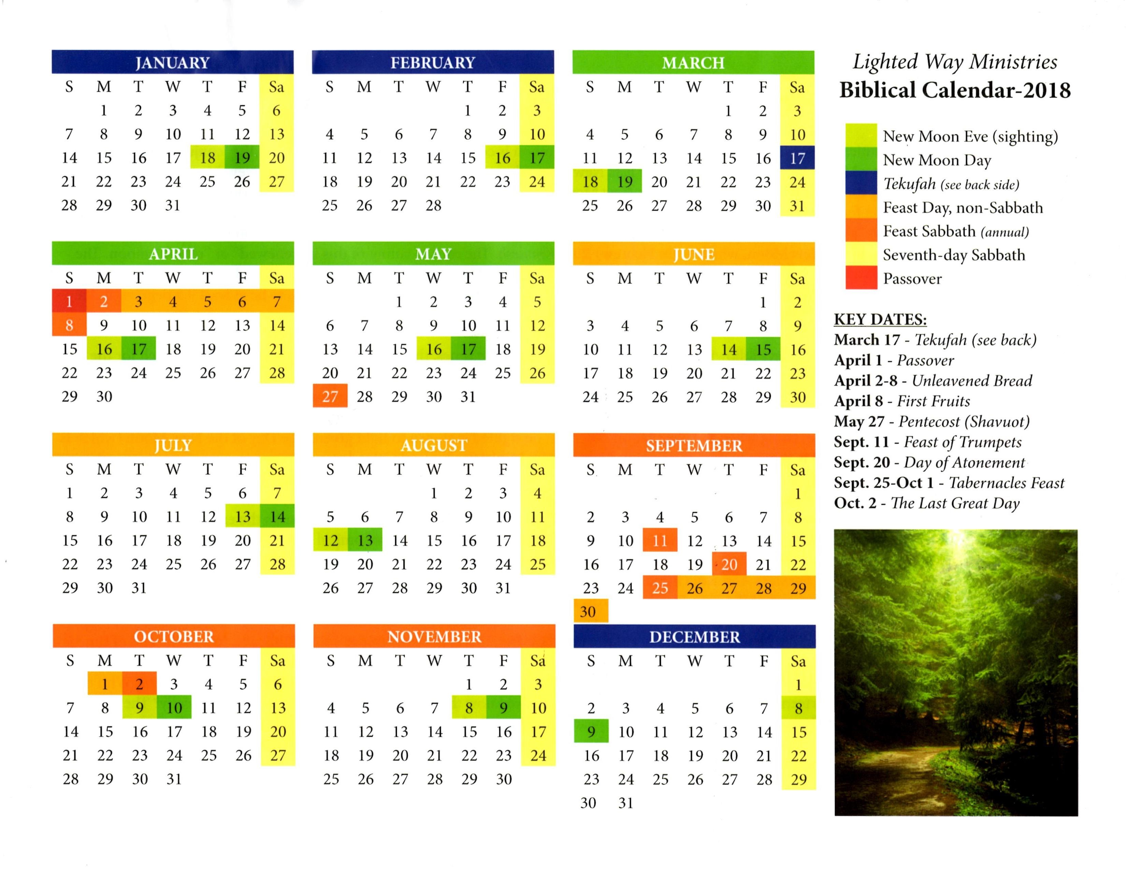
Adventist Feast
Calendar
Salem, OR
Lighted Way Ministries (Oregon) – Calendar for 2018:
The back page of this calendar lists exactly the reason why Lighted Way changed their calendar substituting equinox for equi-LUX this year. This is their explanation:
“The spring Tekufah is the Tekufah which marks the end of the Biblical Year. Like the New Moon, the astronomical Equinox and the sightable Tekufah are on different days. The astronomical Vernal Equinox, as dictated by the Council of Nicea, takes place on March 20 or 21. But the visual Tekufah (the day when the hours of daylight and darkness are both 12 hours) is actually on March 17. This is why the older Farmer’s Almanacs listed March 17, not March 20, as the Vernal Equinox, or Tekufah in Hebrew. The Tekufah is a significant date because it is the Biblical end of the year. In other words, the year doesn’t Biblically end until March 17th.

Slide 47
Adventist Feast
Calendar
Salem, OR
Lighted Way Ministries (Oregon) – Calendar for 2018: (Con’t)
“In the Eastern, Gentile, way of thinking, the New Year should begin the next day. But, this is not how things work, Biblically. Just as the end of time is not a single day, but a period of time, there is a shadow picture given of this every year. March 17 is the last day of the year, but the period of the end continues until the next New Moon, following the Tekufah. So, the first day of the New Biblical Year is actually (New Moon Day) March 19. With this date as the first day, Passover is the 14th day, or 13 days later. How do we know that the Tekufah is the End of the Year, Biblically? The word Tekufah is Strong’s H8622. It appears four times in the Bible. In 2 Chron 24:23, we find the term Tekufah connected with being the end of the year, occurring in the Spring. This same verse is translated as “end of the year” and “spring” in other Bible versions, one of which is the RSV.”

Slide 48
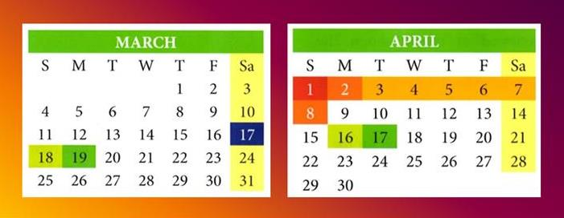
Adventist Feast
Calendar
Salem, OR
Lighted Way Ministry (Oregon) – Calendar for 2018:
We just read the reason LWM is substituting equi-lux for tequfah on Mar 17.
The next crescent moon is sighted on Mar 18th.
They also count 14 days from the WINTER sliver moon to the full moon.
Passover begins at sunset on Mar 31st. Passover Day is on Rome’s Easter!!
Notes:
Add notes from their back page for change of tequfah. 1000 am

Slide 49
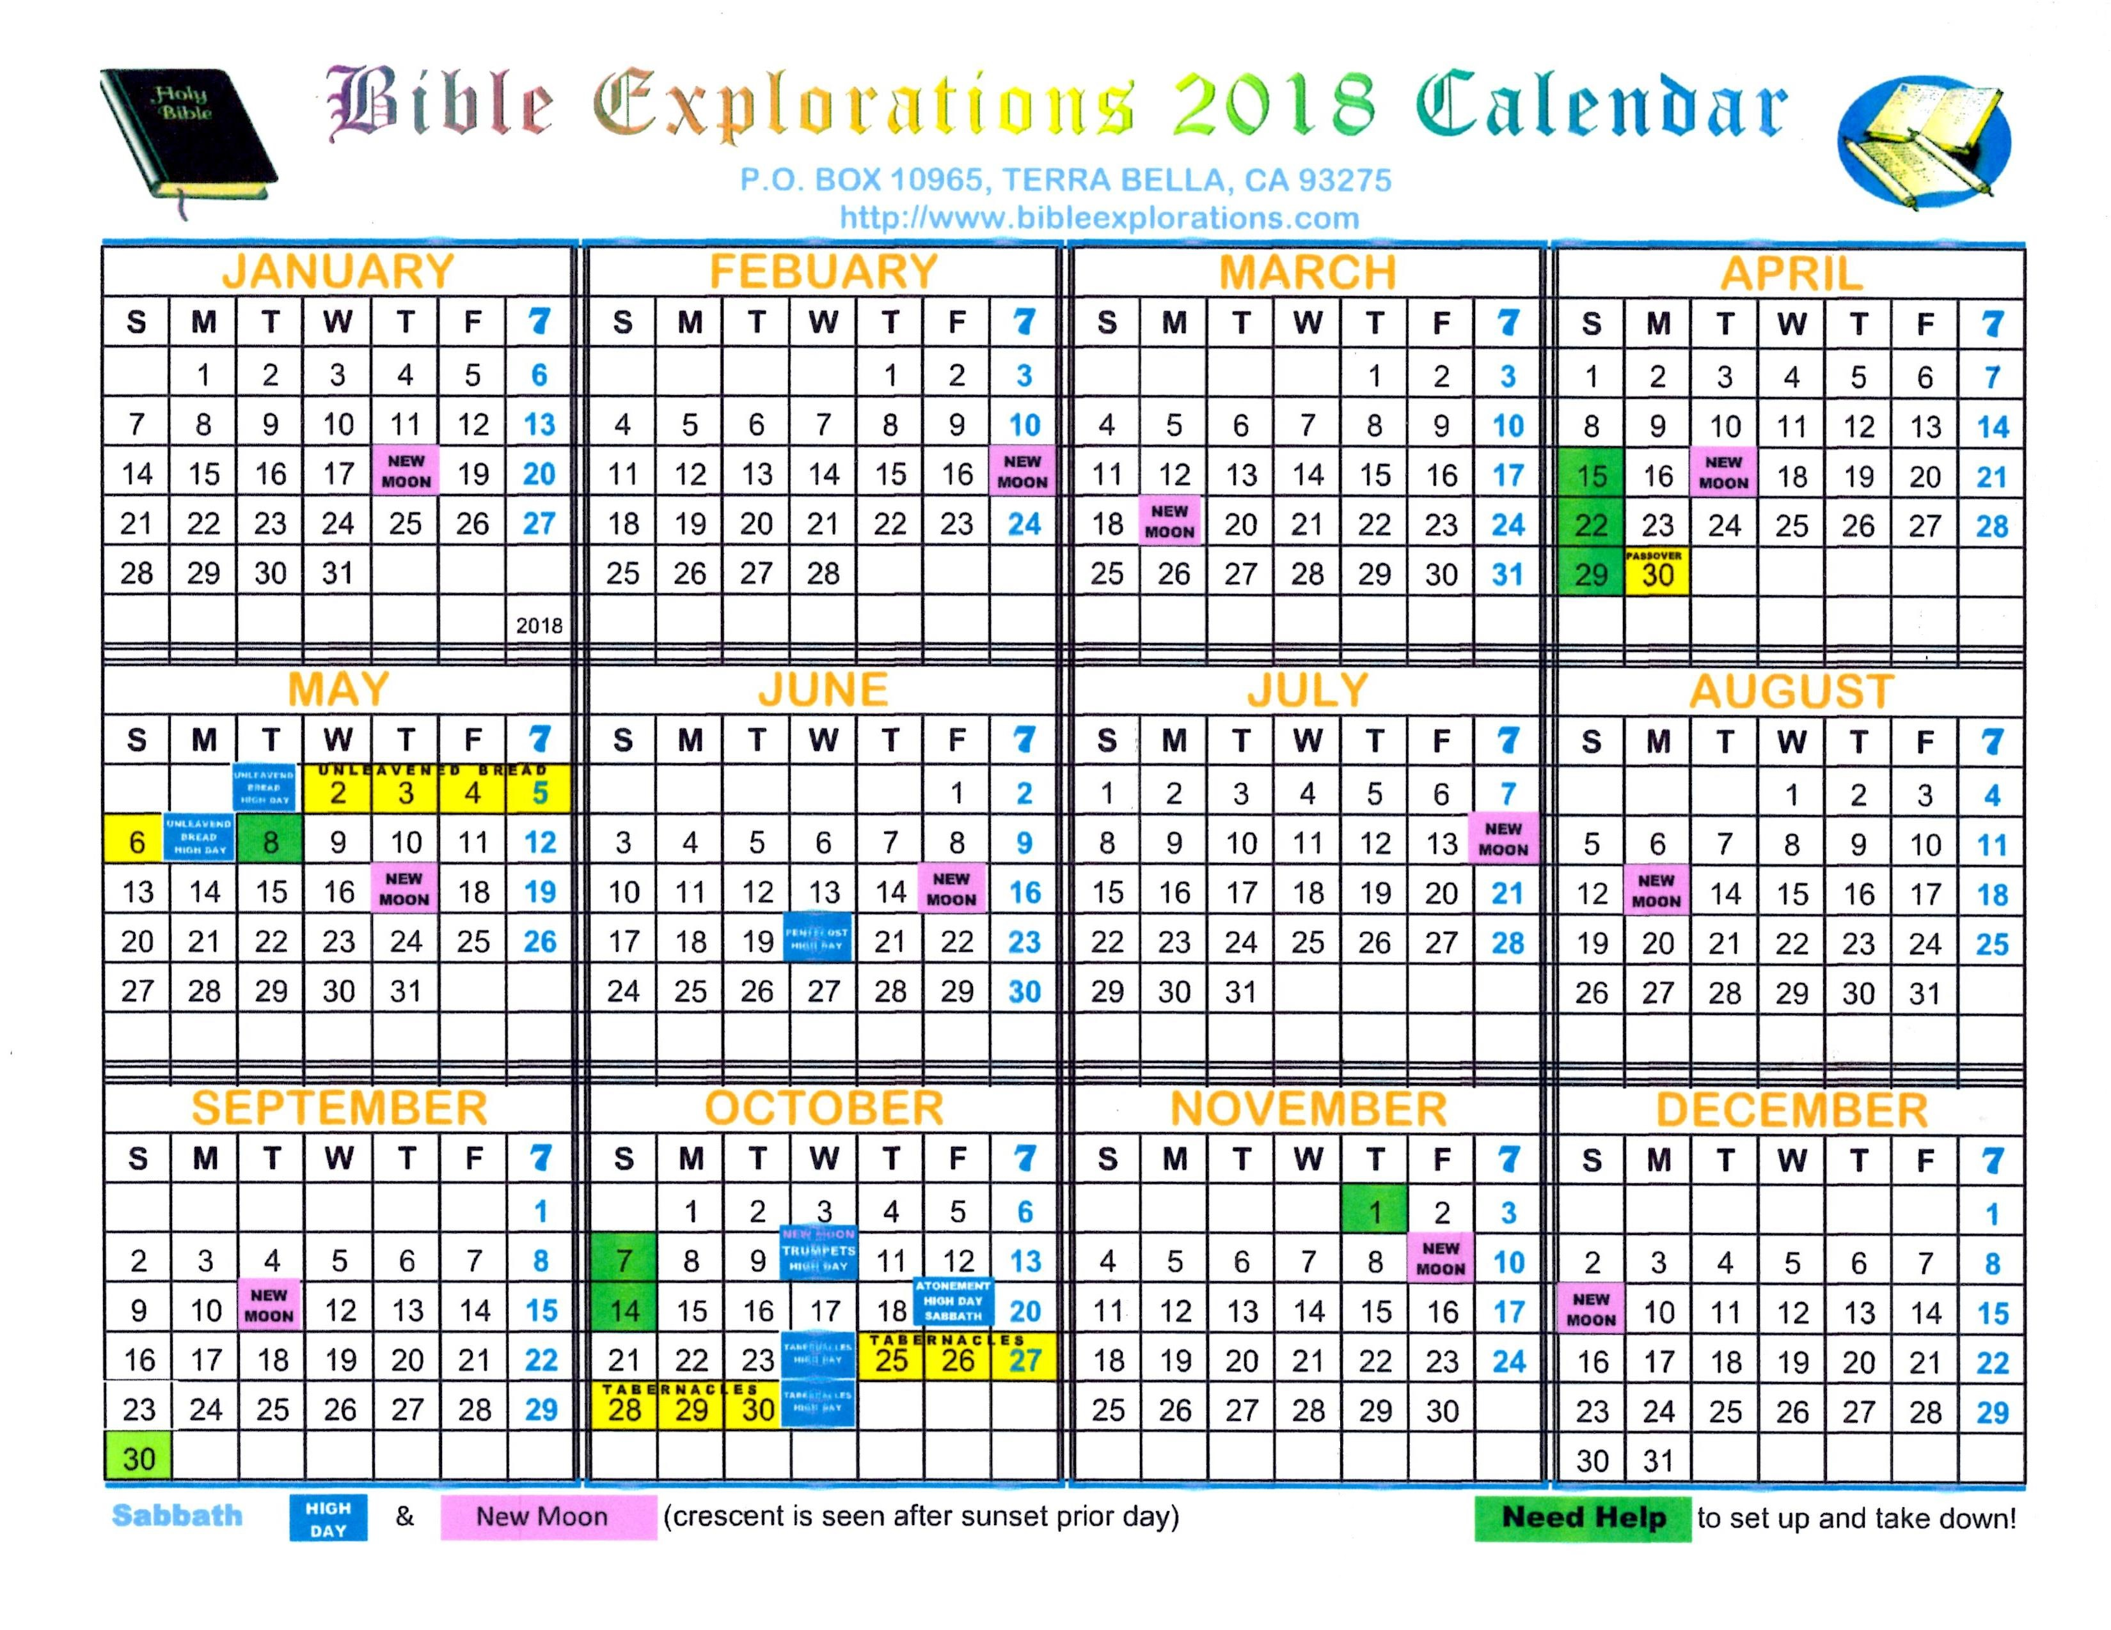
Adventist Feast
Calendar
Terra Bella, CA
Counterfeit Passover Calculation:
Determine Equinox for the world over
Find next Crescent Moon – Apr 17th
Count 14 days to Full Moon
Passover begins at sunset – Apr 30th
Passover Day is May 1st – very late.

Slide 50
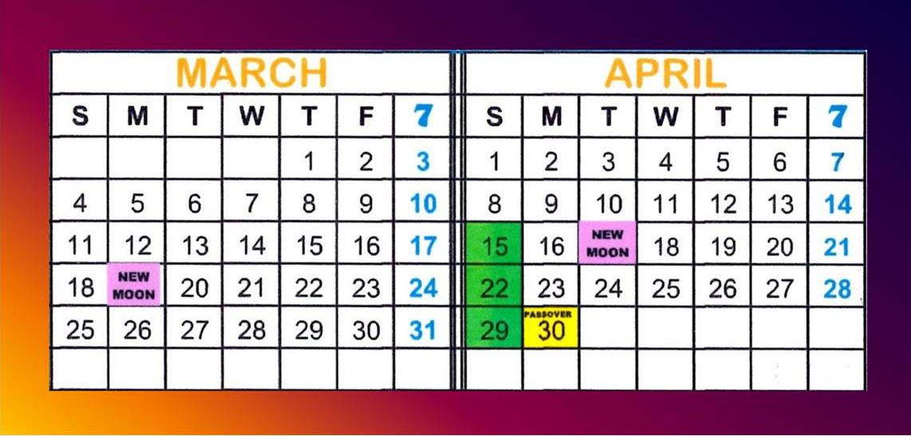
Adventist Feast
Calendar
Terra Bella, CA
(Their feast calculations unchanged.)
Passover may be late, but year-start rules were not changed.

Slide 51
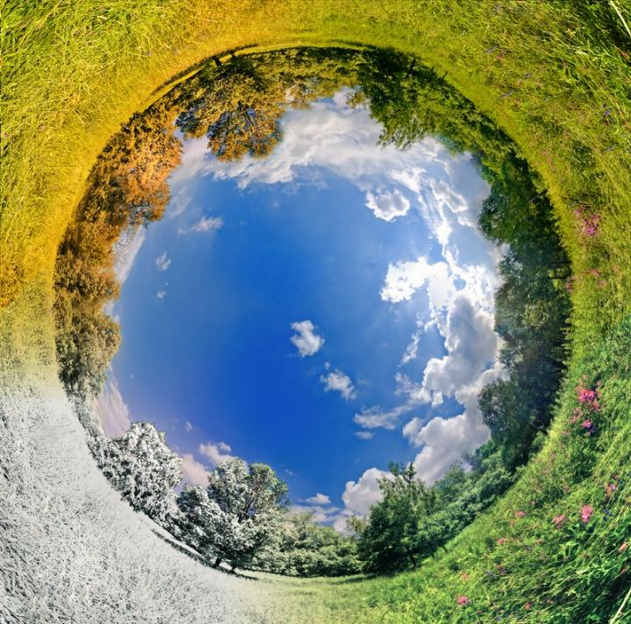
Problem #3
Equi-Lux Disunity
Many former equinox calendars are being changed
to equi-LUX calculation.
These are calendars from
well-known feast camps.
Most of these feast calendars use the moon month.
Calculating the year start becomes even more difficult if:
  The new moon is just prior to equi-LUX;
  There are 2 new moons
  in the month.
The calendars
just observed
were all USA.
Let’s check further …

Slide 52
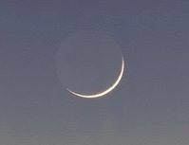

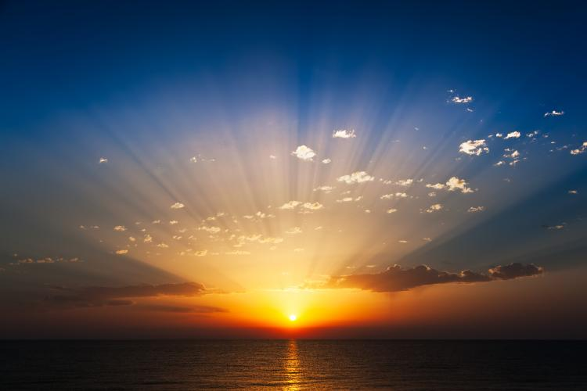
2018 World equi-lux tour
2018 Sliver moon sighted on Mar 18th
 | Locations of Equi-lux Investigation | Date | Sunrise / Sunset
1 | Inuvik, Northwest Territories | Mar 18th | 9:02 / 9:05
2 | Anchorage, Alaska | Mar 17th | 8:09 / 8:07
3 | Barentsburg, Norway | Mar 17th | 7:04 / 6:54
4 | Salem, Oregon | Mar 17th | 7:20 / 7:20
5 | Roseburg, Oregon | Mar 17th | 7:22 / 7:22
6 | Orlando, Florida | Mar 15th & Mar 16th | 7:35 / 7:34 7:33 / 7:34
7 | Jerusalem, Israel | Mar 16th | 5:46 / 5:47
8 | Mexico City, Mexico | Mar 14th | 6:45 / 6:45
9 | Panama | Mar 5-6-7 | 6:29 / 6:29
10 | Cape Town, South Africa | Mar 23rd | 6:52 / 6:52
11 | Sydney, Australia | Mar 29th | 7:04 / 6:54
12 | Stanley, Falkland Islands (S America) | Mar 29th | 7:06 / 6:43
These are the 12 random places in the world that were chosen to test the date of Equi-LUX.

Slide 53
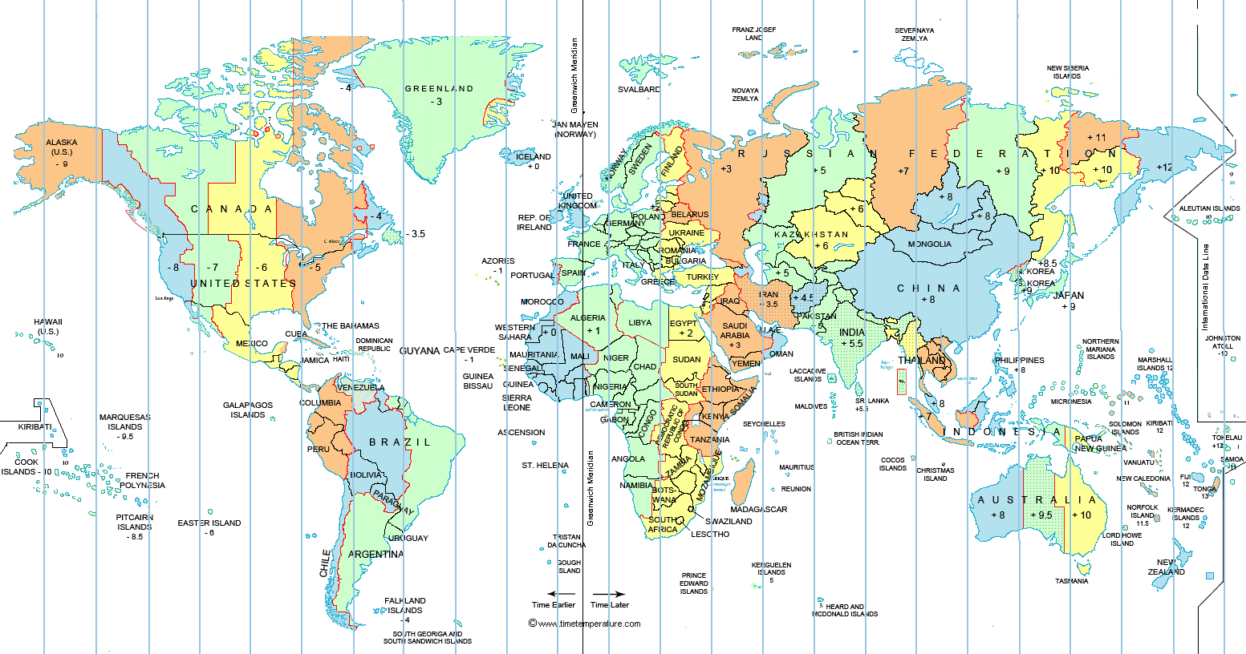

World Investigation of Equi-Lux!
Norway
Inuvik, NWT
Mar 18th
Anchorage, AK
Oregon
Orlando
Jerusalem
Mexico
Panama
S. Africa
Australia
Falkland Isl.
Let’s find these 12 random places on the map.

Slide 54
2018 World equi-lux tour
Is equi-lux on Mar 17th all over the world? (Sliver Moon: Mar 18th)
 | Locations of Equi-lux Investigation | Date | Sunrise / Sunset
1 | Inuvik, Northwest Territories | Mar 18th | 9:02 / 9:05
2 | Anchorage, Alaska | Mar 17th | 8:09 / 8:07
3 | Barentsburg, Norway | Mar 17th | 7:04 / 6:54
4 | Salem, Oregon | Mar 17th | 7:20 / 7:20
5 | Roseburg, Oregon | Mar 17th | 7:22 / 7:22
6 | Orlando, Florida | Mar 15th & Mar 16th | 7:35 / 7:34 7:33 / 7:34
7 | Jerusalem, Israel | Mar 16th | 5:46 / 5:47
8 | Mexico City, Mexico | Mar 14th | 6:45 / 6:45
9 | Panama | Mar 5-6-7 | 6:29 / 6:29
10 | Cape Town, South Africa | Mar 23rd | 6:52 / 6:52
11 | Sydney, Australia | Mar 29th | 7:04 / 6:54
12 | Stanley, Falkland Islands (S America) | Mar 29th | 7:06 / 6:43
Notice the Equi-lux dating for these 12 random locations!

Slide 55
2018 World equi-lux tour
Is equi-lux on Mar 17th all over the world? (Sliver Moon: Mar 18th)
 | Locations of Equi-lux Investigation | Date | Sunrise / Sunset
1 | Inuvik, Northwest Territories | Mar 18th | 9:02 / 9:05
2 | Anchorage, Alaska | Mar 17th | 8:09 / 8:07
3 | Barentsburg, Norway | Mar 17th | 7:04 / 6:54
4 | Salem, Oregon | Mar 17th | 7:20 / 7:20
5 | Roseburg, Oregon | Mar 17th | 7:22 / 7:22
6 | Orlando, Florida (Which day should be chosen for the true equi-LUX?) | Mar 15th & Mar 16th | 7:35 / 7:34 7:33 / 7:34
7 | Jerusalem, Israel | Mar 16th | 5:46 / 5:47
8 | Mexico City, Mexico | Mar 14th | 6:45 / 6:45
9 | Panama (Which day is the true equilux?) | Mar 5-6-7 | 6:29 / 6:29
10 | Cape Town, South Africa | Mar 23rd | 6:52 / 6:52
11 | Sydney, Australia | Mar 29th | 7:04 / 6:54
12 | Stanley, Falkland Islands (S America) | Mar 29th | 7:06 / 6:43
Imagine! Equi-lux dates from Mar 5th to Mar 29th!

Slide 56
2018 World equi-lux tour
Is equi-lux on Mar 17th all over the world? (Sliver Moon: Mar 18th)
 | Locations of Equi-lux Investigation | Date | Sunrise / Sunset
1 | Inuvik, Northwest Territories | Mar 18th | 9:02 / 9:05
2 | Anchorage, Alaska | Mar 17th | 8:09 / 8:07
3 | Barentsburg, Norway | Mar 17th | 7:04 / 6:54
4 | Salem, Oregon | Mar 17th | 7:20 / 7:20
5 | Roseburg, Oregon | Mar 17th | 7:22 / 7:22
6 | Orlando, Florida (Which day should be chosen for the true equi-LUX?) | Mar 15th & Mar 16th | 7:35 / 7:34 7:33 / 7:34
7 | Jerusalem, Israel | Mar 16th | 5:46 / 5:47
8 | Mexico City, Mexico | Mar 14th | 6:45 / 6:45
9 | Panama (Which day is the true equilux?) | Mar 5-6-7 | 6:29 / 6:29
10 | Cape Town, South Africa | Mar 23rd | 6:52 / 6:52
11 | Sydney, Australia | Mar 29th | 7:04 / 6:54
12 | Stanley, Falkland Islands (S America) | Mar 29th | 7:06 / 6:43
Are ALL sunrise/ sunset times identical for
these 12 places?

Slide 57
2018 World equi-lux tour
Is equi-lux on Mar 17th all over the world? (Sliver Moon: Mar 18th)
 | Locations of Equi-lux Investigation | Date | Sunrise / Sunset
1 | Inuvik, Northwest Territories | Mar 18th | 9:02 / 9:05
2 | Anchorage, Alaska | Mar 17th | 8:09 / 8:07
3 | Barentsburg, Norway | Mar 17th | 7:04 / 6:54
4 | Salem, Oregon | Mar 17th | *7:20 / 7:20
5 | Roseburg, Oregon | Mar 17th | *7:22 / 7:22
6 | Orlando, Florida (Which day should be chosen for the true equi-LUX?) | Mar 15th & Mar 16th | 7:35 / 7:34 7:33 / 7:34
7 | Jerusalem, Israel | Mar 16th | 5:46 / 5:47
8 | Mexico City, Mexico | Mar 14th | *6:45 / 6:45
9 | Panama (Which day is the true equilux?) | Mar 5-6-7 | *6:29 / 6:29
10 | Cape Town, South Africa | Mar 23rd | *6:52 / 6:52
11 | Sydney, Australia | Mar 29th | 7:04 / 6:54
12 | Stanley, Falkland Islands (S America) | Mar 29th | 7:06 / 6:43
Only 5 of the 12 have identical sunrise/sunset times!

Slide 58

Pick Your equi-LUX in March 2018!
17th
18th
Mar 18th
17th
17th
15/16th
16th
14th
Is there something
wrong with this picture?
5-6-7!
23rd
29th
29th
Most equi-LUX feast calendars have tequfah on Mar 17th.

Slide 59

Problem #4 ~ Poor Bible Study
of the word “evening”
A simple study in the Scriptures will detect the counterfeit and deal with it effectively. There needs to be a proper study of the terms:
“evening” & “morning”
This will give a good understanding for the twilights, showing that the Scriptural definition for these twilights places this part of the 24 hour cycle “with” the Light Season.
When “twilights” are counted as part of the Light Season, equi-LUX no longer aligns with a single thing in Scripture.
If equi-LUX was really about equal DAY and equal NIGHT, there would be no problem.
But, equi-LUX completely revolves around looking at
the sun above the horizon!

Slide 60
Equi-LUX / Twilight Problem
Equi-LUX bases the calculations of equal day and equal night according to sunrise and sunset in each individual location with huge variances!!
Equi-LUX does not take into consideration the fact that both “dawn and dusk twilights” are part of the “light” belonging to the Light season.
Therefore: the equal calculation of time for “sunrise to sunset” is not identical to the calculation for the “beginning of dawn twilight to ending of dusk twilight” according to Yahuah.

Slide 61
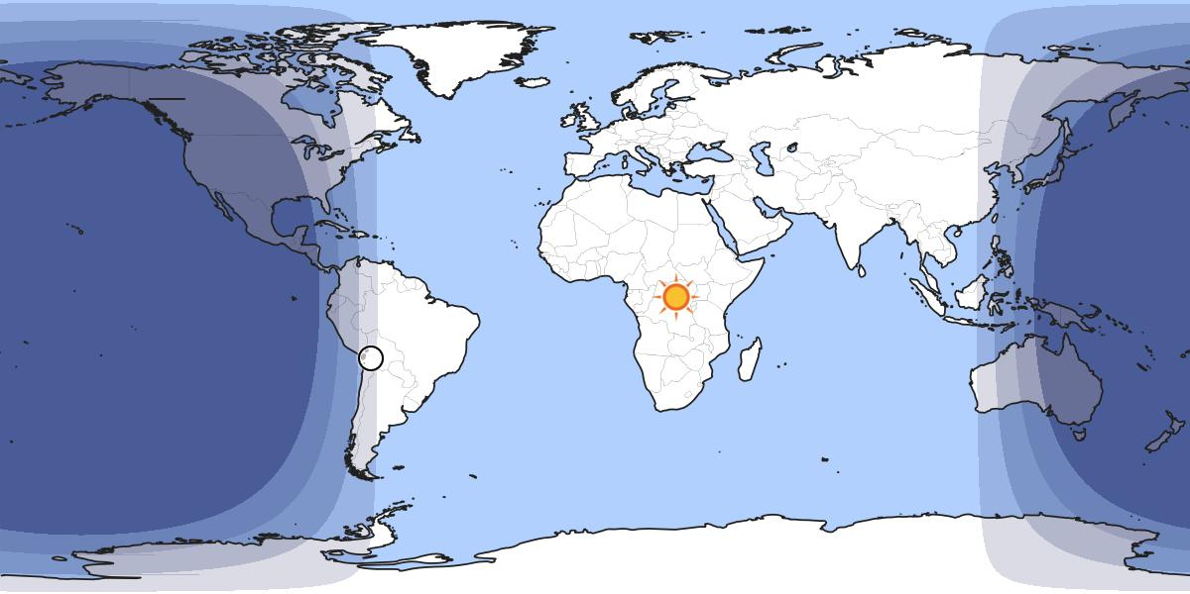
Twilights are Constant
Civil Twilight
Astronomical Twilight
Nautical Twilight
NIGHT – No Twilight

Slide 62
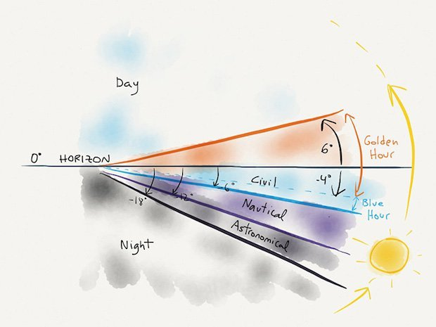
Twilights
Defined
This chart incorrectly shows the three twilights as belonging to the Night Season.
According to Yahuah’s calendar, any portion of the 24 hour cycle with light in the sky that is provided
by the sun (whether above or below the horizon),
is counted as belonging to the Light [Season].

Slide 63
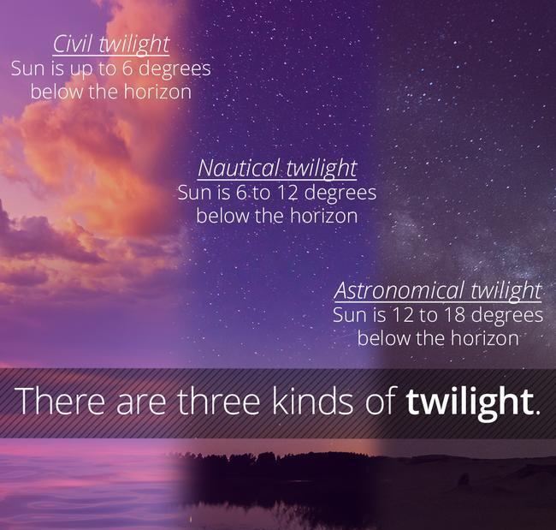
Equi-LUX discards all twilights as being part of the equation for equal day and night.
The only way for equi-LUX to be easily calculated is by using sunrise and sunset times, in each place.
This cannot be done
without a computer!

Slide 64
There has to be an answer to this dilemma somewhere?!
Question:
If equi-LUX is not an equal Light Season and Night Season, then can’t we just find
the “date” that
really is a true equal light and night and call THAT day equi-LUX?
The search
has been
done!
One must
use a
computer!

Slide 65

There’s not one date that qualifies anywhere on the calendar for a true equi-LUX when using twilights!
Four random places were chosen to search out a true “equal light and night” close to the equinox. Here are the results:
Inuvik was the only place that was close to equal day/night with time of: 806 AM and 808 PM on Jan 22/23 (2018).
Jerusalem: closest times were in Dec 2017, all times
were an hour difference between Day/Night Season.
Cape Town, South Africa: Same results as Jerusalem.
Panama: Nothing close to equal day/night.
Salem, Ore: had 600 AM and 620 PM dated Dec 21/17.

Slide 66

Problem #5 ~ Looking to the sun!
Deut 17:2-3 If there be found among you … 3 [that] hath gone and served other gods, and worshipped them, either the sun, or moon, or any of the host of heaven, which I have not commanded … [THEN] …
Deut 4:19 And lest thou lift up thine eyes unto heaven, and … seest the sun, and the moon, and the stars,
even all the host of heaven,
shouldest be driven to worship
them, and serve them … [THEN] …
The penalty was death for linking worship times with the created lights in the sky.
Covenant Calendar observes the “light”
not the object that provides the light.

Slide 67
“THE” Equinox Accusation
This accusation comes in the form of a question for Covenant Calendar.
Would it be
sun worship
to look to
the sun for
equinox?
Answer: That’s the
wrong question! Why?

Slide 68
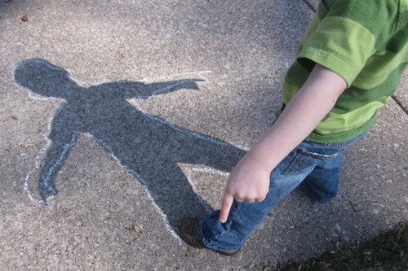
Check out your shadow!
You will have your back to the sun, not your face!
Equinox Components:
Mazzaroth
Sun (provides the light)
Light (provides the shadow)
Earth (receives the shadow)
Yes!

Slide 69
“THE” Next Question
How does one determine the equi-LUX?
Could
that be
considered
as sacred
regard for
the sun,
or sun
worship?
By looking to the SUN-rise &
SUN-set to determine what
is supposed to be equal day
and equal night!

Slide 70
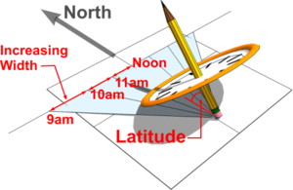
Definition of Equinox Yahuah’s Way
The vernal equinox [tequfah H8622] is one 24 hour cycle
for the whole world.
This is at the exact time
when the celestial equator intersects the sun’s ecliptic path in the heavens.
These are two fixed points
of authority.
The earth receives the “light” –
the “light” casts the shadow
to determine the equinox day.
The equinox can be physically observed by plotting the shadow of
the sun – the Scriptural observation requirement.
On equinox day, the shadow does not turn,
nor arc (James 1:17).

Slide 71
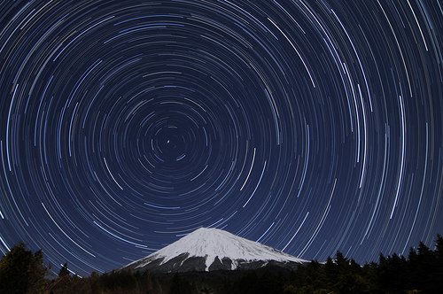
The equinox is calculated
by the perfect movement
of the heavenly lights of
the Mazzaroth and the sun.
This is by Divine Design.
The moon has no involvement in the equinox (or equi-LUX) timing.

Slide 72
There should be no question about the equinox authority!
The equinox is the “day” that Yahuah placed in the physics of creation which witnesses that the actual great change from the old year to the new year is in process.
Abib 1
follows
the day
of no
shadow
or no
shadow arc.

Slide 73
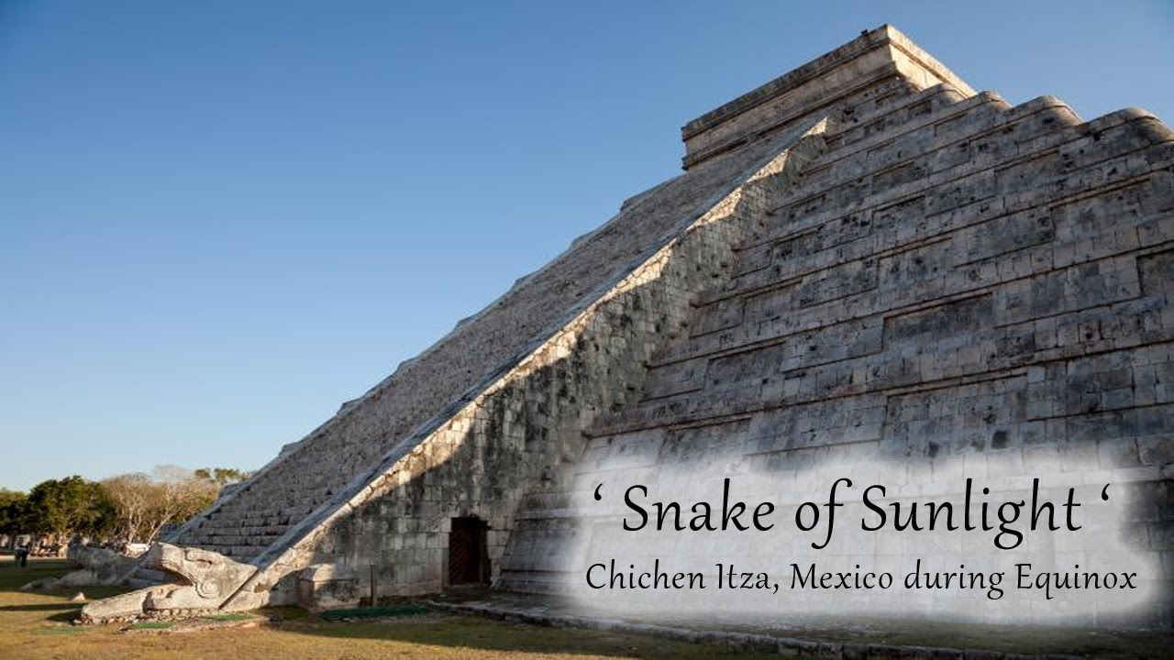
Equinox: Ancient Civilizations
Tequfah [H8622] is properly understood in harmony with the instructions of Moses who was “… learned in all the wisdom of the Egyptians …” (Acts 7:22).
The Egyptians were well-advanced in equinox calculation constructing pyramids to depict this moment.
Ancient civilizations can’t do one thing to alter the equinox.
This moment has ever been orchestrated by Yahuah.

Slide 74
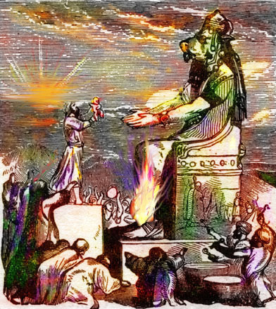
Pagan History & Equinox
Did the pagans use equinox to calculate their feasts day to worship their pagan gods?
Absolutely! The pagan
feasts always counterfeited Yahuah’s feasts.
Equinox was a reliable calculation every year.
There would have been no reason to consider equi-LUX.
Just because the pagans could accurately calculate
the equinox, does that make
the equinox “pagan”?
NO!

Slide 75
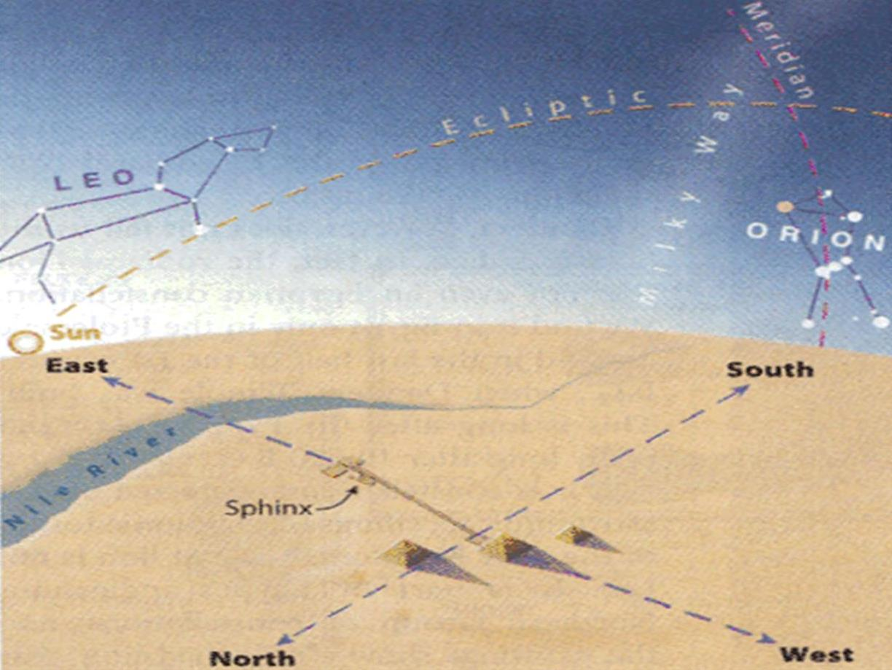
The Equinox Miracle
The point where
the sun’s ecliptic path
intersects the
celestial equator
determines the equinox.
Great
Sphinx
Let’s examine some examples.

Slide 76
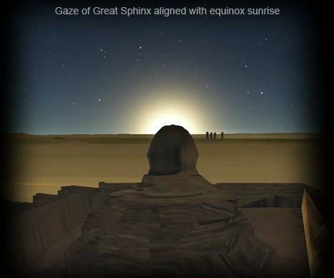
Great Sphinx Aligned with the Equinox Sunrise
on the West Bank of the Nile

Slide 77
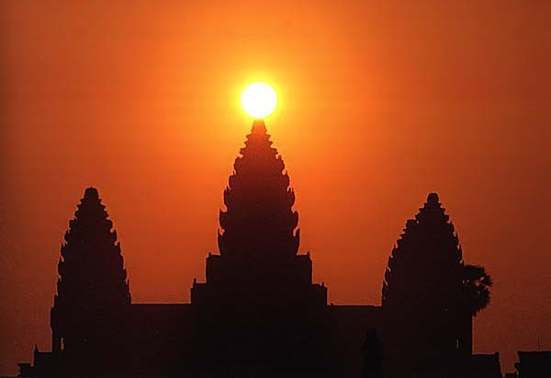
Equinox Sun Aligned with Cambodian Temple
Determine the Equinox
the easy way!

Slide 78
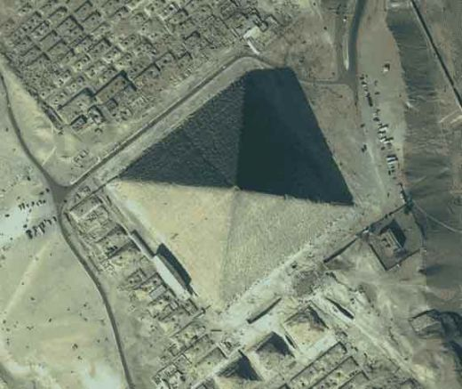
Giza Pyramid:
No Turning of Shadow!

Slide 79

Pyramid Math
The design of the pyramids can accurately calculate ONLY the equinox because the movements of the Mazzaroth and the sun are perfect – untouched by any man including pagans!

Slide 80
Pyramid Math
The shadow/sign on the Giza pyramid easily tells the day of the spring and/or fall equinox very accurately every year.

Slide 81
Pyramid Math
The shadow/sign of the summer solstice is noted when the shadow of just one small pyramid is cast upon the great Giza pyramid.

Slide 82
Pyramid Math
The shadow/sign of the winter solstice is noted when the shadow of all three small pyramids is cast upon the great Giza pyramid.
Equi-LUX is not part of this equation!

Slide 83

Problem #6 ~ The Sanctuary!
There is a special design for the sanctuary that needs consideration.
Will the sanctuary have the last word on what to do with the equinox?
Will the sanctuary
declare “equinox”
as divine, or as a
pagan counterfeit?
Notes:
Information from paper from Tersia in her file called Tequfah Controversy --
Light research for the name of the pillars: Right pillar: Jachin H3199 = “he will establish” (The kingdom of the house of David was established.)
Left pillar: Boaz H1162 “fleetness” [SPEEDINESS/RAPIDNESS] = All the kings from the house of Judah descended from Boaz.

Slide 84

Equinox: Sanctuary Math
Priests had their backs to the sun – except in Ezekiel 8!
Jachin
Boaz
Sanctuary Always Faced East with 2 Pillars at the Front
Notes:
Jachin and Boaz positions: The Bible deals with the pillars in three main passages: I Kings 7:15-22, 41-42 (cf. II Kings 25:17); II Chronicles 3:17; and Jeremiah 52:20-23. The version in I Kings reads, He [Hiram] set up the columns at the portico of the Great Hall; he set up one column on the right and named it Jachin, and he set up the other column on the left and named it Boaz. Upon the top of the columns there was a lily design. Thus the work of the columns was completed (verses 21-22). The text in II Chronicles states: He erected the columns in front of the Great Hall, one to its right and one to its left; the one to the right was called Jachin, and the one to the left, Boaz.
Information from paper from Tersia in her file called Tequfah Controversy --
Light research for the name of the pillars: Right pillar: Jachin H3199 = “he will establish” (The kingdom of the house of David was established.)
Left pillar: Boaz H1162 “fleetness” [SPEEDINESS/RAPIDNESS] = All the kings from the house of Judah descended from Boaz.

Slide 85
Equinox: Sanctuary Math
Priests had their backs to the sun – except in Ezekiel 8!
Jachin
Equinox
Light
Boaz
Sanctuary Always Faced East with 2 Pillars at the Front
On the Equinox Day, the light from the sun shone directly between Jachin & Boaz, straight into the sanctuary.
Notes:
Jachin and Boaz positions: The Bible deals with the pillars in three main passages: I Kings 7:15-22, 41-42 (cf. II Kings 25:17); II Chronicles 3:17; and Jeremiah 52:20-23. The version in I Kings reads, He [Hiram] set up the columns at the portico of the Great Hall; he set up one column on the right and named it Jachin, and he set up the other column on the left and named it Boaz. Upon the top of the columns there was a lily design. Thus the work of the columns was completed (verses 21-22). The text in II Chronicles states: He erected the columns in front of the Great Hall, one to its right and one to its left; the one to the right was called Jachin, and the one to the left, Boaz.
Information from paper from Tersia in her file called Tequfah Controversy --
Light research for the name of the pillars: Right pillar: Jachin H3199 = “he will establish” (The kingdom of the house of David was established.)
Left pillar: Boaz H1162 “fleetness” [SPEEDINESS/RAPIDNESS] = All the kings from the house of Judah descended from Boaz.

Slide 86
Equinox: Sanctuary Math
Priests had their backs to the sun – except in Ezekiel 8!
Summer
Solstice
Jachin
Boaz
Sanctuary Always Faced East with 2 Pillars at the Front
On the day of the Summer Solstice, the light of the sun intersects the Jachin Pillar shining into the SW corner.
Notes:
Jachin and Boaz positions: The Bible deals with the pillars in three main passages: I Kings 7:15-22, 41-42 (cf. II Kings 25:17); II Chronicles 3:17; and Jeremiah 52:20-23. The version in I Kings reads, He [Hiram] set up the columns at the portico of the Great Hall; he set up one column on the right and named it Jachin, and he set up the other column on the left and named it Boaz. Upon the top of the columns there was a lily design. Thus the work of the columns was completed (verses 21-22). The text in II Chronicles states: He erected the columns in front of the Great Hall, one to its right and one to its left; the one to the right was called Jachin, and the one to the left, Boaz.
Information from paper from Tersia in her file called Tequfah Controversy --
Light research for the name of the pillars: Right pillar: Jachin H3199 = “he will establish” (The kingdom of the house of David was established.)
Left pillar: Boaz H1162 “fleetness” [SPEEDINESS/RAPIDNESS] = All the kings from the house of Judah descended from Boaz.

Slide 87
Equinox: Sanctuary Math
Priests had their backs to the sun – except in Ezekiel 8!
Jachin
Boaz
Winter
Solstice
Sanctuary Always Faced East with 2 Pillars at the Front
On the day of the Winter Solstice, the light of the sun intersects the Boaz Pillar shining into the NW corner.
Notes:
Jachin and Boaz positions: The Bible deals with the pillars in three main passages: I Kings 7:15-22, 41-42 (cf. II Kings 25:17); II Chronicles 3:17; and Jeremiah 52:20-23. The version in I Kings reads, He [Hiram] set up the columns at the portico of the Great Hall; he set up one column on the right and named it Jachin, and he set up the other column on the left and named it Boaz. Upon the top of the columns there was a lily design. Thus the work of the columns was completed (verses 21-22). The text in II Chronicles states: He erected the columns in front of the Great Hall, one to its right and one to its left; the one to the right was called Jachin, and the one to the left, Boaz.
Information from paper from Tersia in her file called Tequfah Controversy --
Light research for the name of the pillars: Right pillar: Jachin H3199 = “he will establish” (The kingdom of the house of David was established.)
Left pillar: Boaz H1162 “fleetness” [SPEEDINESS/RAPIDNESS] = All the kings from the house of Judah descended from Boaz.

Slide 88
Equinox: Sanctuary Math
Priests had their backs to the sun – except in Ezekiel 8!
Summer
Solstice
Jachin
Equinox
Light
Boaz
Winter
Solstice
Sanctuary Always Faced East with 2 Pillars at the Front
Why would Yahuah design His Sanctuary to receive these “lights” if “equinox” is only linked to paganism?
Notes:
Jachin and Boaz positions: The Bible deals with the pillars in three main passages: I Kings 7:15-22, 41-42 (cf. II Kings 25:17); II Chronicles 3:17; and Jeremiah 52:20-23. The version in I Kings reads, He [Hiram] set up the columns at the portico of the Great Hall; he set up one column on the right and named it Jachin, and he set up the other column on the left and named it Boaz. Upon the top of the columns there was a lily design. Thus the work of the columns was completed (verses 21-22). The text in II Chronicles states: He erected the columns in front of the Great Hall, one to its right and one to its left; the one to the right was called Jachin, and the one to the left, Boaz.
Information from paper from Tersia in her file called Tequfah Controversy --
Light research for the name of the pillars: Right pillar: Jachin H3199 = “he will establish” (The kingdom of the house of David was established.)
Left pillar: Boaz H1162 “fleetness” [SPEEDINESS/RAPIDNESS] = All the kings from the house of Judah descended from Boaz.

Slide 89

Sanctuary: Yahuah’s Design
1st Question: If the equinox is purely a pagan invention,
then why did Yahuah insist His sanctuary be constructed to receive the “light” directly
into the Most Holy Place
on the day of equinox?
2nd Question:
Or, was this Yahuah’s simple and perfect design for His people to declare His
year-start
(the day after the equinox) without having to look
to the moon or
to the sun?
Notes:
Information from paper from Tersia in her file called Tequfah Controversy --
Light research for the name of the pillars: Right pillar: Jachin H3199 = “he will establish” (The kingdom of the house of David was established.)
Left pillar: Boaz H1162 “fleetness” [SPEEDINESS/RAPIDNESS] = All the kings from the house of Judah descended from Boaz.

Slide 90

The Conclusion of the Matter
Ecclesiastes 12:13
Let us hear the conclusion
of the whole matter:
Fear [Yahuah], and keep his commandments: for this is the whole duty of man. [Even His Torah commands for Covenant Calendar.]
Prov 25:2 It is the glory of [Yahuah] to conceal a thing: but the honour of kings is
to search out a matter.
Luke 12:2
For there is
nothing covered,
that shall not
be revealed;
neither hid,
that shall not
be known.

Slide 91

Refuting Counterfeit Calendars egw quote
A Thought to Ponder
The points of Yahuah’s Covenant Calendar which are to be presented to others must be rooted in His Word. It is important, in defending this marvelous teaching that everything be considered.
We should never consider arguments that are not wholly sound because while they may silence the accuser, they do not uphold the truth of Yahuah’s Covenant Calendar.
Scriptural arguments must be presented that will not only silence every opponent, but will also bear the closest and most searching scrutiny. Every calendar is thus accountable.

Slide 92

Equi-lux has too much variance to qualify for Yahuah’s plan for year-start.
The definition
of the word
“evening” is the
cornerstone for unraveling the
equi-LUX confusion.

Slide 93

Equi-LUX is a whirlwind of confusion which can only be exposed by a proper study of Yahuah’s Covenant Calendar.
Eph 5:8 & 11 For ye were sometimes darkness, but now are ye light in [Yahuah]:
walk as children of light: 11 And have no fellowship with the unfruitful works of darkness, but rather reprove them.
1 Cor 14:40 Let all things be done
decently and in order.

Slide 94

All Problems are Solved ~
By Looking into Yahuah’s Word
So far,
Yahuah’s Covenant Calendar
detects all the counterfeits
and solves every
calendar problem!
It’s easy ~
try it!
Notes:
Finished Mar 30/18 9:15 pm – 2 very long days on this PPT – about 30 hrs..
Proofed: 1041 PM

Slide 95

Project: Learn how to determine
the equinox by tracking “no shadow”
or a shadow with “no arc.”
equi-LUX – being named as equal day and equal night – that particular event varies greatly around the world with many dates within a 5+ week span of time.
Their day begins with sunrise.
Their day ends with sunset.

Slide 96

Next Study: Rev 12 &
The Woman Standing
on the Moon
by
Timothy Astleford
Does the “moon” have
a prominent position
in Rev 12, or not?

Slide 97


The End
Send your questions/comments to:
charlene@torahtothetribes.com

