Slide 1
Jan 28/18:
Fixed title page and final slide with new email address; emailed PDF to Mario to upload to website.
Mar 25/18
Fixed all sacred names and another Yah spelling mistake on #42. Made new PDF.
Got ready for CCC Website.
Exodus 12 Passover ~ to Exodus 16 Quail/Manna ~ to Exodus 19 Pentecost

Slide 2
Yahuah’s
Elegant Calendar
From Exo 12 Passover to Exo 20 Pentecost
Yahuah’s Calendar addresses all components for the Day, Month and Year ~ according to Yahuah’s divine design, (not man’s traditions).
This presentation introduces the month-start & month-length.

Slide 3
Section #1
Exodus 12 – 1st Month
Interesting note:
The 2018 Covenant Feast Calendar is identical to this study.
Preparation for Egyptian Deliverance
~ Passover ~
This is a very important chapter.
Everything starts right here for understanding the month-start.
However, we cannot be firm about all dates until we work to the end of Exodus 19 with information from the 3rd month.
Remember, we are using the calculations of 30 days/month according to the information given in Genesis 7-8:
5 months = 150 days
(Gen 7:11; 8:4 & Gen 7:24 & 8:3)

Slide 4
Important Note About the Placement of Passover
Abib 1 must begin on Wednesday, the 4th day of the week (in THIS year ONLY). This selection has not been “pulled out of thin air.” Such a placement is divinely appointed by Yahuah with the command of “3 days’ travel” to accurately determine several appointed times in this study such as:
“weekday” of Exo 12 Passover
“manna week” of Exo 16
“Pentecost date” of Exo 19 (which will also confirm the “Firstfruits date” of Exo 12.)

Slide 5
Scriptural Clues to Discover Timing
Yahuah does not repeat things of “no great consequence.”
Remember Pharaoh’s dream of the 7 cows & 7 heads of grain in Gen 41:17-31 indicating the 7 years of plenty, then the 7 years of famine.
Gen 41:32 then says: And the dream was repeated to Pharaoh twice because the thing is established by [Yahuah], and [Yahuah] will shortly bring it to pass. NKJV
If a command that is repeated twice is important, what about a command that is repeated 3 times?

Slide 6
A Command Given by Yahuah 3 Times
In preparation for the flight from Egypt, the “the length of the departure” is given THREE times with the reason as to why.
1st command in Exo 3:18 - Yahuah tells Moses: Ye shall say unto him, The [Elohim] of the Hebrews hath met with us: and now let us go, we beseech thee, three days' journey into the wilderness, that we may sacrifice to our [Elohim].
2nd command in Exo 5:3 is from Moses to Pharaoh: And they [Moses & Aaron] said, The [Elohim] of the Hebrews hath met with us: let us go, we pray thee, three days' journey into the desert and sacrifice unto [Yahuah our Elohim]; lest he fall upon us with pestilence, or with the sword.
3rd command in Exo 8:27 is Moses’ reminder to Pharaoh: We [Israel] will go three days' journey into the wilderness, and sacrifice to [Yahuah our Elohim], as he shall command us. KJV

Slide 7
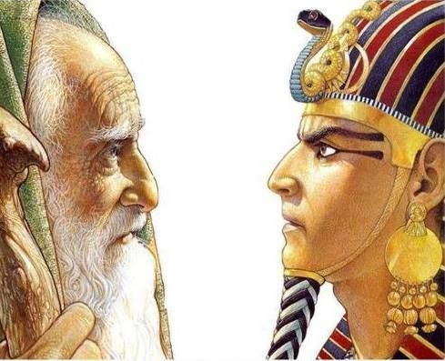
Yahuah’s Command is Very Specific
Yahuah fully intended a minimum of three cycles (days) of travel for the Hebrew nation before they were required to SAFELY SACRIFICE to Him. This point is extremely crucial to recognize.
But, Pharaoh suggested another option.

Slide 8
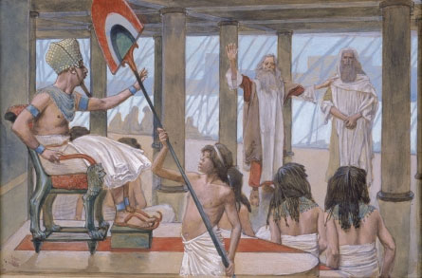
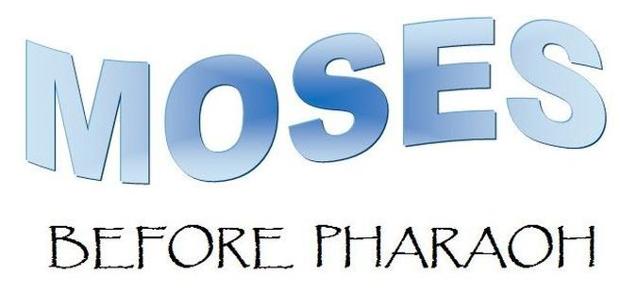
What did Pharaoh Suggest?
Exo 8:25 Pharaoh then called for Moses and Aaron, and said, Go, slaughter to your Elohim in the land.
Exo 8:26 And Moses said,
It is not right to do so, for we would be slaughtering the abomination of the Egyptians to [Yahuah] our Elohim. See, if we slaughter the abomination of the Egyptians before their eyes, would they not stone us?

Slide 9
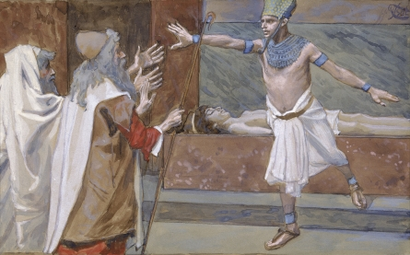
The “3 day command” is Absolute!
Exo 8:27 Let us go three days’ journey into the wilderness, then we shall slaughter to [Yahuah] our Elohim,
AS HE COMMANDS US.
Why? The sacrificing of animals “in the land” [that were considered sacred by the Egyptians] would be a serious offense to them.
Yahuah knew Israel would need 3 cycles of travel, before any sacrificing to eliminate additional problems.
Under high stress created by Yahuah, Pharaoh accepted this reasoning but only after losing his son and the nation’s firstborn of each home.

Slide 10
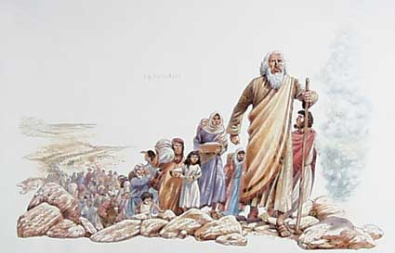
The Next Important Consideration
In order to have 3 cycles of travel into the wilderness, without violating the weekly Sabbath, it is impossible for Passover to land on cycles 4 to 7 (or Wed, Thurs, Fri & Sabbath).
The following Scriptural evidence will show beyond any doubt that the Passover of Moses was celebrated on Tuesday; with departure on Wednesday morning.
How can we know for sure? By the placement of: 1) the day of departure; 2) 3 days’ of travel; 3) the time of crossing the Red Sea; 4) determining which day is the Sabbath; 5) the placement of Firstfruits for the purpose of … 6) the 50 day Omer Count to Pentecost.

Slide 11
1. Exo 12:3 ‘On the tenth day of this month … take a lamb.
2. Exo 12:6 (a) ‘And you shall keep it until the fourteenth day of the same month. Then all the assembly of the congregation of Yisra’ĕl shall kill it between the evenings. Exo 12:8 ‘And they shall eat the flesh on that night, roasted in fire – with unleavened bread and with bitter herbs they shall eat it. Exo 12:22 “… and you, none of you shall go out of the door of his house until morning [Dawn of Abib 15].
3. Lev 23:6 ‘And on the fifteenth day of this month is the Festival of Unleavened Bread to Yahuah – seven days you eat unleavened bread.
morning - OT:1242 boqer (bo'-ker); from OT:1239; properly, dawn (as the break of day); generally, morning: KJV - (+)day, early, morning, morrow.

Slide 12
Three Days’ Journey Before Crossing the Red Sea
4. Exo 12:37 And the children of Yisra’ĕl set out from Raʽmeses to Sukkoth … [Num 33:3]
5. Exo 13:20 And they departed from Sukkoth and camped in Ětham … [Num 33:6]
6. Exo 14:2 … turn and camp before Pi Haḥiroth, between Miḡdol and the sea … [Num 33:7]
7. This brings us through the Light Season of the 3rd day of travel. The NIGHT SEASON will be picked up after first viewing more information.
8. The Hebrew nation had now travelled through the 3rd Light Season [Abib 17] with the intent of camping at Pi Hahiroth. But, there is something brewing in the background!

Slide 13
Promise of Deliverance From the Egyptians
Exo 14:9 And the Egyptians pursued them, and all the horses and chariots of Pharaoh, and his horsemen and his army, and overtook them camping by the sea beside Pi Haḥiroth … (This is on Abib 17.)
Exo 14:13 And Moses said to the people, “Do not be afraid. Stand still, and see the deliverance of [Yahuah], which He does for you today. (Abib 17) For the Egyptians whom you see today (Abib 17), you are never, never to see again.
QUE S T I ONS
Note: Sunset Theory claims the day begins at sunset. 1) When will the salvation of Yahuah occur? 2) Will salvation be realized before the sunset (on Abib 17) … or 3) Will Israel’s experience of “Salvation Today” (KJV) actually be realized at the break of Dawn, the true ending of the “today” … on the 17th?
Most importantly …4) will the Scriptures tell us exactly what “day” Israel was delivered, so there is absolutely no mis-understanding? 5) Is Yahuah’s calendar that precise?

Slide 14
Getting Ready to Cross the Red Sea
9. The next phase of this journey begins with the Friday Night Season on the 3rd day of travel out of Egypt. The Israelites are now ready to cross the Red Sea on dry ground. This crossing of the Red Sea took place during the Night Season of Abib 17, ending just before Dawn of the 7th Day Sabbath!
Notice: there is only 1 fully completed week in Abib so far towards the 7 week Omer count.

Slide 15
Deliverance Before Sabbath Dawn
10. Crossing of the Red Sea during the Night Season of Abib 17.
11. Exo 14:26, 27, 30 Yahuah said … “Stretch out your hand over the sea, and let the waters come back on the chariots and horsemen.” 27 And Mosheh stretched out his hand over the sea, and the sea returned to its usual flow, at the break of day, [on Abib 18] with the Egyptians fleeing into it. Thus Yahuah overthrew the Egyptians in the midst of the sea, 30 Thus Yahuah saved Israel that day [Abib 17] out of the hand of the Egyptians.
“Break of day” is where the new day begins. This was the moment of deliverance. The Scriptures do not say the new day began with sunset.
Abib 18th
Abib 17th

Slide 16
Patterns in the Scriptures Are Abundant
There are many that believe our Messiah died on a Friday cross.
They also believe this is supported with a Friday Passover in Exodus 12.
They believe this because it seems to be a pattern.
Is there any possible way the Exodus 12 Passover could have been on a Friday?
Let’s examine the evidence one more time.

Slide 17
No Possibility of Friday Passover in Egypt
Important Note: The possibility of a 6th cycle (Friday) Passover in Egypt is completely eliminated due to the fact Yahuah had made NO PROVISION or ALLOWANCE for moving out of Egypt, or crossing the Red Sea, on the 7th Day Sabbath. Upon the arrival of Sabbath, their three days’ journey and deliverance was complete. In fact, Israel was on the other side of the Red Sea as Sabbath began to dawn.

Slide 18
Exodus 15
Short
REVIEW
Song of Moses & Song of Miriam
Red Sea crossing all night with Yahuah’s bright cloud guiding the way must have been exciting.
Deliverance from the Egyptians just before DAWN must have been exciting.
Is there any wonder Exodus 15 records the Song of Moses and the Song of Miriam?
Abib 18 on the other side of the Red Sea was the weekly 7th Day Sabbath.
It was a day of Praise and worship. Ex 15:20 records all the women went after Miriam with timbrels and dancing.
Question: Do you think the people were travelling Sabbath? Absolutely not! Not when the ladies are celebrating the recent deliverance and salvation.

Slide 19
Exodus 16 – 2nd Month
Section #2
Arrival of Quail the 1st Time
~ Manna Week ~
We have not established with clarity the timing of Passover in the month of Abib yet.
Exodus 16 has the next timing clue.
In this 2nd month, we are still counting the Omer weeks, looking for 7 completed weeks before Pentecost.
Next is an investigation of the exact “day” and “date” for the arrival of quail and manna in the 2nd month (Zif).
Exodus 16:1 declares Israel entered the Wilderness of Sin on the 15th day of the 2nd month.
Counting 30 days from Wednesday Abib 15 we can pinpoint with exactness which day they arrived in the Wilderness of Sin. (We are still implementing an assumption!)
Remember, there’s no travelling on the 7th day Sabbath, ever!

Slide 20
30 Day Count from Abib 15 to Zif 15
12. Left Egypt on Abib 15.
13. Abib 30 is 15 days since leaving Egypt.

Slide 21
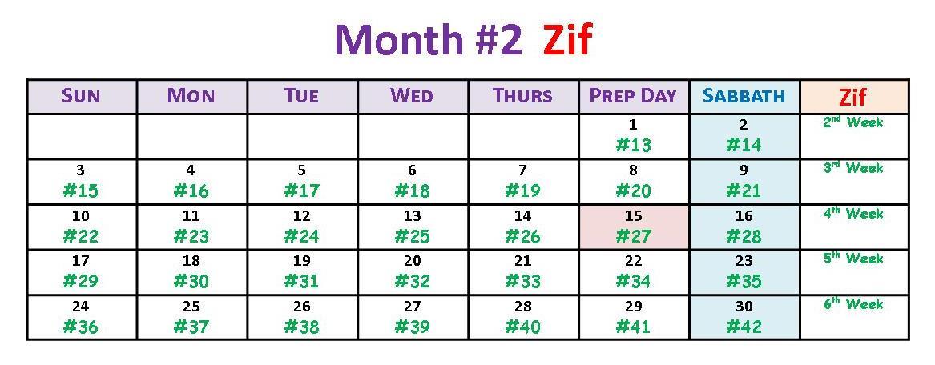
Arrival in the Wilderness of Sin
14. Exo 16:1 And they took their journey from Elim, and all the congregation of the children of Israel came unto [travelled into] the wilderness of Sin, which is between Elim and Sinai, on the fifteenth day of the second month after their departing out of the land of Egypt.

Slide 22
Abib 15-30 = 15 days - Zif 1-15 = 15 days
15. Note: Israel travelled all day on Zif 15 to enter the wilderness of Sin. They were not murmuring then. However, that all changed by Zif 16 – the Sabbath – the day they were assembled for worship!
16. Note: Once they were stopped for the Sabbath rest, there was time to complain, and they did! Exo 16:2 … the whole congregation of the children of Israel murmured against Moses and Aaron in the wilderness [for Egypt’s flesh pots].

Slide 23
What was the Murmuring all About?
Exo 16:3 And the children of Israel said unto them [Moses & Aaron], Would to Yahuah we had died by the hand of the LORD in the land of Egypt, when we sat by the flesh pots, and when we did eat bread to the full; for ye have brought us forth into this wilderness, to kill this whole assembly with hunger. KJV
Clearly, the complaining has something to do with the flesh pots!
This term appears only once in the Scriptures.
Israel had “flesh” in the form of “clean meats” all around them in the herds of livestock including bulls, oxen, heifers, goats, lambs, etc. Could they not have helped themselves at any time?
Apparently not!!
Why not?

Slide 24
Qualifications of Sacrificial Animals
The life of the Hebrew people revolved somewhat around the sacrifices. Every man, without exception, was responsible for their part and the men with families were also responsible for the entire family.
In the Levitical laws, if a family desired flesh for a meal, they were required to offer the animal at the Tabernacle as a sacrifice to Elohim as the primary step before eating the flesh. Clearly, every meal of flesh was a type of sacrifice of some sort.
Question: Would this mean that the “sacrificial animals” (before the Exodus) would have been offered first at the individual family alter before partaking of it for dinner table food?
Is this a requirement of Covenant? … of the Law of the Altar?
Would the sacrifices that Abraham prepared in Gen 15 be a clue?

Slide 25
Laws for Using Sacrificial Animals as Food
Lev 17:3, 4, 6 What man so ever there be of the house of Irael, that killeth an ox, or lamb, or goat, in the camp, or that killeth it out of the camp, 4 and bringeth it not unto the door of the tabernacle of the congregation, to offer an offering unto [Yahuah] before the tabernacle of the LORD; blood shall be imputed unto that man; he hath shed blood; and that man shall be cut off from among his people. 6 And the priest shall sprinkle the blood upon the altar of [Yahuah] at the door of the tabernacle of the congregation, and burn the fat for a sweet savour unto [Yahuah]. KJV
The specific sacrificial animals mentioned are the ox, or lamb, or goat.
Could it be these specific sacrificial animals were not considered the flesh pots of Egypt?

Slide 26
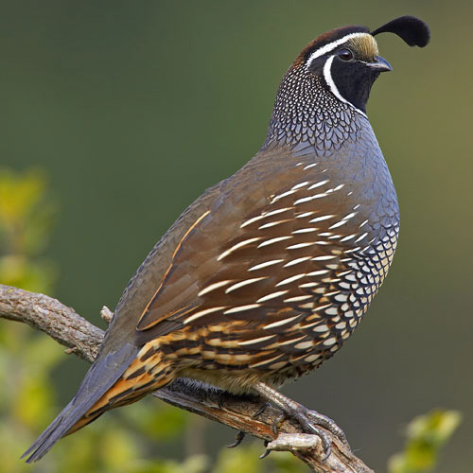
A Few Facts About Quail
The quail is known for its very tender, juicy meat -- delicate to the desires of taste buds.
The spring was also the time of the year that quail migrate north in large numbers.
Due to the long migration path, and being a heavy bird, they tire easily, will fly low to the ground, and can be easily caught.
They also fly in large groups -- sort of like locusts ... bedding down for the night just before sundown, resting in groups of 75+ for safety.
Quail delicacies were an Egyptian treat in the spring of the year. They were easy to catch; and easily preserved by drying in the hot sun.
Could this information fit the context of flesh pots?
Quail are not mentioned as one of the listed sacrificial animals that would first have to be offered as a sacrifice before partaking of it.
Was Israel clamoring for quail as the flesh pots of Egypt?

Slide 27
Arrival of the Quail
17. Question: What was Yahuah supposed to do with this complaining? Exo 16:12 “I have heard the grumblings of the children of Israel. Speak to them, saying, ‘Between the evenings you are to eat meat … And you shall know that I am [Yahuah] your Elohim.’ ”
Yahuah Sends Quail! Exo 16:13
18. Exo 16:13(a) And it came to be that quails came up at evening and covered the camp …

Slide 28
The Quail Arrive on Sabbath Zif 16 and are Devoured the Same Day!
The quail arrive to satisfy the “flesh pot” desires of the people. Arrival of the quail would be typical for this time of the year.
How do we reconcile the fact that Quail arrived on Sabbath, and the people are promised they will eat them before the Sabbath day ends at DAWN the next day? Is this a violation of the weekly Sabbath?

Slide 29
Arrival of the Quail (before the Manna)
Like most other fowl, quail typically bed down for the night just shortly before sundown. They usually do not “roost” but will huddle together in large groups of 75 other quail for protection. Feeding times are normally early in the morning, and evening.
It is very reasonable to understand the arrival of the quail in the evening hours of the day. Flying low, they would be easy to catch.
It is also obvious there was “work involved” to catch, kill, and cook the quail on the Sabbath hours that did not end till the DAWN of the next day.
Did Yahuah “tempt His people” or just “answer their charge” that it was His responsibility to take care of them, even if it was to fulfill their sinful desires they had been clamoring for?
Often Yahuah gives us what we ask for, even when it is not best for us. It’s quite obvious these rebellious people were working on the Sabbath. At this point it seems they cared little about the holiness of the Sabbath.
The passage is clear on identifying this problem is with Israel, not just the great multitude of the Egyptians. This was the reason why Yahuah had to implement the week of manna structure. They simply did not know the proper way to observe the Sabbath.

Slide 30
Was Quail Preparation a Violation of Sabbath?
Let’s read the following verse first:
Exo 16:23 And he said unto them, This is that which the [Yahuah] hath said, To morrow is the rest of the holy sabbath unto the [Yahuah]: bake that which ye will bake to day, and seethe that ye will seethe; and that which remaineth over lay up for you to be kept until the morning. KJV
Moses gave very strict commands for Sabbath observance regarding food preparation. Absolutely, no cooking or baking!
The complete Sabbath day cycle is from Sabbath DAWN to the break of DAWN on the 1st day. However, Quails were available for cooking during the Day Season of the Sabbath evening hours.
According to these instructions, it appears Israel was in violation of dishonoring the Sabbath with the quail preparations. However, the context of verse 23 is 6 days later, given on Zif 22. The quail arrived on Zif 16.
The question is this: Even if “some” of Israel knew about these Sabbath requirements, would Yahuah hold all of them responsible (for complete Sabbath observance) when His full instructions had not been given yet?
Or would He “wink” at their ignorance this time?
No, He did not wink, because He had not given them full instructions yet.

Slide 31
Note: 4th Week of the Omer Count is now complete.
Zif 16 (Sabbath) Quail Arrive
Ex 16:13 (a) And it came to pass, that at even [Zif 16] the quails came up, and covered the camp:
Next: The Manna Week

Slide 32
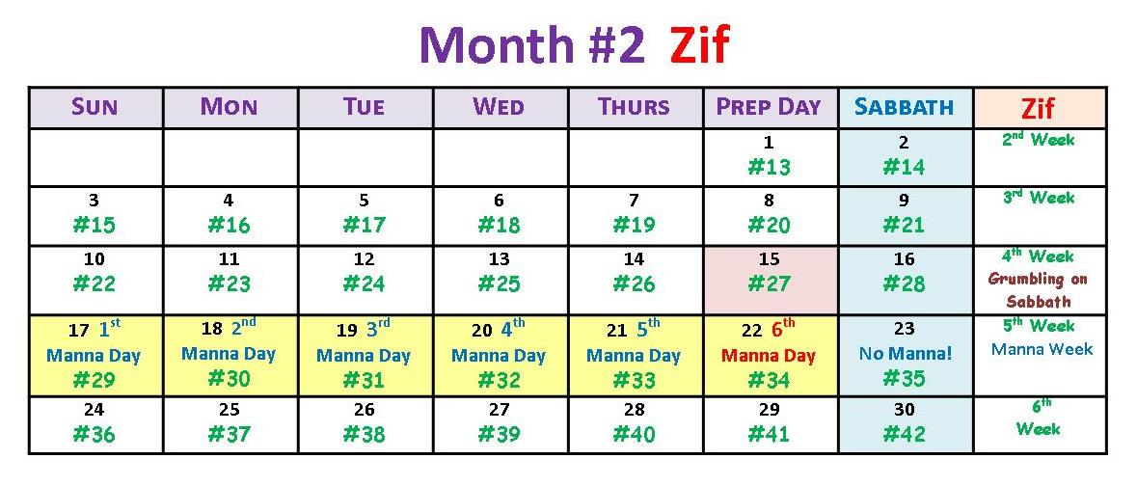
The First Manna Week
19. Exo 16:12(b) … and in the morning you are to be satisfied with bread [manna]. Exo 16:13(b) … in the morning [Zif 17] the dew lay all around the camp. Exo 16:15 … And Moses said to them, “It is the BREAD [manna] which [Yahuah] has given you to eat.” Exo 16:21 And they gathered it every morning. [17-22] Exo 16:22 … on the sixth day [Zif 22], they gathered twice as much bread …
20. Exo 16:23 And he said to them, “this is what [Yahuah] has said, ‘Tomorrow is a rest, a Sabbath set apart to [Yahuah]. That which you bake, bake, and that which you cook, cook. And lay up for yourselves all that is left over, to keep it until morning.’ ”

Slide 33
The Importance of the First Manna Week
Counting from a Tuesday Passover of Abib 14, the Scriptural timing places the first arrival of the manna on the morning of the 1st day of the week. This establishes the pattern of: “work six days, rest the seventh.” What would happen with a Wednesday or Friday Passover in the month of Abib?
Wednesday Passover places the first arrival of manna on Monday, Zif 18.
Friday Passover places the first arrival of manna on Wednesday, Zif 20.
Neither option can establish the pattern from the Creation Week!
Notes:
Fix #71 error

Slide 34
REVIEW
This completes Section #2 and a few of the high points for the 2nd month to demonstrate the perfect Manna Week. Manna fell for the first time on the 1st day of the week, so six days of gathering was completed before the Sabbath, establishing the pattern in the Creation week.
Let’s review this information on the Abib and Zif calendars, before we move to Sivan – the 3rd month.
Notice, both months have 30 days/month. This never happens with a Lunar Calendar, or the Roman Calendar!

Slide 35
Note: 5th Week of the Omer Count is now complete.

Slide 36
Exodus 19 – 3rd Month
Section #3
Preparation for Receiving the Law
~ Pentecost ~
We have not established with clarity the timing of Passover in the month of Abib yet.
Exodus 16 had the 2nd timing clue with the arrival of the manna.
In this 3rd month, we will be completing the count for the Omer weeks, looking for 7 completed weeks before Pentecost.
Next is an investigation of the exact “day” and “date” of Israel’s arrival into the Wilderness of Sinai, and the exact “day” and “date” of the 50th day – Pentecost, also declaring the dating of Firstfruits!
Calendar Clues: Exodus 19:1 states Israel entered the Wilderness of Sinai on a very specific day of the 3rd month.

Slide 37
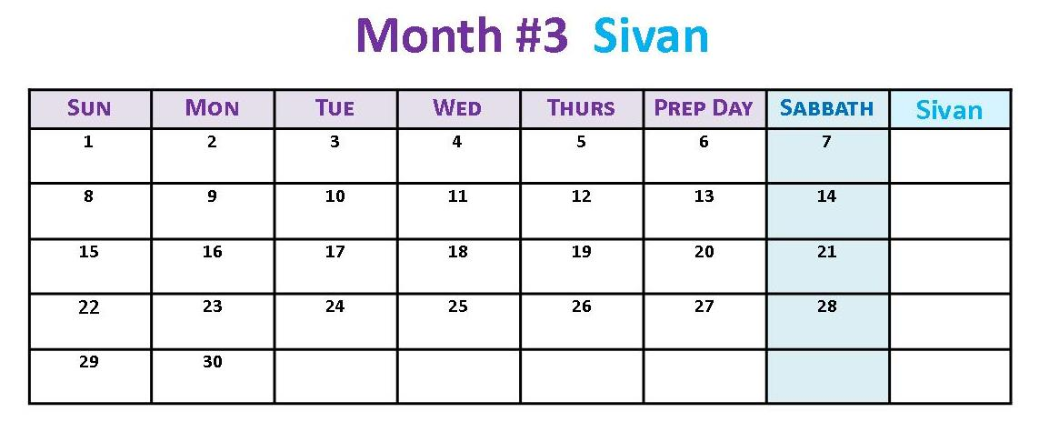
Which Day Did Israel Enter the Wilderness of Sinai?
We are now ready to examine the calendar for Sivan, the 3rd month.
There are calendar clues in this verse to tell us where to begin with our count – as we are still searching for firm dates for Passover and Pentecost. Verse 1 tells us Israel entered the Wilderness of Sinai on this [same] day that they departed from Egypt. They departed from Egypt on Wednesday, Abib 15. There are only two options: Sivan 15, or a Wednesday! Which will it be?
Exo 19:1 In the third month after the children of Israel had come out of the land of Egypt, on this [same] day they came to the Wilderness of Sinai.

Slide 38
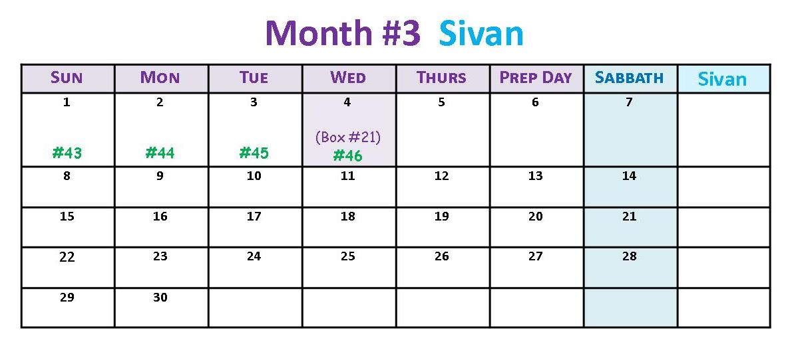
Entering the Wilderness of Sinai
21. Exo 19:1 In the third month after the children of Israel had come out of the land of Egypt, on this day [a Wed. or the 15TH] they came [entered] to the Wilderness of Sinai.
The Omer Count for Sivan 1 is Day #43 of 50. Because Pentecost is on the 50th Day, we can automatically eliminate Sivan 15 as one of the choices for when Israel entered the Wilderness of Sinai. It’s not before Pentecost, and not a Wednesday!
Let’s choose Sivan 4th as the “day and date” Israel entered the Wilderness of Sinai. Keep in mind, Israel is NOT at the foot of Mt Sinai yet.
They entered the Wilderness of Sinai on Wed. the 4th of Sivan.
Sivan 15 is not an acceptable candidate for the “day and date” of entering the Wilderness of Sinai.

Slide 39
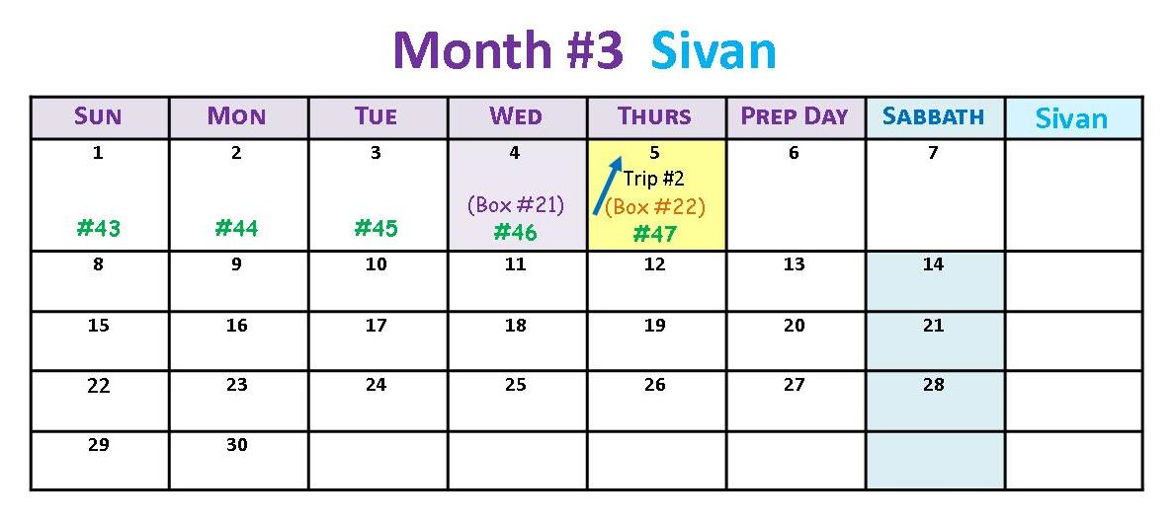
At the Foot of Mount Sinai - Sivan 5
Exodus 19:2 announces Israel is at the foot of Mt Sinai. This is Omer Count #47.
Moses’ first encounter at Mt Sinai was at the burning bush. This 2nd encounter at Mt Sinai is a trip UP the mountain. Yahuah has some instructions for Moses, as Melchizedek Priest, to give to the people in preparation for a great event in a few days. (This is Moses’ 2nd encounter at Mt Sinai, being labeled as Trip #2.)
22a. Exo 19:2 For they were departed from Rephidim, and were come to the desert of Sinai, and had pitched in the wilderness; and there Israel camped before the mount.
22b. *** Moses’ Ascends Mt Sinai (Thurs Sivan 5) *** Exo 19:3 And Mosheh went up to Elohim, and Yahuah called to him from the mountain …

Slide 40
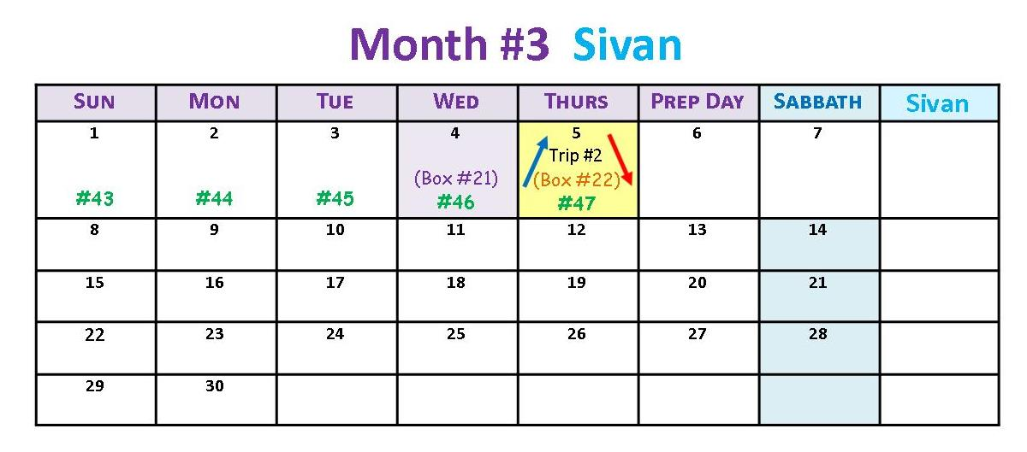
Moses Descends Mount Sinai – Sivan 5
Moses receives Yahuah’s Covenant proposal to give to the people.
22c. *** Moses Descends from Mt Sinai (Thurs Sivan 5) ***
Exo 19:7 And Mosheh came [down and] and called for the elders of the people, and set before them all these words which Yahuah commanded him.
Exo 19:8(a) And all the people answered together and said, “All that Yahuah has spoken we shall do.”

Slide 41
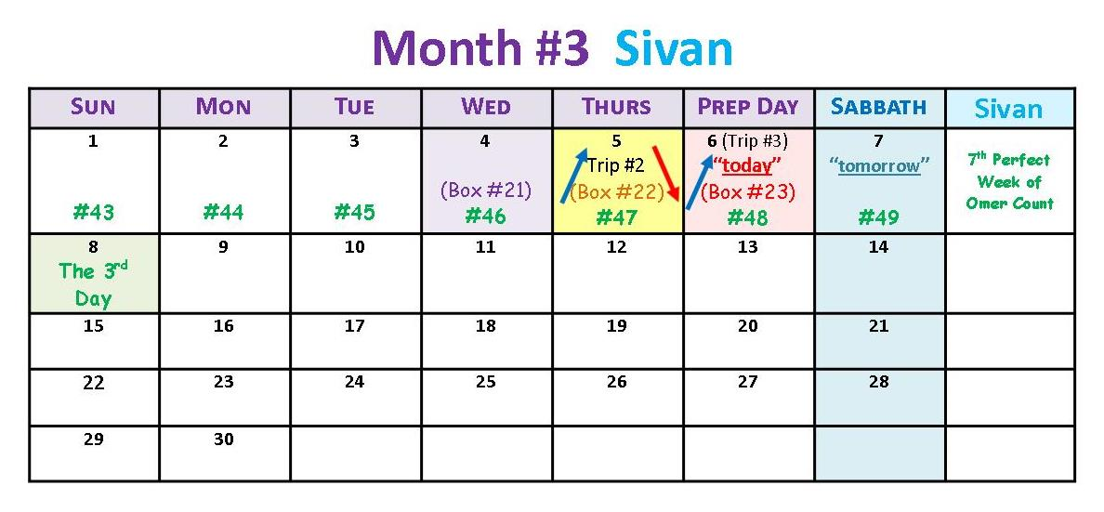
Moses Ascends Mount Sinai – Sivan 6
Moses takes the words of the people back to Yahuah; they accept His covenant proposal.
23a. *** Moses Ascends Mt Sinai (Preparation Day Sivan 6) ***
Exo 19:8(b) So Moses [goes back up the mountain and] brought back the words of the people to Yahuah.
Exo 19:10-11 And Yahuah said to Moses, “Go to the people and set them apart today [Sivan 6] and tomorrow [Sivan 7]. And they shall wash their garments, [11] and shall be prepared by the third day. For on the third day [Sivan 8], Yahuah shall come down upon Mount Sinai before the eyes of all the people.
Note the 3 clues given on Sivan 6: today, tomorrow, and the 3rd day.

Slide 42
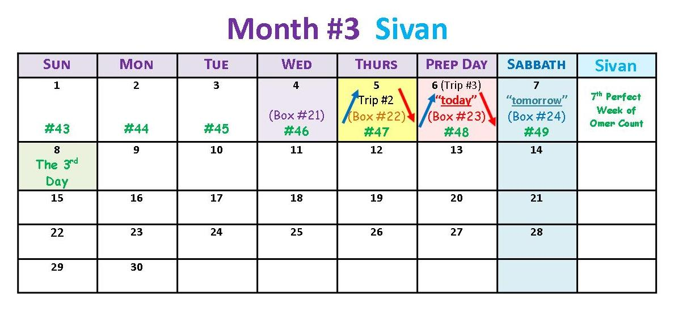
Moses Descends Mount Sinai – Sivan 6
Moses brings back to the people the next set of instructions from Yahuah.
23b. *** Moses Descends from Mt Sinai (Preparation Day Sivan 6) ***
Exo 19:14 And Moses went down from the mount unto the people, and sanctified the people; and they washed their clothes.
Exo 19:15 And he said unto the people, Be ready against the third day: come not at your wives.
“Tomorrow” is the Sabbath on Sivan 7th. This completes the 7 perfect weeks for the Omer Count.

Slide 43
Sabbath at Mount Sinai – Sivan 7
Note: The 7th Week of the Omer Count is now complete.
24. On the “tomorrow” Sabbath of Sivan 7, the people rest and worship. Sabbath is the 49th day of the Omer Count. But the 3rd day is very special!

Slide 44
Section #3 (cont’d)
Yahuah’s Covenant Instructions for the Count from Firstfruits to Pentecost
Lev 23:15-16 And ye shall count unto you from the morrow after the Sabbath^{[H7676]}, from the day that ye brought the sheaf of the wave offering; seven sabbaths shall be complete: 16 Even unto the morrow after the seventh sabbath shall ye number fifty days …
Even though these instructions were written after Exodus 19, they are part of Yahuah’s Covenant from the beginning.
Because Firstfruits follows the H7676 weekly Sabbath, Pentecost will also follow the H7676 weekly Sabbath 50 days later.

Slide 45
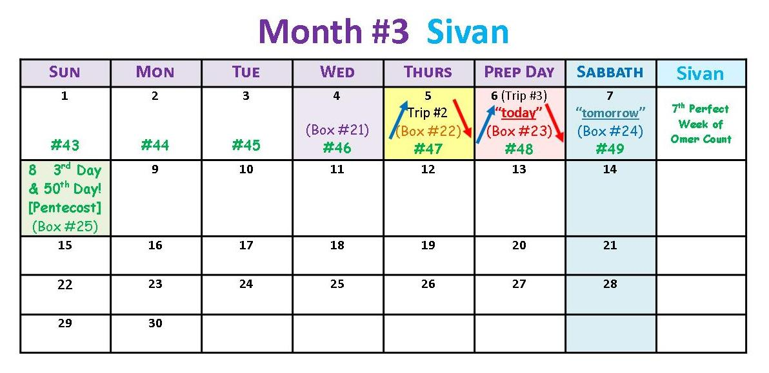
Forward to Pentecost at Mount Sinai – Sivan 8
The Omer Count finishes with the 50th Day.
Sivan 8 Pentecost (a Qodesh [Holy] Convocation!) (Box 25)
50 thDay
25. Exo 19:16-17 And it came to pass on the third day in the morning, that there were thunders and lightnings, and a thick cloud upon the mount, and the voice of the trumpet exceeding loud; so that all the people that was in the camp trembled. 17 And Moses brought forth the people out of the camp to meet with God the third day [the 50th day of the Omer Count to Pentecost]; and they stood at the nether part of the mount. KJV

Slide 46
Section #3 (Completed)
We’ve completed this part of the study, so let’s see if we really can determine the days and dates for Passover, Firstfruits, the Manna Week and Pentecost.
Interesting note:
The 2018 Covenant Feast Calendar is identical to this study.

Slide 48
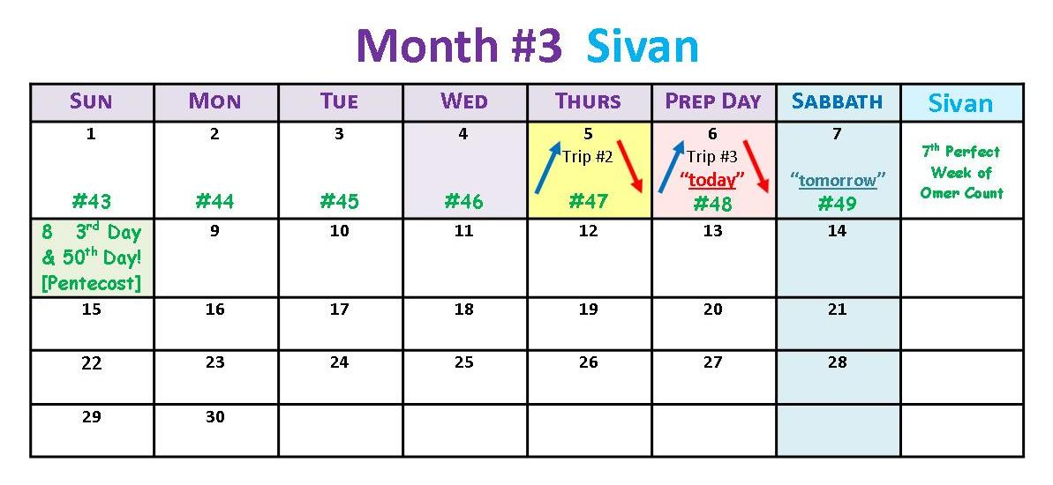
Sivan 8 Pentecost (a Qodesh [Holy] Convocation!)
The timing from Passover (1st Mon.) to Quail/Manna (2nd Mon.) to Pentecost (3rd Mon.) is PERFECT!
50 thDay

Slide 49
Facts for the Calendar Count from Exodus 12 Passover to Exodus 19 Pentecost
The timing for Sivan 8th - the day of Pentecost is perfect.
We can now work the calendar timing from Passover “forward” (or from Pentecost “backwards”) to establish the exact “days of the week” and “dates of the month” for all the important events from Exodus 12 to Exodus 19.
Passover on Abib 14 must be on a Tuesday, to allow for three days’ travel before the Sabbath.
The proper placement of Firstfruits is on Abib 19, the day following the weekly Sabbath in the week of the spring festival. (There is also a very strong witness in the Joshua study for the exact and proper placement of Firstfruits every year.)
Firstfruits begins the 50 day count towards Pentecost, which must also be placed on the day following the weekly Sabbath.
Exodus 16 tells us the exact “day and date” of the arrival of the quail, and the first 6 days of the Manna week. Indeed, the Manna is gathered for a full 6 days, verifying the lesson, “gather 5 days, and double on the 6th day … and no gathering on the Sabbath.”
Exodus 19 gave us several clues as to exactly when Israel entered the Wilderness of Sinai, and when they arrived at the foot of Mt Sinai. The very specific clues that were given to Moses on his trips up Mt Sinai were: a. “today, tomorrow and the 3rd day” – be ready for the 3rd day! b. The 3rd day was Pentecost.
The calendar study is complete and perfect!

Slide 50
Questions/Comments? for the month component of Melchizedek’s Covenant Calendar?
charlene@torahtothetribes.com OR
timothy@torahtothetribes.com

